Slide 1
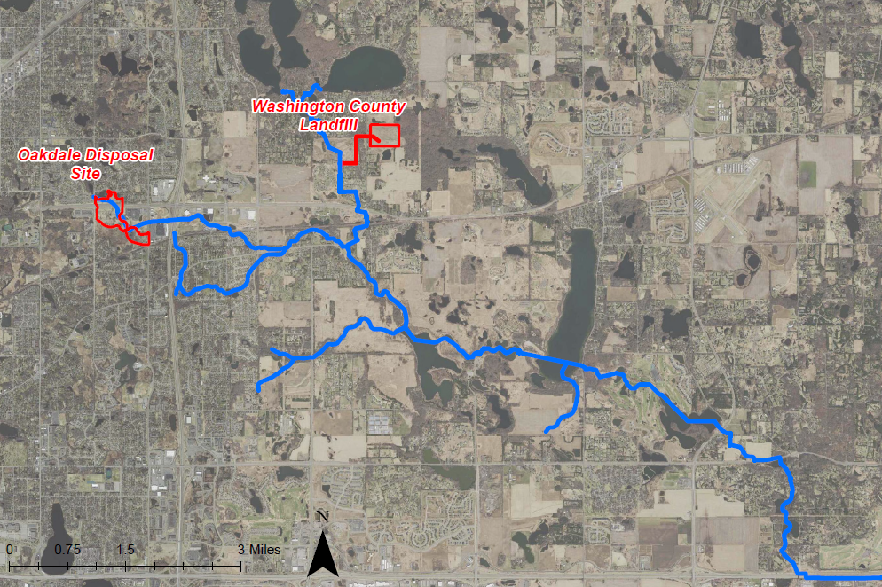
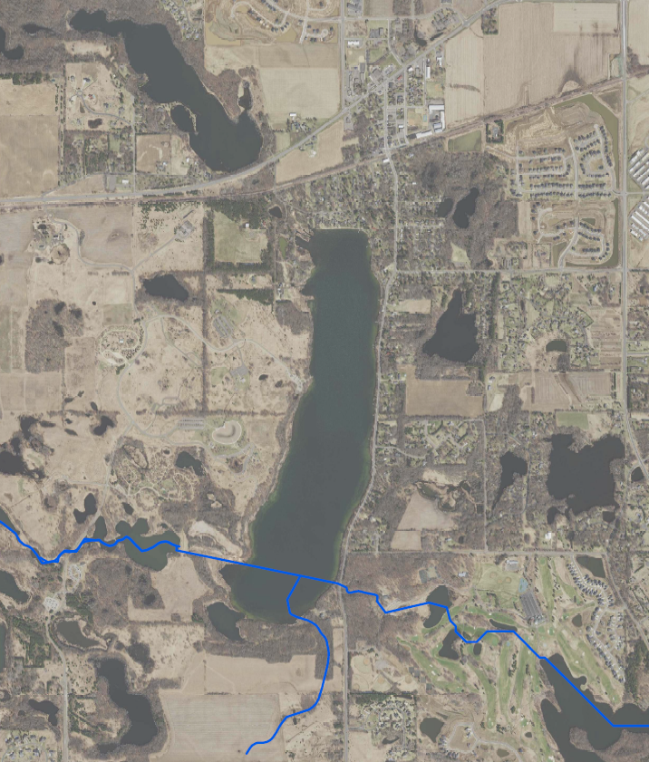
Segment 5| Project 1007
Minnesota Pollution Control Agency
Project 1007 Focused Investigation Progress Report - Segment 5
October 2021 Minnesota Pollution Control Agency
Segment 5: Lake Elmo and Bedrock Valley
P1007 Corridor Map
Segment 5 Site Map
Tri-Lakes
Segment 5
Sunfish Lake
Sunfish Lake
Raleigh Creek
Lake Elmo
Lake Elmo
Eagle Point Lake
Horseshoe Lake
Downs Lake
Browns Pond

Slide 2
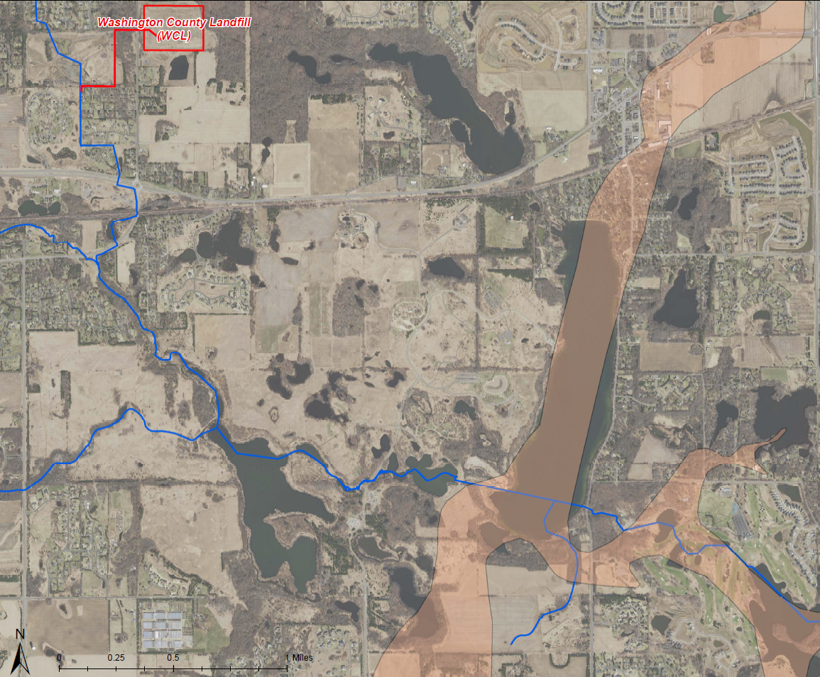
Project 1007 Focused Investigation Progress Report - Segment 5
October 2021 Minnesota Pollution Control Agency
Segment 1 | Project 1007
Minnesota Pollution Control Agency
Introduction: Segment 5 Surface and Groundwater Systems
Surface Water Flow Systems
The dominant surface water feature in Segment 5 is Lake Elmo. Lake Elmo is approximately 284 acres in surface area and has a maximum depth of 137 feet. It is primarily groundwater fed although it also receives surface water from the secondary outlet structure of the Eagle Point Dam. Surface water from Eagle Point Lake moves through a 22-inch pipe running along the bottom of Lake Elmo. In effort to reduce water levels and improve water quality in Lake Elmo, the Eagle Point Lake discharge pipe was constructed as part of the P1007 flood mitigation infrastructure project completed in 1987. When water levels exceed an elevation of 896.5 feet, water will flow through a secondary outlet structure that discharges directly into Lake Elmo.
Sunfish Lake is located upgradient of Lake Elmo and is likely connected to Lake Elmo through shallow subsurface groundwater infiltration and discharge.
Groundwater Flow Regimes: Bedrock Valley
Lake Elmo is situated within a buried bedrock valley, a unique geologic feature whereby ancient streams and rivers eroded bedrock layers creating deep valleys later filled in with glacial and alluvial sediments. The combination of high conductivity of the surficial sediments, an absent bedrock aquitard, and the fractured bedrock zone underlying and adjacent to the valley allow for a direct pathway for PFAS-impacted surface and shallow groundwater to enter deeper bedrock aquifers.
The extent that PFAS is transported through the surficial sediments within the valley and discharging into other lakes is unknown.
Washington County Landfill
Since the construction of the Eagle Point Lake discharge pipe in 1987, impacted surface water from the Oakdale Disposal Site has been diverted from Lake Elmo when the surface elevation of Eagle Point Lake is 896.5 feet above mean sea level and below. The extent to which the Washington County Landfill (WCL) contributes to PFAS impacts in Lake Elmo is poorly understood but is likely connected via surface water infiltration and groundwater discharge between Sunfish Lake and Lake Elmo and further facilitated by the presence of the bedrock valley.
Sunfish Lake
P1007 Conveyance
Lake Elmo
P1007 + Raleigh Creek
Confluence
Downs Lake
EPL Diversion Pipe
Eagle Point Lake (EPL)
Brown’s Pond
  Surface water flow direction
  Groundwater flow direction
  Surface to Ground Infiltration
  Ground to Surface Discharge

Slide 3
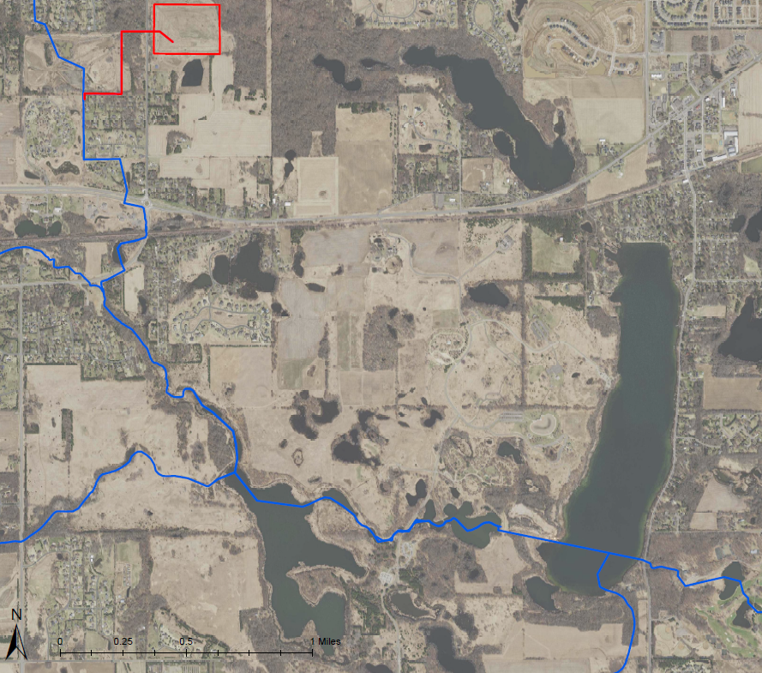
Project 1007 Focused Investigation Progress Report - Segment 5
October 2021 Minnesota Pollution Control Agency
Project 1007: Historic and Current Surface Water Flow from WCL
Washington County Landfill History
From 1969 to 1975, the Washington County Landfill (WCL) accepted PFAS-containing waste including wastewater treatment plant sludge, incinerator scrubber sludge and ash, and iron oxide sludge. As part of a larger flood mitigation infrastructure project completed in 1987 (P1007), a series of pipes and channels were constructed between the Tri-Lakes and Tablyn Park to direct surface water out of the land-locked Tri-Lakes area and away from the regularly-flooded residential area southward towards Raleigh Creek.
In 1988, the WCL began directly discharging untreated gradient control well effluent into P1007 via a stormwater sewer connection. As a result, PFAS-impacted waters from WCL were discharged to the P1007 system until the piped connection was sealed off in 1995.
Prior to and after this connection, PFAS-impacted waters from WCL likely migrated via surface runoff to the east-southeast for a limited distance and vertically into the subsurface via infiltration. Groundwater flow direction around WCL is not well understood and varies by depth. However, PFAS-impacted groundwater likely flows from WCL to the south, southwest, and southeast and into Sunfish Lake and Lake Elmo via infiltration and discharge between the surface water bodies and the shallow subsurface.
Washington County Landfill
Preferential PFAS Pathways
Sunfish Lake
P1007 + Raleigh Creek
Confluence
Lake Elmo
Landfill Closed
Activities
at WCL
Accepted PFAS- Containing Waste
Installation of VOC Remediation System
Effluent Discharge to P1007
Eagle Point Lake
1969
1975
1983
1988
1995
Present
Preferential PFAS Pathway:
Surface Water via P1007
Surface Water Flow Direction (1988-1995)
Surface Water Flow Direction (Present)
Inferred Runoff Direction
  Surface Water Infiltration
  Groundwater Flow Direction
Groundwater Infiltration

Slide 4
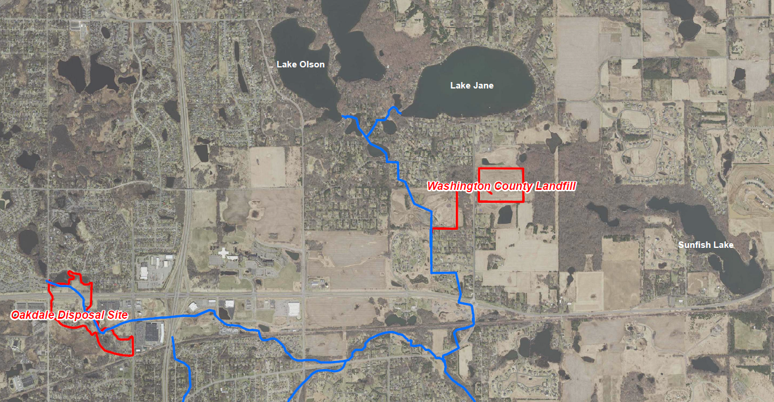

Project 1007 Focused Investigation Progress Report - Segment 5
October 2021 Minnesota Pollution Control Agency
Comparison of Two Source Areas: Oakdale Disposal Site vs. WCL
Disposal Site-Specific PFAS-Containing Waste
The Oakdale Disposal Site (ODS) accepted liquid and solid industrial waste, while the Washington County Landfill (WCL) accepted a variety of industrial and wastewater treatment plant waste. The PFAS contamination associated with these two historic waste streams is made up of different PFAS compounds, resulting in a PFAS “signature” that may be unique to each source area.
The PFAS signature associated with ODS is generally PFOS-dominant, while the PFAS signature from WCL is generally PFBA-dominant. As a result, analysis of the PFBA:PFOS ratio or the relative distribution of key compounds can be used to evaluate a possible PFAS source contribution at different locations.
Locations that are not associated with either ODS or WCL impacted waters may have a similar PFAS signature; however, the concentrations of all compounds will be significantly lower. This PFAS has an unknown anthropogenic source that is likely a result of widespread PFAS use.
PFAS Distribution by Source Area
WCL PFAS Signature
ODS PFAS Signature
Low Concentration Widespread PFAS
Typical PFAS Distribution: ODS vs WCL
ODS
PFOS-Dominant
WCL
PFBA-Dominant
Low Concentration Widespread PFAS*
Future Chemometrics Forensic Analysis
By applying multivariate statistical tools such as principal component analysis, hierarchical clustering, and logarithmic transformations to chemistry data using PFAS Chemometrics as a forensics tool, potential source area signatures can be identified and separated by subtle variations to provide powerful forensic interpretations. This will aid in future understanding of partitioning, source mixing, and PFAS fate and transport.
Future data analysis will use the above tools to refine the CSM and develop a deeper understanding of how PFAS is behaving in the surface and subsurface features of Project 1007.
*Key difference between unknown anthropogenic source and WCL is lower concentrations.

Slide 5
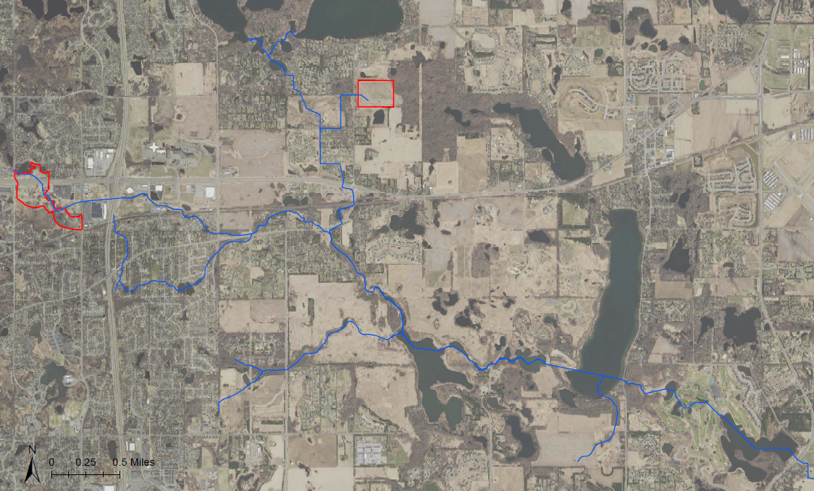
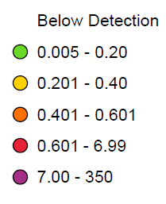
Project 1007 Focused Investigation Progress Report - Segment 5
October 2021 Minnesota Pollution Control Agency
Site-Wide Surface Water Results: Distribution of PFAS Impacts and PFBA
PFBA Impacts – Sunfish Lake and Lake Elmo
Sunfish Lake and Lake Elmo both have distinct PFBA-dominant PFAS signatures similar to impacts from the Washington County Landfill (WCL). When compared to Raleigh Creek and other major water bodies in the corridor, PFBA concentrations in Sunfish Lake and Lake Elmo are between one and two orders of magnitude greater than the rest of the corridor.
The similar distribution of PFAS impacts between Sunfish Lake and Lake Elmo suggests a groundwater-surface water connection between Sunfish Lake and Lake Elmo. This combination of a PFBA-dominant signature and elevated PFBA concentrations when compared site-wide PFBA concentrations point to the WCL as the source of these elevated impacts.
PFAS Distribution and PFBA Heat Map:
Site-Wide 2019-2020
Washington County Landfill
Oakdale Disposal Site
Typical PFAS Distributions
ODS
PFOS-Dominant
WCL
PFBA-Dominant
PFBA (ppb)
PFAS Distribution
St. Croix River
Low Concentration Widespread PFAS*
*Key difference between unknown anthropogenic source and WCL is lower concentrations.

Slide 6
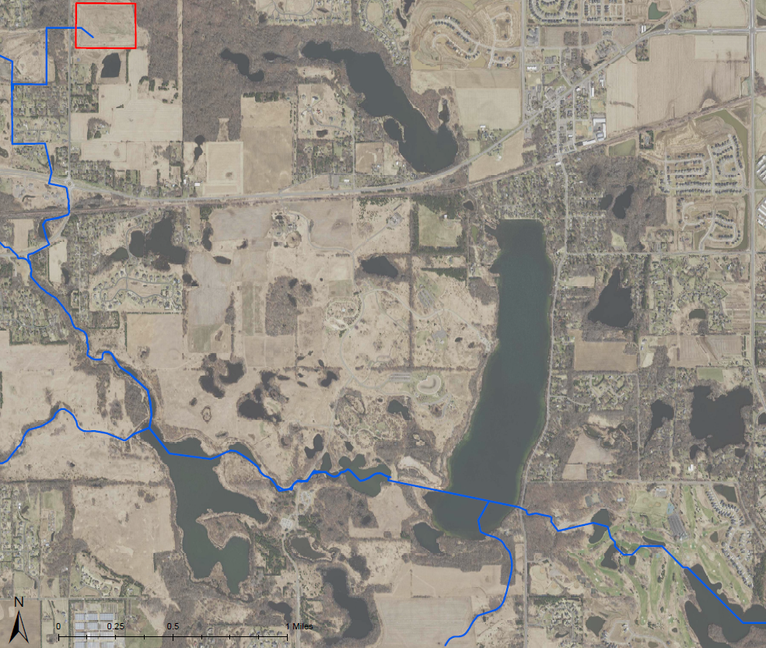
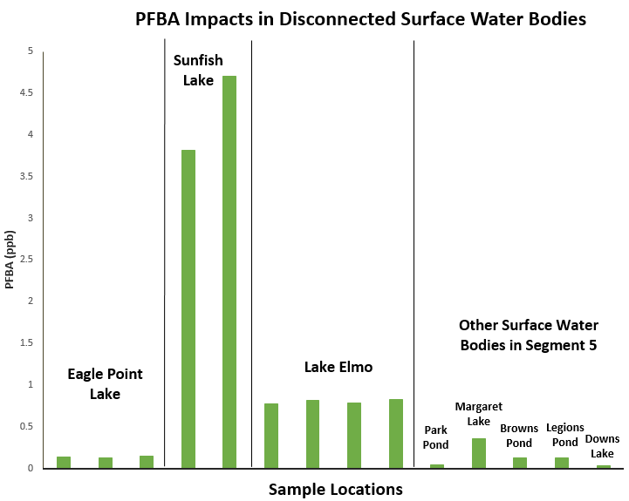
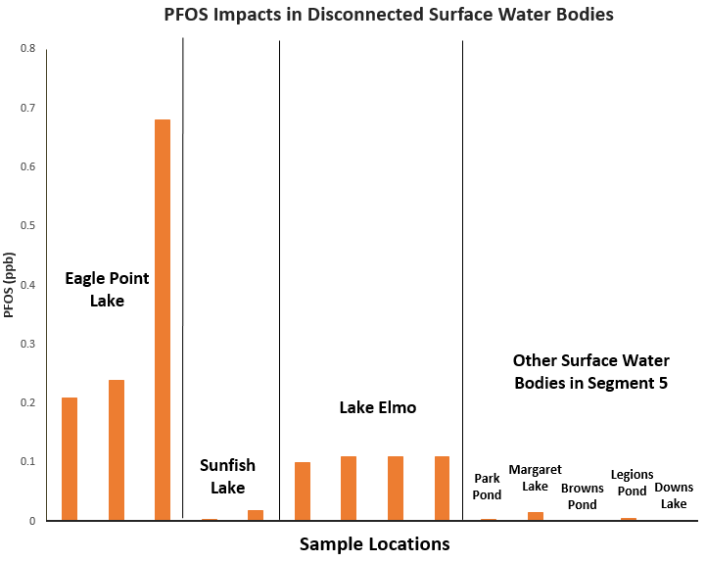
Project 1007 Focused Investigation Progress Report - Segment 5
October 2021 Minnesota Pollution Control Agency
Other Associated Water Bodies in Segment 5
Washington County Landfill
Typical PFAS Distributions
PFAS Impacts: Disconnected Surface Water Bodies
Brown’s Pond, Margaret Lake and Park Pond are located southeast of Eagle Point Lake. Down’s Lake and Legion’s Pond are located east of Lake Elmo. These five small, disconnected water bodies were sampled to determine the extent of impacts outside of the main Project 1007 surface water flow path to assess surface-groundwater connections with Eagle Point Lake, Sunfish Lake, and Lake Elmo.
Like Lake Elmo and Sunfish Lake, PFBA is the dominant compound in all five smaller, disconnected water bodies. However, the concentrations of PFBA in the five water bodies are one and two orders of magnitude lower than Lake Elmo and Sunfish Lake, respectively.
With respect to PFOS, all five water bodies are in exceedance of the Site-Specific Water Quality Criteria for PFOS (0.00005 ppb) but are an order of magnitude lower in concentration than Lake Elmo and more than two orders of magnitude lower than that of Eagle Point Lake. Site-wide, PFAS concentrations in these five water bodies are among the lowest in surface water bodies.
ODS
PFOS-Dominant
WCL
PFBA-Dominant
Sunfish Lake
Low Concentration Widespread PFAS*
*Key difference between unknown anthropogenic source and WCL is lower concentrations.
Legion’s Pond
Lake Elmo
Down’s Lake
Eagle Point Lake
Margaret Lake
Findings
The combination of overall low PFAS concentrations and a PFBA-dominant distribution of PFAS compounds suggest the PFAS impacts in these water bodies are associated with anthropogenic widespread used of PFAS.
Park Pond
Brown’s Pond
PFAS Distribution:
Disconnect Surface Water Bodies

Slide 7
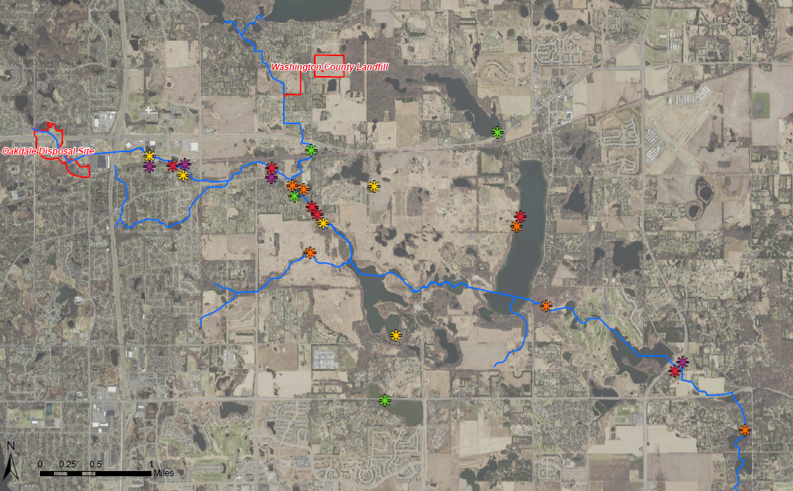
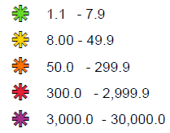

Project 1007 Focused Investigation Progress Report - Segment 5
October 2021 Minnesota Pollution Control Agency
Site-Wide Foam Results: PFOS
Legend
PFOS Heat Map: Foam
PFOS in Foam (ppb)
Sunfish Lake
Raleigh Creek
Segment 5
P1007 Confluence
Circled symbols denote targeted repeat foam sample locations
Foam in Segment 5
Foam has been observed rarely in Segment 5 along the shores of Lake Elmo and Sunfish Lake and only with high wind conditions. The locations with foam vary depending on wind direction, but the types and appearances of foam have been consistently fresh, fluffy, and lighter in color.
PFOS concentrations in Lake Elmo foam were moderate in magnitude, but the enrichment factors were among the highest in the overall corridor. Sunfish Lake foam had the lowest concentration of PFOS in foam in the corridor.
Lake Elmo
Eagle Point Lake
Horseshoe Lake
WLSS Ponds

Slide 8
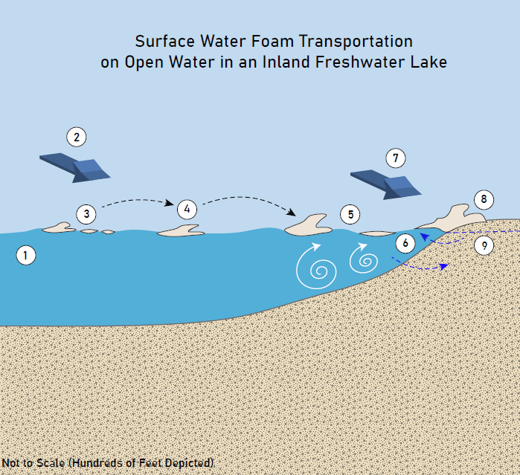
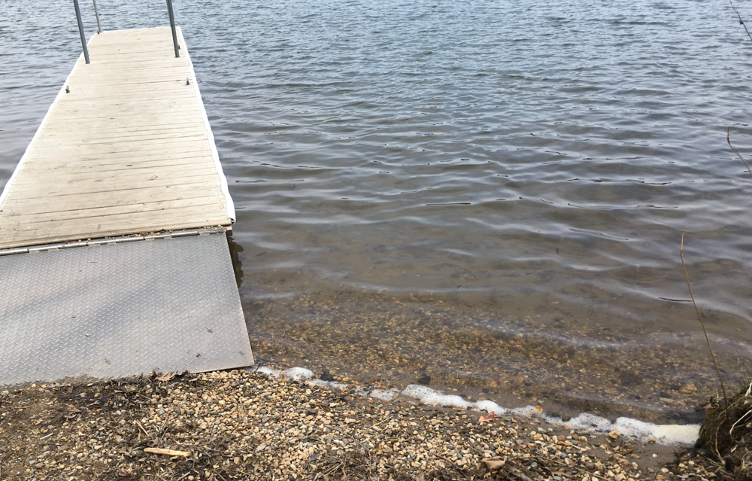
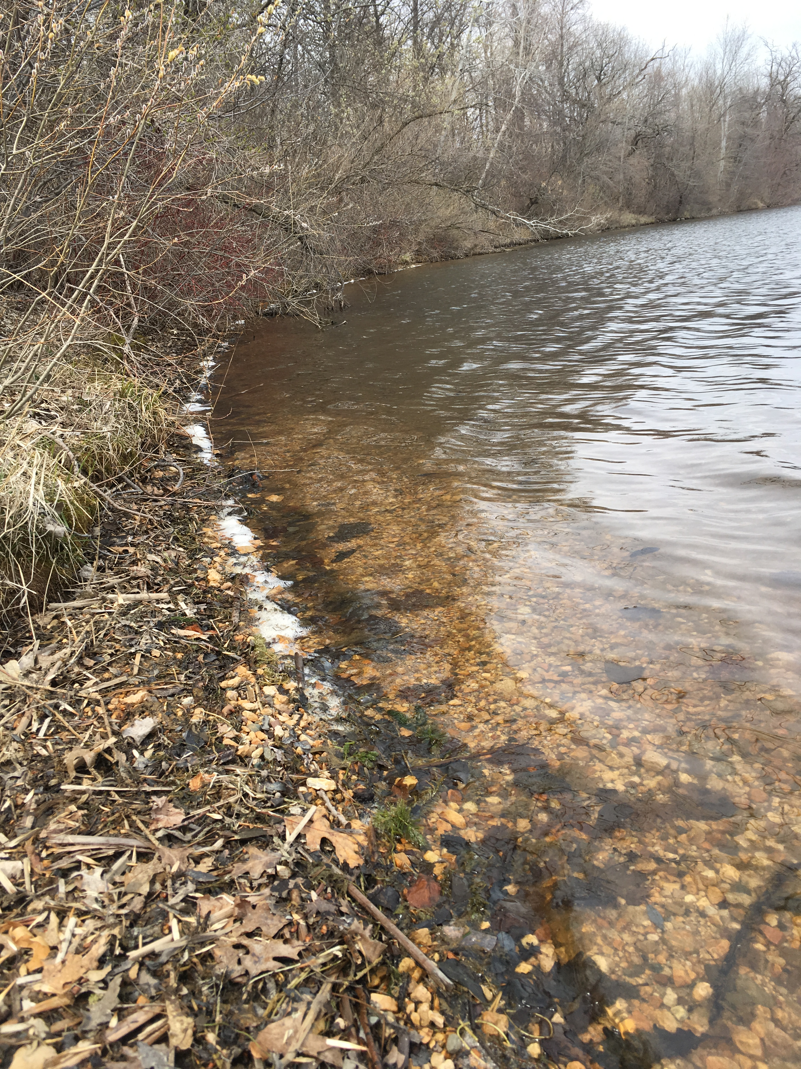
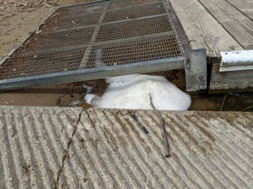
Project 1007 Focused Investigation Progress Report - Segment 5
October 2021 Minnesota Pollution Control Agency
Foam Formation in Segment 5
Requirements for PFAS-Containing Foam Formation and Accumulation
Turbulence
Air must be mixed into the water column for foam to form. In Segment 5, this turbulence was the result of agitation from waves from wind currents or the use of watercraft.
Solid Substrate for Foam to Accumulate Against
After generation, the foam bubbles must have a solid substrate in relatively calmer water to accumulate along or against. Without accumulation, the foam bubbles will collapse back into the water column. In Segment 5, foam was found to accumulate along the lake shores as well as under and against docks. The larger, fluffier piles of foam were observed in locations sheltered by wind, such as under docks.
PFAS Concentrations in Surface Water
Foam will naturally form regardless of the presence of PFAS. However, it is not well understood how the presence of PFAS in water affects foam formation. It is also not well understood how much PFAS will preferentially separate (enrich) into the foam relative to the PFAS in the corresponding surface water.
Depiction of the physical process of wind-generated foam and the subsequent accumulation on shore.
Accumulated foam observed along the shore (above and left) and below a dock (bottom). Foam in Segment 5 tends to be whiter and contain little to no organic matter. The types of foam observed in Segment 5 were the product of wind-generation and were very similar in appearance.

Slide 9
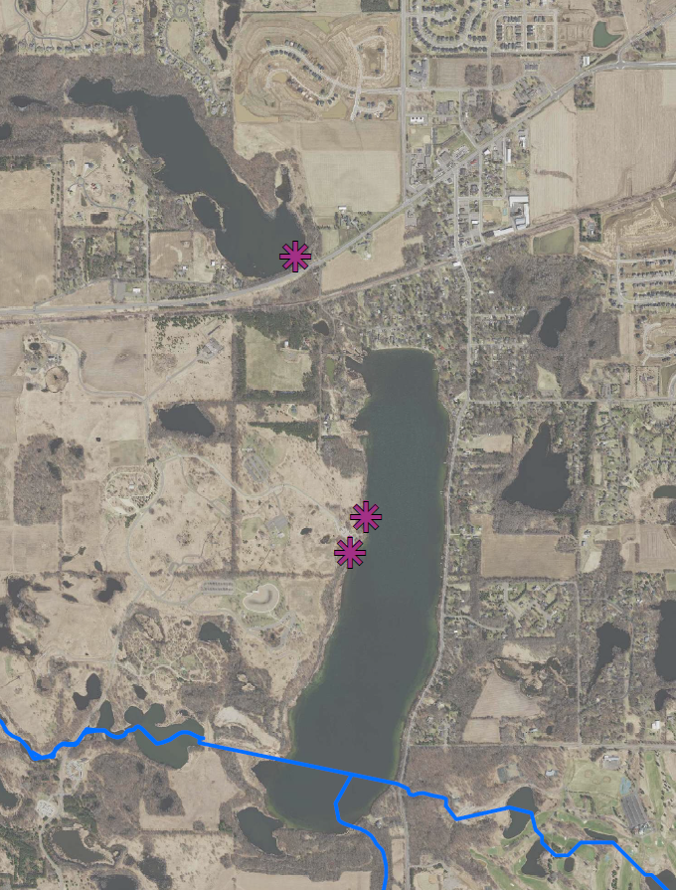
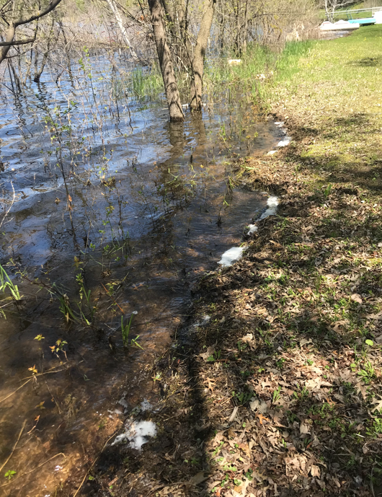
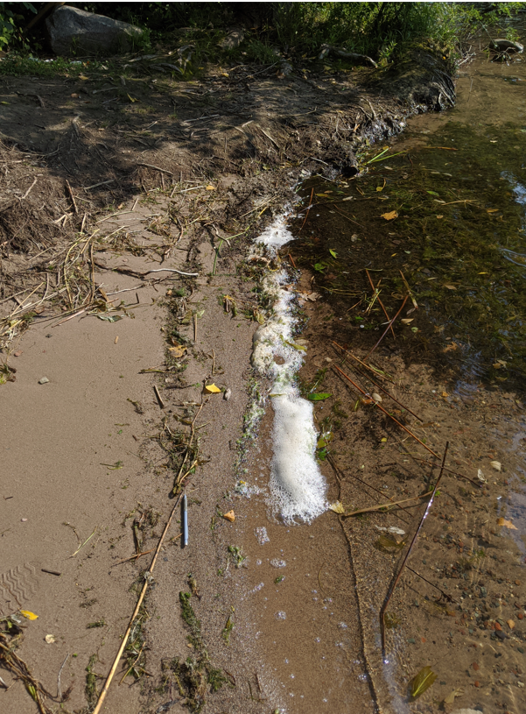

Project 1007 Focused Investigation Progress Report - Segment 5
October 2021 Minnesota Pollution Control Agency
Foam Segment 5: Results and Enrichment Factors
Segment 5: Foam Locations
Findings: PFOS Results
Site-wide, the foam sample from Sunfish Lake (EP25) had the lowest PFOS concentration, while PFOS concentrations in foam from Lake Elmo were among the higher samples.
As in other segments in the corridor, PFOS concentrations in foam sampled from the same location can vary in magnitude.
5/11/20 –
Wind-Generated
Sunfish Lake
EP25
Lake Elmo
EP21-Boat Launch
EP21-Boat Launch
EP21-Canoe Launch
EP25
Findings: Enrichment Factors and Foam Type
An enrichment factor is the ratio of the PFAS concentration in the foam to that in the water.
In comparing the two foam samples from eastern portion of Lake Elmo, the enrichment factor increased by an order of magnitude. Both samples are wind-generated, fresh foam. However, as in Segments 2 and 6, the foam sample with the higher PFOS and higher enrichment factors is the fluffier foam.
Thin Foam Along Shoreline
4/23/20
Wind-Generated
Lake Elmo Foam Types
EP21-Canoe Launch
05/05/20 – Wind-Generated
Fluffy Foam Piled Under Dock
216 ppb PFOS
904 ppb PFOS

Slide 10
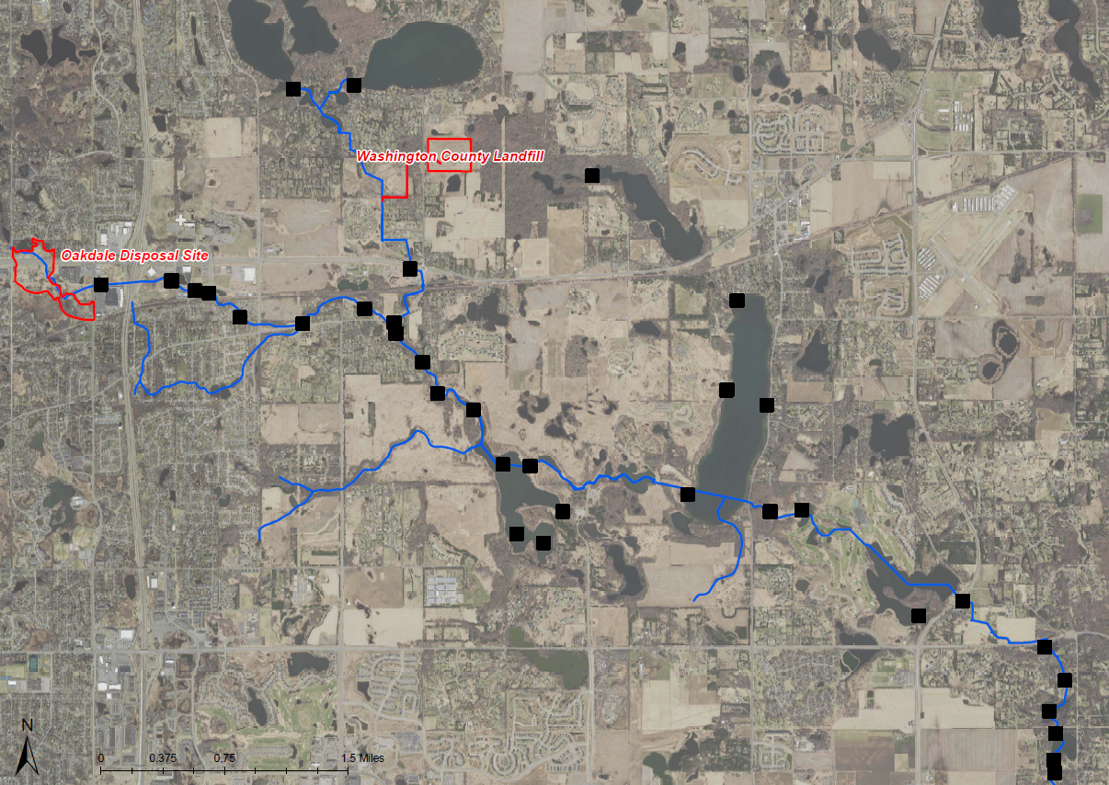
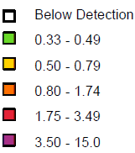
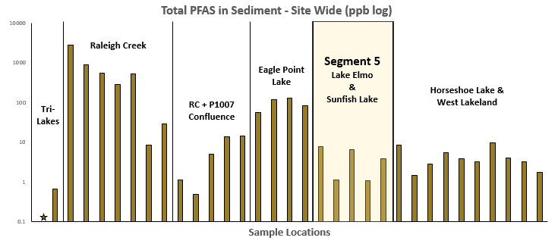
Project 1007 Focused Investigation Progress Report - Segment 5
October 2021 Minnesota Pollution Control Agency
Segment 5 Sediment Results
Sediment Heat Map:
PFBA
PFBA (ppb)
PFBA vs PFOS in Sediment
Concentrations of PFBA in sediment in Sunfish Lake and northern Lake Elmo, which are both in close proximity to the Washington County Landfill (WCL), are among the highest in the corridor. Only sediment collected in the western portion of Raleigh Creek, located immediately downstream of the Oakdale Disposal Site (ODS), had higher concentrations of PFBA. However, while PFOS sediment concentrations in this portion of Raleigh Creek are the highest in the corridor, sampled sediment in Sunfish Lake and north Lake Elmo have among the lowest concentrations of PFOS corridor-wide. The opposing maximum PFBA and PFOS sediment concentrations between these two areas point to proximity to source area as the largest contributing factor to PFAS impacts and suggests two distinct source areas, one with elevated PFOS impacts (ODS) and one with elevated PFBA impacts (WCL).
Segment 5
P1007 Conveyance
Sunfish Lake
Sediment Heat Map:
PFOS
Segment 5
Sunfish Lake
PFAS in Sediment in
Segment 5 vs Site-Wide
PFAS in sediment in Segment 5 is relatively lower than elsewhere in the corridor. All sediment samples are below the MPCA 2-Day and 5-Day per Week Site-Specific Sediment Screening Values (SDSVs) for PFOS of 140 ug/kg and 54 ug/kg, respectively.
Raleigh Creek
Lake Elmo
PFBA (ppb)
Eagle Point Lake

Slide 11
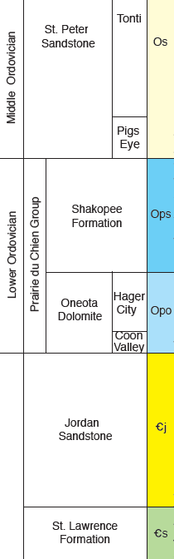
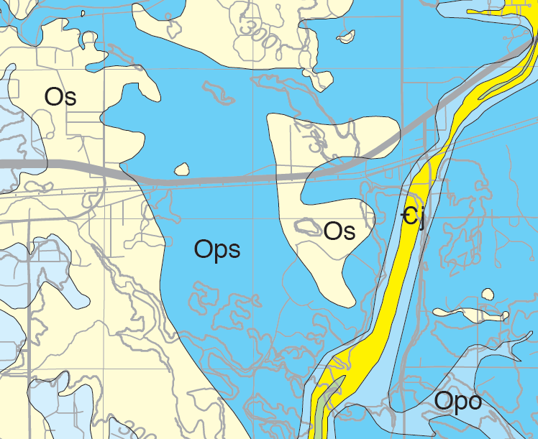
Project 1007 Focused Investigation Progress Report - Segment 5
October 2021 Minnesota Pollution Control Agency
From the Surface to the Subsurface
Washington County Landfill
First Encountered Bedrock Map
Bedrock Valley: Geology and Hydrogeology
Lake Elmo is situated within a buried bedrock valley, a thin, deeply incised paleochannel comprised of deeply eroded bedrock units filled in with glacial and alluvial sediments. The bedrock valley exposes deeper bedrock aquifers to the surficial sediments and surface water bodies.
As a result of the high conductivity typical of these surficial sediments, groundwater flow within the bedrock valley is both eastward across the valley and downward through the valley. Specifically in Lake Elmo, the absence of the Oneota Dolostone Aquitard, which typically inhibits vertical groundwater flow from the shallow subsurface, allows for a direct connection from the surface to the Jordan Aquifer.
Sunfish Lake
Ops
Ꞓj
Lake Elmo
  Approximate Extent of Bedrock Valley
  Surface Water Body Extent
  Source Area Extent
  Surface Water Infiltration
  Horizontal Groundwater Flow Direction
  Vertical Groundwater Flow Direction
Eagle Point Lake
Ꞓs
Segment 5: Bedrock Geology and Hydrogeology
The bedrock geology in Segment 5 is diverse and contributes to a hydrogeologically complex system that likely influences PFAS migration from the Washington County Landfill (WCL) and nearby surface water bodies to groundwater.
The Sunfish Lake area is underlain by both the St. Peter Sandstone and Shakopee Dolostone. The St. Peter Aquifer is disconnected throughout the area and thin where present. Due to the lack of confining layers between these units, both the St. Peter and the Shakopee aquifers are connected to the overlying shallow subsurface groundwater and surface water. The Shakopee Aquifer is underlain by the Oneota Dolostone Aquitard, which can be fractured and “leaky.” The extent to which the aquitard functions as a barrier to the underlying Jordan Aquifer is not well understood.
Due to the presence of the Bedrock Valley, the first encountered bedrock under Lake Elmo is primarily the Jordan Aquifer. The absence of the overlying bedrock units creates a unique direct connection between surface water and the Jordan Aquifer. Further vertical groundwater migration from the Jordan Aquifer is likely inhibited by the St. Lawrence Aquitard.
These geologic conditions may allow groundwater migration into the Jordan Aquifer through two pathways: through the “leaky” Oneota Aquitard and through the Bedrock Valley.

Slide 12
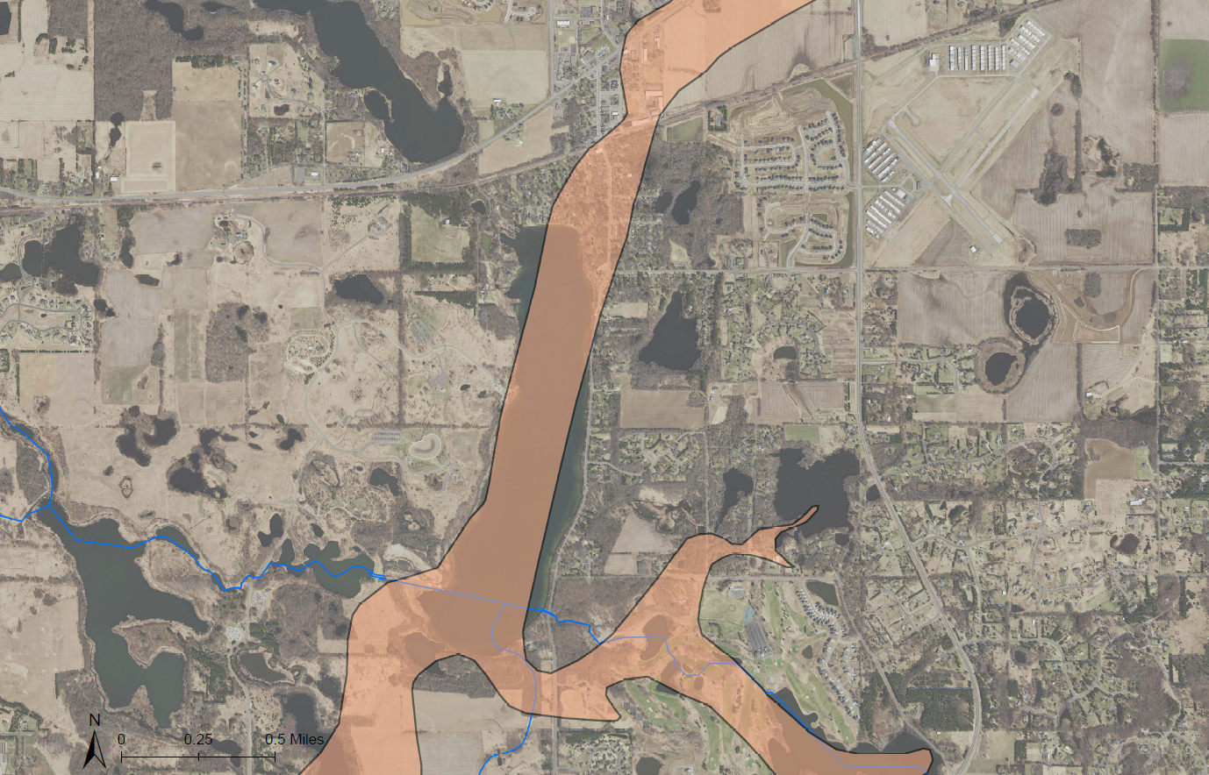
Project 1007 Focused Investigation Progress Report - Segment 5
October 2021 Minnesota Pollution Control Agency
Beta Sites and Features
Segment 5
AECOM Beta Sites
Beta Site 4 (BS4)
MW4A: Oneota Aquitard Well
Beta Site 5 (BS5)
MW5A: Jordan Aquifer Well
MW5B: Shakopee Aquifer Well
(Vertical Aquifer Profile Samples from the Quaternary Aquifer)
Beta Site 6 (BS6)
MW6A: Jordan Aquifer Well
MW6B: Oneota Aquitard Well
MW6C: Quaternary Aquifer Well
MW6D: Quaternary Aquifer Well
Beta Site 10 (BS10)
MW10C: Quaternary Aquifer Well
Beta Site 13 (BS13)
MW13A: Tunnel City Aquifer Well
MW13B: Jordan Aquifer Well
MW13C: Quaternary Aquifer Well
MW13D: Quaternary Aquifer Well
BS10
Sunfish Lake
Bedrock
Valley
Lake Elmo
BS5
BS4
Eagle Point Lake
BS6
BS13

Slide 13
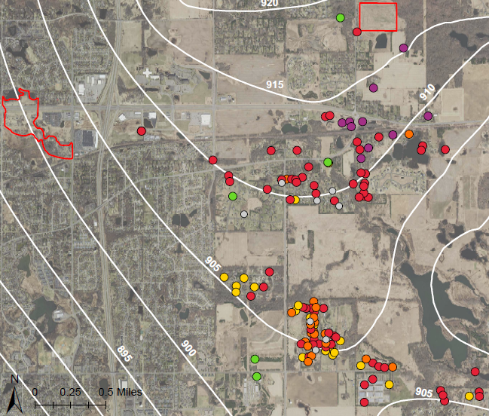
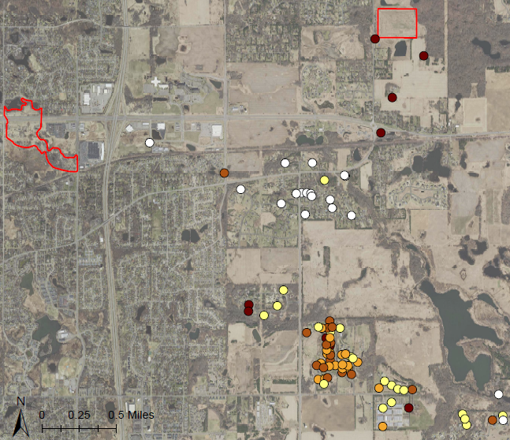
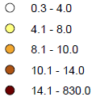
Segment 5 | Project 1007
Minnesota Pollution Control Agency
Project 1007 Focused Investigation Progress Report - Segment 5
October 2021 Minnesota Pollution Control Agency
Segment 5| Project 1007
Minnesota Pollution Control Agency
PFAS Preferential Pathway from WCL to the Shakopee Aquifer: Southernly Component
PFBA/PFOS Distribution: WCL to Shakopee Aquifer
The highest PFBA/PFOS ratios occur in the Shakopee Aquifer in close proximity to the Washington County Landfill (WCL). High PFBA/PFOS ratios, resulting in a PFBA-dominant signature, is typical of PFAS impacts associated with WCL. Conversely, near the Oakdale Disposal Site (ODS), the PFBA/PFOS ratio is between three and four orders of magnitude lower due to PFOS-dominant impacts. At Tablyn Park, the PFAS distribution becomes more equal, likely the result of mixing of PFOS-dominant impacts from ODS to the west with PFBA-dominant impacts from WCL to the north. Continuing southward, the PFBA/PFOS ratios increase again and the distribution shifts back to that typical of WCL impacts.
PFBA Heat Map: Shakopee Aquifer
Washington County Landfill
PFBA/PFOS Ratio and Distribution Map: Shakopee Aquifer
Typical PFAS Distributions
Oakdale Disposal Site
Tablyn Park
Washington County Landfill
ODS
PFOS-Dominant
WCL
PFBA-Dominant
Oakdale Disposal Site
Mixed-Source
PFAS
Eagle Point Lake
Tablyn Park
PFBA/PFOS Ratio
PFBA (ppb)
PFBA Impacts in Groundwater: WCL to Shakopee Aquifer
The highest PFBA concentrations are observed in the Shakopee Aquifer at WCL. Moving south, though the PFBA/PFOS ratio decreases, PFBA concentrations remain elevated. Continuing southward, the PFAS distribution in groundwater shifts back to the PFBA-dominant signature due to a reduction in PFOS concentrations while concentrations of PFBA remain elevated. Relative to PFOS and other-longer chained PFAS compounds, PFBA has a smaller molecular size, more hydrophilic nature, and higher water solubility. These chemical properties allow the compound to travel faster and farther in groundwater and likely explain the elevated PFBA impacts beyond the extent of PFOS-dominant impacts to the north.
Eagle Point Lake
Map Features
  Surface to Ground Infiltration
  Groundwater Flow Direction
  Shakopee Potentiometric Surface
  (5-ft Contours)

Slide 14
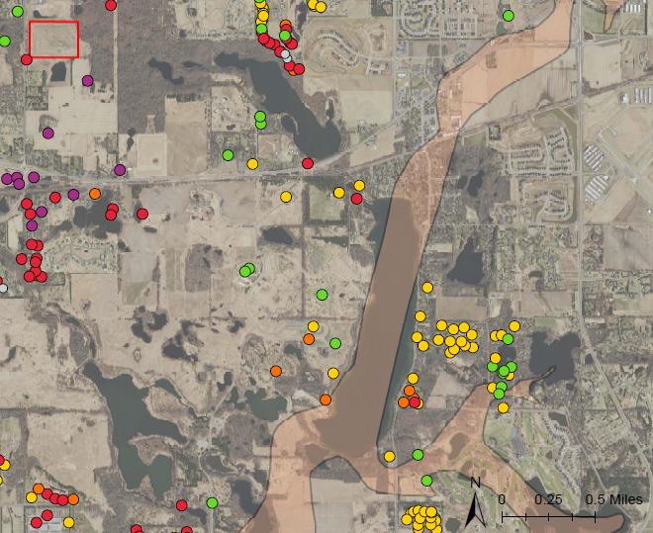
Segment 5 | Project 1007
Minnesota Pollution Control Agency
Project 1007 Focused Investigation Progress Report - Segment 5
October 2021 Minnesota Pollution Control Agency
Segment 5| Project 1007
Minnesota Pollution Control Agency
PFBA Groundwater Results: WCL to the Shakopee Aquifer
PFBA Heat Map: Shakopee Aquifer
PFBA Impacts in Groundwater: WCL to Shakopee Aquifer
Elevated PFBA concentrations in the Shakopee Aquifer with the distinct PFBA-dominant signature typical of the Washington County Landfill (WCL) are observed along the northern portion of Sunfish Lake. The pathway for these impacts is likely the result of surface water infiltration at the landfill, followed by groundwater discharge to the Sunfish Lake. Sunfish Lake is similarly connected via infiltration and groundwater discharge to Lake Elmo, which also has elevated PFBA impacts in surface water. Finally, surface water infiltration from Lake Elmo into the Shakopee Aquifer is likely facilitated by the underlying Bedrock Valley and discussed in the next slide.
Washington County Landfill
Sunfish Lake
Bedrock Valley
Lake Elmo
Typical PFAS Distributions
Map Features
PFBA (ppb)
ODS
PFOS-Dominant
Eagle Point Lake
  Surface to Ground
  Infiltration
  Groundwater Flow
  Direction (Horizontal)
  Groundwater to
  Surface Discharge
WCL
PFBA-Dominant
Mixed-Source
PFAS

Slide 15
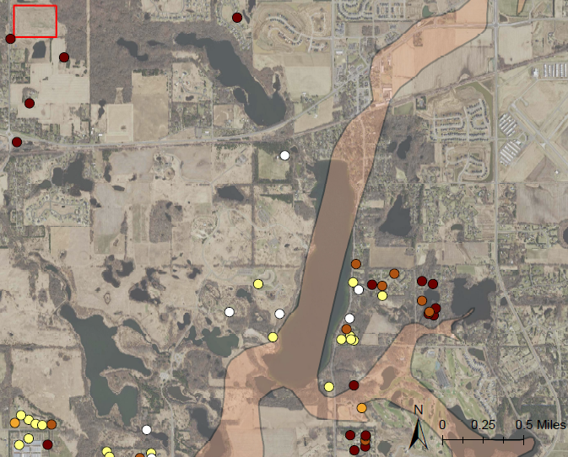
Segment 5 | Project 1007
Minnesota Pollution Control Agency
Project 1007 Focused Investigation Progress Report - Segment 5
June 2021 Minnesota Pollution Control Agency
Project 1007 Focused Investigation Progress Report - Segment 5
October 2021 Minnesota Pollution Control Agency
Segment 5| Project 1007
Minnesota Pollution Control Agency
PFBA/PFOS Distribution in Groundwater: WCL to the Bedrock Valley
Fate and Transport: WCL to Shakopee Aquifer via Bedrock Valley
The unique hydrogeologic properties of the Bedrock Valley, which is mapped approximately under Lake Elmo, may facilitate the migration of PFAS-impacted waters from Lake Elmo into bedrock aquifers. Though PFBA concentrations are up to two orders of magnitude less on either side of the Bedrock Valley (as shown in the previous slide), groundwater impacts at WCL and east of the Bedrock Valley have elevated PFBA/PFOS ratios, sharing the PFBA-dominant signature characteristic of WCL. Further, PFBA/PFOS ratios from wells west of the Bedrock Valley are up to four orders of magnitude lower that those east of the valley, resulting in a more equal distribution of PFAS compounds. The combination of the similarity between WCL wells and those east of the Bedrock Valley with the dissimilarity between wells west and east of the Bedrock Valley suggest a migration pathway from the WCL, to the Bedrock Valley, and on to the Shakopee Aquifer eastward.
Fate and Transport: Lake Elmo to Shakopee Aquifer via Bedrock Valley
In addition to the shared PFBA-dominant signature observed between Shakopee Aquifer wells, similarly elevated PFBA/PFOS ratios are also observed between Sunfish Lake and Lake Elmo and the Shakopee Aquifer east of the Bedrock Valley, further supporting a connection between these surface water bodies and impacted groundwater downgradient of the Bedrock Valley. Although other variables may influence the PFBA and PFOS distribution in Segment 5, the similarity in ratios between Lake Elmo and groundwater downgradient of Lake Elmo point to the Bedrock Valley as the key in surface and groundwater connection in Segment 5.
Washington County Landfill
PFBA/PFOS Ratio and Distribution Map: Shakopee Aquifer
PFBA/PFOS Ratio
Sunfish Lake
Bedrock Valley
Lake Elmo
Eagle Point Lake
PFAS Distributions
Shakopee Aquifer PFAS Distribution: High PFBA/PFOS Ratio
Surface Water PFAS Distribution: High PFBA/PFOS Ratio
ODS
PFOS-Dominant
WCL
PFBA-Dominant
Mixed-Source
PFAS
Shakopee Aquifer PFAS Distribution: Low PFBA/PFOS Ratio
Surface Water PFAS Distribution: Low PFBA/PFOS Ratio
Map Features
  Groundwater to Surface
  Discharge
  Surface to Ground Infiltration
  Groundwater Flow Direction (Horizontal)

Slide 16
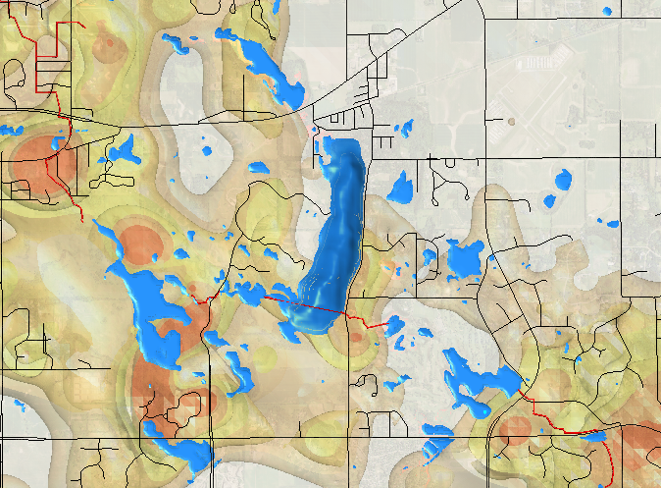
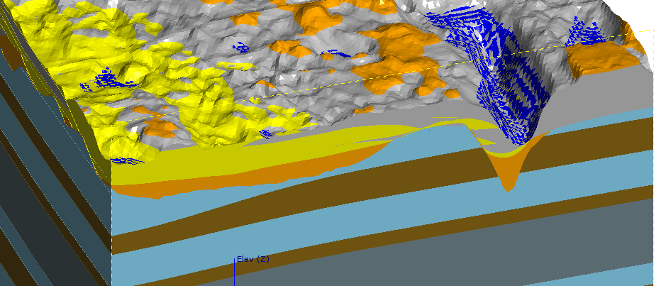
Project 1007 Focused Investigation Progress Report - Segment 5
October 2021 Minnesota Pollution Control Agency
A Closer Look: Groundwater Results and the Bedrock Valley
Leapfrog Modeled Plume Map: PFOS in Groundwater
Washington County Landfill
(WCL)
BS13 Bedrock Valley
BS5:
Pre-Bedrock Valley
BS6:
Post-Bedrock Valley
BS5
BS6
Geologic 3D Model: Beta Site Locations Relative to Bedrock Valley
BS13
BS6
BS5
BS13
SHAKOPEE
AQUIFER
BURIED
BEDROCK
VALLEY
Quaternary
Sediments
ONEOTA AQUITARD
Quaternary
Sediments
PFOS in Jordan Aquifer: Bedrock Valley
Quarterly sampling of Jordan Aquifer wells upgradient of, within, and downgradient of the Bedrock Valley have consistently shown notably greater amounts of PFOS within the valley. Although the exact mechanisms and flow dynamics within the Bedrock Valley are not fully understood, these results point to the valley as a contributing factor in the migration of PFAS-impacted waters within the corridor.
JORDAN AQUIFER
ST. LAWRENCE AQUITARD
JORDAN FORMATION
ST. LAWRENCE FORMATION
TUNNEL CITY GROUP
TUNNEL CITY GROUP

