Slide 1
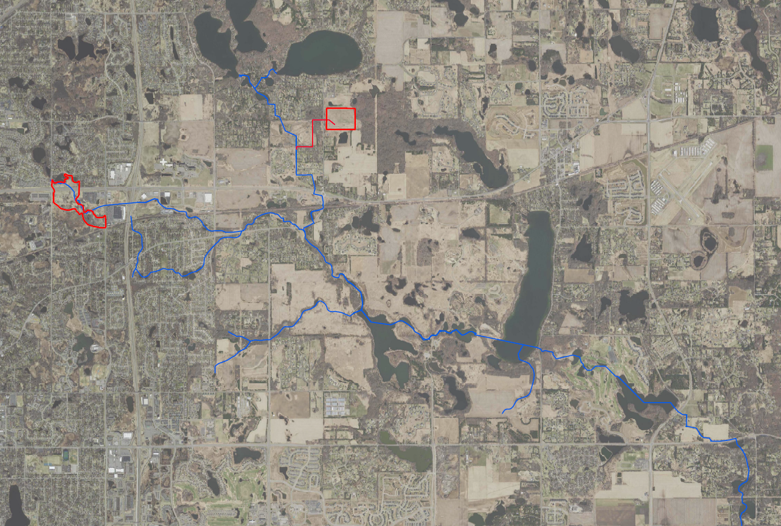
Segment 5| Project 1007
Minnesota Pollution Control Agency
Project 1007 Focused Investigation Progress Report - Segment 4
November 2021 Minnesota Pollution Control Agency
Segment 3: Confluence
Segment 4: Eagle Point Lake
P1007 Corridor Map
Tri-Lakes
Washington County Landfill
Segment 4 Site Map
Raleigh Creek and P1007 Conveyance
Sunfish Lake
Oakdale Disposal Site
Segment 4
Lake Elmo
Farney Creek
Eagle Point Lake
Lake Elmo
Eagle Point Lake
Margaret Lake
Horseshoe Lake
Park Pond
Brown’s Pond
Goose Lake

Slide 2
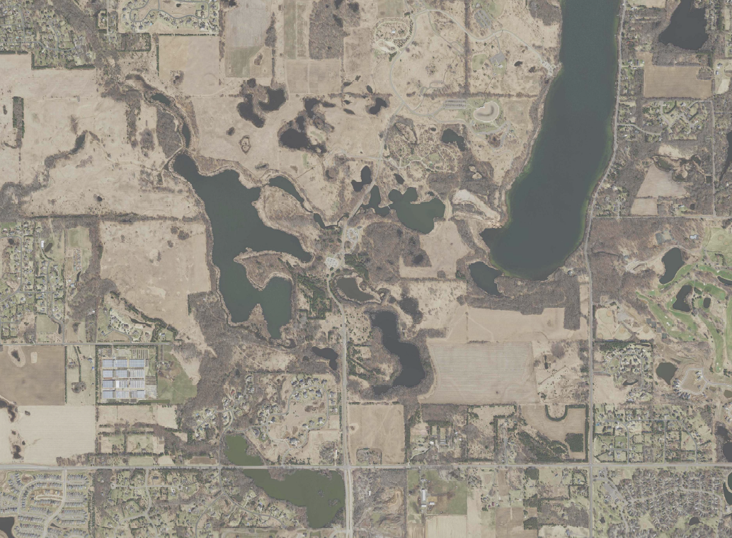
Project 1007 Focused Investigation Progress Report - Segment 4
November 2021 Minnesota Pollution Control Agency
Introduction: Segment 4 Surface and Groundwater Systems
PFAS Preferential Pathways
Surface Water Systems
The dominant surface water feature in Segment 4 is Eagle Point Lake. The surface area of Eagle Point Lake is approximately 120 acres although this can vary depending on the lake elevation as the lake edge is predominantly shallow wetlands. The maximum depth is approximately 10 feet. The primary surface water input to Eagle Point Lake is the combined flow at the Confluence of Raleigh Creek and the Project 1007 Conveyance System (P1007).
Raleigh Creek, the headwaters of which is located immediately northwest of the former Oakdale Disposal Site (ODS), flows west to east and passes through a series of wetlands and small ponds until the Ideal Avenue Wetland Complex (IAWC), where flow is controlled by the culvert elevation and flood mitigation structure at the intersection of Raleigh Creek and Ideal Avenue. Between IAWC and Tablyn Park, flow in Raleigh Creek is precipitation-dependent and as a result is intermittent.
The P1007 Conveyance System begins with the Tri-Lakes, which discharge southward through a series of pipes and channels until the Confluence with Raleigh Creek at Tablyn Park.
After the Confluence with the P1007 Conveyance System at Tablyn Park (indicated in the map with a star), Raleigh Creek continues flowing southeast to the Lake Elmo Park Reserve and is perennial except during extreme drought conditions. At the input to Eagle Point Lake, Raleigh Creek transitions from an incised creek with variable flow to a channelized wetland area with multiple secondary flow paths and small ponded water bodies.
Farney Creek, flowing west to east, also flows into Eagle Point Lake but is dependent on precipitation and as a result regularly dry. During periods of high surface water elevations, Goose Lake is pumped into Eagle Point Lake to prevent overflow onto 10th Avenue.
Surface water from Eagle Point Lake exits via a 22-inch pipe running along the bottom of Lake Elmo, which discharges to the east of Lake Elmo just south of 20th Avenue. When water levels exceed an elevation of 896.5 feet, water will flow through a secondary outlet structure that discharges directly into Lake Elmo.
Groundwater Flow
In Segment 4, shallow groundwater generally flows the west to east. It is not yet fully understood the extent to which groundwater discharges to the lake or how and where surface water from Eagle Point Lake infiltrates to the subsurface.
Washington County Landfill
Lake Elmo
Lake Elmo
Sunfish Lake
Oakdale Disposal Site
Raleigh Creek
P1007 Conveyance
IAWC
Confluence
(Tablyn Park)
Horseshoe Lake
Horseshoe Lake
Lake
Elmo
Farney Creek
EPL Dam
EPL Diversion Pipe
WLSS Ponds
WLSS Ponds
Eagle Point Lake
Legend
Surface Water Flow Direction (Continuous)
Surface Water Flow Direction (Intermittent)
Surface Water Infiltration
Shallow Groundwater Flow Direction
Ground to Surface Discharge
P1007 Flow Path
(Continuous Flow)
Source Areas Extent
Notes:
Show more zoomed out map to include WCL and more or Raleigh Creek. Add in blue line and pipe.

Slide 3
Project 1007 Focused Investigation Progress Report - Segment 4
November 2021 Minnesota Pollution Control Agency
Historic and Current Surface to Groundwater Pathways from WCL and ODS
Washington County Landfill
PFAS Preferential Pathways
Washington County Landfill and Oakdale Disposal Site History
Since the early 1950’s, the 3M facility in Cottage Grove, Minnesota has produced commercial products containing PFAS compounds. Both liquid and solid wastes generated from the perfluorochemical production process were disposed of at the production facility in Cottage Grove as well as several other disposal sites including the Oakdale Disposal Site (ODS) and the Washington County Landfill (WCL). According to available documentation, ODS accepted PFAS-containing waste from between the mid-1950's and the early 1960’s, and WCL accepted PFAS-containing waste from 1969 to 1975.
Between 1988 and 1995, groundwater at WCL was directly discharged to the P1007 Conveyance system via a stormwater sewer connection. Prior to and after this connection, PFAS-impacted waters from WCL likely migrated via both surface runoff to the east-southeast for a limited distance and vertically into the subsurface.
At ODS, multiple efforts have been made to mitigate impacted groundwater in response to VOC impacts as well as the identified PFAS impacts. These activities included soil excavation, multi-aquifer well sealing, and the implementation of a pump and treat system. However, PFAS-impacted surface water continues to migrate into Raleigh Creek and flow downstream. In addition, the absence of a complete monitoring network has limited the ability to document how the pump and treat system is preventing vertical and horizontal migration of PFAS-impacted groundwater.
Although the exact mechanisms of surface to groundwater interactions are not fully understood, this continued contribution of PFAS-impacted surface water from the ODS and the PFAS-impacted groundwater from both sites likely allow for the migration of PFAS impacts to Segment 4.
Lake Elmo
Lake Elmo
Oakdale Disposal Site
P1007 Conveyance
Raleigh Creek
IAWC
Confluence
(Tablyn Park)
Horseshoe Lake
Horseshoe Lake
EPL Dam
WLSS Ponds
Farney Creek
WLSS Ponds
Eagle Point Lake
PFAS Preferential Pathways: Surface to Ground
ODS to Raleigh Creek to Segment 4
During periods of continuous flow throughout Raleigh Creek, PFAS-impacted surface water can migrate directly from the ODS to Eagle Point Lake. Once in the lake, impacted surface water may continue eastward along the P1007 pathway or infiltrate to the subsurface.
IAWC to Subsurface to Segment 4
During periods of normal flow conditions, PFAS-impacted surface water at the Ideal Avenue Wetland Complex (IAWC) infiltrates to the shallow subsurface and migrates to the south-southeast towards Eagle Point Lake. These impacts may discharge to Eagle Point Lake, continue eastward in the direction of groundwater flow, or migrate downward into deeper aquifers.
WCL to Segment 4
Shallow subsurface PFAS-impacted waters at WCL may migrate southward through the subsurface to Segment 4.
Legend
ODS to Raleigh Creek to Segment 4
IAWC to Subsurface to Segment 4
WCL to Segment 4
Surface Water Flow Direction (Continuous)
Surface Water Flow Direction (Intermittent)
Surface Water Infiltration
Surface to Ground Infiltration (uncertain)
Shallow Groundwater Flow Direction
Ground to Surface Discharge
(uncertain)
Surface to Ground Infiltration
Shallow Groundwater Flow Direction

Slide 4
Project 1007 Focused Investigation Progress Report - Segment 4
November 2021 Minnesota Pollution Control Agency
Comparison of Two Source Areas: Oakdale Disposal Site vs. WCL
Disposal Site-Specific PFAS Signature
The Oakdale Disposal Site (ODS) accepted liquid and solid industrial waste, while the Washington County Landfill (WCL) accepted a variety of industrial and wastewater treatment plant waste. The PFAS contamination associated with these two historic waste streams is made up of different PFAS compounds, resulting in a PFAS “signature” that is unique to each source area. The PFAS signature associated with the ODS is generally PFOS-dominant, while the PFAS signature from the WCL is generally PFBA-dominant. As a result, analysis of the PFBA:PFOS ratio or the relative distribution of key compounds is one diagnostic technique used to evaluate possible PFAS source contribution at different locations.
Variations in PFAS Signatures
Another consideration of the distribution of PFAS compounds in a groundwater samples is subsurface distance traveled from a primary or secondary source area. PFBA moves faster in groundwater than PFOS and other longer-chain PFAS compounds due to its smaller molecular size and more hydrophilic nature. PFOA, while similar in size to PFOS, is more hydrophilic and may also travel at a faster rate than PFOS. As a result, the leading edges of the plume often have a PFBA and to a lesser extent, PFOA, dominant signature.
Mixing of PFAS impacts from the two source areas can also result in a unique PFAS signature. High PFBA concentrations from WCL in combination with high PFOS concentrations from ODS can result in a signature that can vary based on relative contribution from each source area. Analysis of the PFAS concentrations with other lines of evidence is required to distinguish between these variations and non-source PFAS and will be the focus of future forensic analysis (see box at lower right).
PFAS Distribution Signatures
Washington County Landfill
Oakdale Disposal Site
Low Concentration Widespread PFAS
WCL PFAS Signature
Mixed Plume Signature
ODS PFAS Signature
Long-Travelled PFAS Signature
Surface Water Sample Location
Well Location
Typical PFAS Distributions
ODS
PFOS-Dominant
WCL
PFBA-Dominant
Low Concentration Widespread*
Mixed Plume Signature⁺
Long-Travelled
PFAS Signature⁺
Future Chemometrics Forensic Analysis
By applying multivariate statistical tools such as principal component analysis, hierarchical clustering, and logarithmic transformations to chemistry data using PFAS Chemometrics as a forensics tool, potential source area signatures can be identified and separated by subtle variations to provide powerful forensic interpretations. This will aid in future understanding of partitioning, source mixing, and PFAS fate and transport.
Future data analysis will use the above tools to refine the CSM and develop a deeper understanding of how PFAS is behaving in the surface and subsurface features of Project 1007.
*Anthropogenic Unknown Source PFAS is distinguished by low PFAS concentrations.
⁺ Mixed Plume and Long-Travelled PFAS Signatures can be varied and similar to each other based on the location.

Slide 5
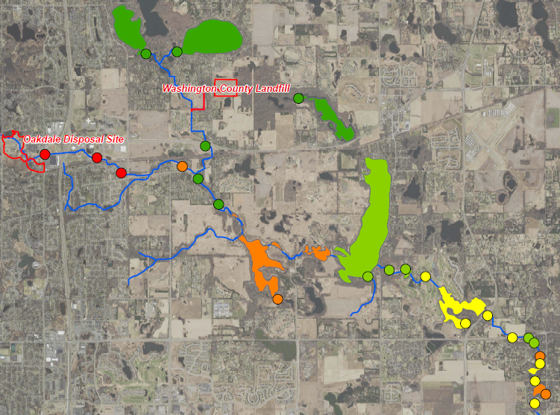
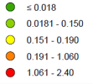


Project 1007 Focused Investigation Progress Report - Segment 4
November 2021 Minnesota Pollution Control Agency
Site-Wide Surface Water Results: PFAS Impacts
Surface Water Impacts in Segment 4
PFOS concentrations in Post-Confluence Raleigh Creek vary by three orders of magnitude, depending on flow conditions. When Raleigh Creek flows continuously from the Oakdale Disposal Site (ODS) to the Confluence with P1007 at Tablyn Park, PFOS concentrations in Post-Confluence Raleigh Creek are consistently higher. Conversely, during low flow conditions when Raleigh Creek is not connected with P1007, PFOS concentrations in surface water downstream of the Confluence are consistently lower.
Though Post-Confluence Raleigh Creek appears to be the primary surface water input into Eagle Point Lake, PFOS concentrations in Eagle Point Lake appear relatively stable under all flow conditions. In addition, PFOS concentrations in Eagle Point Lake (ranging from 0.11 to 1.05 ppb, in exceedance of the MDH Health Based Value of 0.015 ppb) remain elevated even when concentrations in the Post-Confluence Raleigh Creek are up to two orders of magnitude lower, pointing to other PFAS inputs to Eagle Point Lake. Similar to PFOS, concentrations of PFOA and PFBA in Eagle Point Lake also appear relatively stable in comparison to impacts in Post-Confluence Raleigh Creek.
PFOS Heat Map:
Surface Water
Tri-Lakes
P1007 Conveyance
Sunfish Lake
Raleigh Creek
Confluence
Lake Elmo
Eagle Point Lake
Temporal Variation in PFOS:
Post-Confluence Raleigh Creek
to Eagle Point Lake
Spring
Summer
Fall
Spring
Summer
Fall
PFOS (ppb)
Horseshoe Lake
Elevated PFAS Concentrations in Eagle Point Lake
Multiple factors may influence elevated concentrations of PFAS in Eagle Point Lake.
Stability
Dispersion and Mixing of PFAS-Impacted Waters in Large Water Body
The longer retention time, typical of larger water bodies, may limit temporal variability of PFAS in surface water.
Additional Inputs
Release of PFAS from Impacted Surficial Sediments
PFAS-impacted lake and bank sediments not normally submerged may release PFAS to surface water during flooding.
Discharge of PFAS-Impacted Groundwater
Subsurface PFAS-impacted waters likely discharge into Eagle Point Lake.
0
Spring
Summer
Fall
Spring
Summer
Fall
Temporal Variation in PFOA:
Post-Confluence Raleigh Creek
to Eagle Point Lake

Slide 6
Project 1007 Focused Investigation Progress Report - Segment 4
November 2021 Minnesota Pollution Control Agency
Site-Wide Surface Water Results: Distribution of PFAS Impacts
PFAS Distribution Map:
Site-Wide 2019-2020
PFAS Impacts: Eagle Point Lake
Post-Confluence Raleigh Creek (when not connected to Pre-Confluence Raleigh Creek) and Farney Creek discharge to Eagle Point Lake and share a PFBA-dominant signature with relatively low concentrations of PFBA, which is typical of the anthropogenic unknown source background or non-source associated PFAS impacts. When Pre-Confluence Raleigh Creek is connected to P1007 Conveyance following high precipitation events, the PFAS signature in Post-Confluence Raleigh Creek shifts to a PFOS dominant (see “Post-Confluence Raleigh Creek: Connected” at left). The PFAS impacts in Eagle Point Lake have elevated concentrations of PFOS, PFOA, and PFBA and a PFOS-dominant signature that are typically comparable to Oakdale Disposal Site (ODS). Though Eagle Point Lake primarily receives surface water from these PFBA-dominant inputs and only infrequently does it receive PFOS dominant surface water (as discussed in Segment 3 slides), the PFOS dominant signature in the lake points to ODS as the primary source of impacts.
PFAS Impacts: Disconnected Surface Water Bodies
PFAS impacts in Brown’s Pond, Margaret Lake, and Goose Lake have a PFBA-dominant signature with relatively low concentrations of PFBA, PFOA, and PFOS. This PFAS signature is typical of anthropogenic background PFAS impacts that are observed elsewhere, suggesting these three water bodies are not directly connected to Eagle Point Lake and do not receive PFAS-impacted groundwater discharge.
Tri-Lakes
ODS:
PFOS-Dominant
Washington
County Landfill
Sunfish Lake:
PFBA-Dominant
Pre-Confluence
Raleigh Creek
P1007 Conveyance
Lake Elmo
Oakdale
Disposal Site
Post-Confluence Raleigh Creek
Connected
Post-Confluence Raleigh Creek:
Not Connected
Lake Elmo
Farney Creek
Eagle Point Lake:
PFOS-Dominant
Margaret Lake
Typical PFAS Distribution
WCL
PFBA-Dominant
Post Lake Elmo and Eagle Point Lake Outlets
ODS
PFOS-Dominant
Brown’s Pond
Horseshoe Lake
Low Concentration Widespread PFAS*
Goose Lake
*Key difference between anthropogenic unknown source and WCL PFAS is lower concentrations of PFBA.

Slide 7
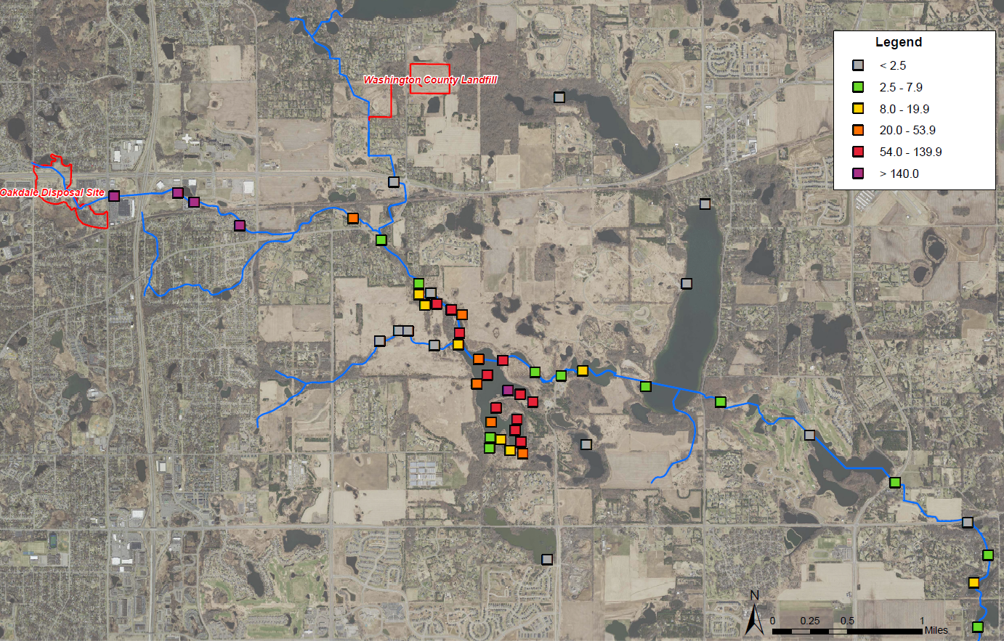
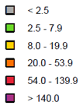
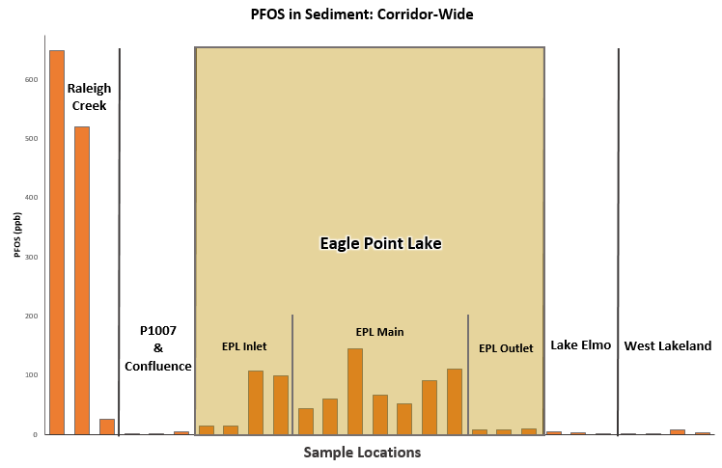
Project 1007 Focused Investigation Progress Report - Segment 4
November 2021 Minnesota Pollution Control Agency
Site-Wide Surface Sediment Results: PFOS
Site-Wide Sediment Results: Distribution of PFAS Impacts
Sediment in Segment 4
PFOS in sediment in Segment 4 is among the highest in the corridor, only lower than Segment 2, which is adjacent to the Oakdale Disposal Site (ODS). Aside from Raleigh Creek (upstream of the Confluence), sediment in Eagle Point Lake is the only location with PFOS concentrations in exceedance of the MPCA 5-Day Site-Specific Sediment Screening Value (SDSV) of 54 ppb.
Factors that may contribute to elevated PFOS in sediment in Eagle Point Lake include:
Total Organic Carbon Content
Depositional Environment
PFAS-Impacted Surface Water
PFOS Heat Map:
Sediment Sampling Locations
PFOS (ppb)

Slide 8
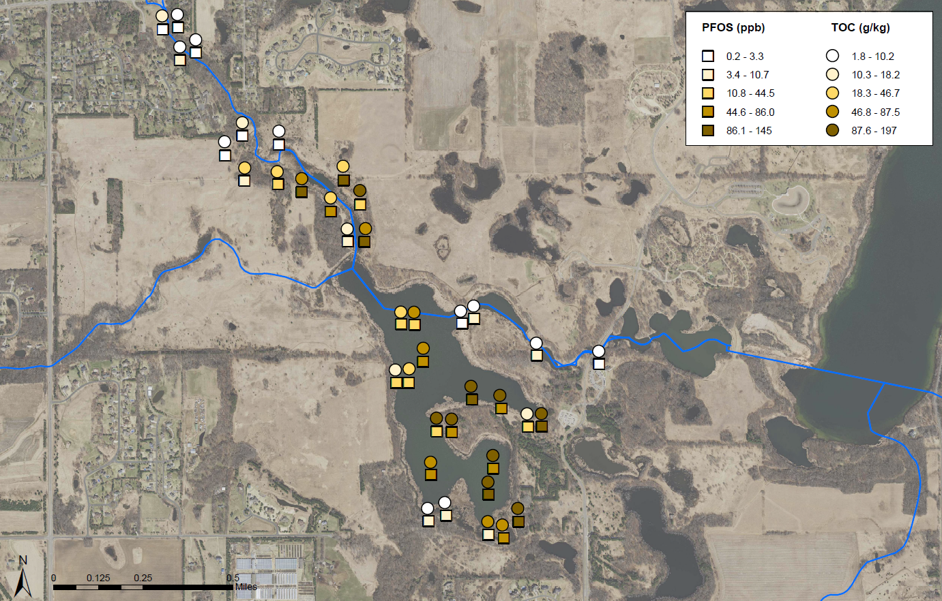
Project 1007 Focused Investigation Progress Report - Segment 4
November 2021 Minnesota Pollution Control Agency
Surface Sediment Impacts: Total Organic Content
Site-Wide Sediment Results: Distribution of PFAS Impacts
Total Organic Content
Total organic content (TOC) may have a causal influence on elevated concentrations of PFAS in sediment. When looking at the statistical relationship between PFAS impacts and TOC, variations in PFOS, PFOA, and PFHxS have a statistically significant, strong positive correlation to TOC. PFOS in particular has a very strong correlation to TOC, pointing to organic content as the primary factor in PFOS spatial variation in sediment in Eagle Point Lake.
Spearman’s Analysis
When compared to a traditional best fit analysis, Spearman’s normalizes the data by ranking each variable from low to high (and renumbering them in order) before calculating correlation. As a result, both variables are represented by numbers of the same scale (e.g., 1 - 30 rank versus the full range of PFOS and TOC concentrations), resulting in a calculation of only the statistical strength of one variable’s correlation to another. In this case, a strong positive correlation of PFOS to TOC is shown in the Ranked Spearman’s Correlation graph.
Eagle Point Lake: PFOS to TOC Heat Map

Slide 9
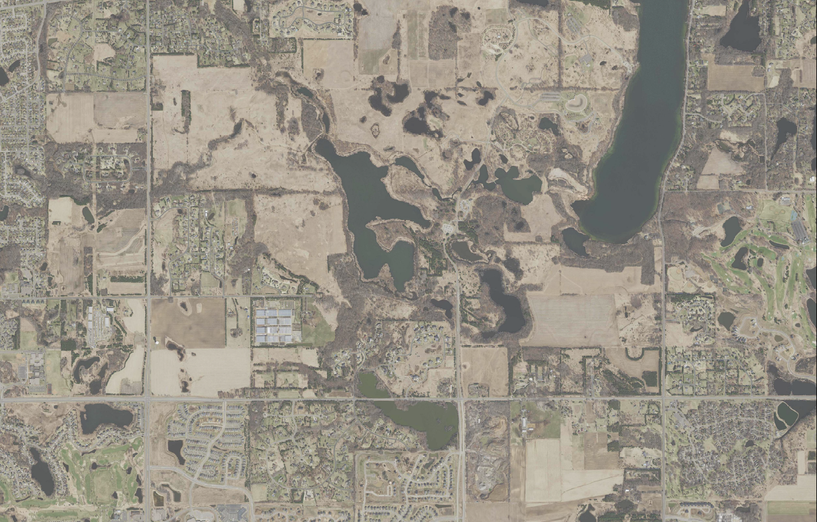
Project 1007 Focused Investigation Progress Report - Segment 4
November 2021 Minnesota Pollution Control Agency
Subsurface Investigation: Site *Beta Sites and Focused Investigation
Segment 4
Beta Sites*
Beta Site 3 (BS3)
MW3A: Jordan Aquifer Well
MW3B: Shakopee Aquifer Well
(Vertical Aquifer Profile Samples from the Quaternary Aquifer)
Piezometers
A Through J
Ten piezometer pairs were installed around Eagle Point Lake. Each piezometer pair consists of one shallow two-inch well screened to straddle the water table and a second deep well installed 10 feet below the screen of the shallow well.
Vertical Aquifer Profile Sampling
Prior to installation of the piezometer pairs, borings were advanced to the top of bedrock in seven of the ten piezometer pair locations in order to collect Vertical Aquifer Profile (VAP) samples. Three of these seven locations (locations E, F, and J) included sampling of the St. Peter Aquifer. Locations B and D were excluded from VAP sampling due to their proximity to other VAP sampling locations. Location G did not include an additional borehole for VAP sampling since G is co-located with BS3.
B
Lake Elmo
C
BS5
BS20
(new)
A
D
J
BS4
Eagle Point Lake
E
I
F
BS13
H
G/BS3
Goose Lake
*Beta Site refers to an investigation area where groundwater sampling and monitoring has been completed from multiple aquifers.

Slide 10
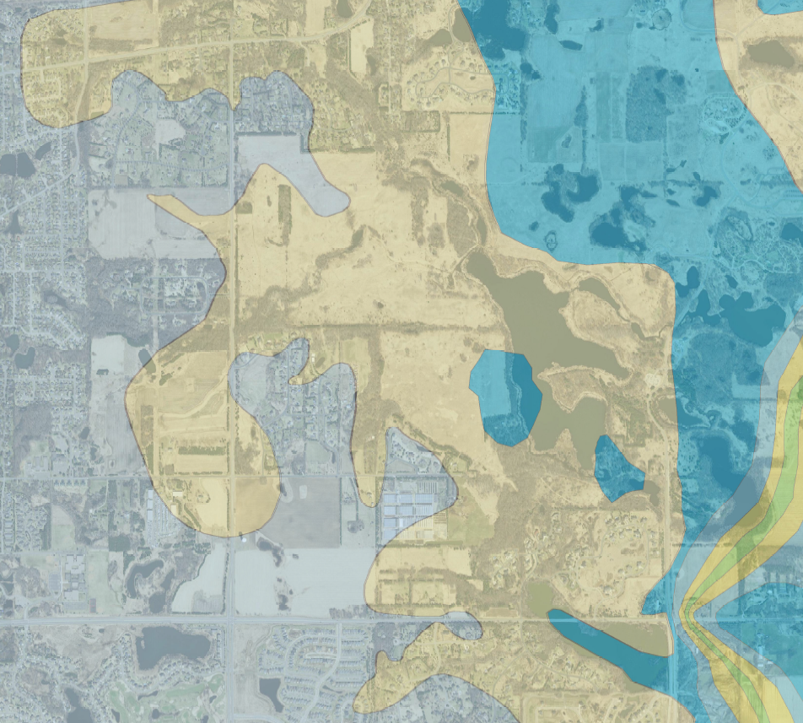
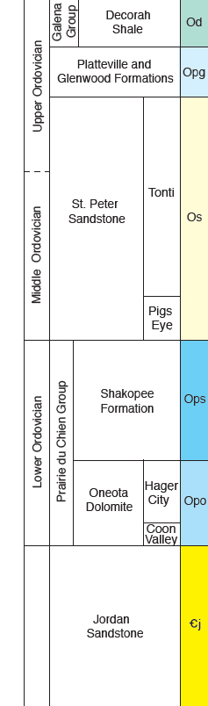
Project 1007 Focused Investigation Progress Report - Segment 4
November 2021 Minnesota Pollution Control Agency
From the Surface to the Subsurface
Confluence
First Encountered Bedrock Map
Segment 4 Bedrock Geology and Hydrogeology
The first encountered bedrock units in Segment 4 are the Platteville Limestone Aquifer, the St. Peter Sandstone Aquifer, and the Shakopee Dolostone Aquifer. The Platteville Aquifer, which is only present in the far southwestern portion of Segment 4, is underlain by the Glenwood Shale Aquitard, which acts as barrier to vertical groundwater movement. As a result, groundwater flows horizontally to the east until the Platteville and Glenwood units vertically pinch out.
The St. Peter Aquifer is the first encountered bedrock unit in the western portion Segment 4, underlying Post-Confluence Raleigh Creek and much of Eagle Point Lake. The lack of an overlying confining unit in these portions allows for a direct connection vertically between the surface and shallow Quaternary waters and the St. Peter Aquifer. Although the St. Peter is classified as an aquifer, the lowermost 10 to 40 ft of the formation grades into a finer-grained sandstone with siltstone and shale lenses and is thought to behave like an aquitard and inhibit vertical groundwater movement. As a result, groundwater within the St. Peter Aquifer likely flows horizontally to the east until the unit terminates and the Shakopee Aquifer becomes the first encountered bedrock.
The Shakopee Aquifer, which is the first encountered bedrock unit in the eastern portion of Segment 4, is underlain by the Oneota Dolostone Aquitard, which can be fractured and “leaky.” The extent to which the aquitard functions as a barrier to the underlying Jordan Aquifer is currently being studied.
IAWC
Post-Confluence
Raleigh Creek
Ops
Segment 4
Os
Eagle Point Lake
Opg
Vertical Groundwater Migration Pathway from St. Peter to Shakopee Aquifer
In Segment 4, a direct connection between the shallow Quaternary, St. Peter, and the Shakopee Aquifers may also exist under three possible conditions:
1) In isolated areas where the St. Peter Aquifer is heavily eroded from glacial activities and nearly absent. The resulting secondary porosity from this weathering and fracturing may introduce heterogeneity to the groundwater flow regime of the St. Peter Aquifer and allow for higher transmissivity within and from the aquifer.
2) In locations where the lowermost portion of the finer-grained St. Peter is thin or absent.
3) Historically, where previously abandoned wells were screened across two or more aquifers and/or an aquitard.

Slide 11
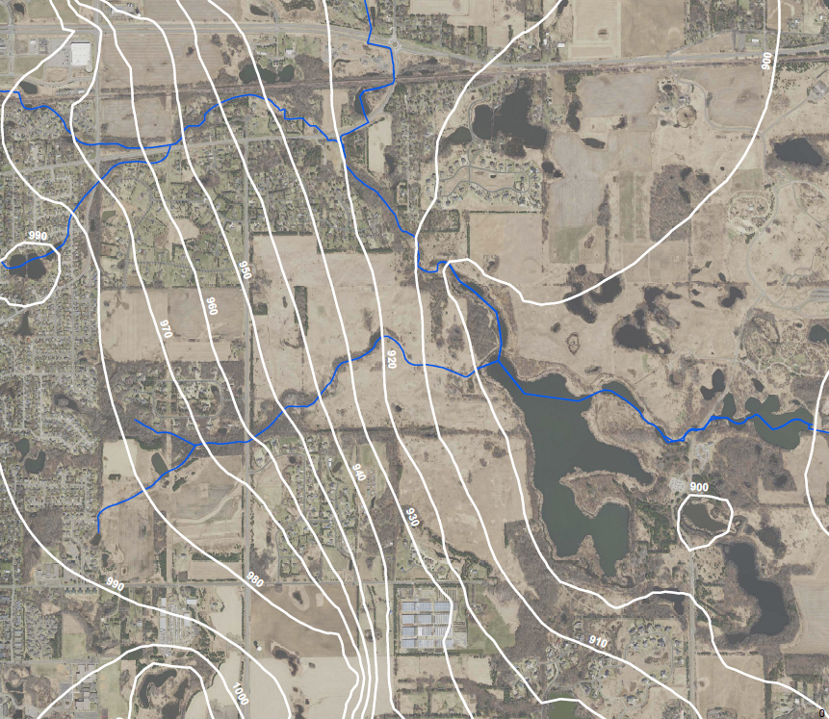
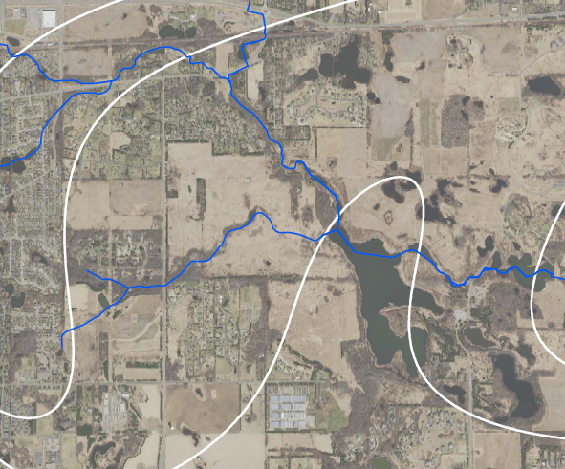
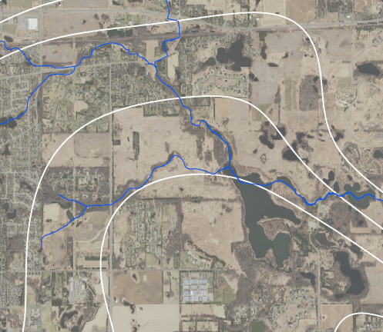
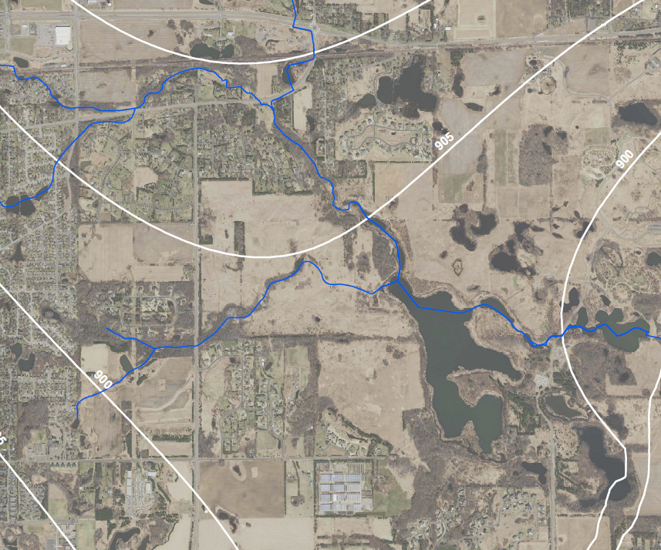
Project 1007 Focused Investigation Progress Report - Segment 4
November 2021 Minnesota Pollution Control Agency
Segment 4: Groundwater Flow Direction
Variable Groundwater Flow Direction
The hydrogeology in Segment 4 is variable and not fully understood. Within Segment 4, groundwater flow in all four aquifers is predominantly to the east and southeast towards Eagle Point Lake. However, west of Segment 4, groundwater flows to the south and to the west in the Jordan and Shakopee Aquifers due to a regional groundwater divide.
Though groundwater flow in the Quaternary Aquifer is generally east across the segment, the Quaternary Aquifer is observed to be dry west of Segment 4, near BS20. Between the Ideal Avenue Wetland Complex (IAWC) and BS20, groundwater likely migrates vertically from the Quaternary into the St. Peter Aquifer where the St. Peter unit is the first encountered bedrock. As a result, Quaternary groundwater around Eagle Point Lake is likely present as a result of infiltration from precipitation west of the lake or from Eagle Point Lake itself and not connected to Quaternary groundwater west of Segment 4.
Once in the St. Peter Aquifer, groundwater flows to the southeast and then east towards Eagle Point Lake. In the central portion of Segment 4, the St. Peter Aquifer begins to thin and is likely highly eroded and, in some areas, absent. It is mapped as completely pinching out just east of Eagle Point Lake which could facilitate vertical PFAS migration into the Shakopee Aquifer.
Groundwater flow direction in all four aquifer units is based on limited available data, including numerous previously abandoned wells. The lack of active wells within and around Segment 4 complicates the understanding of the migration flow path of the subsurface impacts.
Quaternary Aquifer: Groundwater Flow Map
St. Peter Aquifer: Groundwater Flow Map*
BS14 (IAWC)
BS14 (IAWC)
BS2
BS2
?
BS20
BS20
?
BS3
BS3
?
Shakopee Aquifer: Groundwater Flow Map*
Jordan Aquifer: Groundwater Flow Map
BS2
BS2
BS14 (IAWC)
BS14 (IAWC)
BS20
?
BS20
Map Features
Ground to Surface Discharge
Approximate Groundwater Divide
Potentiometric Surface Contours
Note*
Due to the lack of available groundwater gauging data, diffusion interpolation was used to smooth modeled groundwater elevations where high groundwater variability exists within well clusters.
Surface to Ground Infiltration
Horizontal Groundwater Flow Direction
Vertical Groundwater Flow Direction (estimated)
?
BS3
BS3
?

Slide 12
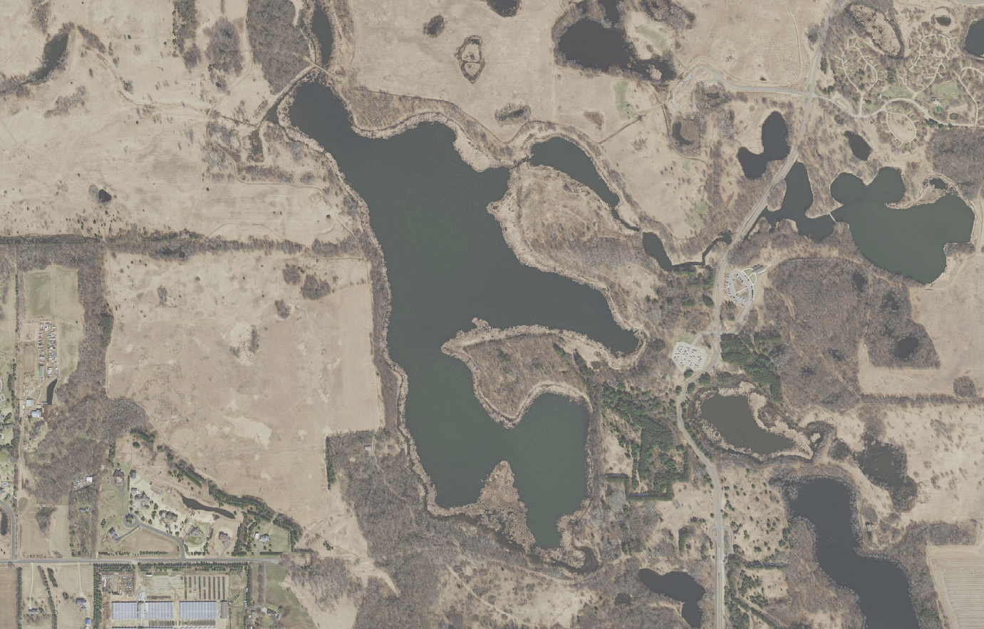
Project 1007 Focused Investigation Progress Report - Segment 4
November 2021 Minnesota Pollution Control Agency
PFAS Concentrations in Quaternary Around Eagle Point Lake
Surface to Groundwater Connection: Shallow Quaternary Aquifer and Eagle Point Lake
PFOS concentrations in the shallow Quaternary Aquifer surrounding Eagle Point Lake are highly variable, ranging from below detection to 0.91 ppb. Along the eastern edge of the Eagle Point Lake, PFOS and PFBA concentrations in shallow Quaternary Aquifer have comparable PFAS concentrations in surface water, suggesting a groundwater-surface water connection.
Along the western side of the lake, however, PFOS concentrations in groundwater are lower than PFOS concentrations in surface water, indicating this shallow Quaternary Aquifer may not be contributing to the high PFOS impacts observed in the lake. As discussed in the previous slide, the Quaternary Aquifer west of Eagle Point Lake is observed to be dry at investigated locations between the Ideal Avenue Wetland Complex (IAWC) and Eagle Point Lake resulting in no complete Quaternary groundwater migration pathway between IAWC and Eagle Point Lake. However, impacts in the St. Peter Aquifer to the west of Eagle Point Lake and the potential connections between the Quaternary, St. Peter Aquifer, and surface water are currently being studied.
PFOS concentrations in groundwater at the southwestern corner of Eagle Point Lake are comparable to PFOS concentrations in Eagle Point Lake. PFBA concentrations in groundwater, however, are up to an order of magnitude greater than PFBA concentrations in surface water and consistently the highest of all the Eagle Point Lake piezometers. Similarly, PFOA groundwater concentrations (data not shown) are also higher at this location than in the surface water or other Quaternary groundwater in Segment 4. Based on limited groundwater gauging data, shallow Quaternary groundwater likely discharges to Eagle Point Lake from the southwest. The source of these elevated PFBA impacts, typical of farther-travelled PFAS plumes, is discussed in further detail in the next slide. Continued monitoring of the surface and groundwater around Eagle Point Lake in addition to groundwater modeling will be used to determine the source of this high PFAS impacted groundwater and the extent it is impacting Eagle Point Lake.
PFOS Heat Map
PFBA Heat Map
Eagle Point Lake
Eagle Point Lake
Map Features
Shallow Piezometer Result
Deep Piezometer Result
Surface Water Result
PFOS (ppb)
PFBA (ppb)
Note: Sample results are from April -September of 2021.
Below Detection
<0.0149
0.015 - 0.055
0.0551 - 0.160
0.161 - 0.509
0.51 – 3.9
Below Detection
<0.002
0.011 - 0.05
0.51 - 0.10
0.11 - 0.50
0.51 – 1.30

Slide 13
Project 1007 Focused Investigation Progress Report - Segment 4
November 2021 Minnesota Pollution Control Agency
PFAS Distribution in Shallow Quaternary Groundwater: Eagle Point Lake
Segment 4: PFAS Signature as an Indicator of Surface-Groundwater Connection
The distribution of PFAS compounds around Eagle Point Lake is highly variable, suggesting varying PFAS-impacted water inputs.
Northern Corner and Eastern Edge (locations B, E, F, and deep D)
The PFOS-dominant signature in these piezometers, similar to that of the Oakdale Disposal Site (ODS), have a PFAS signature comparable to Eagle Point Lake, suggesting a groundwater-surface water connection.
Southwestern Edge (location H)
The PFBA-dominant signature with elevated levels of PFBA, PFOS, and PFOA, may indicate both a longer-travelled PFAS migration route and/or a different PFAS migration pathway than in other areas around Eagle Point Lake.
Western Edge (locations A and I)
The PFBA-dominant signature and the lower PFOS and PFOA concentrations could signify non-source or background PFAS impacts and an absence of a groundwater-surface water connection at these locations. As previously discussed, the Quaternary Aquifer in Segment 4 may be largely disconnected from the PFAS-impacted shallow groundwater to the west of the segment. The extent to which PFAS-impacted groundwater in the underlying St. Peter Aquifer exists and may be connected to impacts in Eagle Point Lake is currently being investigated.
Remaining Locations (locations C, J, G and shallow D)
The PFBA-dominant signature with overall lower concentrations of all PFAS compounds may indicate non-source or background PFAS impacts and an absence of a groundwater-surface water connection at these locations.
Relative Distribution of PFAS Impacts: Quaternary Groundwater
Typical PFAS Distribution
Relative Distribution of PFAS
April
ODS
PFOS-Dominant
Long-Travelled
PFAS Signature*
PZBS
Low Concentration Widespread PFAS*
PZCS
PZBD
PZCD
PZAS
PZDS
PZAD
PZDD
*Key difference between long-travelled impacts and other PFBA-dominant signatures is elevated PFBA, PFOS, and PFOA concentrations.
PZJS
PZJD
PZES
PZIS
Eagle Point Lake
PZED
PZID
PZGS
PZFS
PZHS
PZFD
PZHD
PZGD
PZGS
Blue box denotes surface water PFAS distribution

Slide 14
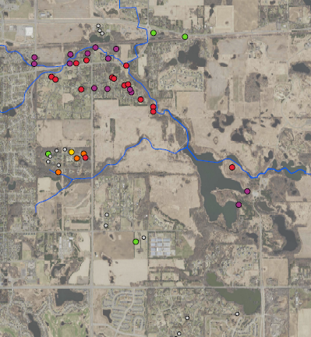
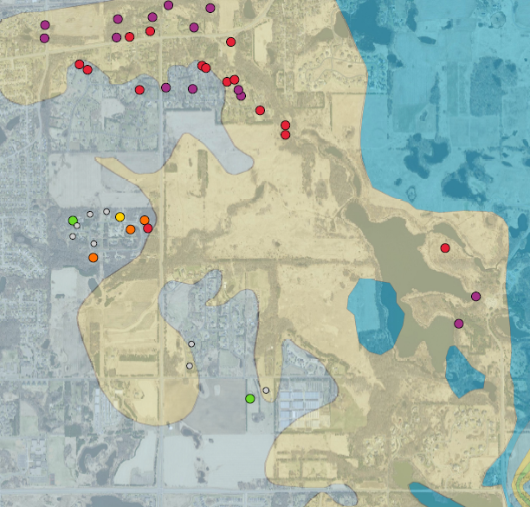
Project 1007 Focused Investigation Progress Report - Segment 4
November 2021 Minnesota Pollution Control Agency
Fate and Transport: St. Peter Aquifer
PFOS Heat Map: St. Peter
PFAS in St. Peter Aquifer
In Segment 4, data from St. Peter Aquifer is limited to three vertical aquifer profile samples collected from boreholes to the east of Eagle Point Lake. PFOS concentrations from these samples ranged from 0.19 to 0.97 ppb, which are an order of magnitude above the MDH Health-Based Value of 0.015 ppb.
Upgradient of Segment 4, between the Ideal Avenue Wetland Complex (Beta Site 14) and Tablyn Park (Beta Site 2), PFOS concentrations in the St. Peter Aquifer historically ranged from 0.065 to 3.90 ppb. However, reported PFOS concentrations in this area are predominantly from wells which were sampled between 2005 and 2008 and have since been abandoned (indicated with the black dots in the left and right maps).
Current groundwater data from the St. Peter Aquifer upgradient of Segment 4 is limited as there are only two active P1007 monitoring wells in this area (BS2 and BS14). Data from recently completed St. Peter Aquifer Vertical Aquifer Profile sampling at BS20 and ongoing surface water and groundwater modeling will assist with understanding the eastward migration of PFAS in the St. Peter Aquifer upgradient and within Segment 4.
St. Peter to Shakopee Aquifer Flow Paths
BS14 (IAWC)
BS2
BS14 (IAWC)
BS2
Segment 4
Segment 4
?
Ops
BS20
BS20
?
Eagle Point Lake
Os
?
BS3
?
PFOS (ppb)
PFOS (ppb)
BS3
Below Detection
<0.0149
0.015 - 0.055
0.0551 - 0.160
0.161 - 0.509
0.51 – 3.9
Below Detection
<0.0149
0.015 - 0.055
0.0551 - 0.160
0.161 - 0.509
0.51 – 3.9
Well Sample
Location
Surface Water
Sample Location
Opg
PFAS in St. Peter Aquifer: Where Is It Going?
As previous discussed, the St. Peter Aquifer within and surrounding Segment 4 is highly variable. Generally, the lowermost 10 to 40 feet can behave like an aquitard and inhibit vertical groundwater movement. However, where the St. Peter Aquifer is the first encountered bedrock, the unit can be heavily eroded from glacial activities, resulting in vertical fracturing through the lower confining portion. Further, the St. Peter Aquifer has been documented as being intermittently absent, likely due to the same weathering from glacial activities. At one such location, BS3, a notable increase of PFOS relative to the surrounding wells and overlying units has been consistently reported in the Shakopee Aquifer well indicating PFAS is migrating into the Shakopee Aquifer (discussed in further detail in next slide).
Map Features
Notes:
Wells with PFOS concentrations below detection and detection limits above 0.5 ppb not shown.
Data results from BS20 are pending.
Surface to Ground Infiltration
Horizontal Groundwater Flow Direction: St. Peter Aquifer
Vertical Migration from St. Peter to Shakopee Aquifer (unknown)
Previously abandoned or unknown status of well; last sampled between 2005-2008
Well open across St. Peter and Shakopee Aquifers

Slide 15
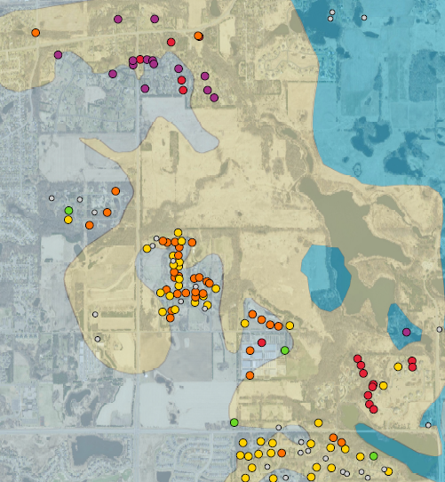
Project 1007 Focused Investigation Progress Report - Segment 4
November 2021 Minnesota Pollution Control Agency
Fate and Transport: Shakopee Aquifer
St. Peter to Shakopee Aquifer Flow Paths
Vertical Migration Pathway: Surface to Bedrock
At Beta Site 3 (BS3), located to the southeast of Eagle Point Lake, PFOS concentrations in the Shakopee Aquifer (ranging from 0.519 to 0.78 ppb) are higher than all other P1007 investigation Shakopee Aquifer wells corridor-wide, consistently higher than PFOS in Eagle Point Lake, and over two orders of magnitude higher than the adjacent overlying Quaternary Aquifer wells. In addition, the distribution of key PFAS compounds (see lower right graph) is distinctly different between the surface water, Quaternary Aquifer, and Shakopee Aquifer waters. The absence of elevated PFAS impacts in the Quaternary Aquifer at BS3 may indicate minimal downward migration of PFAS impacts from Eagle Point Lake to deeper bedrock aquifers and instead an alternative PFAS migration pathways to the Shakopee Aquifer at this location.
Vertical Migration Pathway: St. Peter Aquifer to Shakopee Aquifer
The St. Peter Aquifer is absent at BS3 but is present in several wells located within 1,500 feet to the north, south, and west of BS3. Given the PFAS impacts identified in the St. Peter to the north and northwest of this segment, the elevated PFAS impacts in the Shakopee Aquifer at BS3 and in private wells located south of Eagle Point Lake may be the result of the absence of the St Peter Aquifer as the lowermost confining portion of the St. Peter no longer provides a vertical barrier to downward migration of PFAS-impacted groundwater.
Horizontal Migration Pathway
Based on the south-southeast direction of groundwater flow in the Shakopee Aquifer, PFOS impacts observed south of Eagle Point Lake (BS3 and private wells) are thought to be at least partially a result of horizontal migration of PFAS with groundwater flow from the high PFAS impacts observed in the Shakopee Aquifer near Tablyn Park and BS2. This Shakopee flow path and the role that the presence or absence of the St. Peter Aquifer plays in horizontal migration of PFAS will be further developed following analysis of PFAS groundwater data from recently completed BS20.
BS14 (IAWC)
BS2
BS3
?
Segment 4
Approximate
Groundwater Divide
Ops
?
BS20
Os
Eagle Point Lake
?
?
BS3
PFOS (ppb)
Surface
Below Detection
<0.0149
0.015 - 0.055
0.0551 - 0.160
0.161 - 0.509
0.51 – 3.9
Opg
Shallow
Quaternary
Deep
Quaternary
Map Features
Previously abandoned or unknown status of well; last sampled between 2005-2008
Well open across St. Peter and Shakopee Aquifers
Vertical Migration from St. Peter to Shakopee Aquifer (unknown)
Horizontal Groundwater Flow Direction: Shakopee Aquifer
Approximate Groundwater Divide
Notes:
Wells with PFOS concentrations below detection and detection limits above 0.5 ppb not shown.
Data results from BS20 are pending.
Shakopee

Slide 16
Project 1007 Focused Investigation Progress Report - Segment 4
November 2021 Minnesota Pollution Control Agency
Fate and Transport: Jordan Aquifer
Map Features
Washington County Landfill
Relative PFOS Concentrations:
Jordan Aquifer
Vertical Migration to the Jordan Aquifer
The elevated PFOS impacts in the Shakopee Aquifer in Segment 4 and relatively low PFOS impacts in the Jordan Aquifer upgradient (i.e., to the west and north) of the Jordan Aquifer well at BS3 suggests a downward migration pathway of PFAS impacts from the Shakopee Aquifer into the Jordan Aquifer within Segment 4. Sample results from Jordan Aquifer wells at BS20 (pending) will provide additional hydrogeologic and PFAS data from Jordan Aquifer wells between BS2 and BS3 that can be used to determine if vertical migration is occurring closer to BS3 or farther upgradient.
Horizontal Groundwater Flow Direction: Jordan
Downward Groundwater Flow Direction: Shakopee to Jordan (uncertain)
Oakdale Disposal Site
BS1
BS17
BS14
BS2
Approximate Groundwater Divide
0.1 ppb PFOS
Non-AECOM Well
Segment 4
?
BS5
BS20
?
Notes:
For illustration purposes, PFOS values below 0.009 ppb are enlarged on the map (BS1, BS2, BS17, BS5, and BS6).
Data results from BS20 are pending.
?
BS13
BS6
Non-AECOM Well
?
Approximate Jordan Aquifer
Groundwater Divide
BS3
Segment 4
Beta Site 3: PFOS in the Jordan and Shakopee Aquifers South of Eagle Point Lake
At Beta Site 3 (BS3), located to the southeast of Eagle Point Lake, PFOS concentrations in the Jordan Aquifer well range from 0.05 to 0.4 ppb and are in exceedance of the MDH Health-Based Value of 0.015 ppb. The concentrations observed at BS3 are among the highest corridor-wide for the Jordan Aquifer, lower only than the Jordan Aquifer well at Beta Site 14, which is located closer to the Oakdale Disposal Site (ODS). Additional hydrogeologic and PFAS data from BS20 (pending) will provide more detail on the transport of PFAS in the Jordan Aquifer upgradient and in Segment 4 as groundwater flows from the northwest to southeast.

