Slide 1
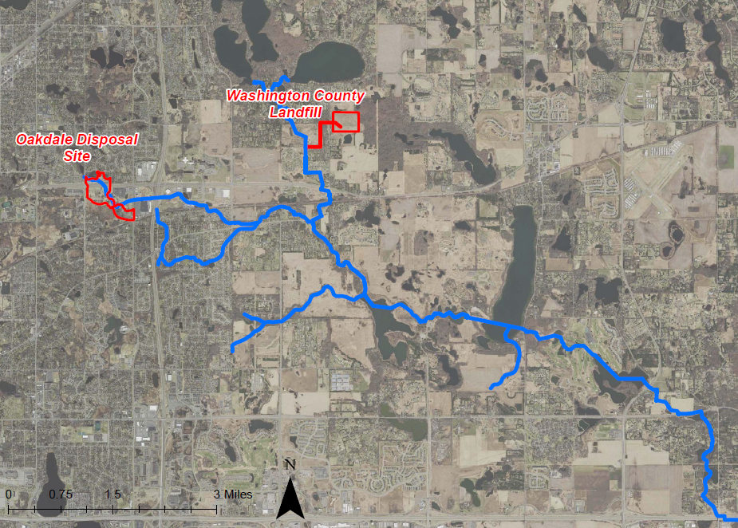
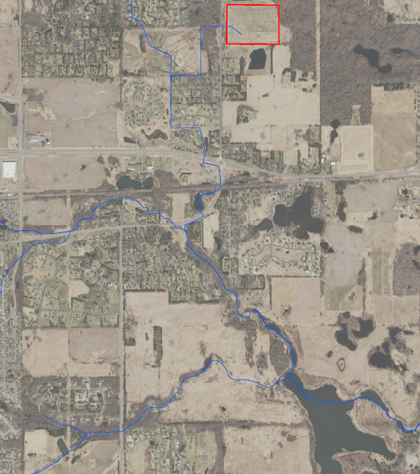
Segment 5| Project 1007
Minnesota Pollution Control Agency
Project 1007 Focused Investigation Progress Report - Segment 3
October 2021 Minnesota Pollution Control Agency
Segment 3: Confluence
Segment 3: Confluence of Raleigh Creek and P1007
P1007 Corridor Map
Segment 3 Site Map
Washington County Landfill
Tri-Lakes
Sunfish Lake
Raleigh Creek:
Intermittent Portion
P1007 Conveyance
Lake Elmo
Eagle Point Lake
Confluence
Tablyn Park
Segment 3
Horseshoe Lake
Eagle Point Lake

Slide 2
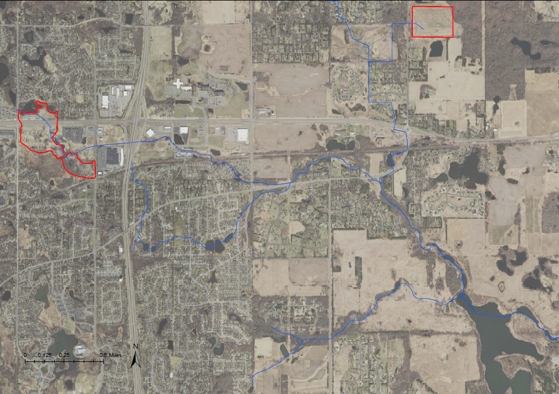
Project 1007 Focused Investigation Progress Report - Segment 3
October 2021 Minnesota Pollution Control Agency
Introduction: Segment 3 Surface Water Systems
PFAS Preferential Pathways
Washington County Landfill
Surface Water Flow Path: Confluence
The primary surface water flow paths in Segment 3 are Raleigh Creek, the Project 1007 Conveyance System, and the confluence of the two flow paths.
Raleigh Creek, the headwaters of which is located immediately northwest of the former Oakdale Disposal Site (ODS), flows west to east and passes through a series of wetlands and small ponds. These wetlands and ponds have PFAS impacts in sediment likely contributing to surface water impacts and infiltrating into the subsurface. Raleigh Creek flow downstream of Ideal Avenue is controlled by the culvert elevations and flood mitigation structure at the intersection of Raleigh Creek and Ideal Ave. Between Ideal Avenue Wetland Complex (IAWC) and Tablyn Park, flow in Raleigh Creek is precipitation dependent and as a result is intermittent.
The P1007 Conveyance system begins with the Tri-Lakes which discharge southward through a series of pipes and channels until the confluence with Raleigh Creek at Tablyn Park. Between 1988 and 1995, groundwater at the Washington County Landfill (WCL) was directly discharged to the P1007 Conveyance system via a stormwater sewer connection.
After the confluence with the P1007 Conveyance system at Tablyn Park (indicated in the map with a star), Raleigh Creek continues flowing southeast to the Lake Elmo Park Reserve and discharges to the northwestern inlet of Eagle Point Lake. Due to the largely continual input from the P1007 Conveyance, flow after the confluence is perennial except during extreme drought conditions when the system between the confluence and Eagle Point Lake has intermittent flow.
Oakdale Disposal Site
P1007 Conveyance
Raleigh Creek
IAWC
Confluence
Continuous Flow
Legend
P1007 Flow Path (Continuous Flow)
P1007 Flow Path
(Intermittent Flow)
Source Areas Extent
Surface Water Flow
Direction (Continuous)
Surface Water Flow
Direction (Intermittent)
Surface Water Flow Direction (1988-1995)
Surface Water
Infiltration

Slide 3
Project 1007 Focused Investigation Progress Report - Segment 3
October 2021 Minnesota Pollution Control Agency
Historic and Current Surface and Groundwater Pathways from WCL and ODS
Washington County Landfill and Oakdale Disposal Site History
From the early 1950’s, the 3M facility in Cottage Grove, Minnesota has produced commercial products containing PFAS compounds. Both liquid and solid wastes generated from the perfluorochemical production process were disposed of at the production facility in Cottage Grove as well as several other disposal sites including the Oakdale Disposal Site (ODS) and the Washington County Landfill (WCL).
Between the mid-1950’s and the early 1960’s, PFAS-containing wastes were disposed of at ODS. From 1969 to 1975, WCL accepted PFAS-containing waste including wastewater treatment plant sludge, incinerator scrubber sludge, ash, and iron oxide sludge.
As part of a larger flood mitigation infrastructure project completed in 1987 (P1007), a series of pipes and channels were constructed between the Tri-Lakes and Tablyn Park to direct overflow from the Tri-Lakes away from the regularly-flooded residential area southward towards Raleigh Creek. Between 1988 and 1995, WCL began directly discharging untreated gradient control well effluent groundwater into P1007 via a stormwater sewer connection, resulting in discharge of PFAS-impacted waters from WCL to the P1007 system. In 1995, groundwater effluent discharge ceased. Prior to and after this connection, PFAS-impacted waters from WCL likely migrated both via surface runoff to the east-southeast for a limited distance and vertically into the subsurface.
In the 1980’s, following the detection of VOC-impacted shallow groundwater, portions of the ODS were excavated, contaminated materials and soils were disposed of offsite, 39 multi-aquifer wells in the area were sealed, and a 12-well pump and treat system was installed at ODS. In 2010, in response to the identified PFAS impacts, the pump and treat system at ODS was expanded to 24 wells. However, PFAS-impacted surface water continues to migrate into Raleigh Creek and flow downstream. In addition, the absence of a complete monitoring network has limited the ability to document how the pump and treat system is preventing vertical and horizontal migration of PFAS-impacted groundwater.
Both source areas have historically contributed to surface water PFAS impacts at the confluence and likely contribute to groundwater PFAS impacts in Segment 3.
PFAS Preferential Pathways
Washington County Landfill
Oakdale Disposal Site
P1007 Conveyance
Raleigh Creek
Confluence
Legend
Surface Water Flow Direction
(1988-1995)
Surface Water Flow Direction
(Present)
Inferred Runoff Direction
Surface Water Infiltration
Groundwater Flow Direction
P1007 Flow Path
Source Areas Extent

Slide 4
Project 1007 Focused Investigation Progress Report - Segment 3
October 2021 Minnesota Pollution Control Agency
Historic and Current Surface and Groundwater Pathways from WCL and ODS (Continued)
Received Industrial Waste
Remedial Activities for VOC-Related Impact
(excavation, well abandonment, well pump-out system)
Activities at ODS
Received PFAS- Containing Waste*
Expansion of Pump-Out System to 24 Wells
1940
1956
1960
1980
1985
2010
Present
Oakdale Disposal Site
(ODS)
Preferential PFAS Pathways
Groundwater Infiltration into Deeper Aquifers
*1956-1960 is an approximate determination of the date range waste was received from 3M
Surface Water via Raleigh Creek
Landfill Closed
Installation of Remediation System to Remove VOCs
Activities at WCL
Accepted PFAS- Containing Waste
Effluent Discharge to P1007
Washington County Landfill
(WCL)
1969
1975
1983
1988
1995
Present
Preferential PFAS Pathway:
Surface Water via P1007
Groundwater Infiltration and General Runoff

Slide 5
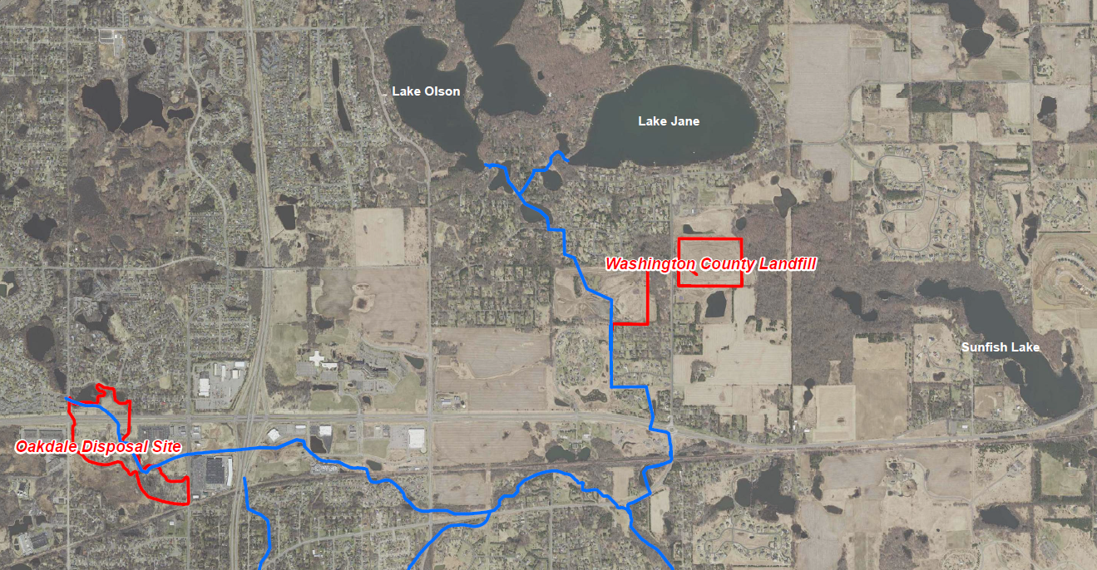

Project 1007 Focused Investigation Progress Report - Segment 3
October 2021 Minnesota Pollution Control Agency
Comparison of Two Source Areas: Oakdale Disposal Site vs. WCL
Disposal Site-Specific PFAS-Containing Waste
The Oakdale Disposal Site (ODS) accepted liquid and solid industrial waste, while the Washington County Landfill (WCL) accepted a variety of industrial and wastewater treatment plant waste. The PFAS contamination associated with these two historic waste streams is made up of different PFAS compounds, resulting in a PFAS “signature” that may be unique to each source area.
The PFAS signature associated with ODS is generally PFOS-dominant, while the PFAS signature from WCL is generally PFBA-dominant. As a result, analysis of the PFBA:PFOS ratio or the relative distribution of key compounds can be used to evaluate a possible PFAS source contribution at different locations.
Locations that are not associated with either ODS or WCL impacted waters may have a similar PFAS signature; however, the concentrations of all compounds will be significantly lower. This PFAS is still anthropogenic but has an unknown source and is likely a result of widespread use.
PFAS Distribution by Source Area
WCL PFAS Signature
ODS PFAS Signature
Low Concentration Widespread PFAS
Typical PFAS Distribution: ODS vs WCL
ODS
PFOS-Dominant
WCL
PFBA-Dominant
Low Concentration Widespread PFAS*
Future Chemometrics Forensic Analysis
By applying multivariate statistical tools such as principal component analysis, hierarchical clustering, and logarithmic transformations to chemistry data using PFAS Chemometrics as a forensics tool, potential source area signatures can be identified and separated by subtle variations to provide powerful forensic interpretations. This will aid in future understanding of partitioning, source mixing, and PFAS fate and transport.
Future data analysis will use the above tools to refine the Conceptual Site Model and develop a deeper understanding of how PFAS is behaving in the surface and subsurface features of Project 1007.
*Key difference between unknown anthropogenic source and WCL is lower concentrations.

Slide 6
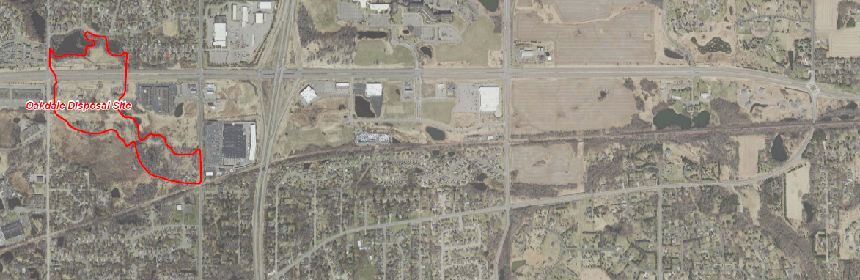
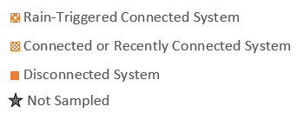
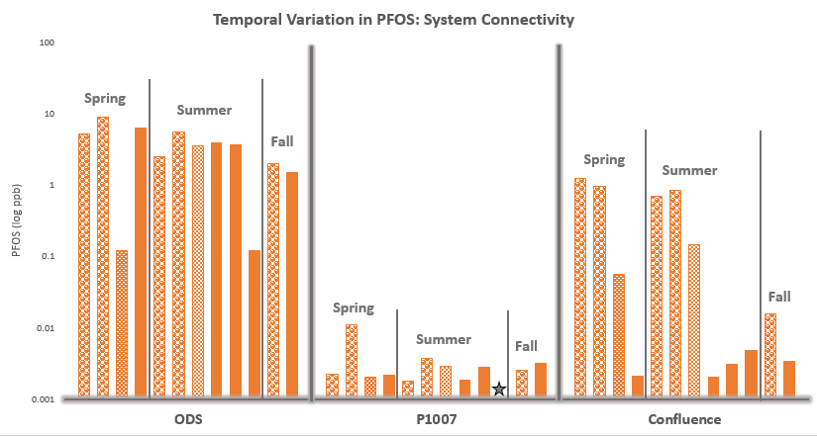
Project 1007 Focused Investigation Progress Report - Segment 3
October 2021 Minnesota Pollution Control Agency
Surface Water Results: Temporal Variation in PFOS at Confluence
Low Flow Exiting ODS
P1007 Conveyance
Disconnected Raleigh Creek
Confluence
Low Flow: Disconnected System
High Flow Exiting ODS
Connected Raleigh Creek
P1007 Conveyance
Confluence
Fluctuation in PFOS in Surface Water
Factors that may influence concentrations of PFAS in surface water at the confluence include:
Though several competing environmental conditions may influence surface water PFAS impacts, the greatest contributing factor driving PFAS concentrations at the confluence appears to be the connection or lack of connection of Raleigh Creek.
High Flow: Connected System
PFOS in Surface Water at the Confluence
PFOS concentrations in surface water immediately adjacent to the Oakdale Disposal Site (ODS) generally remain relatively high, while PFOS in surface water from the P1007 conveyance system, which channelizes the flow from the Tri-Lakes area, remains relatively low. Conversely, PFOS concentrations in surface water at the confluence increase up to three orders of magnitude when Raleigh Creek is connected or was recently connected to the system, usually due to rainfall. In addition, the distribution of the PFAS compounds at the confluence shifts from a PFBA-dominant to a PFOS-dominant signature, similar to that of ODS.
Typical PFAS Distributions
Decrease in PFAS Concentrations
Addition of Rain to Surface Water
Addition of Surface Runoff from Other Unimpacted Locations
Increase in PFAS Concentrations
Release of PFAS from Impacted Surficial Sediments
Connection of Otherwise Disconnected PFAS-Impacted Waters
ODS
PFOS-Dominant
WCL
PFBA-Dominant
Low Concentration Widespread PFAS

Slide 7
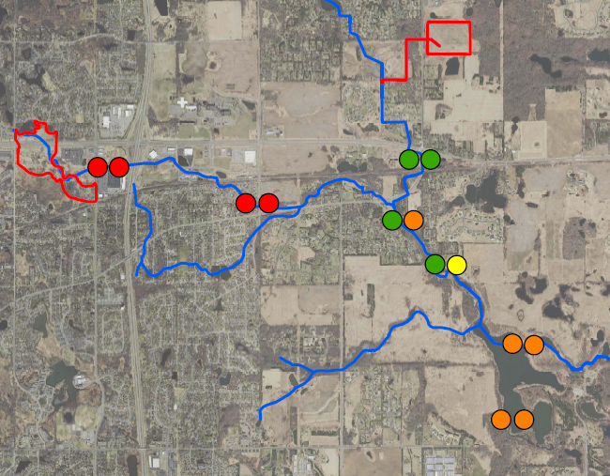
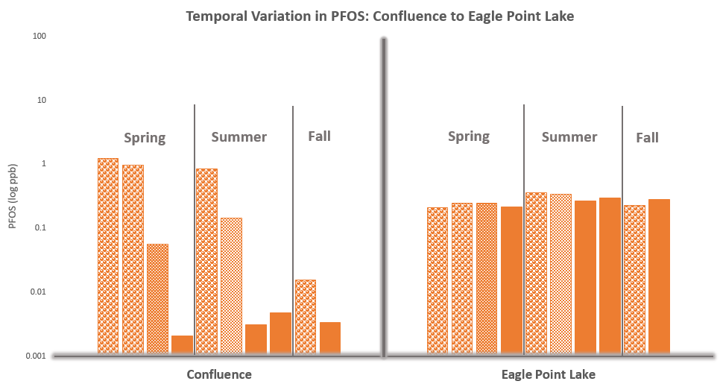
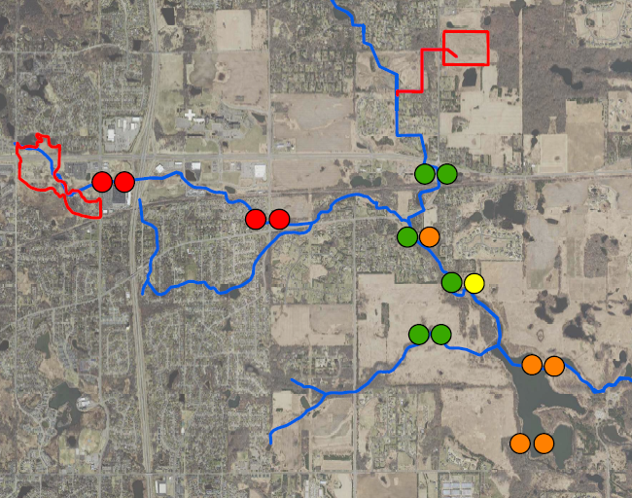
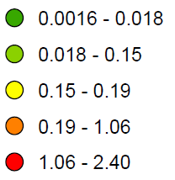
Project 1007 Focused Investigation Progress Report - Segment 3
October 2021 Minnesota Pollution Control Agency
Surface Water Results: Temporal Variation from Confluence to Eagle Point Lake
High Flow vs. Low Flow: PFOS in Surface Water
Washington County Landfill
Oakdale Disposal Site
Raleigh Creek:
Intermittent Portion
P1007 Conveyance
Confluence
PFOS (ppb)
Eagle Point Lake
Blue box outline denotes a connected Raleigh Creek.
Stability of PFOS in Eagle Point Lake
Factors that may influence concentrations of PFAS in Eagle Point Lake include:
Dispersion and Mixing of PFAS-Impacted Waters in Large Water Body
The longer retention time typical of larger water bodies may limit temporal variability of PFAS in surface water.
Release of PFAS from Impacted Surficial Sediments
PFAS-impacted lake and bank sediments not normally submerged may release PFAS during flooding.
Discharge of PFAS-Impacted Groundwater
Shallow subsurface PFAS-impacted waters likely discharge into Eagle Point Lake.
PFOS in Surface Water at the Confluence Compared to Eagle Point Lake
PFOS concentrations in surface water at the confluence can vary up to three orders of magnitude depending on flow conditions. Though the confluence appears to be the primary surface water input into Eagle Point Lake, PFOS concentrations in Eagle Point Lake remain relatively stable under all flow conditions. In addition, PFOS in Eagle Point Lake remain elevated even when concentrations in the confluence decrease by two orders of magnitude.

Slide 8
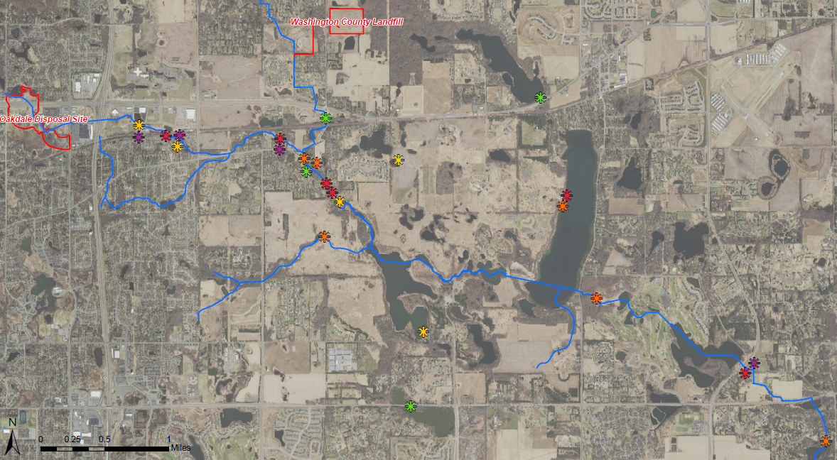
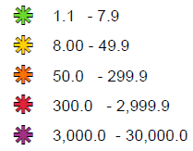

Project 1007 Focused Investigation Progress Report - Segment 3
October 2021 Minnesota Pollution Control Agency
Site-Wide Foam Results: PFOS
PFOS Heat Map: Foam
Legend
PFOS (ppb)
Segment 3
Circled symbols denote repeat foam sample locations
Foam in Segment 3
Foam has been routinely observed in Segment 3. The locations with foam and types of foam observed are variable, largely depending on flow conditions.
PFOS in foam in Segment 3 is highest in Raleigh Creek and the confluence when Raleigh Creek is flowing and connected to the 1007 system

Slide 9
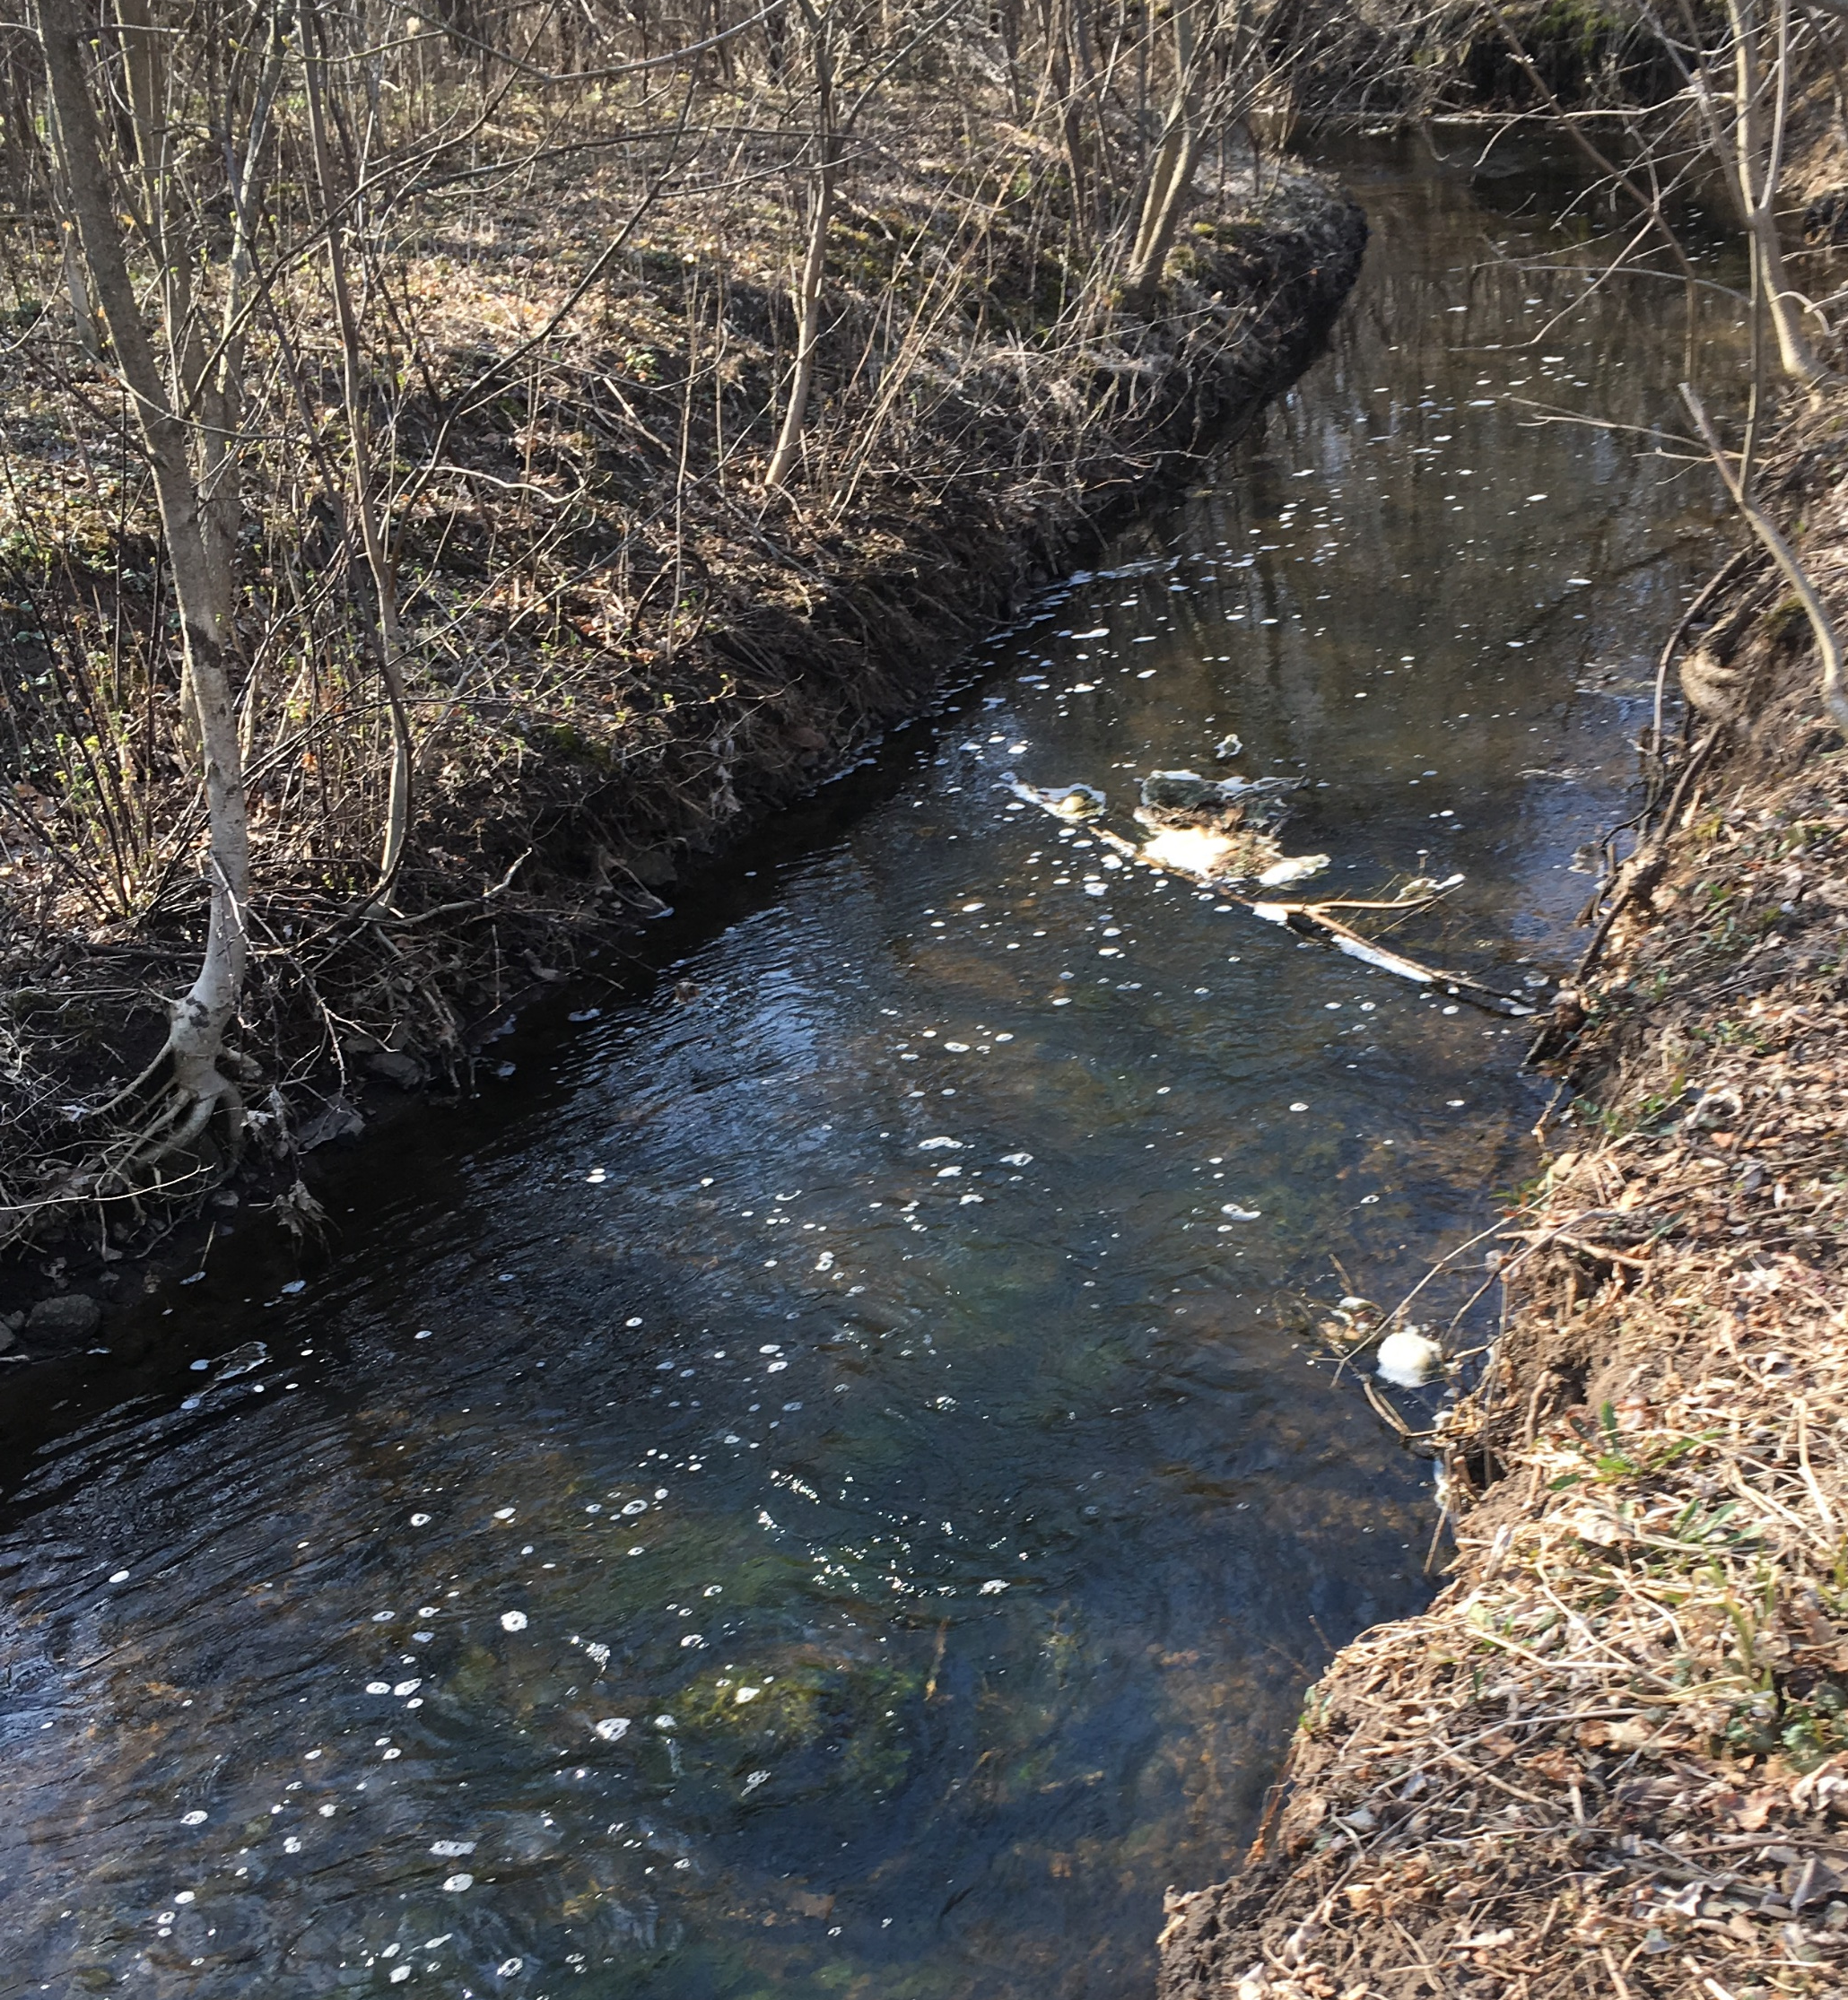
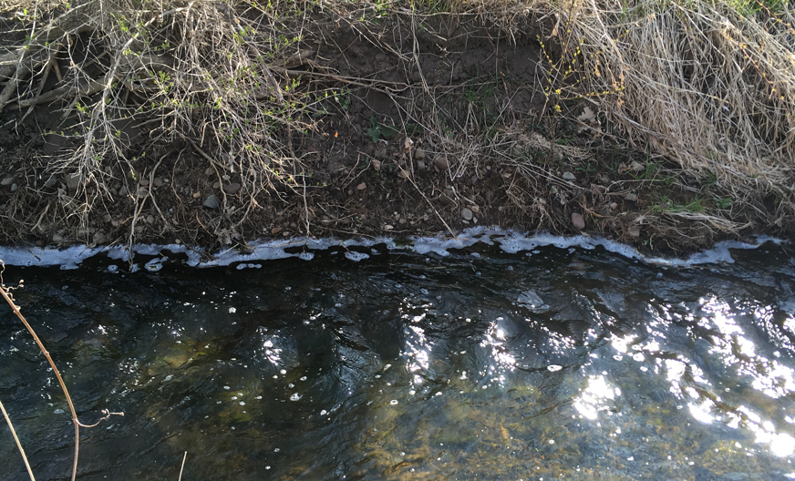
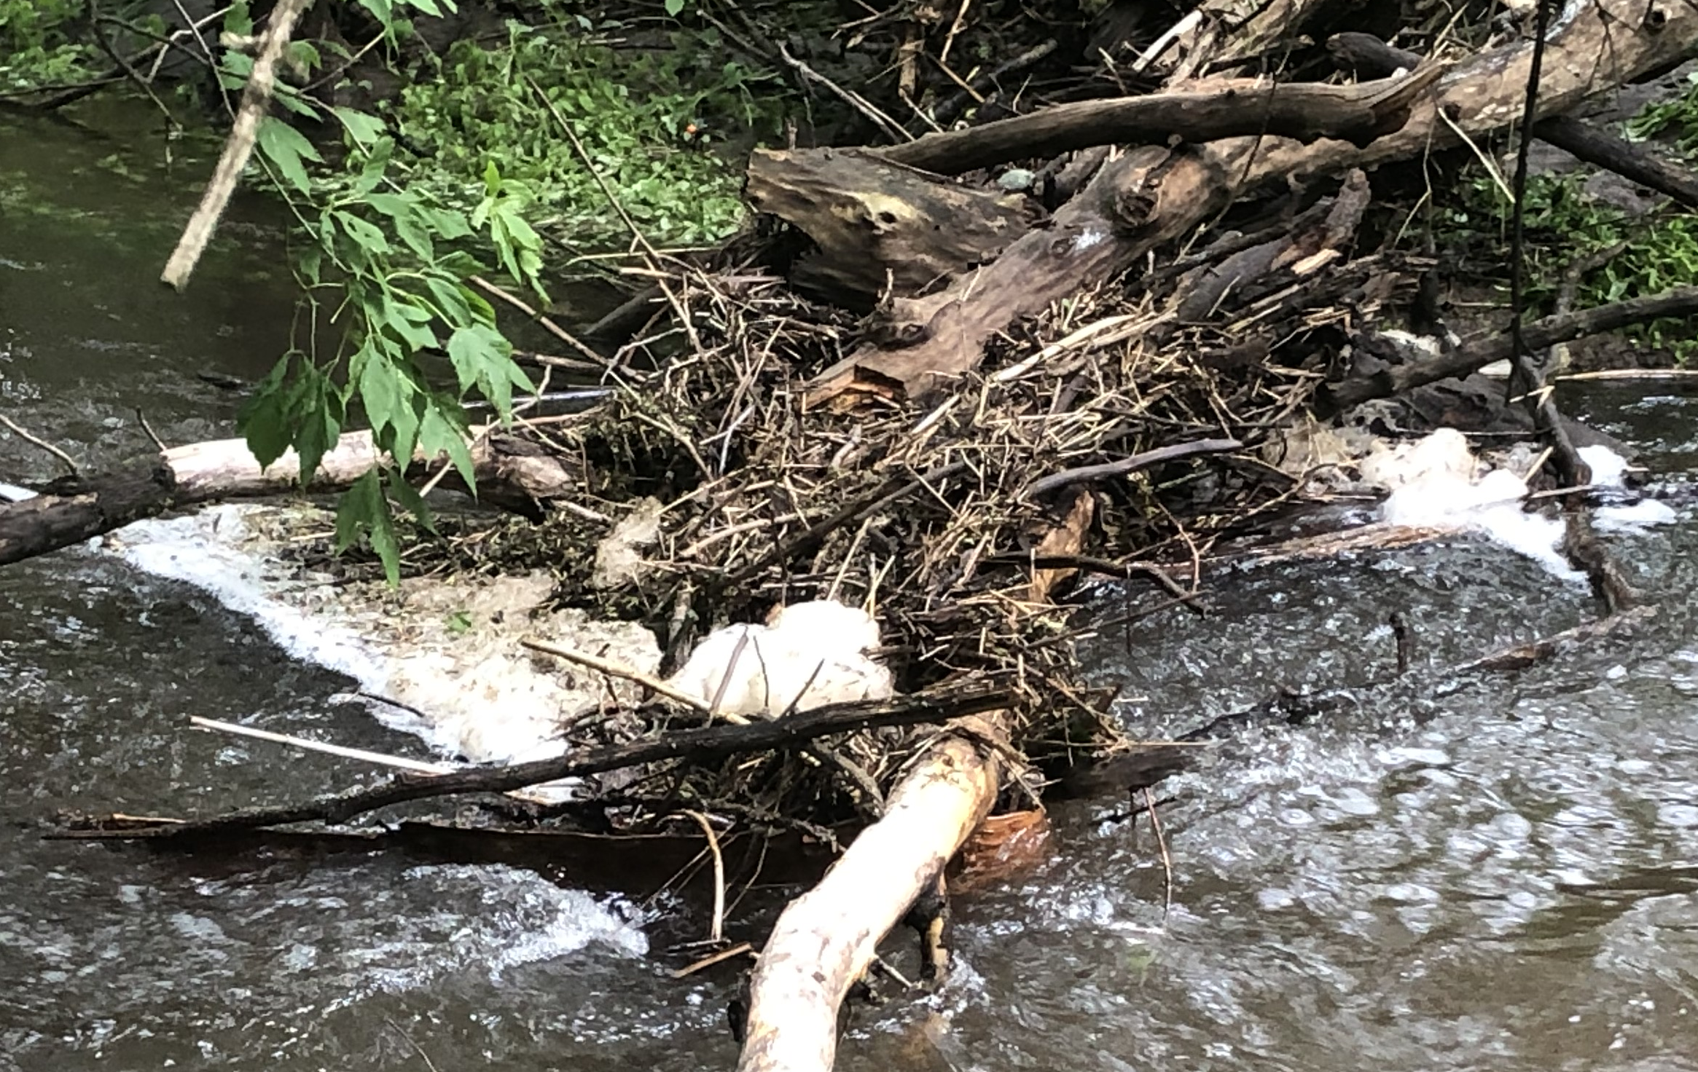
Project 1007 Focused Investigation Progress Report - Segment 3
October 2021 Minnesota Pollution Control Agency
PFAS-Containing Foam Formation in Raleigh Creek
Requirements for PFAS-Containing Foam Formation and Accumulation
Turbulence
Air must be mixed into the water column for foam to form. In Segment 3, this is most often caused by water flowing over rocks, trees, or other debris in the stream. The water level greatly affects the locations of turbulence.
Solid Substrate for Foam to Accumulate Against
After generation, the foam bubbles must have a solid substrate in relatively calmer water to accumulate along or against. Without accumulation, the foam bubbles will collapse back into the stream. In Segment 3, foam was found to accumulate along the stream banks, debris, blocks of ice, and vegetation growing in the stream channel.
PFAS Concentrations in Surface Water
Foam will naturally form regardless of the presence of PFAS. However, it is not well understood the presence of PFAS in water affects foam formation. It is also not well understood how much PFAS will preferentially separate (enrich) into the foam relative to the PFAS in the corresponding surface water.
Shallow water flowing over rocks in the channel created turbulence and foam bubbles in Raleigh Creek.
Accumulated foam observed along the stream bank (photo to the right).
Accumulated foam observed against debris in the stream channel (photo to the left).

Slide 10
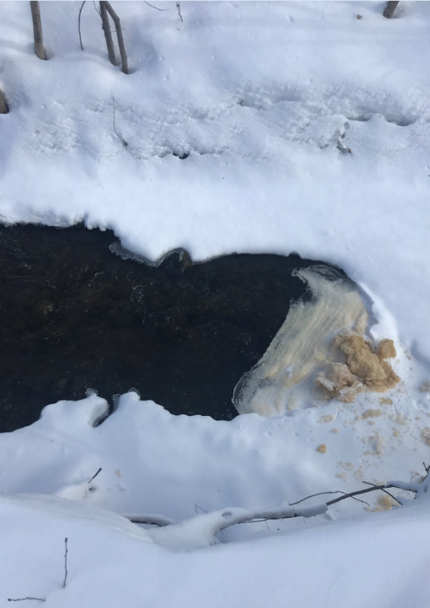
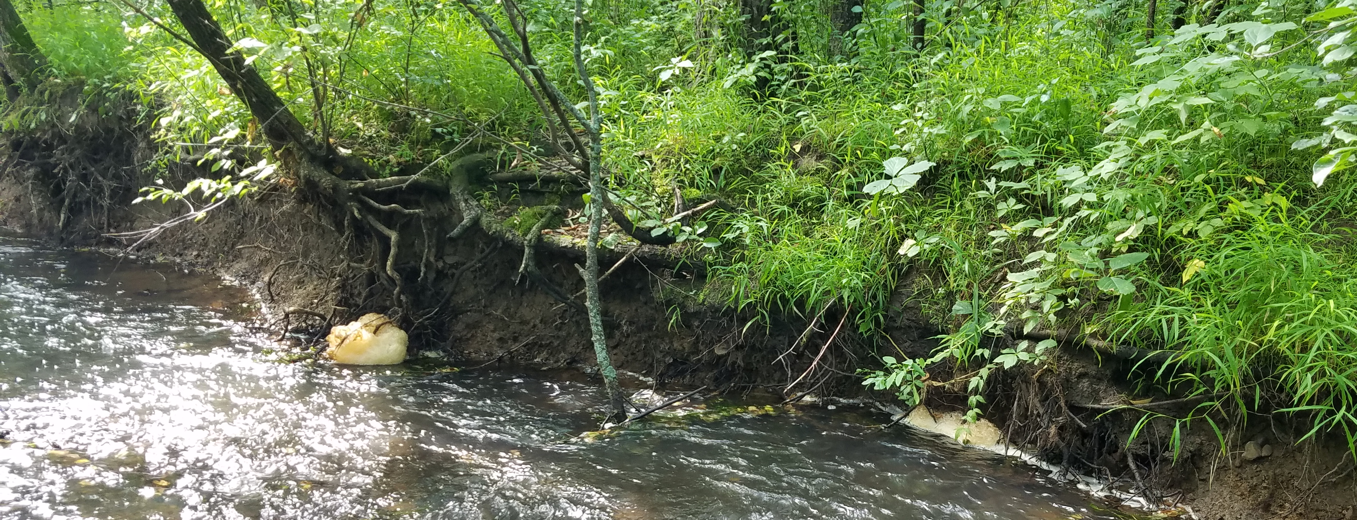
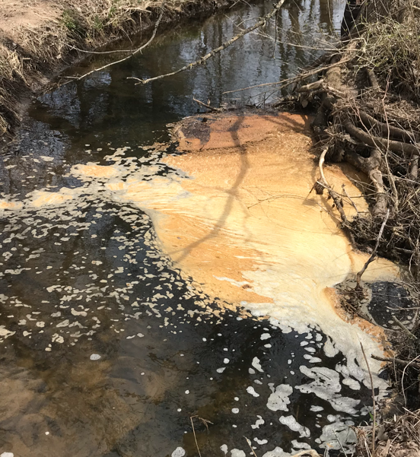
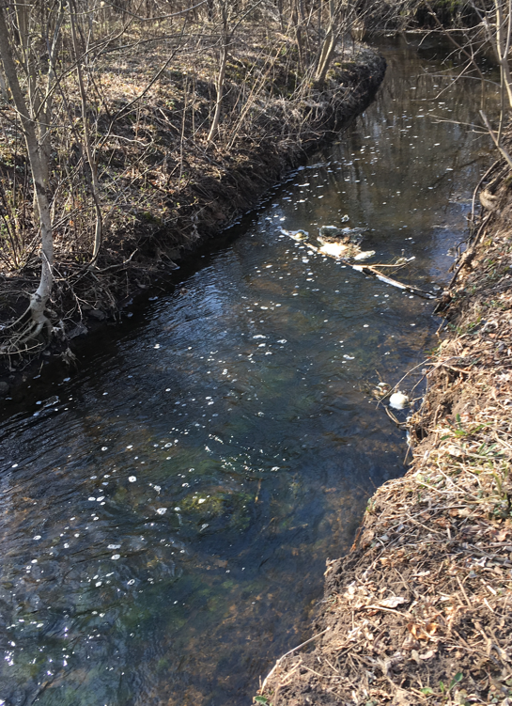
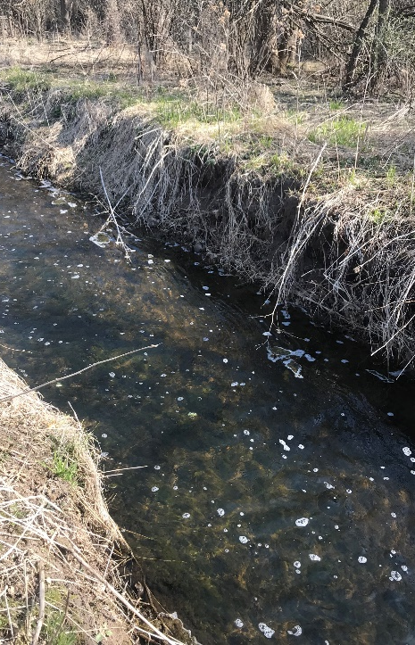
Project 1007 Focused Investigation Progress Report - Segment 3
October 2021 Minnesota Pollution Control Agency
Types of PFAS-Containing Foam
Foam in Segment 3
The foam observed and sampled in Segment 3 had several different appearances. The type of foam observed was not tied to an exact location, precipitation events, or seasons except for frozen foam.
The different types of foam typically observed in Segment 3 are presented in this slide. Foam can present itself in any one of these types or as a combination.
Fluffy
Accumulated piles are larger and whiter in appearance, though some discoloring can occur. Can be more stable than other foam types. Fluffy foam collapses into a smaller liquid volume than other foam types, indicating the presence of more air.
Frozen Conditions
Occurs when foam accumulates against ice or snow. The foam itself may freeze in place or may just accumulate more readily due to the presence of ice dams but remain unfrozen.
Floating (not accumulating)
Foam bubbles that do not accumulate either because they collapse too quickly or because there is no location for accumulation to occur. This foam cannot be isolated from the surface water and thus has not been sampled.
Organic-Rich
Typically wrinkled and discolored with organic matter present. This location was actively generating and in large quantities.
Wrinkled
Foam bubbles that flow over a biosheen and then accumulate into thin layers that gather against and on top of each other, forming a wrinkled appearance. This foam is frequently discolored due to the organic matter.
Actively Generating and Accumulating (fresh)
Foam observed as actively accumulating. The accumulated foam can have a wide range of appearances from thin bubbles to fluffy piles. This foam is typically whiter than other types.

Slide 11
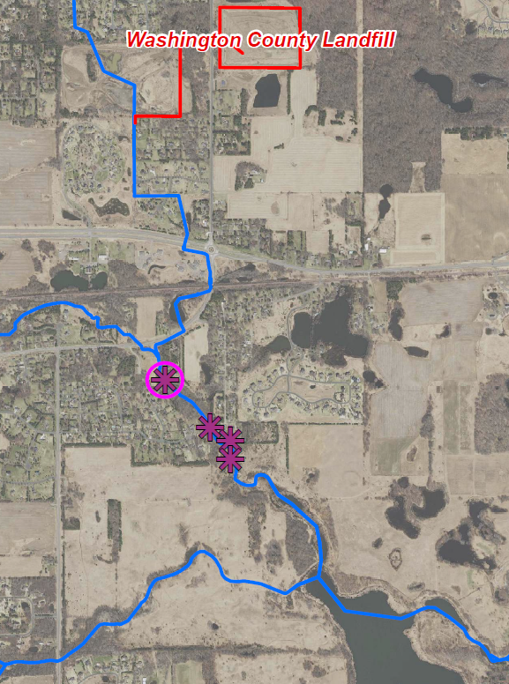
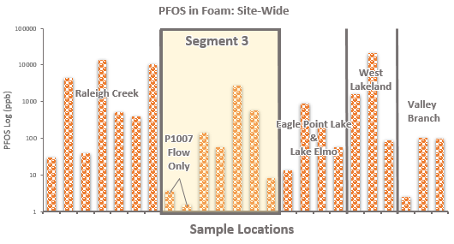
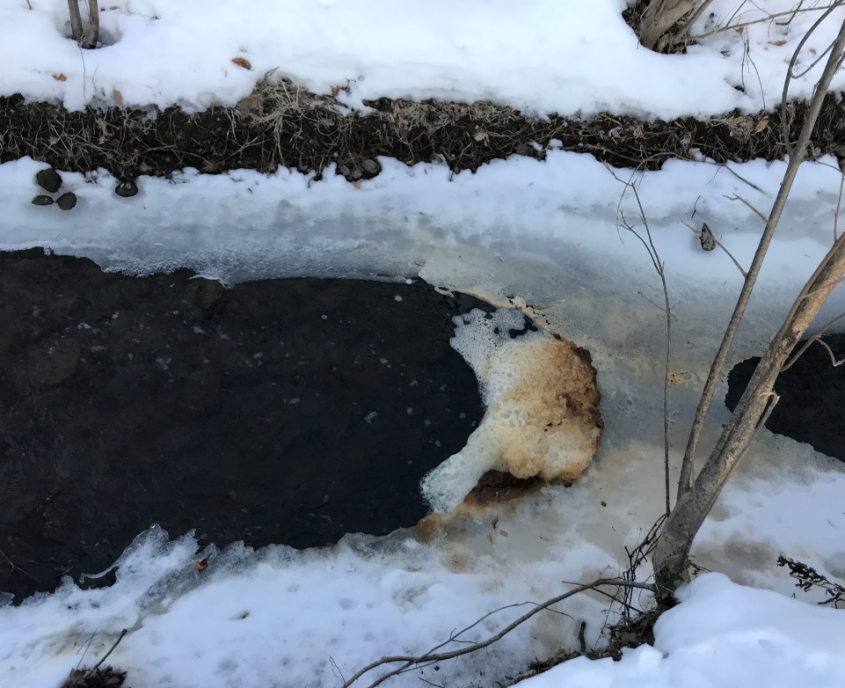
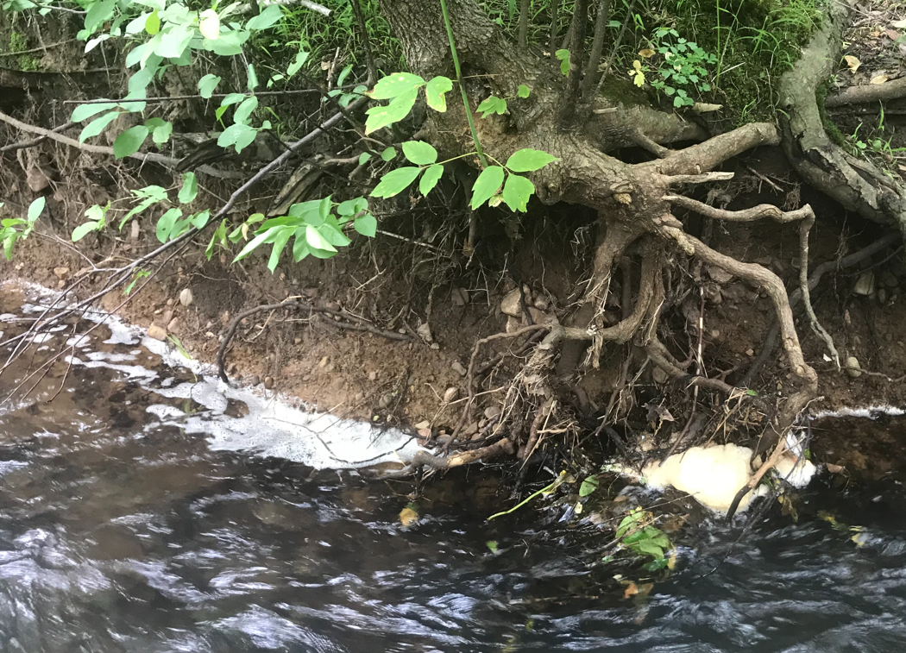

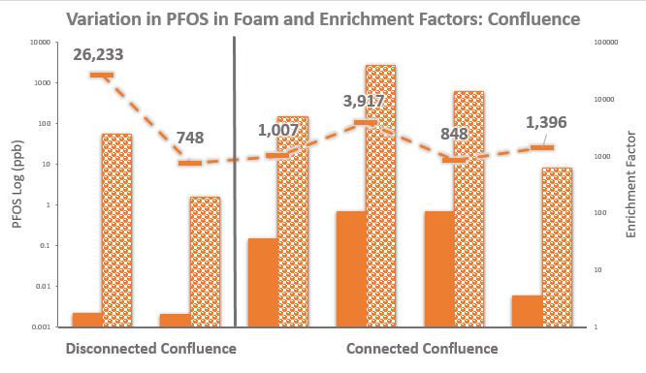
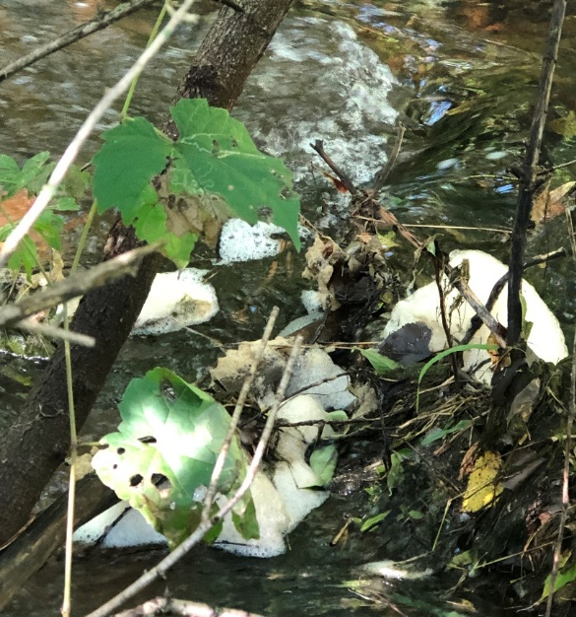
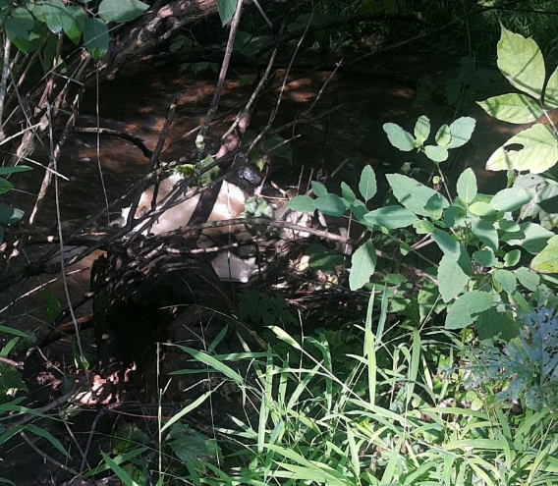
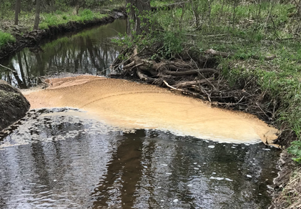
Project 1007 Focused Investigation Progress Report - Segment 3
October 2021 Minnesota Pollution Control Agency
Variation in PFOS in PFAS-Containing Foam at the Confluence
Findings: PFOS Results
Site-wide, PFOS concentrations in foam are among the lowest in the P1007 conveyance system and the confluence when Raleigh Creek is not connected. When the system is connected, PFOS in foam in the confluence is similar in magnitude to Raleigh Creek upstream of Segment 3.
2/24/20 – RC21 Disconnected
7/22/20 – RC21 Connected
4/23/20 –RC21 Disconnected
Confluence
Findings: Enrichment Factors
An enrichment factor is the ratio of the PFAS concentration in the foam to that in the water (usually the top 6 inches of the water column). As in other segments in the corridor, the enrichment factors of PFOS at the confluence varied by over an order of magnitude, suggesting PFAS enrichment in foam may depend on environmental conditions in addition to PFOS concentrations in the corresponding surface water. The specific environmental conditions that may influence PFAS enrichment are not well understood.
8/14/19 – RC17
8/14/19 – RC17A
5/5/20 - RC18A

Slide 12
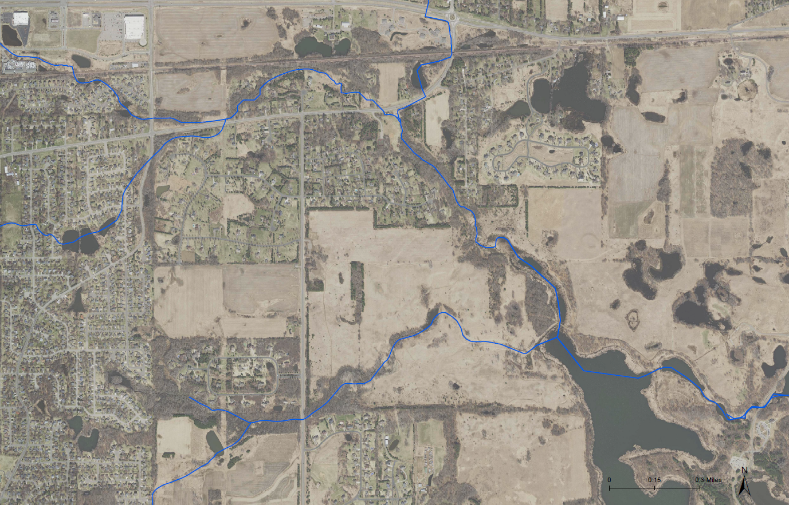
Project 1007 Focused Investigation Progress Report - Segment 3
October 2021 Minnesota Pollution Control Agency
Segment 3 Beta Site Wells and Features
P1007 Conveyance
AECOM Beta Sites
Beta Site 2 (BS2)
MW2A: Jordan Aquifer Well
(Vertical Aquifer Profile Samples from the Shakopee Aquifer and Oneota Aquitard)
MW2B: Quaternary Aquifer Well
MW2C: Quaternary Aquifer Well
MW2D: Quaternary Aquifer Well
MW2E: Quaternary Aquifer Well
Beta Site 14 (BS14)
Well Nest Downgradient of IAWC:
MW14A: Jordan Aquifer Well
MW14B: St Peter Aquifer Well
MW14C: Quaternary Aquifer Well
(Vertical Aquifer Profile Samples from Shakopee Aquifer and Oneota Aquitard)
Well Upgradient of IAWC:
MW14D: Quaternary Aquifer Well
Beta Site 20 (BS20) – Proposed Wells
PW20J-1: Jordan Aquifer Well
OW20S-1: Shakopee Aquifer Well
OW20J-1: Jordan Aquifer Well
(Proposed Vertical Aquifer Profile Samples from the Upper and Lower St. Peter Aquifer and Oneota Aquitard)
OW20J-2: Jordan Aquifer Well
OW20J-3: Jordan Aquifer Well
BS14
Raleigh Creek
Segment 3
Ideal Avenue Wetland Complex (IAWC)
BS2
Confluence
BS20
(new)
Eagle Point Lake
*Beta Site refers to an investigation area where groundwater sampling and monitoring has been completed from multiple aquifers.

Slide 13
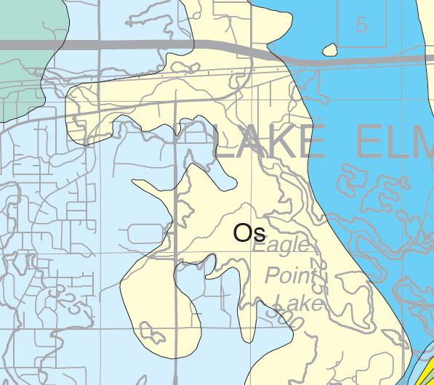
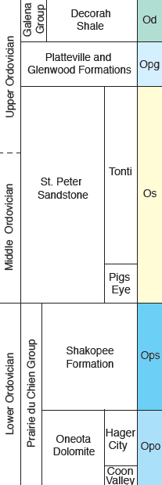
Project 1007 Focused Investigation Progress Report - Segment 3
October 2021 Minnesota Pollution Control Agency
From the Surface to the Subsurface
Segment 3 Bedrock Geology and Hydrogeology
The bedrock geology in Segment 3 is diverse and contributes to a hydrogeologically complex system that influences PFAS migration from Raleigh Creek to groundwater. The first encountered bedrock units in Segment 3 are the Platteville Limestone Aquifer, the St. Peter Sandstone Aquifer, and the Shakopee Dolostone Aquifer.
The Platteville Aquifer, which is predominantly present as the first encountered bedrock unit in the southwestern portion of Segment 3, is underlain by the Glenwood Shale Aquitard, which acts as barrier to vertical groundwater movement. As a result, groundwater flows horizontally to the east until the Platteville and Glenwood units vertically pinch out and vertical flow downward to the St. Peter Aquifer is uninhibited.
The St. Peter Aquifer is the first encountered bedrock unit in the northwestern and central portions of Segment 3, underlying Raleigh Creek, the confluence with the P1007 Conveyance System, and much of Eagle Point Lake. The lack of an overlying confining unit in these portions allows for a direct connection vertically between the surface and shallow quaternary waters and the St. Peter Aquifer.
The Shakopee Aquifer, which is the first encountered bedrock unit in the eastern portion of Segment 3, is underlain by the Oneota Dolostone Aquitard, which can be fractured and “leaky.” The extent to which the aquitard functions as a barrier to the underlying Jordan Aquifer is currently being studied.
Od
P1007 Conveyance System
Segment 3
Raleigh Creek
Opg
Ops
Eagle Point Lake
First Encountered Bedrock Map
Groundwater Migration Pathways: St. Peter and Shakopee Aquifer
Underlying the St. Peter Aquifer is the Shakopee Aquifer. Although the St. Peter Aquifer is classified as an aquifer, the lowermost 10 to 40 feet of the sandstone grades into a finer-grained sandstone with siltstone and shale lenses and is thought to behave like an aquitard and inhibit vertical groundwater movement. As a result, groundwater within the St. Peter Aquifer likely flows horizontally to the east until the unit vertically pinches out and the Shakopee Aquifer becomes the first encountered bedrock.
A direct connection between the shallow quaternary and St. Peter Aquifer groundwater and the Shakopee Aquifer groundwater may also exist under three possible conditions:
1) In intermittent areas where the St. Peter Aquifer is heavily eroded from glacial activities and nearly absent. The resulting secondary porosity from this weathering and fracturing may introduce heterogeneity to the groundwater flow regime of the St. Peter Aquifer and allow for higher transmissivity within and from the aquifer.
2) In locations where the lowermost portion of the finer-grained St. Peter is thin or absent.
3) Historically, where previously abandoned wells were screened across both aquifers.
MGS, 2016.

Slide 14
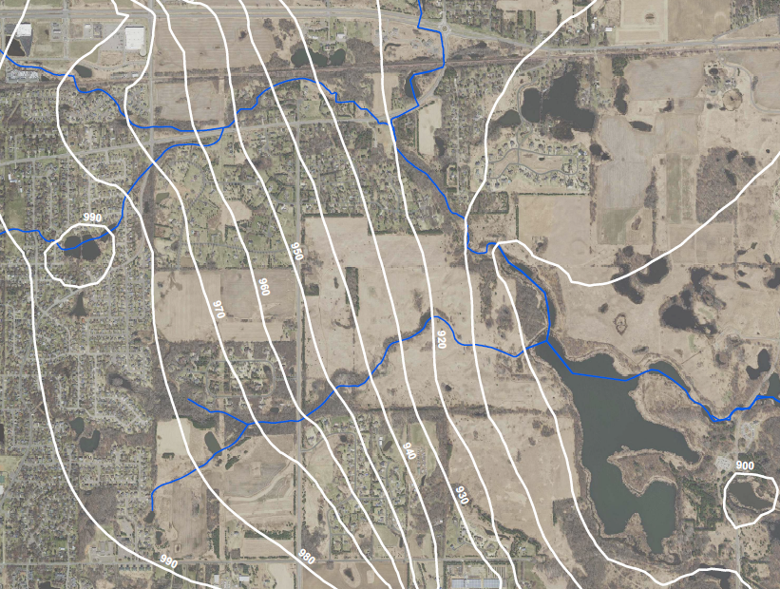
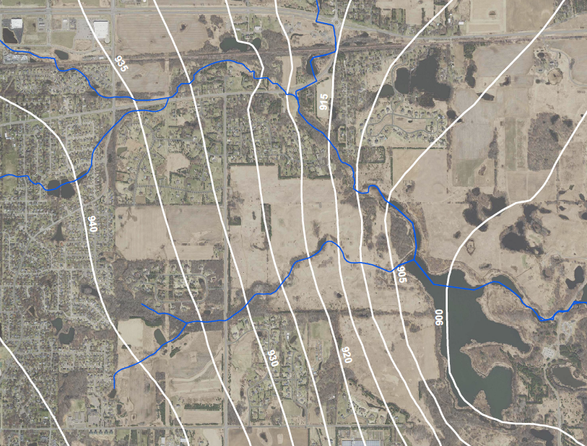
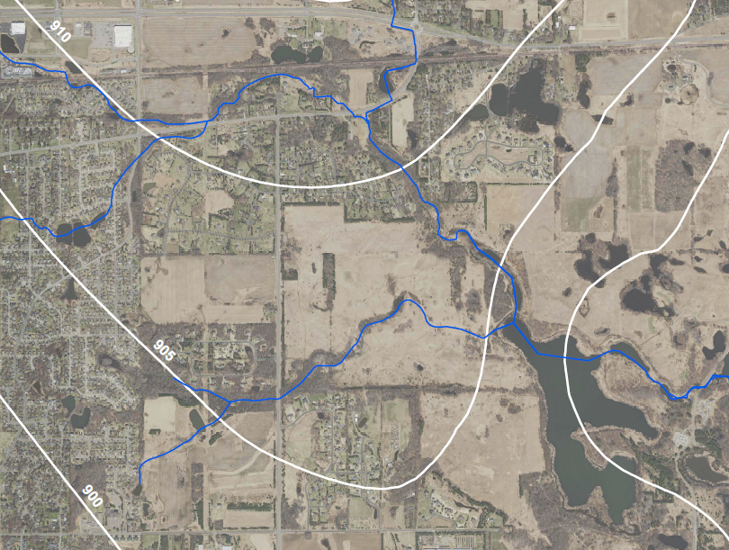
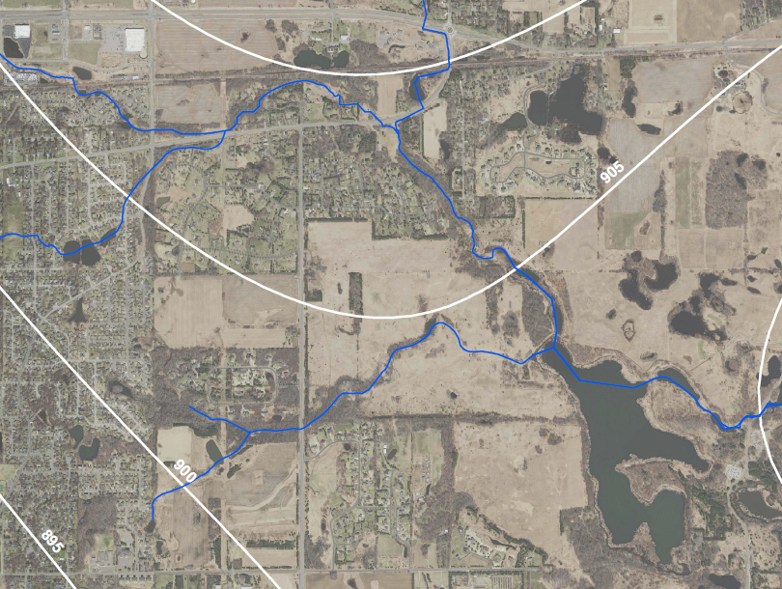
Project 1007 Focused Investigation Progress Report - Segment 3
October 2021 Minnesota Pollution Control Agency
Segment 3: Groundwater Flow Direction
Variable Groundwater Flow Direction
The hydrogeology in Segment 3 is variable and not fully understood. Groundwater flow in the Quaternary and St. Peter Aquifers is predominantly to the east with a southernly component near Eagle Point Lake, while groundwater flow in the Shakopee and Jordan Aquifers is predominantly to the south. The Shakopee and Jordan Aquifers both have a component of eastern and western flow due to the presence of a local groundwater divide, which is approximately mapped west of Eagle Point Lake.
Groundwater likely migrates from the quaternary into the St. Peter Aquifer where the St. Peter unit is the first encountered bedrock. Similarly, groundwater within the St. Peter is expected to migrate vertically into the Shakopee Aquifer where the St. Peter unit is absent.
Groundwater flow direction in both the upper and lower aquifer units is based on limited available data, including numerous previously abandoned wells. The lack of active wells within Segment 3 complicates the understanding of the migration flow path of the subsurface impacts. The key to understanding the PFAS flow path may be in evaluating historic data from previously abandoned wells, as presented in the next slide.
Quaternary Aquifer: Groundwater Flow Map
St. Peter Aquifer: Groundwater Flow Map
Map Features
Surface to Ground Infiltration
Horizontal Groundwater Flow Direction
Vertical Groundwater Flow Direction (estimated)
Approximate Groundwater Divide
Potentiometric Surface Contours
Shakopee Aquifer: Groundwater Flow Map
Jordan Aquifer: Groundwater Flow Map

Slide 15
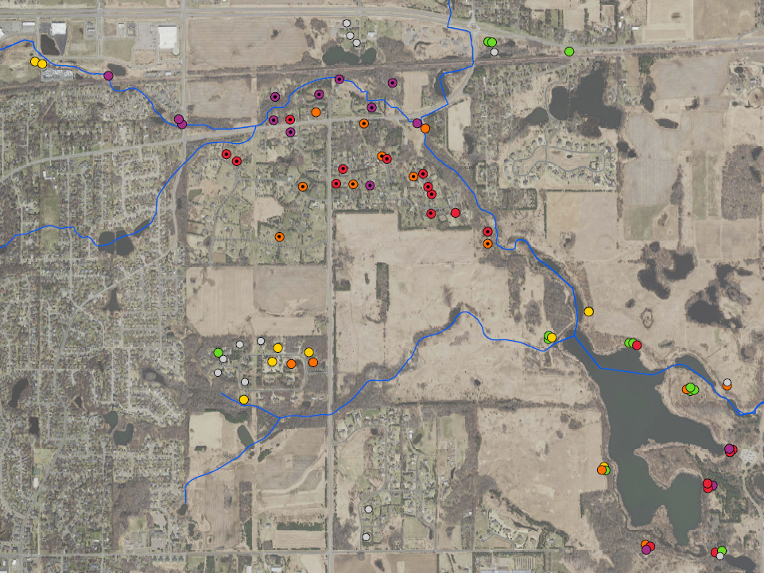
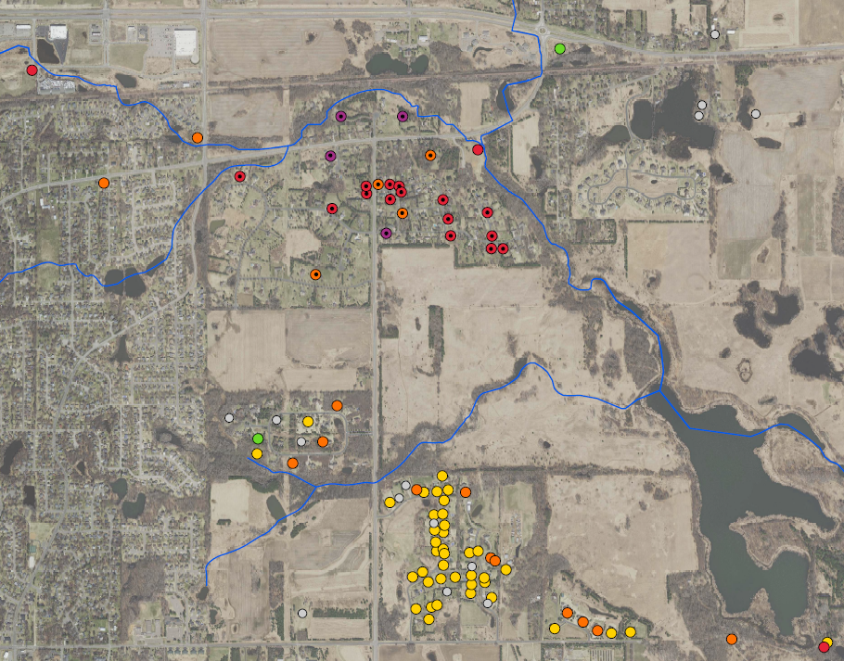
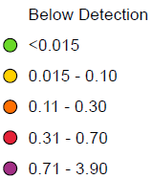
Project 1007 Focused Investigation Progress Report - Segment 3
October 2021 Minnesota Pollution Control Agency
PFOS Results in Groundwater
Segment 3
Segment 3
BS2
BS14
BS2
BS14
BS20
(new)
BS20
(new)
PFOS Heat Map – Quaternary & St. Peter Aquifers
PFOS Heat Map: Shakopee Aquifer
PFOS (ppb)
Notes
Segment 3: PFOS in Groundwater
In the northern portion of Segment 3, PFOS concentrations in the Quaternary, St. Peter, and Shakopee Aquifers range between 0.11 and 3.90 ppb, two to three orders of magnitude greater than the Minnesota Department of Health (MDH) Health-Based Value of 0.035 ppb. However, reported PFOS concentrations in the northern portion of Segment 3 are predominantly from wells which were sampled between 2005 and 2008 and have since been abandoned (indicated with the black dots in the maps above). The only remaining active wells within or close to this portion of Segment 3 are AECOM monitoring wells from Beta Sites 2 and 14 (BS2 and BS14). Due to the lack of recently collected data from the northern portion of Segment 3 and the limited available data in the central portion of Segment 3, it is not yet fully understood where and to what extent impacts in the St. Peter Aquifer migrate downward into the Shakopee Aquifer. As a result, a new beta site (BS20) will be positioned in this central portion to further understand the fata and transport of PFAS in Segment 3.
The hypothesized alternative PFAS migration pathways using current and historic data is discussed in further detail in the next slide.
Previously abandoned or unknown status of well; last sampled between 2005-2008
Well open across St. Peter and Shakopee Aquifers
Wells with PFOS below detection and detection limits above 0.5 ppb not shown

Slide 16
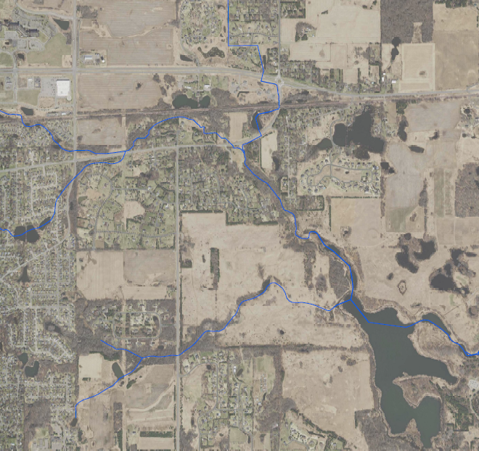
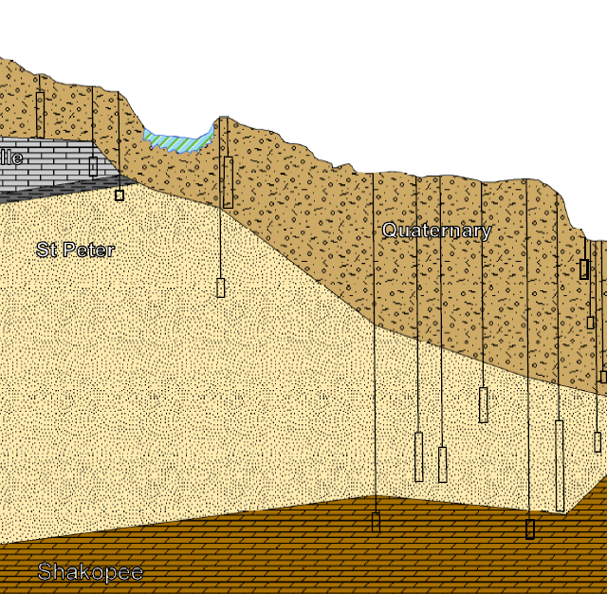
Project 1007 Focused Investigation Progress Report - Segment 3
October 2021 Minnesota Pollution Control Agency
A Closer Look: Historic and Current Groundwater Results
St. Peter to Shakopee Aquifer: PFAS Migration Pathway
PFOS impacts in the quaternary and St. Peter Aquifers at BS14 and BS2 are similar in magnitude to the previously abandoned wells. However, the PFOS concentrations in these locations are an order of magnitude lower in the Shakopee Aquifer, suggesting limited current downward migration of PFAS impacts from the quaternary and St. Peter Aquifers into lower bedrock aquifers. This lack of PFOS impacts in the Shakopee Aquifer at BS2, relative to the upper aquifer units and the surrounding historic Shakopee Aquifer wells, could be due a migration pathway leading in a more southernly direction (towards proposed BS20). A possible explanation for this historic apparent downward migration from the St. Peter into the Shakopee Aquifer may be poor well construction and wells constructed through multiple aquifers, including wells open across both the St. Peter and Shakopee Aquifers.
Current PFOS Impacts in St. Peter Aquifer:
Map View
Quaternary Aquifer
Current PFOS Results in Groundwater: Cross Sectional View
BS14
BS14
P1007 Conveyance
Raleigh Creek
BS17
0.803
Quaternary Aquifer
BS2
BS2
Platteville
?
1.23
?
Quaternary
?
St Peter
?
2.46
0.644
?
0.829
?
BS20
(new)
?
?
Eagle Point Lake
0.115
Shakopee Aquifer
?
*0.438
Map Features
Notes
Vertical exaggeration is 24.5:1.
Horizontal extent is approximately 2.1 miles.
All sample results are in ppb (collected between 2020 and 2021).
* Denotes samples collected during drilling.
Surface to Groundwater Infiltration
Horizontal GW Flow: Quaternary and St. Peter
Vertical GW Migration from Quaternary and St. Peter
0.25 ppb PFOS
Shakopee
*0.11
W
E

