Slide 1
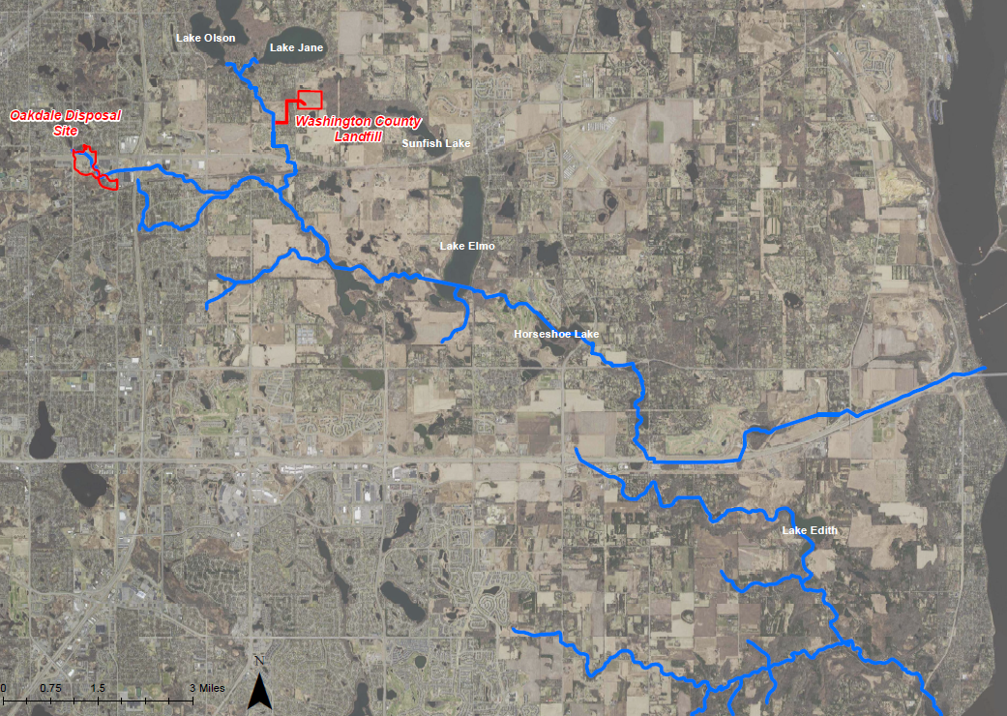
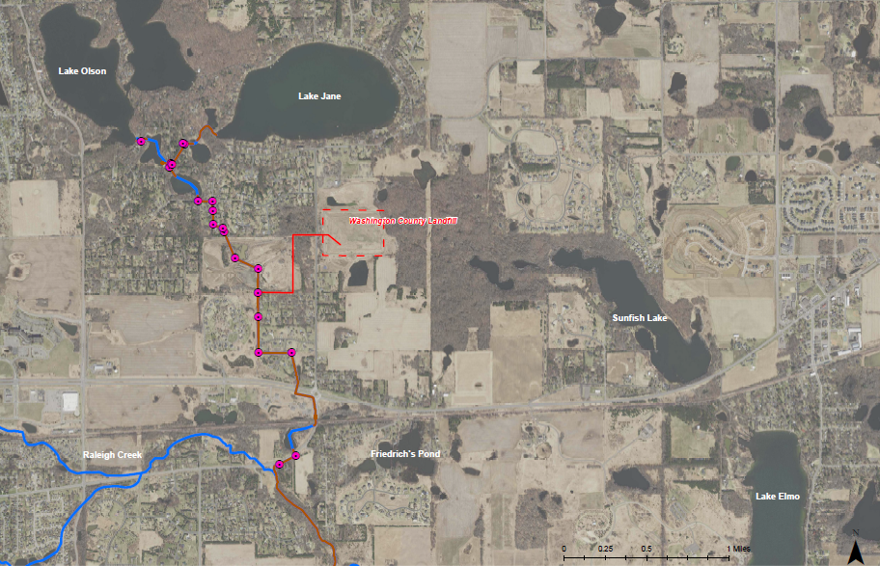
Segment 1| Project 1007
Minnesota Pollution Control Agency
Project 1007 Focused Investigation Progress Report - Segment 1
June 2021 Minnesota Pollution Control Agency
Tri-Lakes to Tablyn Park
Segment 1

Slide 2
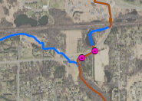
Project 1007 Focused Investigation Progress Report - Segment 1
June 2021 Minnesota Pollution Control Agency
Segment 1 | Project 1007
Minnesota Pollution Control Agency
Introduction: Segment 1 Surface Water System
Surface and Groundwater Flow Regimes
Surface water in Segment 1 begins with the Tri-Lakes which discharge southward through a series of pipes and channels until the confluence with Raleigh Creek at Tablyn Park. Segment 1 also includes Sunfish Lake, which is likely connected to Lake Elmo through shallow subsurface groundwater infiltration and discharge.
The primary PFAS source area associated with Segment 1 is the Washington County Landfill (WCL). Historic PFAS releases to the environment from WCL have changed over time, are influenced by a regional groundwater flow divide, and are poorly understood.
Key Questions
Are surface water impacts continuing from WCL to the confluence with Raleigh Creek?
Do historically impacted sediments downstream of WCL present a current secondary source to surface water?
Is WCL an active source of groundwater impacts, and if so, where are the groundwater impacts migrating? Are they discharging to other surface water bodies or migrating downward to deeper aquifers?
Confluence with Raleigh Creek
The Tri-Lakes are channelized and piped to the south until Tablyn Park where the flow path joins with Raleigh Creek.

Slide 3
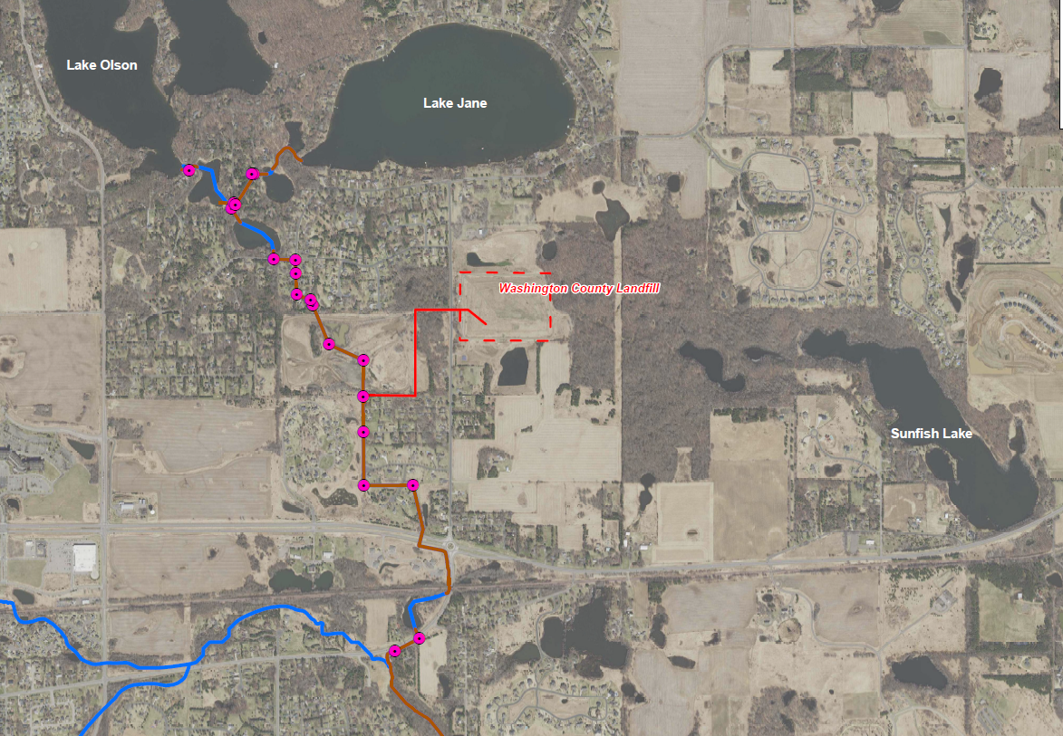
Project 1007 Focused Investigation Progress Report - Segment 1
June 2021 Minnesota Pollution Control Agency
Project 1007: Historic and Current Surface Water Flow from WCL
Washington County Landfill History
From 1969 to 1975, WCL accepted PFAS-containing waste including wastewater treatment plant sludge, incinerator scrubber sludge and ash, and iron oxide sludge. As part of a larger flood mitigation infrastructure project completed in 1987 (P1007), a series of pipes and channels were constructed between the Tri-Lakes and Tablyn Park to direct overflow from the Tri-Lakes away from the regularly-flooded residential area southward towards Raleigh Creek.
In 1988 in order to dewater the area, the WCL began directly discharging untreated gradient control well effluent into P1007 via a stormwater sewer connection. As a result, PFAS-impacted waters from WCL were discharged to P1007 system until the piped connection was sealed off in 1995.
Prior to and after this connection, PFAS-impacted waters from WCL likely migrated either via surface runoff to the east-southeast or vertically into the subsurface.
Preferential PFAS Pathways
  Known surface water flow path (1988-1995)
  Inferred runoff direction
Landfill Closed
Installation of Remediation System to Remove VOCs
Activities at WCL
Accepted PFAS- Containing Waste
Effluent Discharge to P1007
1969
1975
1983
1988
1995
Present
Preferential PFAS Pathway:
Surface Water via P1007
Groundwater Infiltration and General Runoff

Slide 4
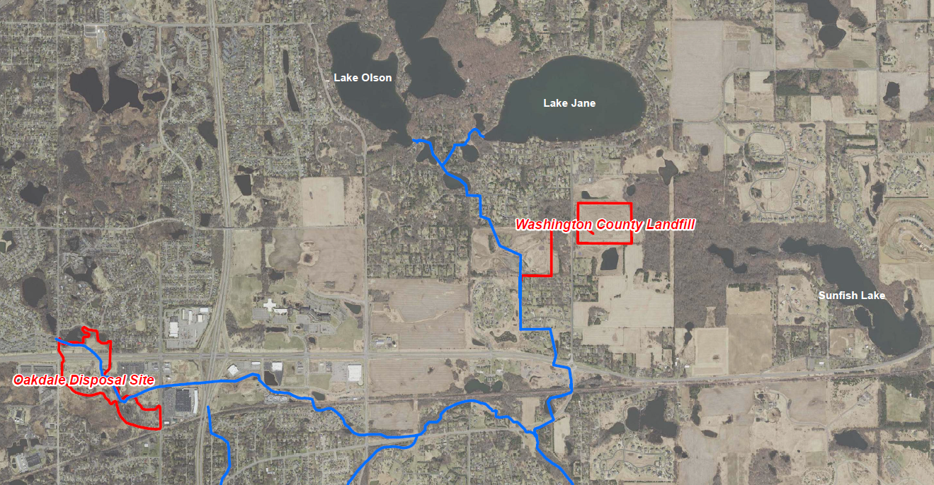
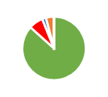
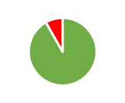
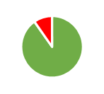
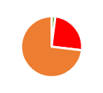
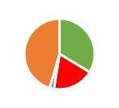
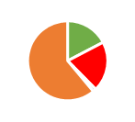

Project 1007 Focused Investigation Progress Report - Segment 1
June 2021 Minnesota Pollution Control Agency
Comparison of Two Source Areas: Oakdale Disposal Site V.S. WCL
Disposal Site-Specific PFAS-Containing Waste
The Oakdale Disposal Site (ODS) accepted liquid and solid industrial waste, while the Washington County Landfill (WCL) accepted wastewater treatment plant sludge, incinerator scrubber sludge and ash, and iron oxide sludge. The PFAS contamination associated with these two historic waste streams has a different ratio of PFAS compounds, resulting in a PFAS “signature” that may be unique to each source area.
The PFAS signature associated with ODS is generally PFOS-dominant, while the PFAS signature from WCL is generally PFBA-dominant. As a result, analysis of the PFBA:PFOS ratio or the relative distribution of key compounds can be used to evaluate a possible PFAS source contribution at different locations.
PFAS Distribution by Source Area
WCL PFAS Signature
ODS PFAS Signature
Low Concentration Widespread PFAS
Typical PFAS Distribution: ODS v.s. WCL
ODS
PFOS-Dominant
WCL
PFBA-Dominant
Low Concentration Widespread PFAS*
Important Points to Consider about PFBA
PFBA is found across the site in low concentrations in surface and groundwater due to atmospheric deposition and widespread use. This is consistent with studies in Minnesota and elsewhere. This PFAS does still have an anthropogenic source but it is unknown at this time.
PFBA moves faster in groundwater than PFOS and other longer-chain PFAS chemicals due to its smaller molecular size, more hydrophilic nature, and water solubility. This aspect of PFBA makes the compound both more ubiquitous in nature and present in greater relative amounts in the leading edges of plumes.
PFBA-dominated contamination that is also relatively low in other key PFAS compounds could be “background” PFAS impacts.
*Key difference between unknown anthropogenic source and WCL is lower concentrations.

Slide 5
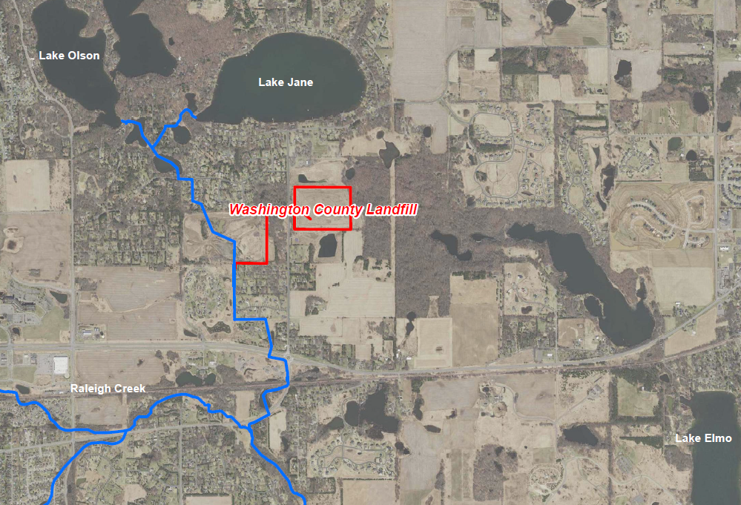
Project 1007 Focused Investigation Progress Report - Segment 1
June 2021 Minnesota Pollution Control Agency
Surface Water Results: Tri-Lakes and Sunfish Lake
Tri-Lakes to Confluence: P1007 Flow Path
The distribution and concentrations of PFAS compounds are consistent in surface water from the Tri-Lakes to the confluence with Raleigh Creek (P1007).
Concentrations of PFBA in surface water are similar to those measured in an athropogenic background study of PFAS in lakes in Minnesota, suggesting these detections could be a product of atmospheric deposition and the ability for PFBA to move faster and farther in the environment.
PFOS and PFOA concentrations in surface water in Segment 1 are elevated over the widespread background concentrations, but lower than the overall corridor by at least an order of magnitude.
There appears to be no effect on PFAS concentrations related to seasonal variation in Segment 1 surface water in the P1007 flow path.
PFOS, PFOA, and PFBA Log Concentrations
Sunfish Lake
P1007
PFOS
PFOA
PFBA
0.1 ppb
1 ppb
Sunfish Lake Compared to Tri-Lakes
While PFOS concentrations were generally very similar in Sunfish Lake and P1007 surface water, PFOA and PFBA were one and two orders of magnitude greater in Sunfish Lake compared to P1007, respectively.
0.001 ppb
0.01 ppb

Slide 6
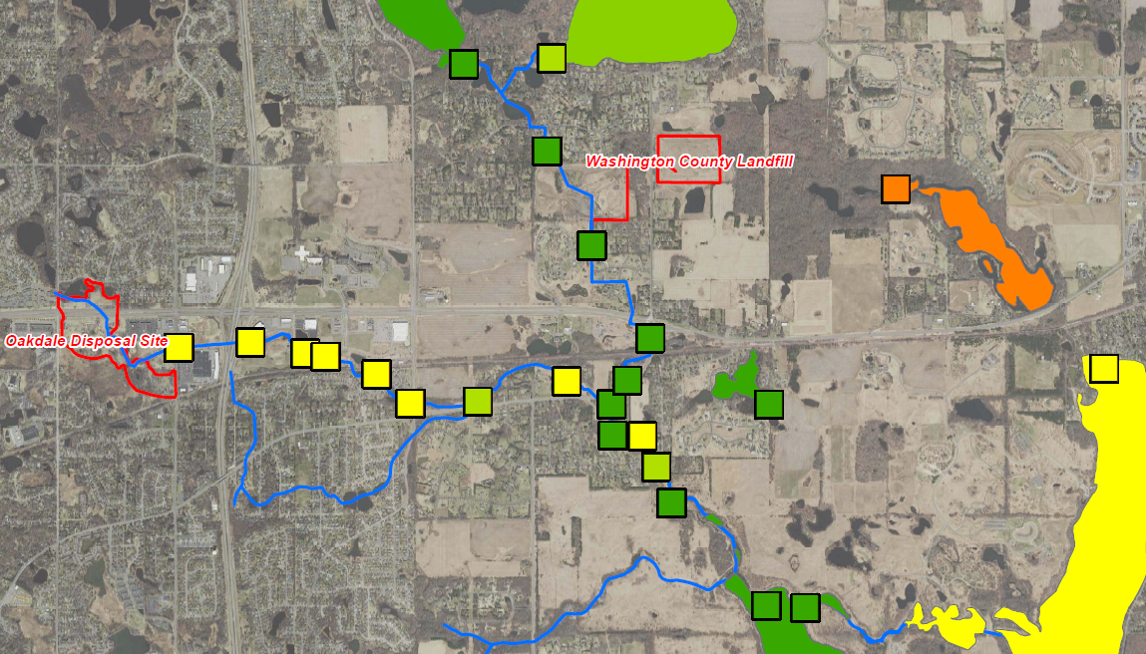
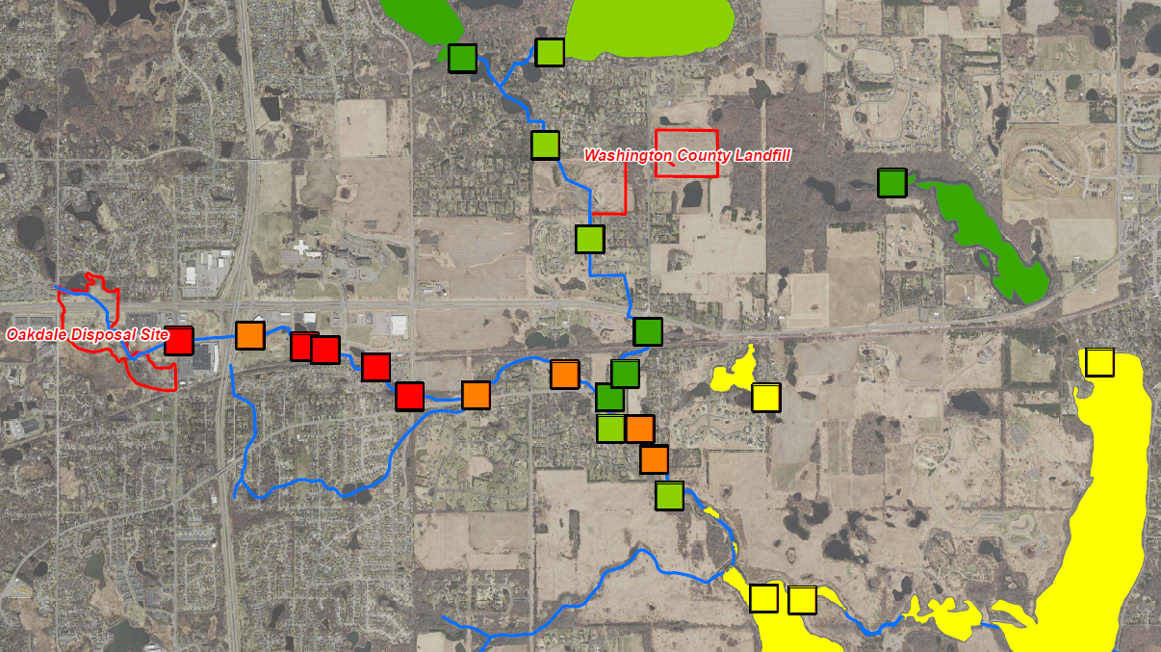
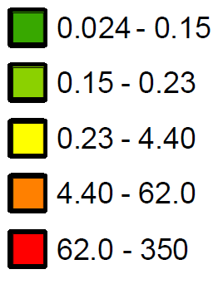
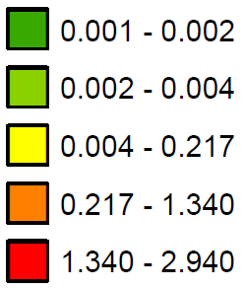
Project 1007 Focused Investigation Progress Report - Segment 1
June 2021 Minnesota Pollution Control Agency
Site-Wide Surface Water Results: PFBA and PFOS
PFBA in Surface Water
Tri-Lakes
Low PFOS Impacts – Segment 1
When compared to Raleigh Creek and other major lakes in the corridor, PFOS concentrations in Segment 1 are among the lowest. PFOS impacts in Sunfish Lake and Lake Olson are over three orders of magnitude lower than those in Raleigh Creek.
The low PFOS to PFBA ratio in Sunfish Lake surface water is similar to the WCL PFAS signature.
Sunfish Lake
Raleigh Creek
PFOS in Surface Water
Tri-Lakes
Eagle Point Lake
Sunfish Lake
Elevated PFBA Impacts – Sunfish Lake
When compared to Raleigh Creek and other major lakes in the corridor, PFBA in Sunfish Lake is up to two orders of magnitude greater than the Tri-Lakes and an order of magnitude greater than Raleigh Creek. The lack of PFBA impacts in the Tri-Lakes points to the WCL as the source of these elevated impacts in Sunfish Lake.
Elevated PFBA impacts in Lake Elmo, which are nearly an order of magnitude greater than those in Eagle Point Lake, suggest a groundwater-surface water connection with both Sunfish Lake and WCL.
Raleigh Creek
Lake Elmo
Eagle Point Lake

Slide 7
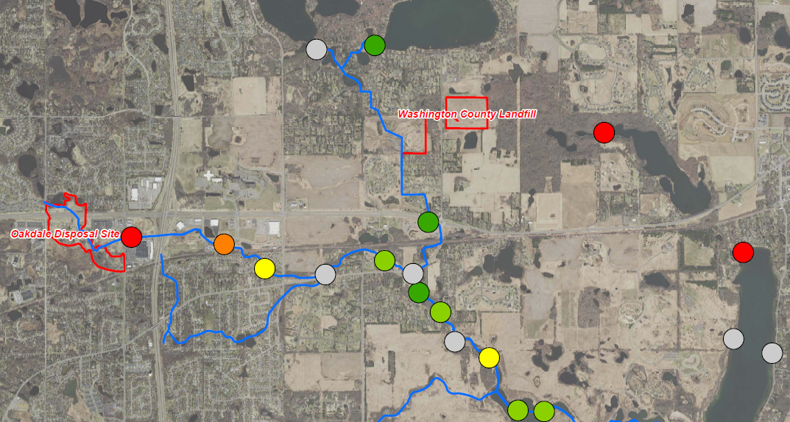
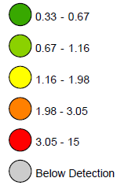
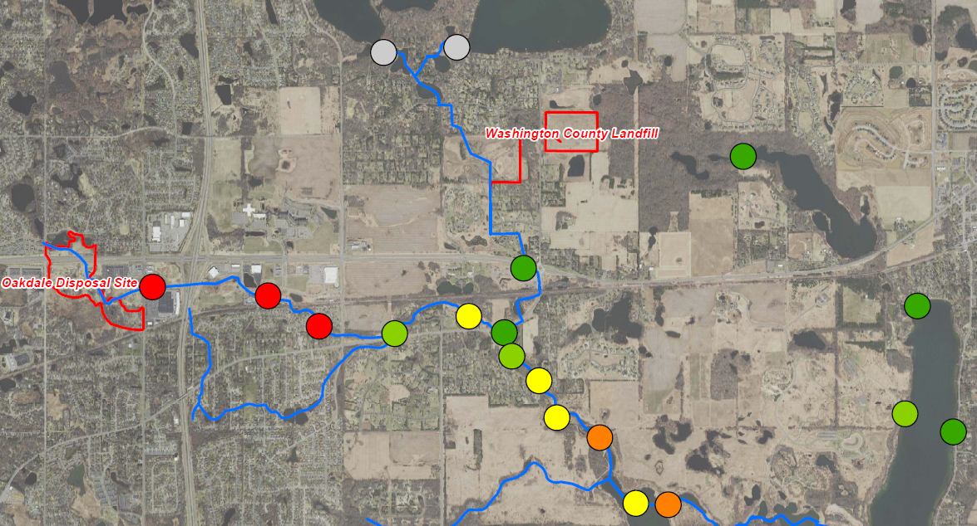
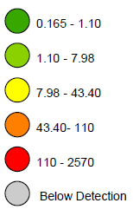
Project 1007 Focused Investigation Progress Report - Segment 1
June 2021 Minnesota Pollution Control Agency
Site-Wide Surface Sediment Results: PFBA and PFOS
PFBA in Sediment
Tri-Lakes
Low PFOS Impacts – Segment 1
When compared to Raleigh Creek and other major lakes in the corridor, sediment PFOS concentrations in Segment 1 are among the lowest. PFOS impacts in Raleigh Creek are between three and four orders of magnitude greater than Sunfish Lake. PFOS in the Tri-Lakes sediment is below detection limits.
The low PFOS to PFBA ratio in Sunfish Lake sediment is similar to the WCL PFAS signature.
Sunfish Lake
Raleigh Creek
Lake Elmo
Tri-Lakes
PFOS in Sediment
Eagle Point Lake
Sunfish Lake
PFBA Impacts – Segment 1
The lack of elevated PFBA sediment impacts in locations between the historical WCL connection with Project 1007 and the confluence suggest that the seven years of gradient control well discharges from WCL did not leave lasting PFAS impacts in the sediment.
Elevated PFBA sediment impacts in Sunfish Lake and the northern portion of Lake Elmo, like surface water, could indicate a connection to WCL PFAS impacts through the shallow subsurface. The PFBA impacts, though elevated, are still well below the established Site-Specific Sediment Screening Value (SDSV) of 280,000 ppb.
Raleigh Creek
Lake Elmo
Eagle Point Lake

Slide 8
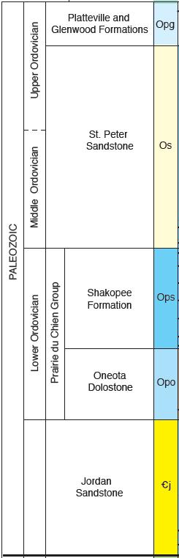
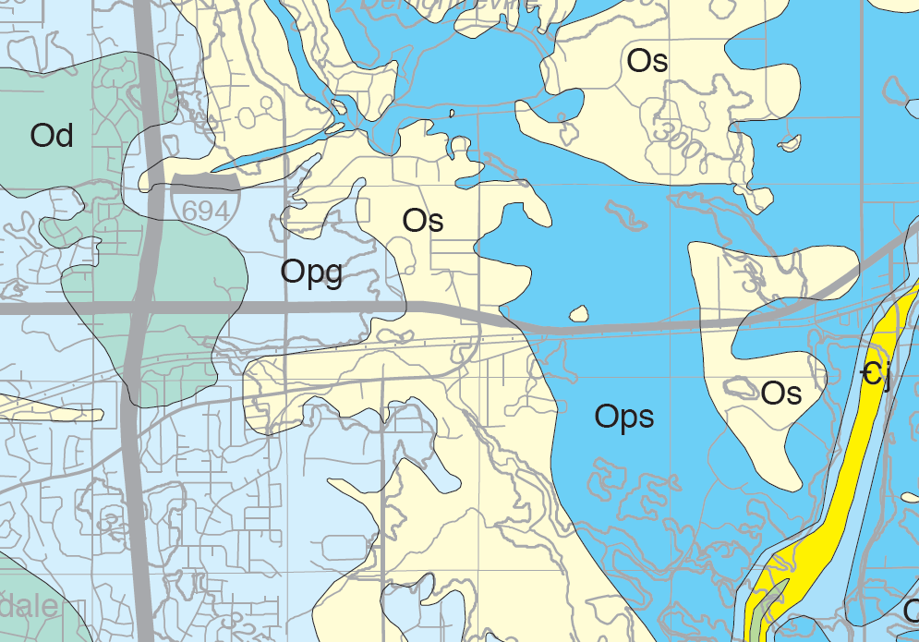
Project 1007 Focused Investigation Progress Report - Segment 1
June 2021 Minnesota Pollution Control Agency
From the Surface to the Subsurface: Water Flow Paths
Segment 1 Bedrock Geology and Hydrogeology
The bedrock geology in Segment 1 is diverse. The Tri-Lakes and Sunfish Lake are underlain by both the St Peter Sandstone and Shakopee Dolostone. The St Peter aquifer is disconnected throughout the area and thin where present.
Due to the lack of confining layers between these units, both the St Peter and the Shakopee aquifers are connected to the overlying shallow groundwater in the quaternary units.
This geology allows for a direct pathway from surface water to shallow quaternary groundwater to the deeper bedrock aquifers.
The Shakopee aquifer is underlain by the Oneota Dolostone aquitard, which can be fractured and “leaky”. The extent to which the aquitard functions as a barrier to the underlying Jordan Sandstone aquifer is not well understood.
Lake Olson
Lake Jane
Washington County Landfill
Sunfish Lake
Raleigh Creek
Lake Elmo
Eagle Point Lake

Slide 9
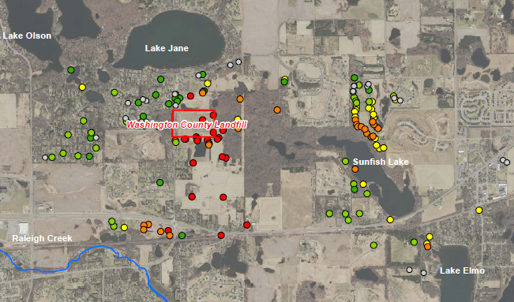
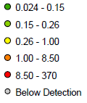
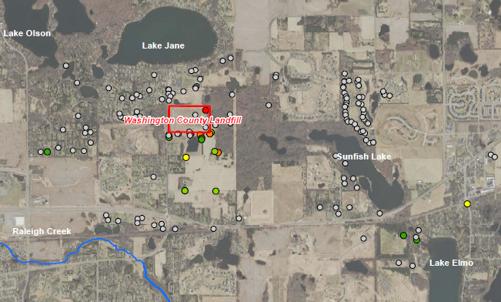
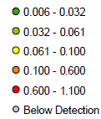
Project 1007 Focused Investigation Progress Report - Segment 1
June 2021 Minnesota Pollution Control Agency
PFAS in Groundwater: Segment 1
PFBA in Groundwater
PFOS Impacts – Segment 1
Corridor-wide, PFOS in groundwater was detected at a lower levels in Segment 1. Though PFOS is detected within close proximity to WCL, PFOS is below detection in the majority of wells in Segment 1.
The low PFOS to PFBA ratio around Sunfish Lake and south of WCL is similar to the WCL PFAS signature.
PFOS in Groundwater
PFBA Impacts – Segment 1
Like surface water downstream of Washington County Landfill, groundwater in Segment 1 has elevated PFBA impacts south and southeast of the landfill.
PFBA was detected in concentrations exceeding the MDH Health-Based Value (HBV) of 7.0 ppb in the majority of the wells sampled near WCL.

Slide 10
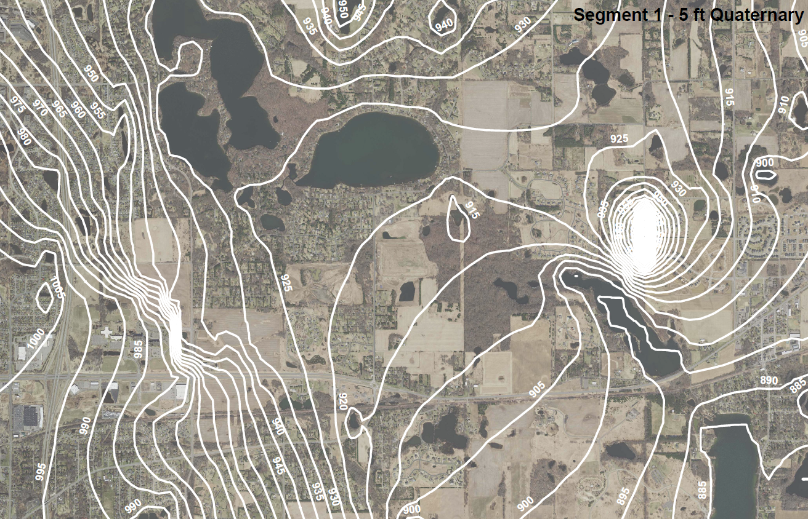
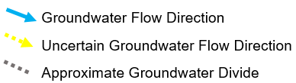
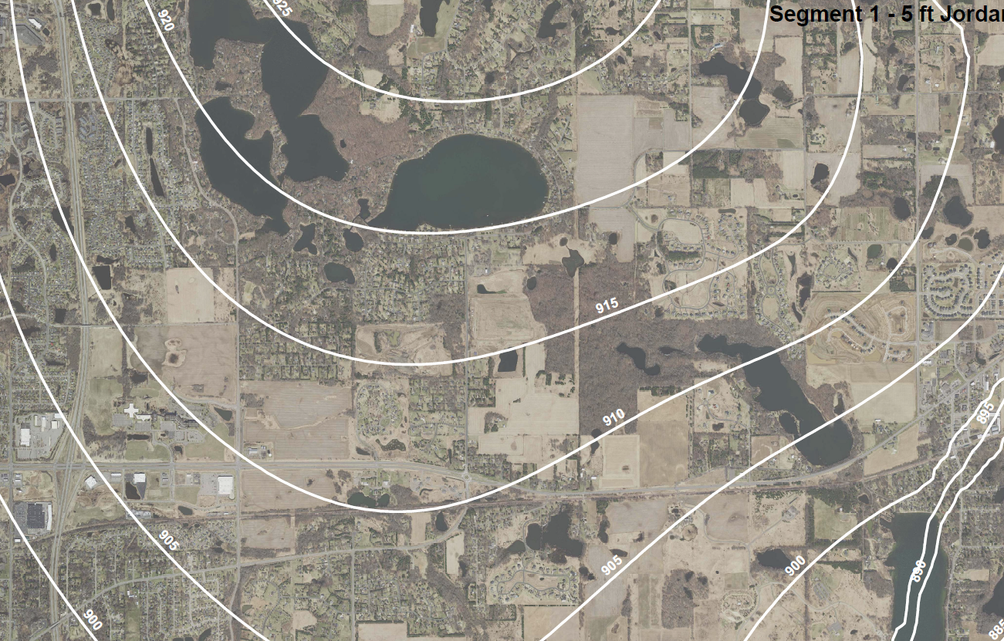
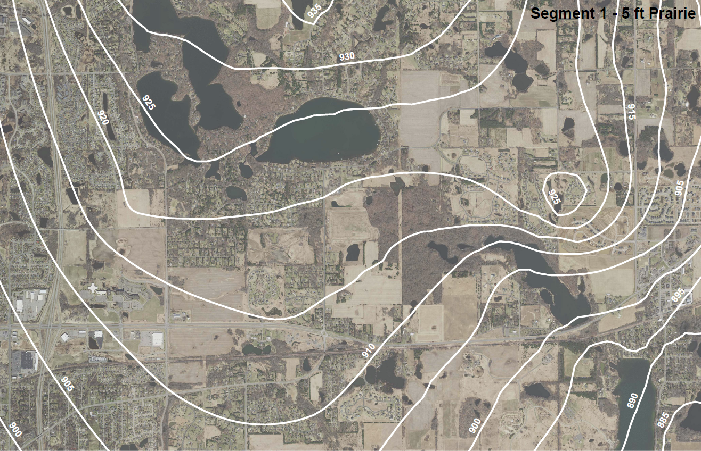
Project 1007 Focused Investigation Progress Report - Segment 1
June 2021 Minnesota Pollution Control Agency
Varying Groundwater Flow Regime from Source Area: Segment 1
Quaternary Aquifer
Jordan Aquifer
Washington County Landfill
Washington County Landfill
Shakopee Aquifer
Washington County Landfill
Groundwater contours are modeled based on available well data.
Quaternary Aquifer Flow
Like surface water, flow within the shallow Quaternary Aquifer is to the east, from the Tri-Lakes to WCL to Sunfish Lake and Lake Elmo.
Bedrock Aquifer Flow: Expected vs Actual Bedrock Flow
From what is known about the orientation of the bedrock units, a bedrock groundwater divide running north to south is currently mapped approximately between the Tri-Lakes and Sunfish Lake, immediately east of the WCL. As a result of this bedrock groundwater divide, flow within the deeper bedrock aquifers would be expected to have a western and southern component from the WCL.
However, the flow direction as modelled by collected well gauging data indicates that subsurface flow is southward and eastward east of WCL. Due to a lack of wells screened in the Jordan aquifer in Segment 1, the full extent of the eastward flow direction is uncertain at this time.
Lake Elmo

Slide 11
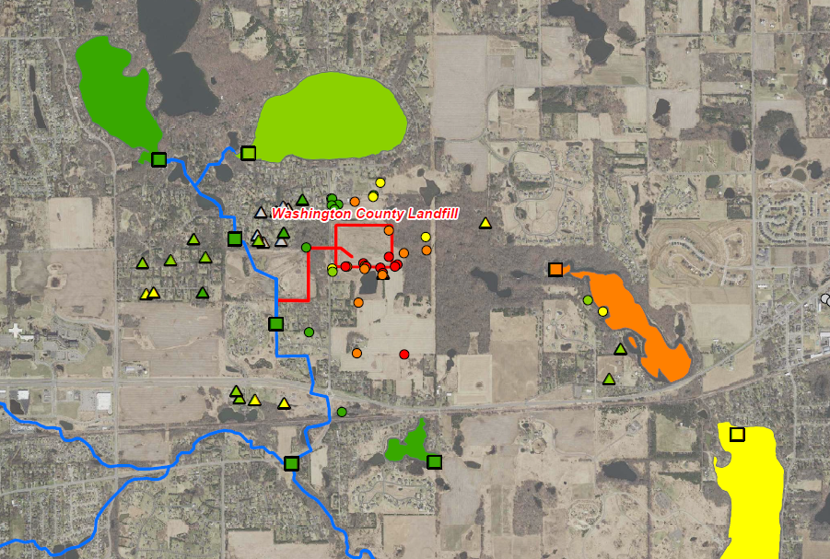
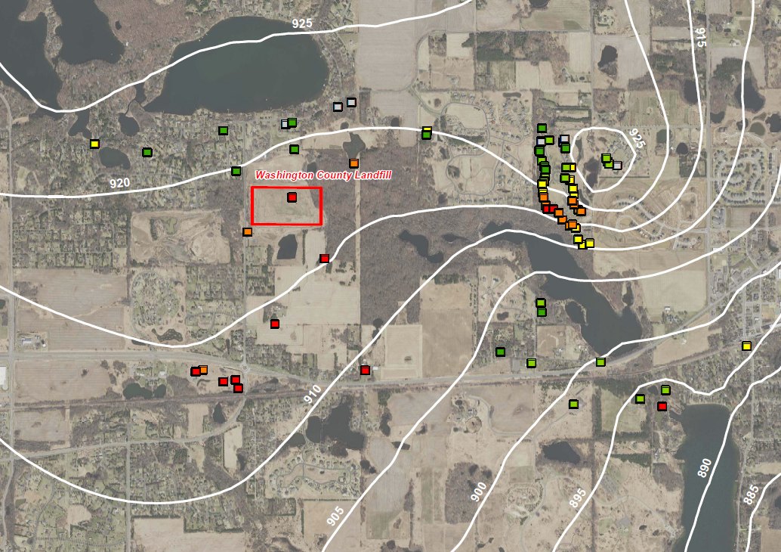
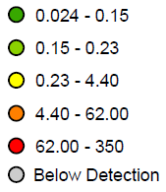
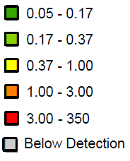
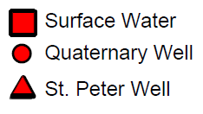
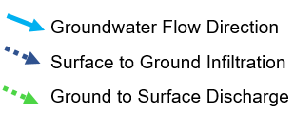

Segment 1| Project 1007
Minnesota Pollution Control Agency
Fate and Transport: Surface to Ground and Ground to Surface Preferential PFAS Pathways
PFBA Pathway: Surface, Quaternary, and St Peter
PFBA Pathway: Shakopee Aquifer
Lake Olson
Lake Jane
Lake Jane
Sunfish Lake
Sunfish Lake
Friedrichs Pond
Lake Elmo
Lake Elmo
Surface to Ground PFAS Pathway
The low PFBA impacts in both surface and shallow subsurface in the Tri-Lakes area suggest the elevated PFBA in the quaternary are the result of surface to ground infiltration from the Washington County Landfill. The PFBA-dominated impacts in Sunfish Lake are likely the result of eastward moving quaternary groundwater discharging to the lake.
Surface water gauging data suggest that Sunfish Lake infiltrates into the subsurface and then discharges to Lake Elmo. This pathway could explain the elevated PFBA in Lake Elmo.
Shakopee Aquifer Vertical PFAS Pathway
Relative to the surface and shallow subsurface, PFBA in the Shakopee aquifer is in lower concentrations. The highest PFBA impacts are closest to the WCL, supporting a vertical PFAS pathway from the surface into the Shakopee aquifer.
The wells northeast of Sunfish Lake are not in the groundwater flow path from WCL. The relative increase in PFBA in these wells is more likely the result of vertical groundwater movement from overlying impacted St Peter or Quaternary aquifers.

Slide 12
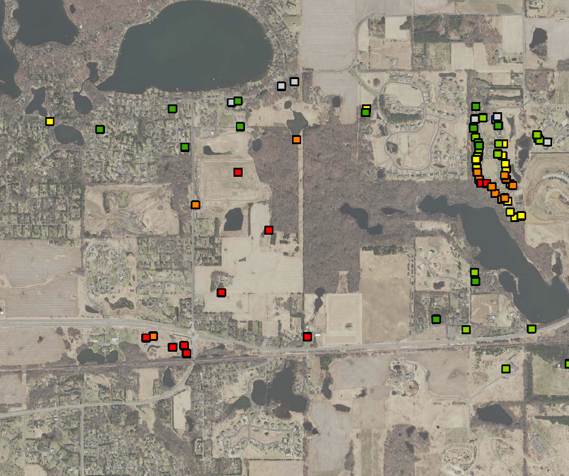


Segment 1| Project 1007
Minnesota Pollution Control Agency
Project 1007 Focused Investigation Progress Report - Segment 1
June 2021 Minnesota Pollution Control Agency
A Closer Look: WCL PFAS Signature Impacts South of WCL at Beta Site 17
Beta Site 17
At Stillwater and 34th St N (BS17), groundwater from multiple aquifers was sampled for PFAS during the installation of a monitoring well nest. This location is outside of the Quaternary flow path from WCL, but within the expected groundwater flow path of the deeper bedrock aquifers from WCL.
Results from the Quaternary show low levels of PFAS compounds. The deeper bedrock samples, however, indicate elevated PFBA impacts and a PFAS distribution that matches the “signature” of WCL impacts. These results provide insight into what is migrating from WCL into the rest of the corridor and might be co-mingling with ODS impacts. Results from the Jordan aquifer are pending.
PFBA: Shakopee Aquifer and BS17
Lake Jane
Washington County Landfill
Sunfish Lake
BS17
*
*
*
*
* Exceeds MDH HBV of 7.0 ppb for PFBA and 0.035 ppb for PFOA

