Slide 1
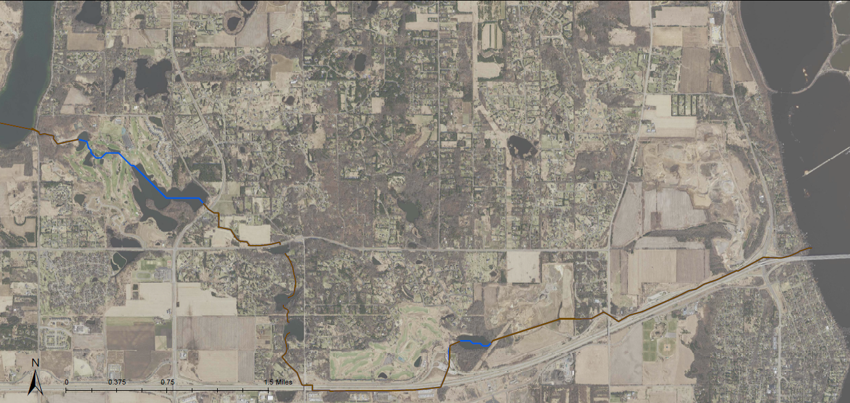
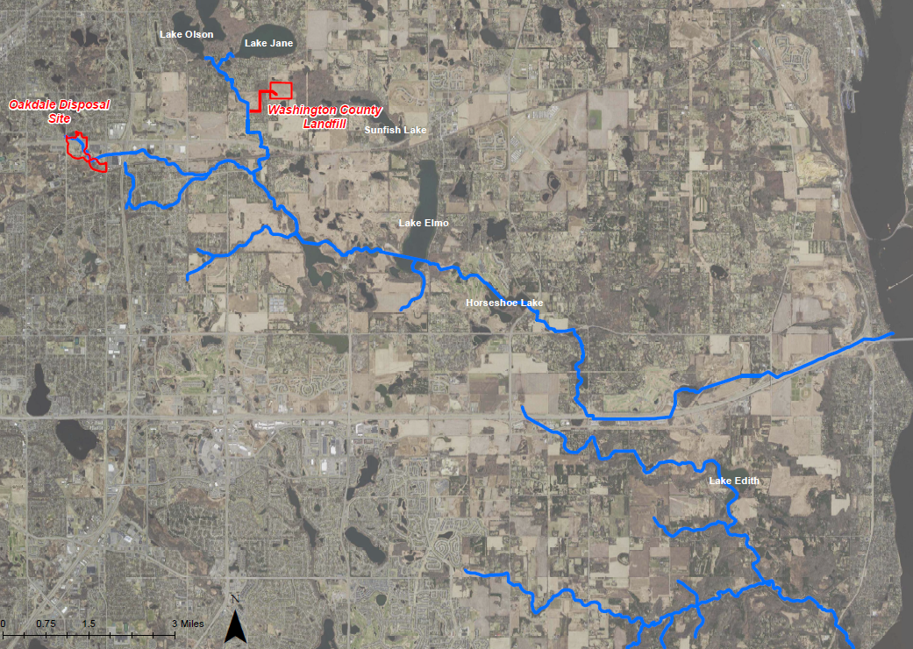
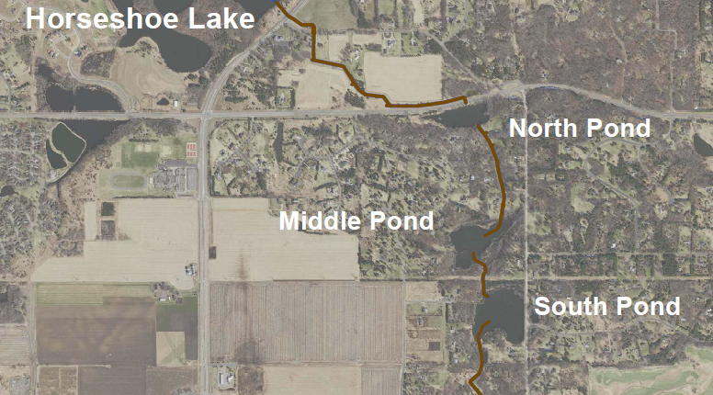
Project 1007 Focused Investigation Progress Report - Segment 6
June 2021 Minnesota Pollution Control Agency
Segment 6: Lake Elmo to the St. Croix River
Lake Elmo
Segment 6 Site Map
Lake Elmo
St. Croix River
St. Croix River
Horseshoe Lake
Horseshoe Lake
P1007 Corridor Map
WLSS Ponds
WLSS Ponds
Segment 6
WLSS Ponds Map

Slide 2
Project 1007 Focused Investigation Progress Report - Segment 6
June 2021 Minnesota Pollution Control Agency
Segment 6: Lake Elmo to the St. Croix River
Flow Path Map: Segment 6
  Legend
  Known Surface Water Flow Path
  Potential Surface to Groundwater Infiltration
Surface Water Systems
Segment 6 consists of two small ponds within Royal Golf Club, followed by a large lake (Horseshoe Lake), and a series of artificially modified ponds with wetland edges (WLSS Ponds) connected via stormwater pipes, catch basins, and incised stream channels.
In an effort to control water quality and levels, outflow from Eagle Point Lake is diverted from Lake Elmo via a sunken 22-inch pipe. The Eagle Point Lake and Lake Elmo outflow pipes both discharge immediately east of Lake Elmo at the western edge of Segment 6, upstream of Horseshoe Lake.
The west and central sections of Segment 6 are comprised of an interconnected system of water bodies that convey water from upstream Project 1007 to Horseshoe Lake and the WLSS Ponds.
The eastern section of Segment 6 downstream of the WLSS Ponds is primarily comprised of enclosed pipes that convey water directly to the St. Croix River.
Lake Elmo
Lake Elmo
Discharge from Lake Elmo & Eagle Point Lake
Horseshoe Lake
St. Croix River
Horseshoe Lake
St. Croix River
WLSS Ponds
WLSS Ponds
Preferential PFAS Pathways: Deposition and Migration
Compared to other Segments, Segment 6 is farther from known source areas and contains fewer channelized wetlands, which are typically higher in organic content and more likely to contain higher concentrations of PFAS in sediment.
Key Water Bodies: Horseshoe Lake is a large lake with minimal vegetation compared to other lakes in the corridor. The WLSS Ponds retain PFAS-impacted water for longer periods of time and are designed to facilitate infiltration. The unique hydrologic properties of the WLSS Ponds result in a higher potential for PFAS-impacted surface water infiltration to shallow groundwater.
Channels: Flow is more consistent and like the WLSS Ponds, the channels were designed to facilitate surface water infiltration to groundwater.

Slide 3
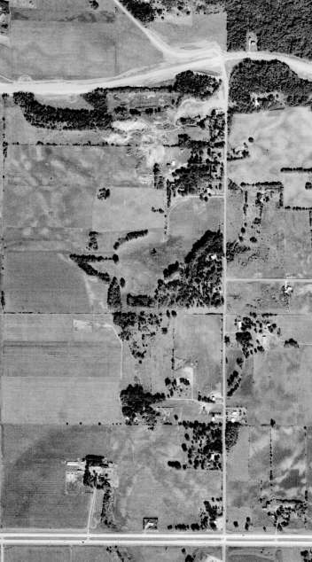
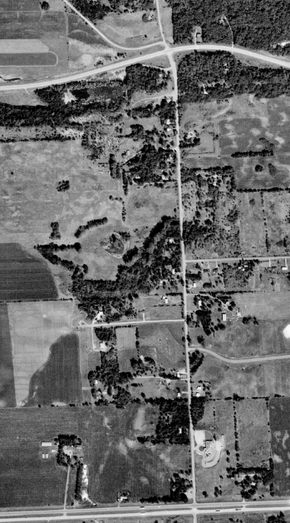
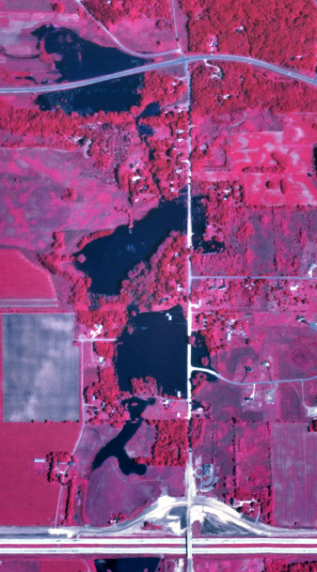
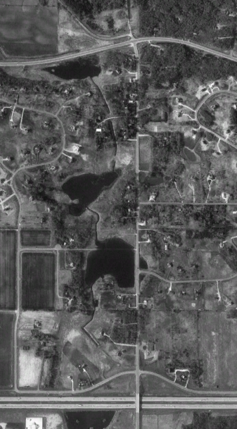
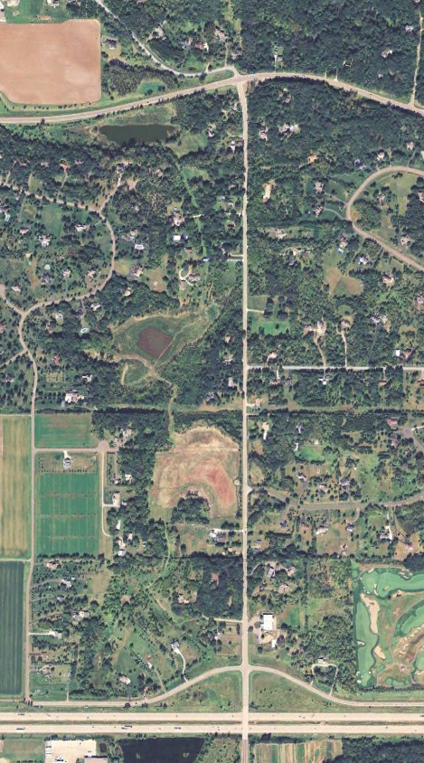
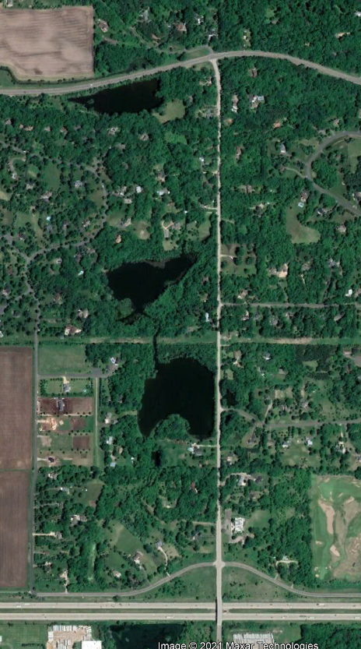
Project 1007 Focused Investigation Progress Report - Segment 6
June 2021 Minnesota Pollution Control Agency
A Closer Look: West Lakeland Storage Site Ponds
1970
1980
1986
1992
2011
2020
1970 & 1980: Pre-P1007
The three storage ponds are not visible in historic imagery from 1953 to 1980, except for what may be a dry South Pond in 1970. From at least 1957 until 1974, a rock quarry is present at the location of the North Pond. Land use appears to consist of farming and undeveloped wetlands.
Post-P1007 Implementation
As part of the implementation of Project 1007, water from Eagle Point Lake, Lake Elmo, and Horseshoe Lake was directed into the WLSS Ponds. In the 1986 aerial image, taken during the implementation of P1007, all three ponds are visible for the first time and appear to be significantly flooded.
Once P1007 was completed (1987), North Pond was widened, channels were constructed between the ponds, and an outlet from South Pond was connected to the MnDOT Interstate 94 storm sewer system. The improvements facilitate the exit of surface water overflow from the ponds via the MnDOT storm sewer system and infiltration to ground.
Current Conditions
Pond water levels can vary significantly from year to year depending on annual precipitation.
The ponds have been reported to have seepage rates ranging from 3.5 to 5 cubic feet per second (Barr, 2015). In addition, sink holes have been reported along the channel between North and Middle Ponds.
The high infiltration capacity of these three ponds makes interaction between surface water and groundwater a key mechanism for PFAS transport and migration in Segment 6.
Implementation of P1007
Pre-P1007:
Ponds Not Visible
Current Conditions:
North, Middle, and South Pond Present
WLSS Ponds Development Timeline
1940
Quarry at
North Pond
1986-1987
Present
1957
1974

Slide 4
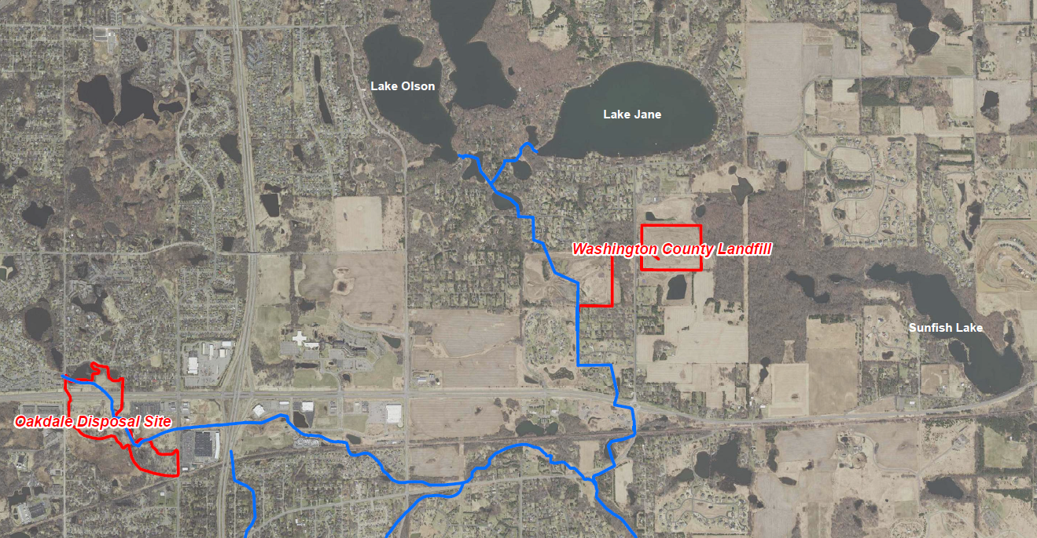

Project 1007 Focused Investigation Progress Report - Segment 6
June 2021 Minnesota Pollution Control Agency
Comparison of Two Source Areas: Oakdale Disposal Site vs. WCL
Disposal Site-Specific PFAS-Containing Waste
The Oakdale Disposal Site (ODS) accepted liquid and solid industrial waste, while the Washington County Landfill (WCL) accepted a variety of industrial and wastewater treatment plant waste. The PFAS contamination associated with these two historic waste streams is made up of different PFAS compounds, resulting in a PFAS “signature” that may be unique to each source area.
The PFAS signature associated with ODS is generally PFOS-dominant, while the PFAS signature from WCL is generally PFBA-dominant. As a result, analysis of the PFBA:PFOS ratio or the relative distribution of key compounds can be used to evaluate a possible PFAS source contribution at different locations.
Locations that are not associated with either ODS or WCL impacted waters may have a similar PFAS signature; however, the concentrations of all compounds will be significantly lower.
PFAS Distribution by Source Area
WCL PFAS Signature
ODS PFAS Signature
Low Concentration Widespread PFAS
Typical PFAS Distribution: ODS vs WCL
Dual Source Input
ODS+WCL
ODS
PFOS-Dominant
WCL
PFBA-Dominant
Future Chemometrics Forensic Analysis
By applying multivariate statistical tools such as principal component analysis, hierarchical clustering, and logarithmic transformations to chemistry data using PFAS Chemometrics as a forensics tool, potential source area signatures can be identified and separated by subtle variations to provide powerful forensic interpretations. This will aid in future understanding of partitioning, fate and transport and source mixing.
Future data analysis will use the above tools to refine the CSM and develop a deeper understanding of how PFAS is behaving in the surface and subsurface features of Project 1007.
Low Concentration Widespread PFAS*
*Key difference between unknown anthropogenic source and WCL is lower concentrations.

Slide 5
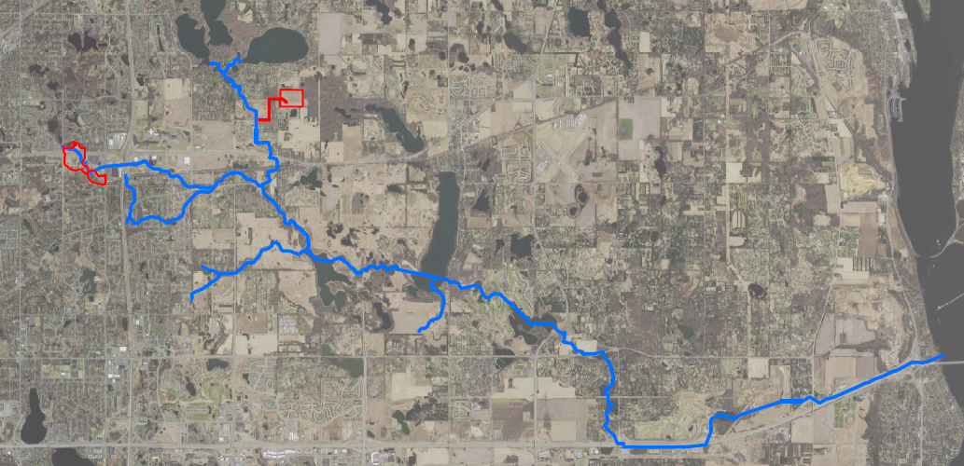
Project 1007 Focused Investigation Progress Report - Segment 6
June 2021 Minnesota Pollution Control Agency
Site-Wide Surface Water Results: Distribution of PFAS Impacts
PFAS Distribution Map:
Site-Wide 2019-2020
PFAS Distribution: Source Area Mixing
Surface water in Segment 6 begins at the confluence of the discharge pipes from Eagle Point Lake and Lake Elmo. Surface water in Eagle Point Lake is similar to that of the Oakdale Disposal Site (ODS) PFOS-dominant impacted surface water, while surface water in Lake Elmo is closer to the Washington County Landfill (WCL) signature of PFBA-dominant surface water impacts. The resulting chemistry of the PFAS impacts in surface water in Segment 6 is a mixture of the two source area PFAS signatures.
PFAS Distribution as a Function of Distance From Source Areas
The distribution of the PFAS impacts in surface water in Segment 6 is also influenced by the distance from each source area. PFBA moves faster in water than PFOS and other longer-chain PFAS chemicals due to its smaller molecular size, more hydrophilic nature, and water solubility. This aspect of PFBA makes the compound both more ubiquitous in nature and present in greater relative amounts in the leading edges of plumes.
Tri-Lakes
Washington
County Landfill
Sunfish Lake
Oakdale
Disposal Site
Raleigh Creek
Lake Elmo: PFBA-Dominant
P1007 Confluence
Confluence of EPL and Lake Elmo
Segment 6
Typical PFAS Distribution: ODS vs WCL
Dual Source Input
ODS+WCL
St. Croix River
ODS
PFOS-Dominant
WCL
PFBA-Dominant
Horseshoe Lake
Eagle Point Lake:
PFOS-Dominant
Low Concentration Widespread PFAS*
WLSS Ponds
*Key difference between unknown anthropogenic source and WCL is lower concentrations.
.

Slide 6
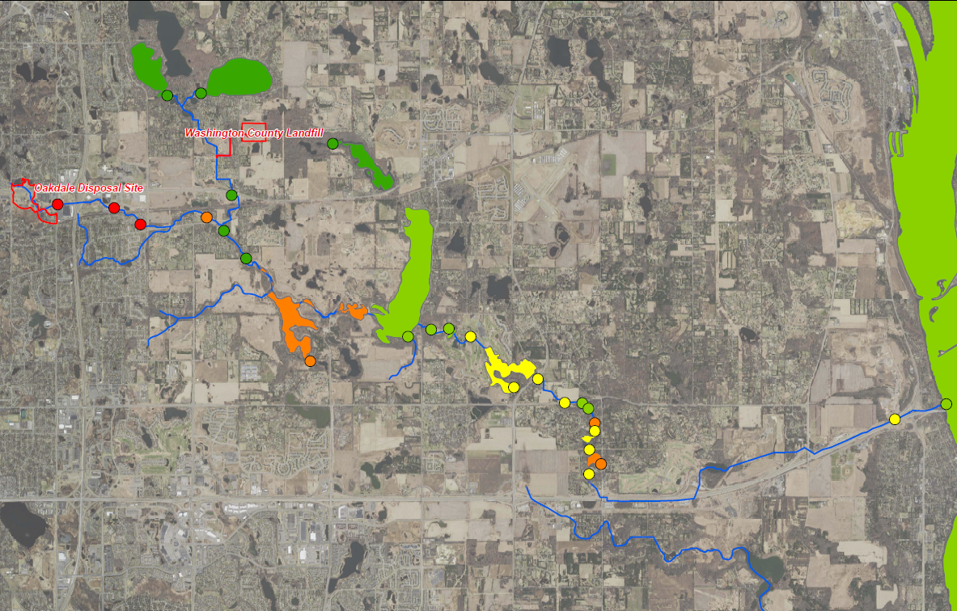
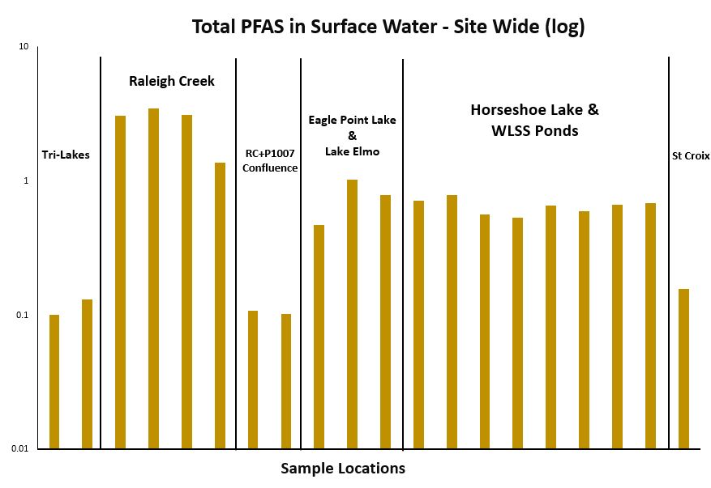
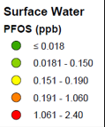
Project 1007 Focused Investigation Progress Report - Segment 6
June 2021 Minnesota Pollution Control Agency
Site-Wide Surface Water Results: PFAS Impacts
Surface Water Impacts in Segment 6
Though all surface water samples in Segment 6 exceed MPCA’s PFOS Site-Specific Surface Water Quality Criteria of 0.00005 ppb, the overall concentrations are lower (by an order of magnitude) than the western portion of the corridor. The areas with lower overall impacts, including the Tri-Lakes Area and P1007 Confluence, have either intermittent or no surface water connection with Raleigh Creek, which flows directly from the Oakdale Disposal Site (ODS). Seasonal variation and precipitation events appear to have minimal effect on PFAS impacts in Segment 6.
PFOS Heat Map:
Surface Water Sampling Locations
Tri Lakes
Sunfish Lake
Raleigh Creek
P1007 Confluence
Lake Elmo
St. Croix River
Segment 6
Eagle Point Lake
Horseshoe Lake
WLSS Ponds

Slide 7
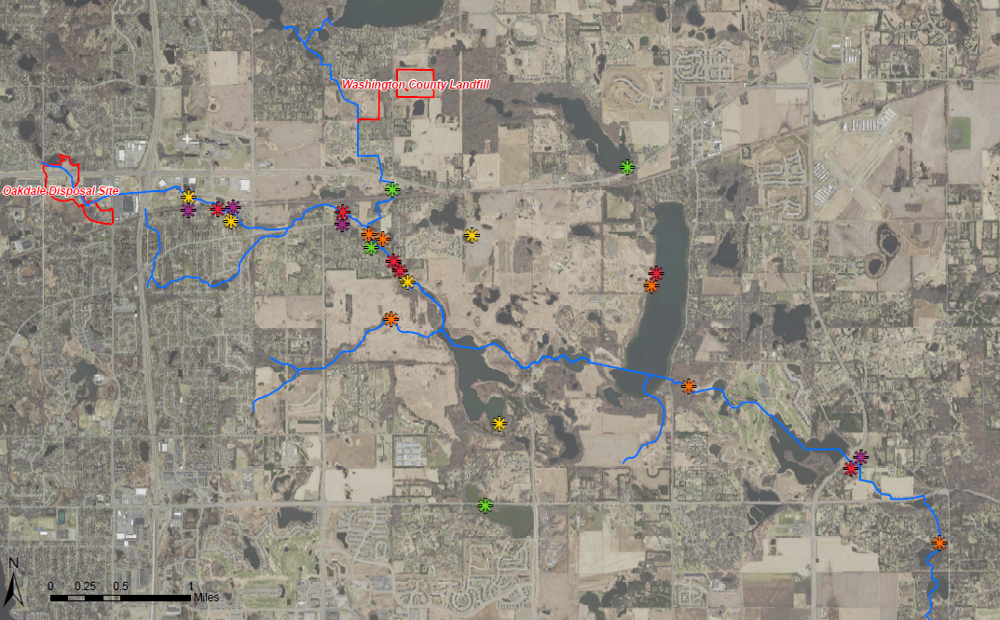
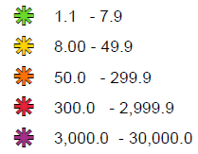

Project 1007 Focused Investigation Progress Report - Segment 6
June 2021 Minnesota Pollution Control Agency
Site-Wide Foam Results: PFOS
PFOS Heat Map: Foam
Legend
PFOS (ppb)
Sunfish Lake
Raleigh Creek
P1007 Confluence
Circled symbols denote repeat foam sample locations
Lake Elmo
Foam in Segment 6
Foam has been regularly observed downstream of Horseshoe Lake at culverts in Segment 6. The locations with foam and types of foam observed are variable, largely depending on flow conditions.
PFOS concentrations in foam in Segment 6 are variable, but also have exhibited the highest concentrations in the corridor despite the generally lower concentrations in surface water.
Eagle Point Lake
Segment 6
Horseshoe Lake
WLSS Ponds

Slide 8
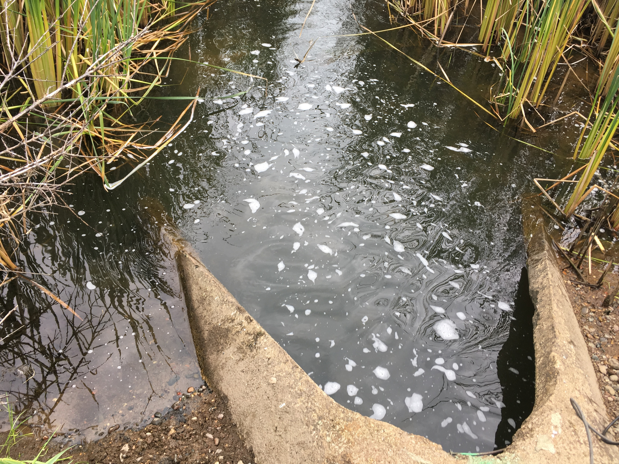
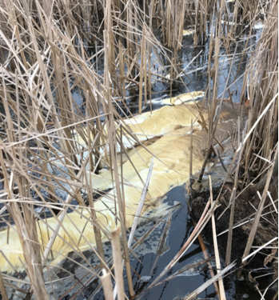
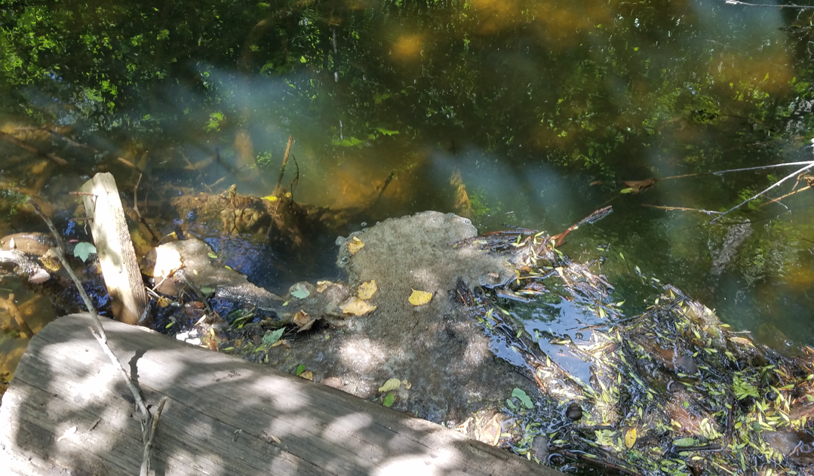
Project 1007 Focused Investigation Progress Report - Segment 6
June 2021 Minnesota Pollution Control Agency
Foam Formation in Segment 6
Requirements for PFAS-Containing Foam Formation and Accumulation
Turbulence
Air must be mixed into the water column for foam to form. In Segment 6, this is most often caused by water flowing over rocks, trees, or other debris in the stream. The water level greatly affects the locations of turbulence.
Solid Substrate for Foam to Accumulate Against
After generation, the foam bubbles must have a solid substrate in relatively calmer water to accumulate along or against. Without accumulation, the foam bubbles will collapse back into the stream water column. In Segment 6, foam was found to accumulate along the stream banks, debris, blocks of ice, and vegetation growing in the stream channel.
PFAS Concentrations in Surface Water
Foam will naturally form regardless of the presence of PFAS. However, it is not well understood how the presence of PFAS in water affects foam formation. It is also not well understood how much PFAS will preferentially separate (enrich) into the foam relative to the PFAS in the corresponding surface water.
High flowing water exiting a culvert created significant turbulence, resulting in foam bubbles observed downstream of Horseshoe Lake.
Accumulated foam observed against debris in a stream channel, among cattails, and against ice dams. The foam types observed in repeat locations tend to be vary more in Segment 6 than those observed elsewhere.

Slide 9
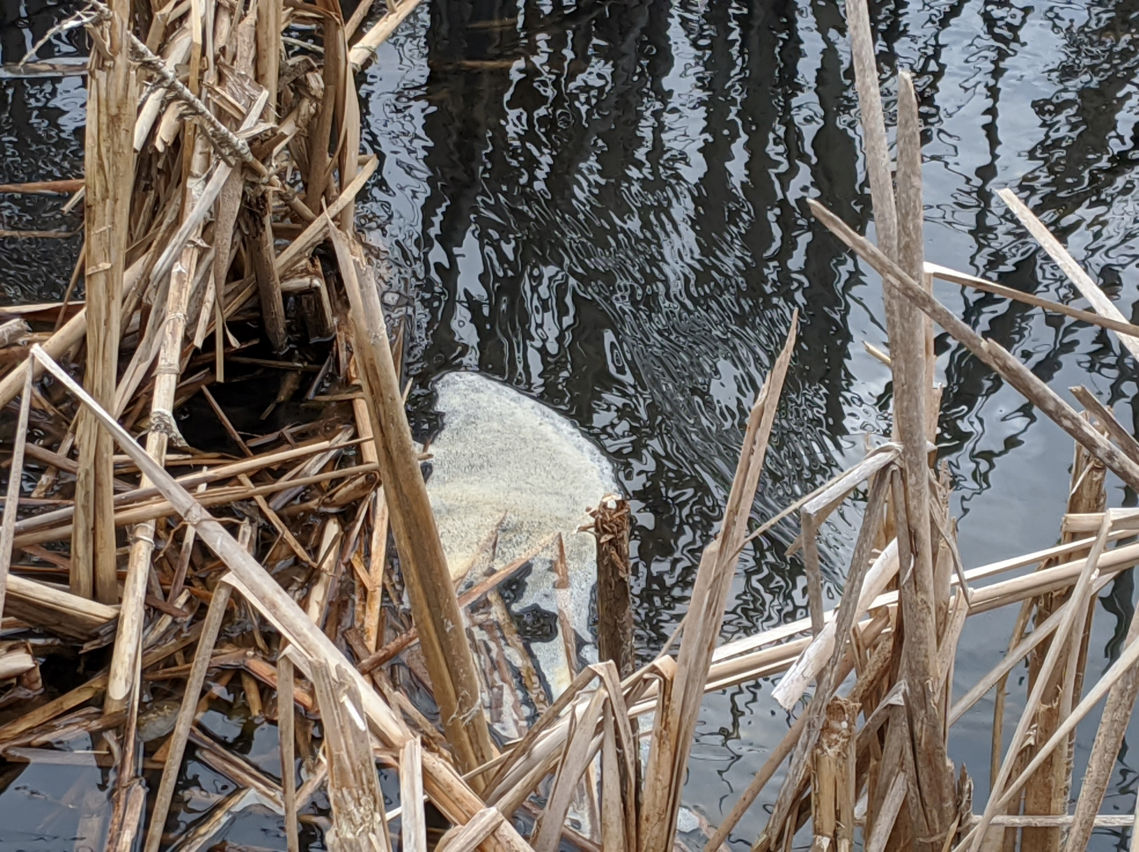
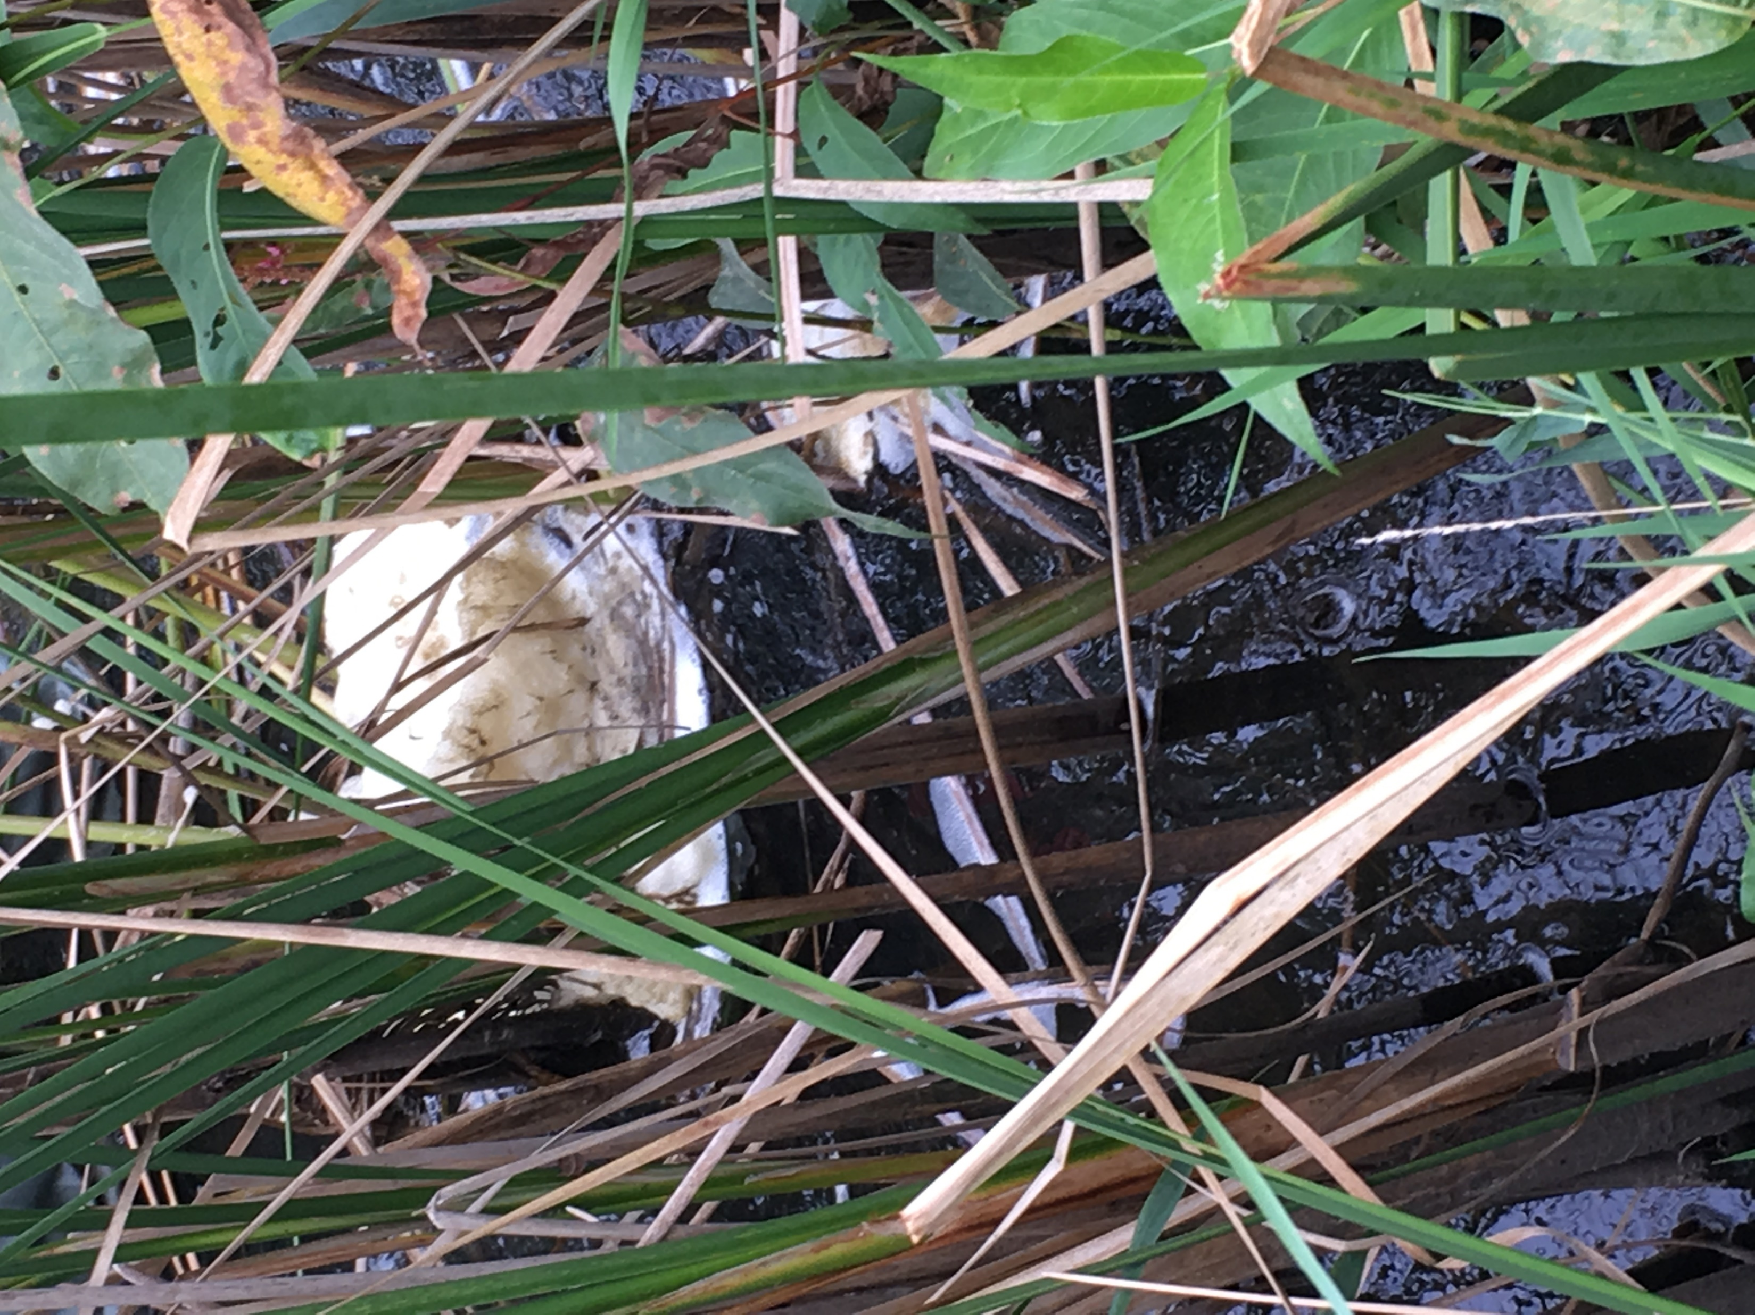
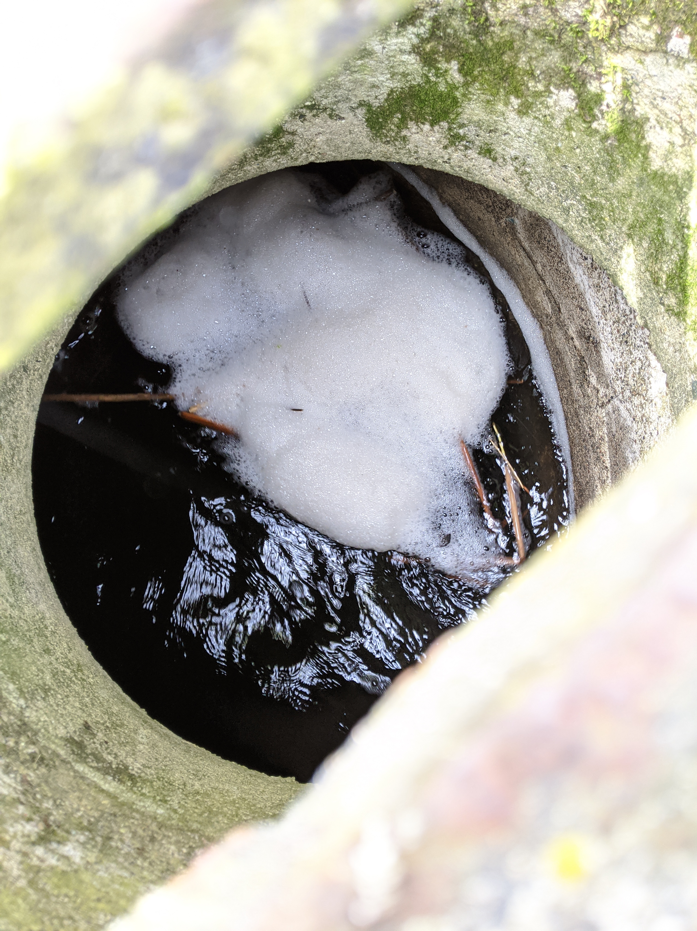
Project 1007 Focused Investigation Progress Report - Segment 6
June 2021 Minnesota Pollution Control Agency
Types of Foam
Foam in Segment 6
The foam observed and sampled in Segment 6 had several different appearances. The type of foam observed was not tied to an exact location, precipitation events, or seasons with the exception of foam accumulating on top of ice.
The different types of foam typically observed in Segment 6 are presented in this slide. Foam can present itself in any one of these types or as a combination.
Fluffy
Accumulated piles are larger and whiter in appearance, though some discoloring can occur. Can be more stable than other foam types. Fluffy foam condenses into a smaller liquid volume than other foam types, indicating the presence of more air.
Frozen Conditions
Occurs when foam accumulates against ice or snow. The foam itself may freeze in place (above photo) or may just accumulate more readily due to the presence of ice dams but remain unfrozen (below photo).
Floating (not accumulating)
Foam bubbles that do not accumulate either because they collapse too quickly or because there is no location for accumulation to occur. This foam cannot be isolated from the surface water and thus has not been sampled.
Actively Generating (fresh)
Foam observed as actively generating due to significant turbulence. The accumulated foam can have a wide range of appearances from thin bubbles to fluffy piles. This foam is typically whiter than other types.
Deflated (old)
Typically thin, in smaller quantities, and discolored with organic matter present. Not actively reaccumulating.

Slide 10

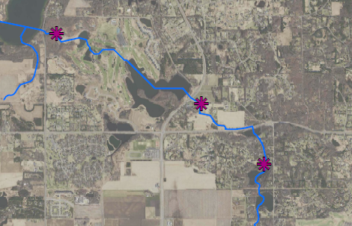
Project 1007 Focused Investigation Progress Report - Segment 6
June 2021 Minnesota Pollution Control Agency
Foam Segment 6: Results and Enrichment Factors
EP16
WL6
WL11
Segment 6: Foam Locations
9/17/20 - Frozen
EP16
7/29/20 - Old
WL6
Findings
PFAS concentrations in foam can vary by an order of magnitude in the same location (WL6 Foam: 1,630 to 20,700 ppb PFOS).
Site-wide, the highest PFOS concentration in foam was from a foam sample collected in Segment 6 (WL6, 9/17/20). This suggests that distance from source area does not necessarily lead to lower PFAS concentrations in foam despite overall lower PFAS concentrations in surface water.
An enrichment factor is the ratio of the PFAS concentration in the foam to that in the water.
Foam enrichment factors of PFOS in Segment 6 ranged from 700 to over 100,000 pbb and can vary in the same location as well (up to an order of magnitude of difference).
5/5/20 - Fresh
WL11
9/17/20 - Fluffy

Slide 11
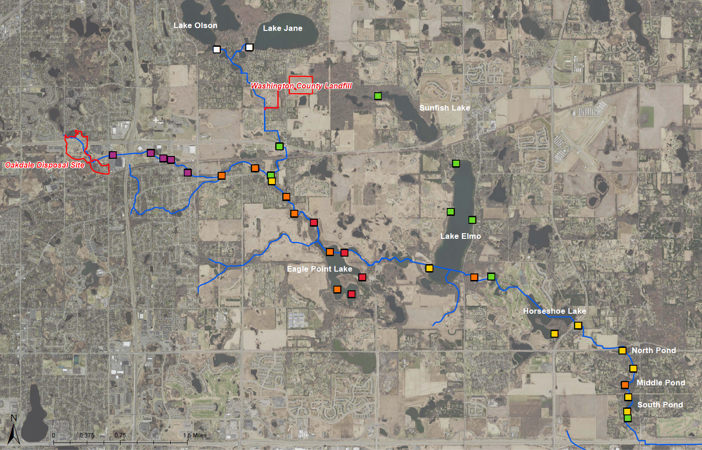
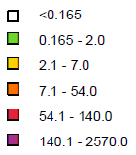

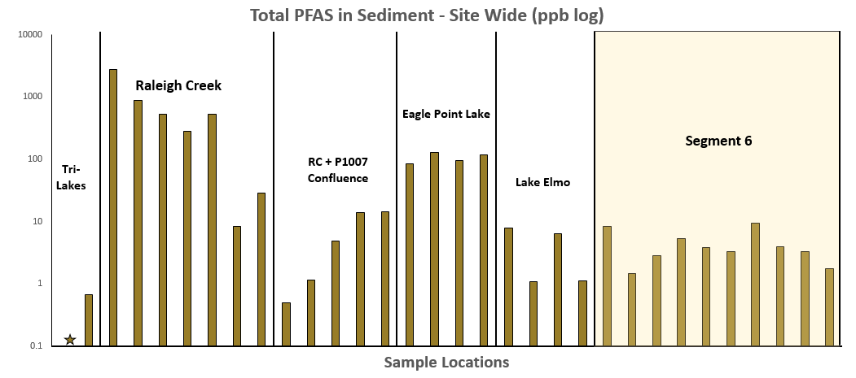
Project 1007 Focused Investigation Progress Report - Segment 6
June 2021 Minnesota Pollution Control Agency
Site-Wide Surface Sediment Results: PFOS
Sediment in Segment 6
PFAS in sediment in Segment 6 is relatively lower than elsewhere in the corridor. All sediment samples are below the MPCA 2-Day and 5-Day per Week Site-Specific Sediment Screening Values (SDSVs) for PFOS of 140 ug/kg and 54 ug/kg, respectively.
Though factors such as depositional environment and organic content may influence the sorption and retention of PFAS, the largest contributing factor to lower relative PFAS in sediment in Segment 6 appears to be the greater distance from known source areas.
Tri-Lakes
PFOS Heat Map:
Sediment Sampling Locations
Legend
P1007 Conveyance
Sunfish Lake
Raleigh Creek
Lake Elmo
Eagle Point Lake

Slide 12
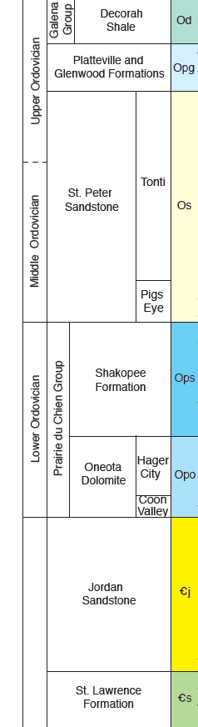
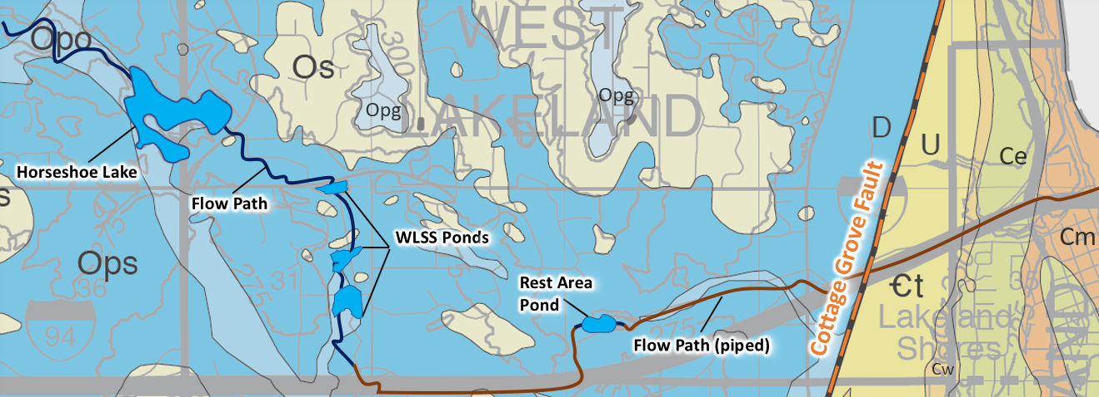
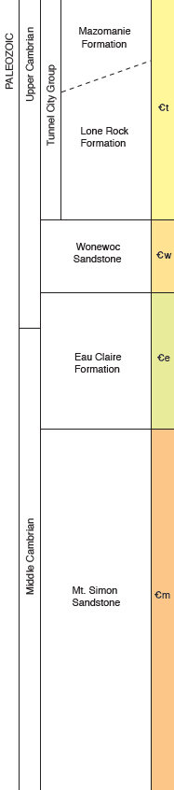
Project 1007 Focused Investigation Progress Report - Segment 6
June 2021 Minnesota Pollution Control Agency
From the Surface to the Subsurface
First Encountered Bedrock Map
Segment 6 Bedrock Geology and Hydrogeology
The groundwater flow in the St. Peter, Prairie du Chien (Shakopee/Oneota), and Jordan formations is generally moving eastward in Segment 6. Groundwater in these formations continues eastward until it flows past the Cottage Grove Fault, where deeper formations were uplifted.
Important considerations include the impact of surface water bodies on the migration of PFAS. Horseshoe Lake, WLSS Ponds, and the I-94 Rest Area Pond are all surface water bodies that may interact with groundwater in the bedrock. No Project 1007 surface water features interact with the groundwater east of the Cottage Grove Fault as the 1007 Flow Path is completely piped west of the Rest Area Pond. The relevant surface water bodies west of the fault are underlain by either the Shakopee Aquifer or the Oneota Aquitard. Due to the fact that the Oneota is considered to be a fractured and “leaky” aquitard, there is a strong possibility that surface water impacts may sink into the Jordan aquifer. The St. Lawrence Aquitard underlies the Jordan Aquifer and although it may be “leaky” regionally, it generally has a low hydraulic conductivity vertically – especially where the Jordan overlies the St. Lawrence. Due to these conditions within Segment 6, the St. Lawrence likely limits any downward migration of PFAS west of the Cottage Grove Fault. Groundwater that flows east over this fault goes into the Tunnel City Group (the upper formation being an aquifer while the lower formation is confining). Due to further erosion of the bedrock units eastward, groundwater flowing towards the St. Croix may interact with the Wonewoc Aquifer and the Eau Claire Aquitard until the erosional edge of the units, at which point groundwater can flow unimpeded from quaternary sediments into the Mt. Simon Aquifer. Any further downward migration of groundwater is confined by the basal metasedimentary units underlying the Mt. Simon aquifer.

Slide 13
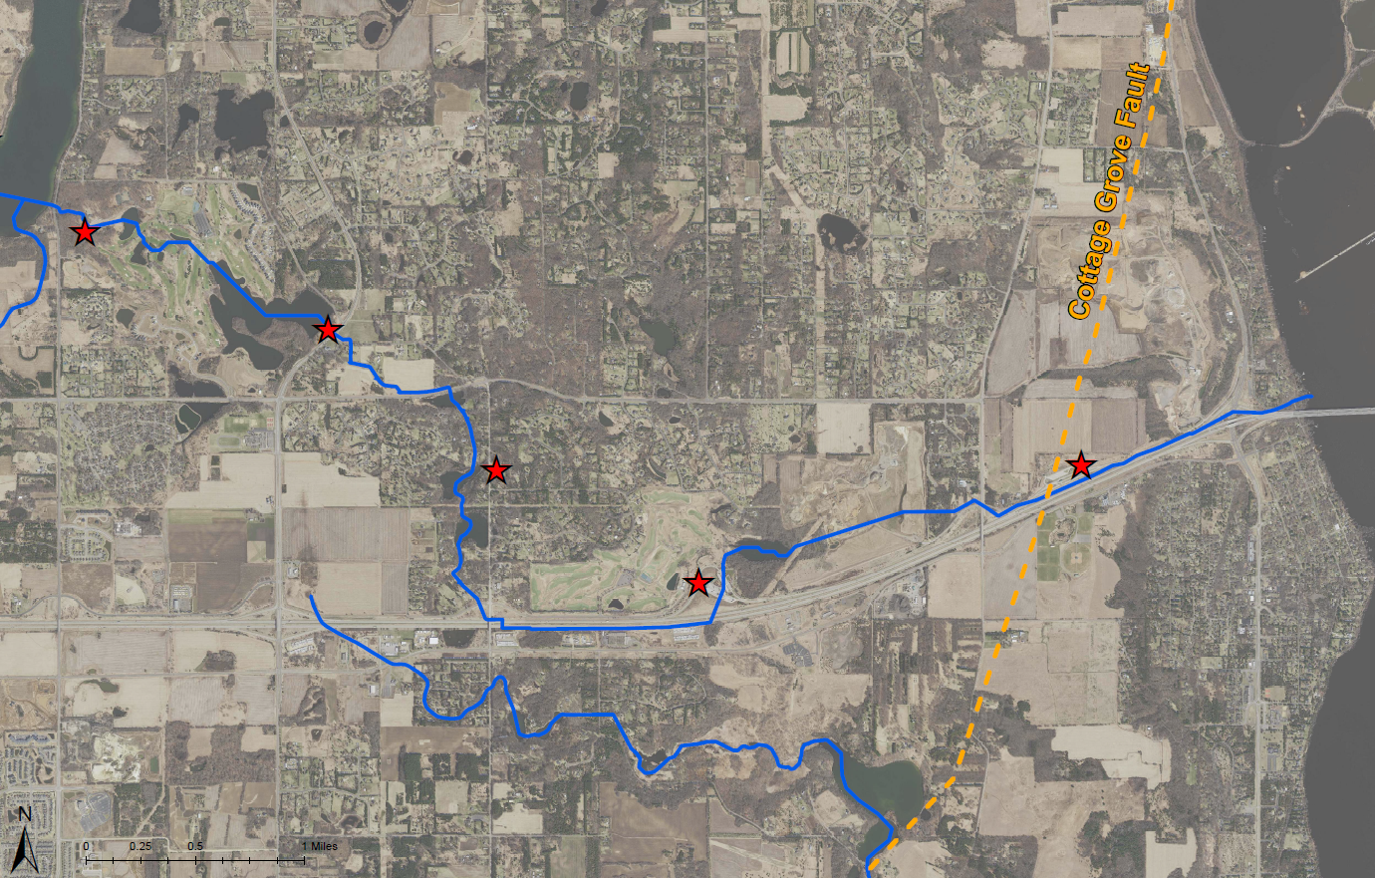
Project 1007 Focused Investigation Progress Report - Segment 6
June 2021 Minnesota Pollution Control Agency
Segment 6: Site Features and Beta Sites
AECOM Beta Sites
Beta Site 6 (BS6)
MW6A: Jordan Aquifer Well
MW6B: Oneota Aquitard Well
MW6C: Quaternary Aquifer Well
MW6D: Quaternary Aquifer Well
Beta Site 7 (BS7)
MW7A: Jordan Aquifer Well
(Vertical Aquifer Profile Samples from the Quaternary Aquifer, Shakopee Aquifer, and Oneota Aquitard)
Beta Site 9 (BS9)
MW9A: Oneota Aquifer Well
MW9B: Quaternary Aquifer Well
Beta Site 12 (BS12)
MW12A: Tunnel City Aquifer Well
(Vertical Aquifer Profile Samples from the Shakopee Aquifer, Oneota Aquitard, and Jordan Aquifer)
Beta Site 15 (BS15)
MW15A: Wonewoc Aquifer Well
MW15B: Tunnel City Aquifer Well
(Vertical Aquifer Profile Samples from the Jordan Aquifer and St. Lawrence Aquitard)
Lake Elmo
Segment 6
BS6
St. Croix River
BS7
Horseshoe Lake
BS9
BS15
WLSS Ponds
BS12

Slide 14
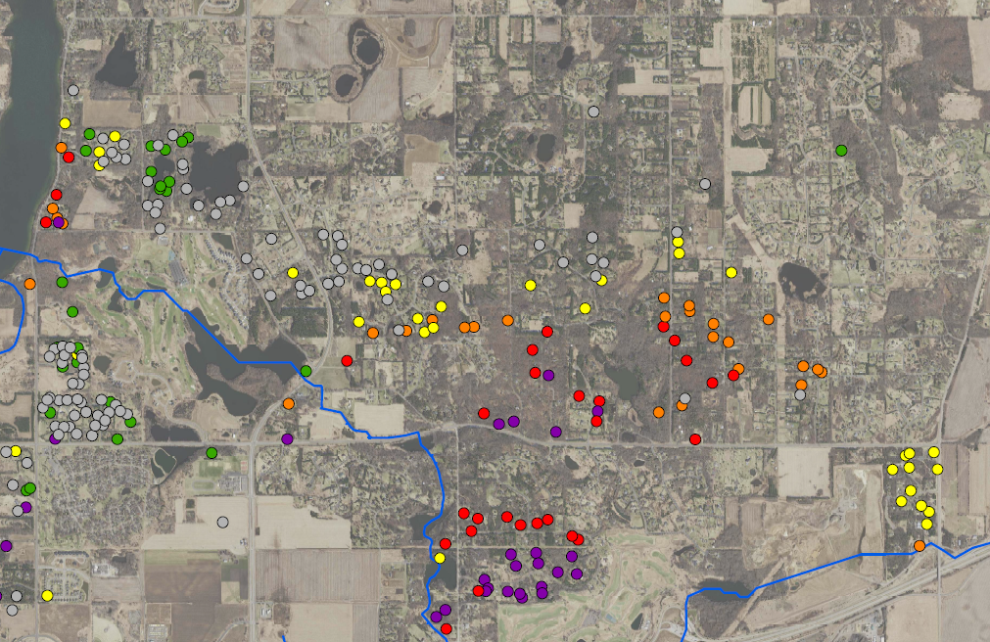
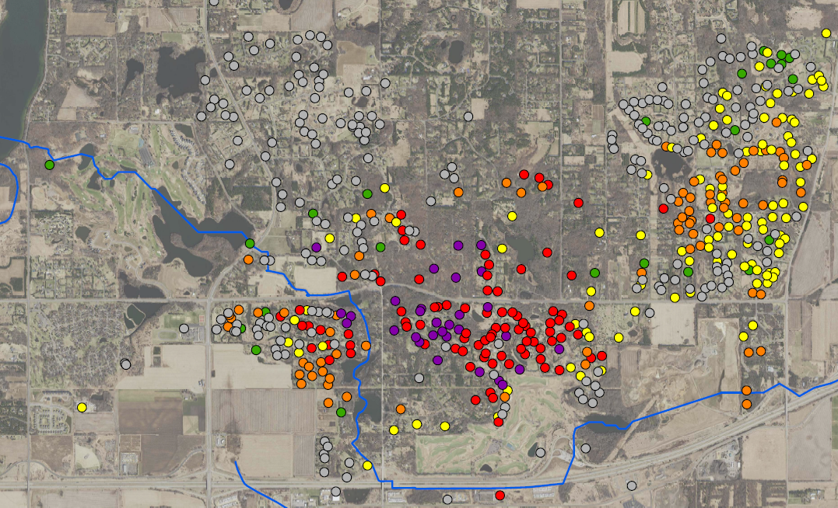
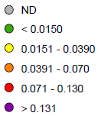
Project 1007 Focused Investigation Progress Report - Segment 6
June 2021 Minnesota Pollution Control Agency
Segment 6 Groundwater Results: PFOS
Lake Elmo
PFOS Heat Map: Prairie du Chien (PDC) Aquifer
Tri-Lakes
PFOS Heat Map: Jordan Aquifer
Lake Elmo
Horseshoe Lake
P1007 Conveyance
Sunfish Lake
Horseshoe Lake
Raleigh Creek
WLSS Ponds
WLSS Ponds
Groundwater Impacts: PFOS
In looking at groundwater impacts in both the Prairie du Chien (PDC) and Jordan Aquifers, a notable increase in PFOS is evident immediately adjacent to and downgradient (east) of the WLSS Ponds. In the PDC aquifer, PFOS impacts increase by nearly two orders of magnitude between Horseshoe Lake and east of the Ponds. In the Jordan Aquifer, PFOS concentrations more than double between wells located on either side of the WLSS Ponds.
Elevated PFAS impacts in groundwater east of the WLSS Ponds suggest a surface water-groundwater connection between the ponds and the subsurface aquifers.
Legend
Lake Elmo
PFOS (ppb)
Surface Water Flow
Surface to Groundwater Infiltration
Horizontal GW Flow: Jordan and PDC Aquifers
Vertical GW Migration from PDC to Jordan Aquifers
Eagle Point Lake

Slide 15
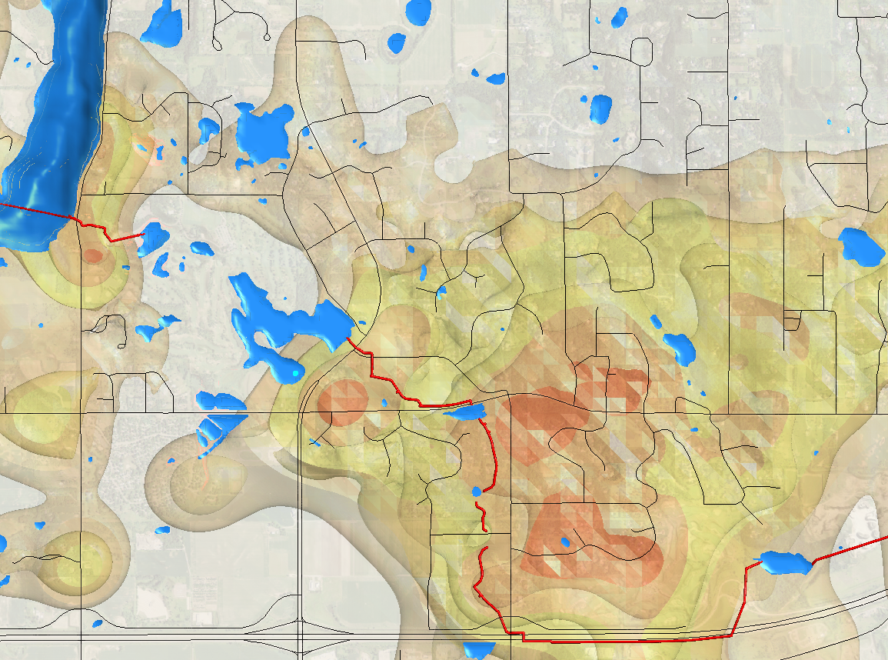

Project 1007 Focused Investigation Progress Report - Segment 6
June 2021 Minnesota Pollution Control Agency
Segment 6 Modeled Groundwater Results: PFOS
Leapfrog
PFOS Plume Map: All Aquifers
Lake Elmo
Sunfish Lake
Horseshoe Lake
WLSS Ponds
Lake Elmo

Slide 16
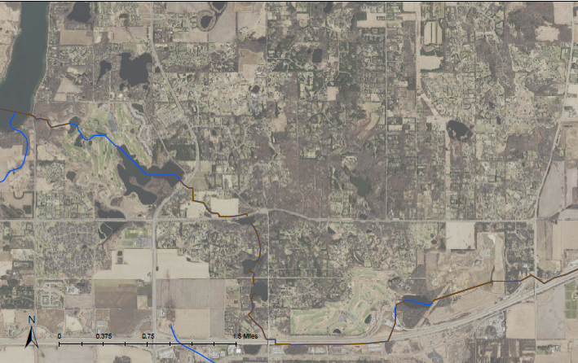
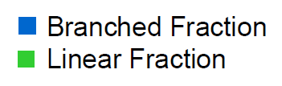
Project 1007 Focused Investigation Progress Report - Segment 6
June 2021 Minnesota Pollution Control Agency
Segment 6 PFOS Forensics: Branched-Linear Analysis
Branched-Linear Results: Surface to Groundwater
PFOS Migration in Groundwater: Branched-Linear Fractions
Several PFAS compounds, including PFOS, are present in the environment in more than one chemical structure type, referred to as linear and branched isomers. Specific to the project corridor, the manufacturing process used by 3M and the subsequent PFOS waste disposed of at the Oakdale Disposal Site and Washington County Landfill was comprised of approximately 30% branched and 70% linear isomer fractions of PFOS (ATSDR, 2008).
Branched and linear isomers migrate at different rates in groundwater, allowing for the determination of the relative distance PFOS travels in water. The linear isomer typically travels slower due to the propensity to become “stuck” in the soil or bedrock. As a result, PFOS in surface water typically has a higher linear fraction, while groundwater has a higher branched fraction. Groundwater that has a nearby surface water input will have a more equal distribution of branched and linear PFOS isomers.
While an exact distance or time traveled in groundwater cannot be determined, the isomer fractions can be compared across the site to identify locations where PFOS-impacted water has more recently migrated from the surface to groundwater, and in turn help identify key areas of infiltration.
Lake Elmo
Surface Water
Beta Site 6
Sunfish Lake
PDC
Jordan
Horseshoe Lake
Beta Site 7
Surface Water
Jordan
Typical Br-L Distributions: Surface vs Groundwater
Lake Elmo
Beta Site 9
Surface Water
Higher Linear Fraction
Groundwater
Higher Branched Fraction
PDC
Equal Distribution
Recent Surface Water Input to Groundwater*
WLSS Ponds
Surface Water
*In surface water, this distribution could be indicative of groundwater discharge.

Slide 17
Project 1007 Focused Investigation Progress Report - Segment 6
June 2021 Minnesota Pollution Control Agency
A Closer Look: Branched-Linear Analysis at WLSS Ponds
Br-L Analysis: WLSS Ponds
Branched Linear Results: Downgradient of WLSS Ponds
In comparison with nearby upgradient wells at BS6 and BS7, the deeper quaternary and PDC wells located downgradient of the WLSS Ponds (i.e., BS9) have relatively higher levels of the linear fraction. The lower linear fraction in bedrock aquifers at BS6 and BS7 suggests that the PFAS-impacted groundwater at those wells has travelled a further distance from the original surface water input than the PFAS-impacted groundwater at BS9.
The deeper quaternary well results at BS9 are nearly identical to that of the nearby surface water. The branched fraction at the BS9 PDC well is slightly higher than that of the overlying quaternary unit, likely due to groundwater mixing and the greater distance from the surface.
WLSS Pond Sample
Horseshoe Lake
BS7
16-20’ Quaternary Sample
Groundwater
40-80’ bgs Clay
Confining Unit
Surface Water
BS9
WLSS Ponds
90-100’ Quaternary Well
Typical Br-L Distributions
Surface Water
Recent Surface Water Input
Groundwater
140-150’ PDC Well

Slide 18
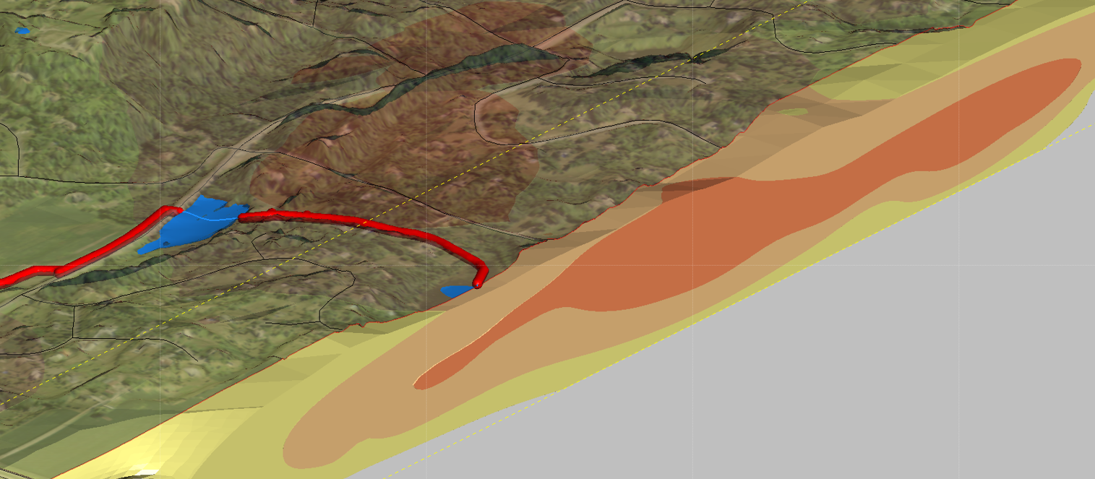
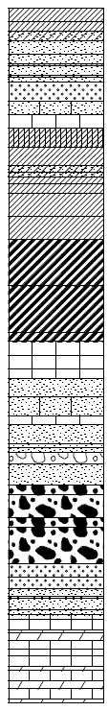
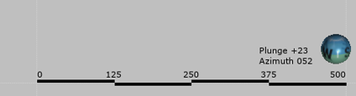
Segment 6 | Project 1007
Minnesota Pollution Control Agency
Project 1007 Focused Investigation Progress Report - Segment 6
June 2021 Minnesota Pollution Control Agency
Preferential PFAS Pathway: WLSS Ponds to the Subsurface
Beta Site 9: Surface to Subsurface
BS9 is positioned within a narrow bedrock valley just east of Middle Pond, resulting in a nearly 130-foot thick quaternary unit.
The quaternary interval consists of a perched sandy shallow aquifer, a 40-ft thick clay confining unit, and a second gravel and sand aquifer unit. The deeper quaternary aquifer has higher PFAS impacts than those of the shallow aquifer and is much closer in concentration to those of the adjacent surface water bodies. In addition, the branched-linear results from the perched, shallow quaternary aquifer have a higher branched fraction. These data results suggest a connection of the deeper quaternary and PDC units to surface water and could be a preferential PFAS flow path from the WLSS Ponds to the subsurface.
The similarities between the deep quaternary and the PDC groundwater may indicate a vertical pathway from the quaternary sediments into the PDC unit and subsequently into the Jordan aquifer.
Legend
PFOS (ppb)
BS9: Branched-Linear Results
Suspected PFAS Flow Path
Surface Water Sample
Groundwater Sample
Branched Fraction
Linear Fraction
Surface Water:
0.15 ppb
Shallow Quaternary:
0.00105 ppb
North Pond
Neal Ave
BS9
0.14 pbb
0.00105 pbb
Deep Quaternary:
0.111 ppb
Middle Pond
0.111 pbb
Midwest Trail N
0.15 pbb
0.101 pbb
PDC Bedrock:
0.101 ppb
Leapfrog
PFOS Modeled Plume Map

Slide 19
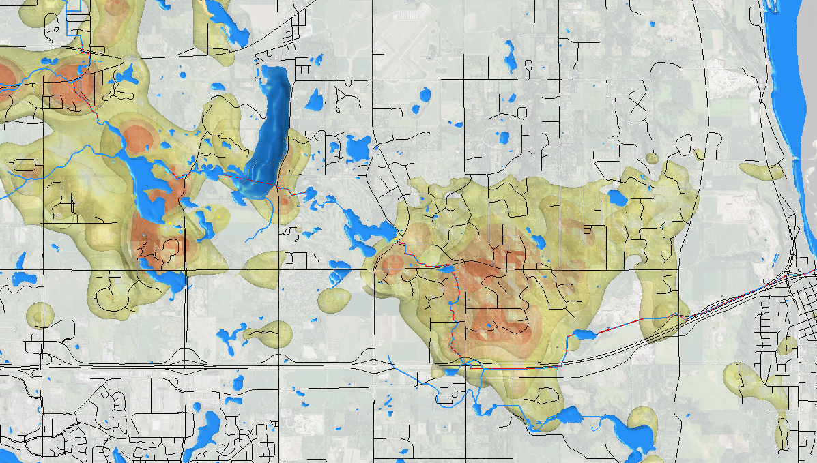
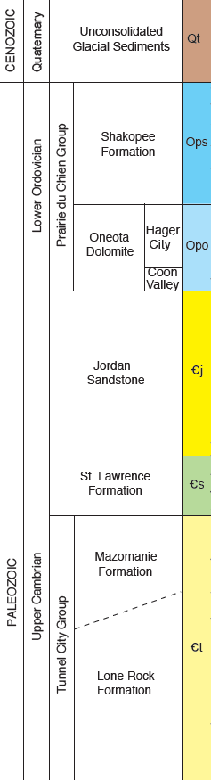
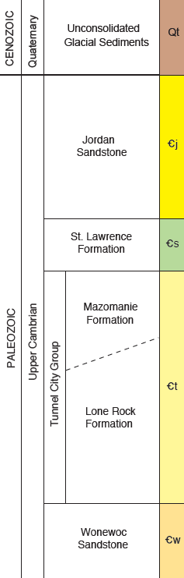
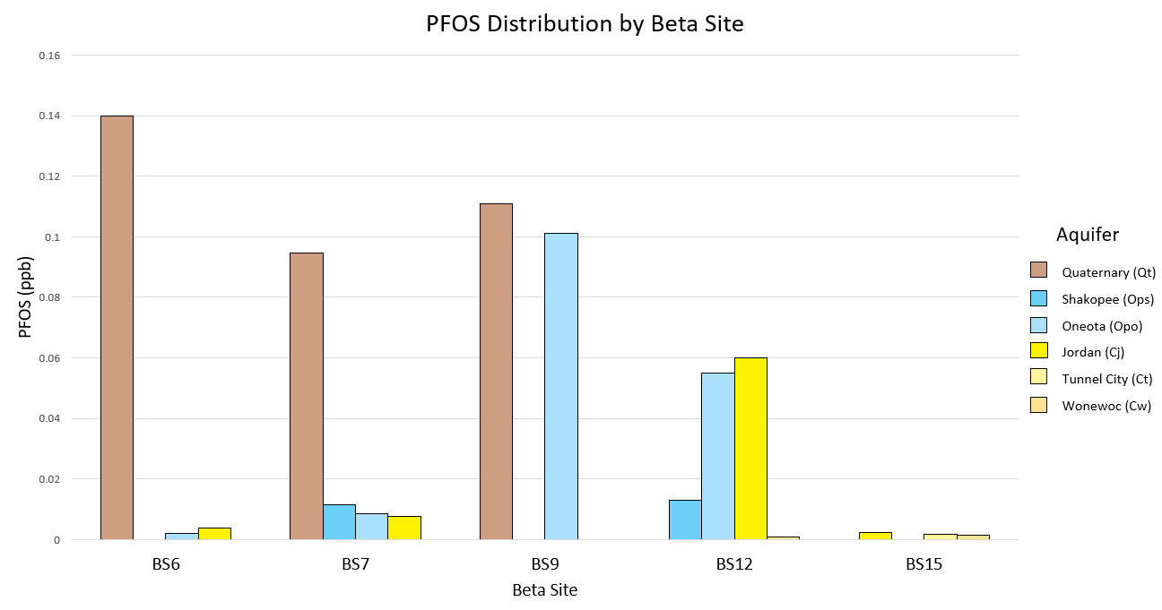
Project 1007 Focused Investigation Progress Report - Segment 6
June 2021 Minnesota Pollution Control Agency
Segment 6 Beta Site Review: PFOS from Lake Elmo to St. Croix River
Leapfrog
PFOS Modeled Plume Map: All Aquifers
Pre-Fault Bedrock Stratigraphy
Post-Fault Bedrock Stratigraphy
BS6
Cottage Grove Fault
BS7
BS9
BS15
Cottage Grove Fault
BS12
PFOS in Groundwater – Segment 6 Beta Sites
Pre-Fault
Post-Fault
Cottage Grove Fault
Groundwater Impacts: BS6 to BS15
From Lake Elmo to the St Croix River, PFAS impacts in groundwater reduce significantly across all aquifers in Segment 6 with groundwater results at least an order of magnitude below applicable regulatory standards for drinking water. The role the Cottage Grove Fault plays in PFAS impacts is not well understood. However, currently available data suggests the PFAS plume in the subsurface is not present east of the fault.
Ops not
observed
Ops not
observed
Cj not
sampled
*

