Slide 1
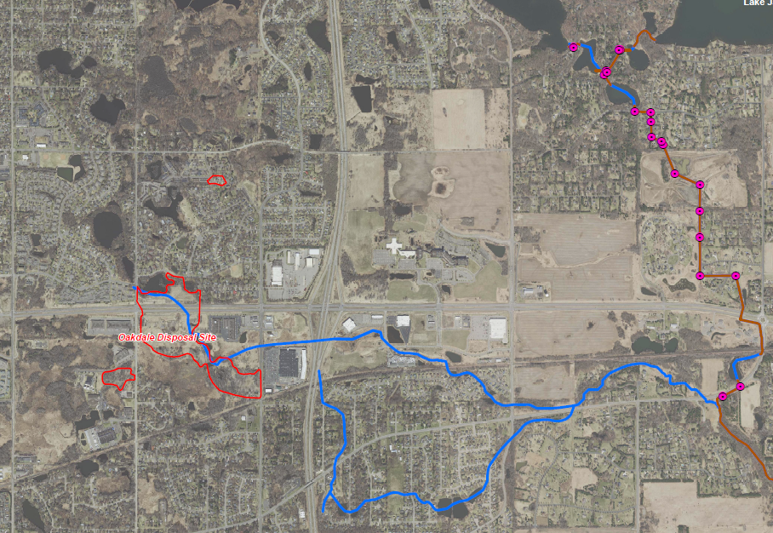
Project 1007 Focused Investigation Progress Report - Segment 2
June 2021 Minnesota Pollution Control Agency
Historic and Current Surface and Ground Water Flow from ODS
Oakdale Disposal Site History
From the early 1950’s through to present day, the 3M facility in Cottage Grove, Minnesota has produced commercial products containing PFAS compounds. Both liquid and solid wastes generated from the perfluorochemical production process were disposed of at the production facility in Cottage Grove as well as several other disposal sites including the Oakdale Disposal Site (ODS).
ODS, which consists of three disposal areas, Eberle (approximately 2 acres), Brockman (approximately 5 acres), and Abresch (approximately 55 acres), accepted a variety of industrial wastes from the late 1940’s until the 1960’s. From 1956 until 1960*, the three areas received PFAS-containing wastes, with the Abresch location receiving the majority of the waste. Waste disposal methods included but were not limited to shallow burial of loose waste; trench burial of PFAS waste-containing drums, pails, and barrels; and open burning.
In the 1980’s, following the detection of VOC-impacted shallow groundwater, portions of the disposal areas were excavated, contaminated materials and soils were disposed of offsite, and 39 multi-aquifer wells were sealed. In addition, a 12 well pump-out system was installed at ODS.
In 2010, in response to the reported PFAS impacts, the pump-out system was expanded to 24 wells. However, PFAS impacts in the subsurface had already migrated far beyond the original boundaries of the VOC-impacted area into Lake Elmo and West Lakeland. In addition, Raleigh Creek continues to flow through ODS and is likely the primary current and historic surface PFAS migration pathway.
Preferential PFAS Pathways
Received Industrial Waste
Remedial Activities for VOC-Related Impact
(excavation, well abandonment, well pump-out system)
Activities at ODS
Received PFAS- Containing Waste*
Expansion of Pump-Out System to 24 Wells
  Legend
  Known Surface Water Flow Path
  Potential Historic Runoff Direction
  Known Historic Groundwater Infiltration (possibly still occurring)
1940
1956
1960
1980
1985
2010
Present
Preferential PFAS Pathways
Groundwater Infiltration into Deeper Aquifers
*1956-1960 is an approximate determination of the date range waste was received
Surface Water via Raleigh Creek

Slide 2
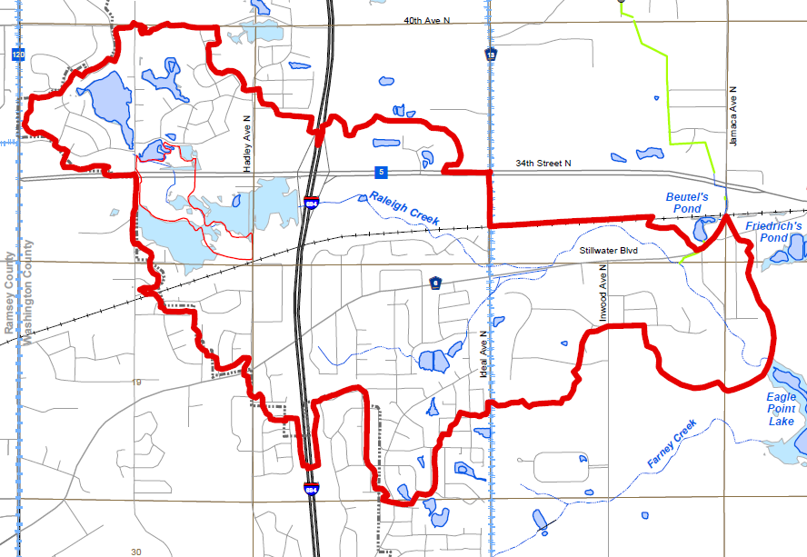
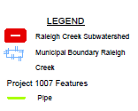
Project 1007 Focused Investigation Progress Report - Segment 2
June 2021 Minnesota Pollution Control Agency
Introduction: Segment 2 Surface Water System
Surface Water Flow Path
The primary surface water flow path in Segment 2 is Raleigh Creek, the headwaters of which is immediately northwest of the former Oakdale Disposal Site (ODS).
Raleigh Creek flows west to east and passes through a series of wetlands and small ponds. These wetlands and ponds have PFAS impacts in sediment that is likely contributing to surface water impacts and infiltrating into the subsurface.
Between ODS and Ideal Avenue, the creek flow is perennial, though much of the creek freezes in the winter months. Raleigh Creek flow downstream of Ideal Avenue is restricted due to the culvert elevations and flood mitigation structure at the intersection of Raleigh Creek and the road. Between Ideal Avenue Wetland Complex (IAWC) and Tablyn Park, Raleigh Creek is dependent on precipitation and as a result is routinely dry.
The combination of the restricted downstream flow and the ponds naturally present at IAWC, make the wetland complex uniquely suited to facilitate the infiltration of PFAS-impacted surface waters from ODS into the subsurface.
After the confluence with the Project 1007 conveyance system at Tablyn Park, Raleigh Creek continues to the southeast to the Lake Elmo Park Reserve and discharges to the northwestern inlet to Eagle Point Lake. Due to the continual input from P1007, this portion of Raleigh Creek is perennial.
Oakdale Disposal Site
Intermittent Flow
Continuous Flow
Continuous Flow

Slide 3
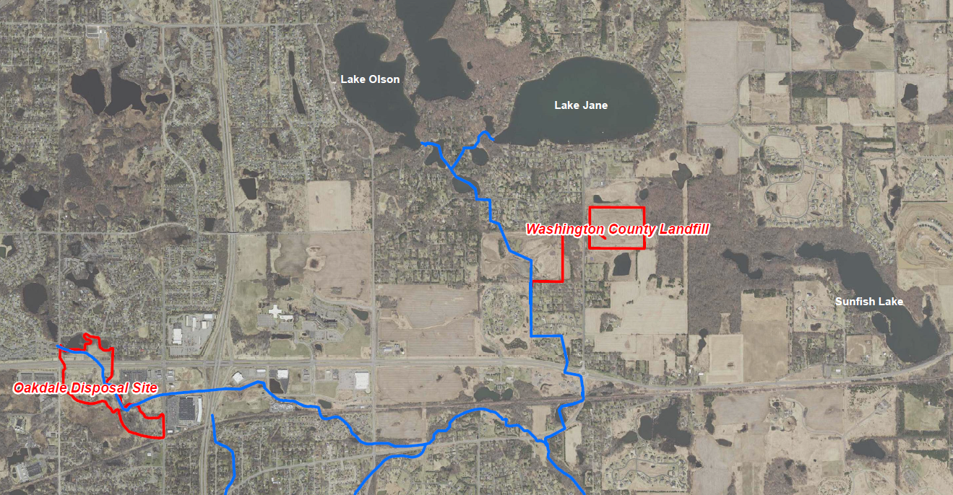

Project 1007 Focused Investigation Progress Report - Segment 2
June 2021 Minnesota Pollution Control Agency
Comparison of Two Source Areas: Oakdale Disposal Site V.S. WCL
Disposal Site-Specific PFAS-Containing Waste
The Oakdale Disposal Site (ODS) accepted liquid and solid industrial waste, while the Washington County Landfill (WCL) accepted a variety of industrial and wastewater treatment plant waste. The PFAS contamination associated with these two historic waste streams is made up of different PFAS compounds, resulting in a PFAS “signature” that may be unique to each source area.
The PFAS signature associated with ODS is generally PFOS-dominant, while the PFAS signature from WCL is generally PFBA-dominant. As a result, analysis of the PFBA:PFOS ratio or the relative distribution of key compounds can be used to evaluate a possible PFAS source contribution at different locations.
Locations that are not associated with either ODS or WCL impacted waters may have a similar PFAS signature; however, the concentrations of all compounds will be significantly lower. This may be a result of widespread anthropogenic use of PFAS and atmospheric deposition
PFAS Distribution by Source Area
WCL PFAS Signature
ODS PFAS Signature
Low Concentration Widespread PFAS
Typical PFAS Distribution: ODS vs WCL
ODS
PFOS-Dominant
WCL
PFBA-Dominant
Low Concentration Widespread PFAS*
Future Chemometrics Forensic Analysis
By applying multivariate statistical tools such as principal component analysis, hierarchical clustering, and logarithmic transformations to chemistry data using PFAS Chemometrics as a forensics tool, potential source area signatures can be identified and separated by subtle variations to provide powerful forensic interpretations. This will aid in future understanding of partitioning, fate and transport and source mixing.
Future data analysis will use the above tools to refine the CSM and develop a deeper understanding of how PFAS is behaving in the surface and subsurface features of Project 1007.
*Key difference between unknown anthropogenic source and WCL is the concentrations.

Slide 4
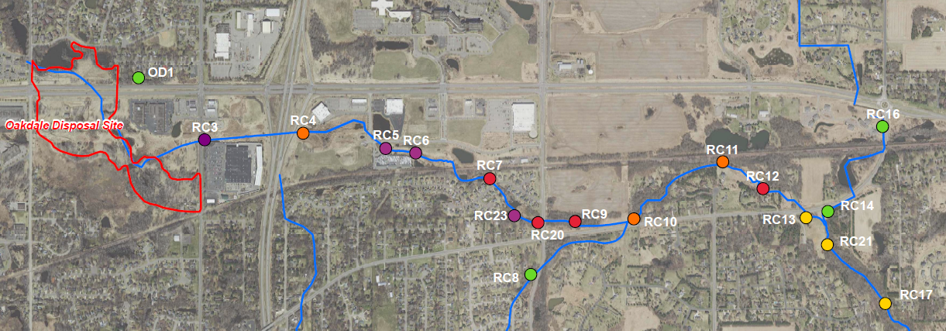
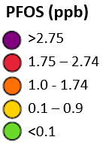
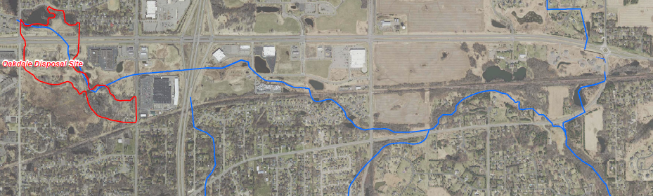
Project 1007 Focused Investigation Progress Report - Segment 2
June 2021 Minnesota Pollution Control Agency
Surface Water Results: PFAS
PFOS Heat Map:
Raleigh Creek 2019-2021
Surface Water Flow Path
Finding: Overall, PFOS concentrations are the highest closest to ODS and decrease steadily the farther away from the source area. Locations with the lowest PFOS concentrations in Segment 2 do not directly receive discharge from ODS (OD1, RC8, RC16, and RC14).
In addition to overall lower PFOS concentrations, locations that are not hydrologically connected to ODS have a distinctly different distribution of PFAS compounds as compared to Raleigh Creek. Impacts at these locations more likely reflect background PFAS impacts rather than a known source.
**Further assessment of the southeastern tributary of Raleigh Creek (i.e., upstream of RC8) is planned for the near future.
Typical PFAS Distributions
PFAS Distribution Map:
Raleigh Creek 2019-2021
ODS
PFOS-Dominant
WCL
PFBA-Dominant
Low Concentration Widespread PFAS*
*PFBA-Dominant and low concentrations

Slide 5
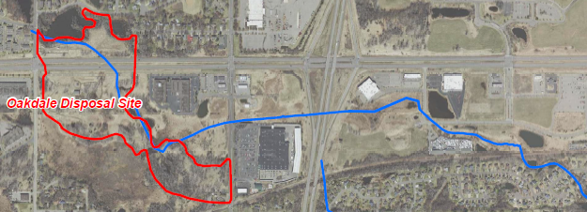



Project 1007 Focused Investigation Progress Report - Segment 2
June 2021 Minnesota Pollution Control Agency
Surface Water Results: Seasonal Variation in PFAS at Source
Spring
Summer
Winter
RC3
Fall
RC7
Finding: PFOS and PFOA fluctuate inconsistently following precipitation events.
Potential causes of this variability in response to rain events is discussed below.
Farther away from the source area along Raleigh Creek, this variability in PFAS concentrations continues. However, the amount of fluctuation appears to be less with greater distance from the source area.
Spring
Winter
Summer
Fall
175 Feet Downstream of ODS
Decrease in PFAS Factors
Addition of rain to surface water
Addition of surface runoff from other unimpacted locations (i.e., roadways, parking lots, etc.)
Frequency, Duration, and Amount of Rainfall
Increase in PFAS Factors
Release of PFAS trapped from surficial sediments at ODS.
Connection of otherwise disconnected PFAS-impacted waters (i.e., isolated wetlands, small ponds, etc.)
Frequency, Duration, and Amount of Rainfall
5,000 Feet Downstream of ODS

Slide 6
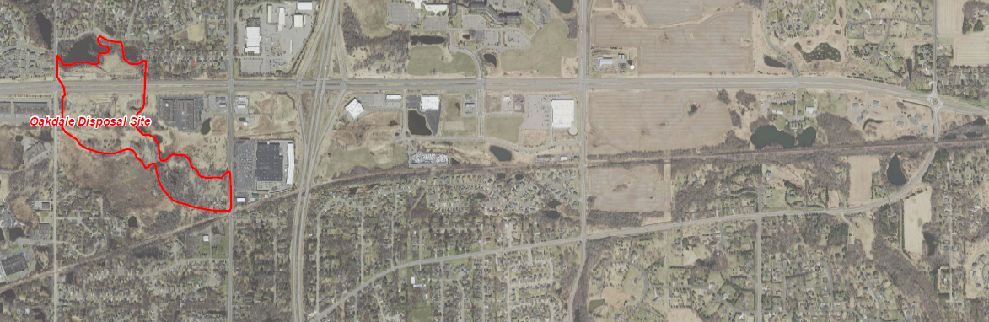
Project 1007 Focused Investigation Progress Report - Segment 2
June 2021 Minnesota Pollution Control Agency
Raleigh Creek Flow Path Morphology
High Flow Conditions
During high flow conditions, either due to a precipitation event or sustained intermittent rain events, surface water in Raleigh flows uninterrupted from ODS to the confluence with the P1007 Conveyance. Surface flow downstream of the confluence continue southeast to Lake Elmo Park Reserve into Eagle Point Lake.
Finding: A continuously flowing Raleigh Creek not only allows for the transport of PFAS-impacted waters downstream into other water bodies but also potential infiltration of PFAS-impacted waters between Ideal Ave and Tablyn Park.
Raleigh Creek Flow Path: High Flow Conditions
Hight Flow Exiting ODS
Connected Raleigh Creek
P1007 Conveyance
IAWC
Confluence
Low Flow Conditions
During dry periods, either due to lack of sufficient precipitation or winter freezing, flow from ODS along Raleigh Creek does not continue east of the IAWC. The IAWC ponds are regularly the extent of the perennial portion of Raleigh Creek partially due to the culvert elevations and flood control structure that inhibits flow from exiting IAWC below a certain elevation.
Finding: The effect of a disconnected Raleigh Creek is not only the restriction of downstream transport of PFAS-impacted waters to other water bodies, but also the facilitation of possible infiltration from the Ideal Avenue Wetland Complex into the subsurface.
Low Flow Exiting ODS
Disconnected Raleigh Creek
P1007 Conveyance
Raleigh Creek Flow Path: Low Flow Conditions
IAWC
Confluence

Slide 7
Project 1007 Focused Investigation Progress Report - Segment 2
June 2021 Minnesota Pollution Control Agency
Surface Water Results: PFOS Variation due to Flow Conditions
High Flow Exiting ODS
High Flow: Rain Event May 2020
PFOS Fluctuation
Variations in PFOS concentrations in surface water are influenced, in part, by the amount of flow leaving ODS.
Finding: Greater variation occurs within close proximity to ODS (RC3), while with increased distance from the source area, PFOS in Raleigh Creek appears to remain largely stable.
At the confluence with P1007 (RC21), PFOS concentrations are much higher in high flow conditions.
Connected Raleigh Creek
RC3
RC7
RC12
RC22
(north pond)
Notes
RC14
The circles represent relative concentrations of PFOS at locations along Raleigh Creek under high and low flow conditions.
← Size represents 1 ppb PFOS
RC23
(south pond)
RC21
Low Flow Exiting ODS
Low Flow: Quarterly Event September 2020
Surface Water Flow Path
High flow conditions either due to seasonality or precipitation events can allow for two key hydrologic occurrences in Segment 2:
Increase in PFAS-impacted water exiting ODS and entering Raleigh Creek.
Connection of Raleigh Creek east of Ideal Avenue, allowing for the transport of PFAS-impacted waters downstream.
RC3
Disconnected Raleigh Creek
RC7
RC22
(north pond)
RC12 (DRY)
RC14
RC23
(south pond)
RC21

Slide 8
Project 1007 Focused Investigation Progress Report - Segment 2
June 2021 Minnesota Pollution Control Agency
Surface Water Results: Distribution of PFAS Compounds in Varying Flow Conditions
High Flow Exiting ODS
High Flow: Rain Event May 2020
Typical PFAS Distributions
ODS
PFOS-Dominant
RC3
WCL
PFBA-Dominant
RC7
Connected Raleigh Creek
RC12
RC14
Low Concentration Widespread PFAS
RC22
(north pond)
RC23
(south pond)
RC21
*PFBA-Dominant and low concentrations
PFAS Distribution
Finding: During high flow conditions, Raleigh Creek is fully connected between ODS and the Confluence resulting in a PFOS-dominant signature throughout the creek. During low flow conditions, the system is completely cuts off downstream of Ideal Ave. Where water is still present (i.e., downstream of Tablyn Park), the PFAS signature shifts completely to a PFBA-dominant signature with low concentrations as is similar to that in the Tri-Lakes (as demonstrated at RC21).
Low Flow Exiting ODS
RC3
Disconnected Raleigh Creek
RC7
RC14
RC22
(north pond)
RC23
(south pond)
RC21
Low Flow: Quarterly Event September 2020

Slide 9
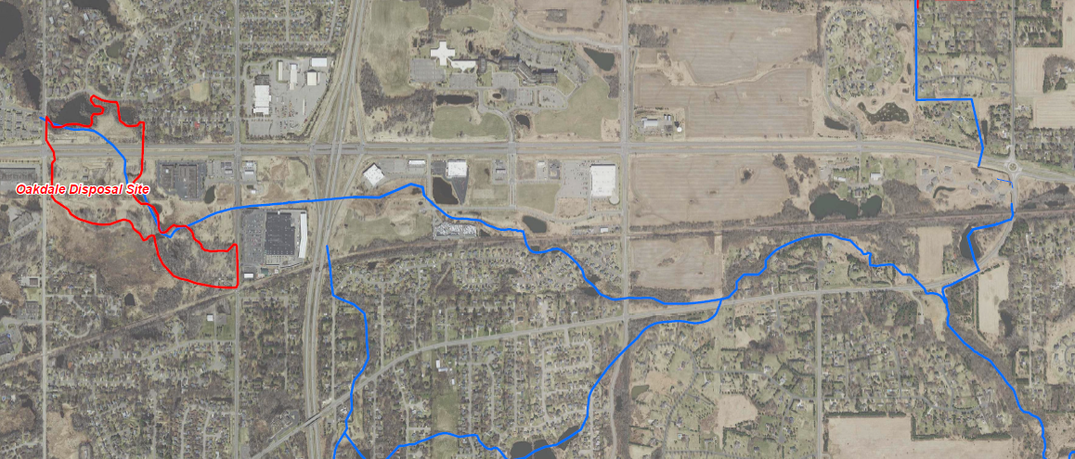
Project 1007 Focused Investigation Progress Report - Segment 2
June 2021 Minnesota Pollution Control Agency
Historic Surface Water Sampling in Raleigh Creek: 2010-2020
Historic Sampling at Segment 2
In 2010, a well pump-out system at ODS was expanded from a system of 12 wells to 24 in an effort to control the release of PFAS-impacted waters from ODS. Prior to this expansion, surface water sampling was conducted once in 2006 by 3M. Since the expansion in 2010, several locations downstream of ODS have been sampled on a routine basis by 3M. Five of these locations, RC3, RC5, RC7, RC10, and RC13, correspond with surface water locations also sampled by AECOM in 2019 and 2020 and are presented in the map below.
Note: AECOM sample IDs RC3, RC5, RC7, RC10, and RC13 correspond to 3M sample locations SW01, SW12, SW13, SW14, and SW15, respectively.
Historic Surface Sample Locations
RC3
RC5
RC7
RC10
RC13

Slide 10
Project 1007 Focused Investigation Progress Report - Segment 2
June 2021 Minnesota Pollution Control Agency
Historic Surface Water Trends Over Time: PFOS
MAX: Jun 2006
(RC7)
2006 Pre-Pumpout Well Expansion Analysis
According to data provided by MPCA, the first surface water sampling event in 2006 identified PFOS concentrations in Raleigh Creek ranging from 0.2 ppb at RC13 (1.9 miles downstream of ODS) to 8 ppb at RC3 (175 feet downstream of ODS).
RC7 and RC10 – highest historical PFOS concentrations reported in 2006
RC3, RC5, and RC13 – highest historic PFOS concentrations reported after 2006
RC3 (closes to ODS) – highest historic PFOS concentration reported in 2020
Jun-06
Expansion of Pump-out System
MAX: Jun 2014 (RC5)
MIN: Mar 2012
MAX: Jun 2006
(RC10)
Jun-06
Jun-06
MAX: May-2020
Expansion of Pump-out System
Expansion of Pump-out System
MIN: Jul & Nov 2017
MAX: Jun 2013
(RC13)
MIN: Jul-2017
2011-2020 Post-Pumpout Analysis: RC3
The maximum PFOS concentration at RC3, the closest sampling point to ODS, was reported in May of 2020. According to Man-Kendall Analysis (run by AECOM for post-expansion data only), since the expansion of the pump-out system in 2010, RC3 has not seen a statistically significant decreasing trend.
2011-2020 Post-Pumpout Analysis: RC5, RC7, RC10, RC13
According to Man-Kendall Analysis (run by AECOM for post-expansion data only), since the expansion of the pump-out system in 2010, none of the above locations have seen a statistically significant decreasing trend. While the maximum recorded PFOS at RC7 and RC10 was in 2006, maximum PFOS at RC5 and RC13 were measured in 2014 and 2013, respectively.

Slide 11
Project 1007 Focused Investigation Progress Report - Segment 2
June 2021 Minnesota Pollution Control Agency
Historic Surface Water: Available Data
Current Surface Sample Locations
MAX: Jun 2006
(RC7)
Jun-06
Expansion of Pump-out System
MAX: Jun 2014 (RC5)
RC3
RC5
RC7
RC10
RC13
MIN: Mar 2012
MAX: Jun 2006
(RC10)
Jun-06
Jun-06
MAX: May-2020
Expansion of Pump-out System
Expansion of Pump-out System
MIN: Jul & Nov 2017
MAX: Jun 2013
(RC13)
MIN: Jul-2017
Surface Water Data at ODS
At the current time, the only surface water data available is from downstream of the Oakdale Disposal Site (ODS). In 2020, surface water samples were collected within the original extent of ODS. Once that data has been made available, it will be reviewed in conjunction with the downstream data.

Slide 12
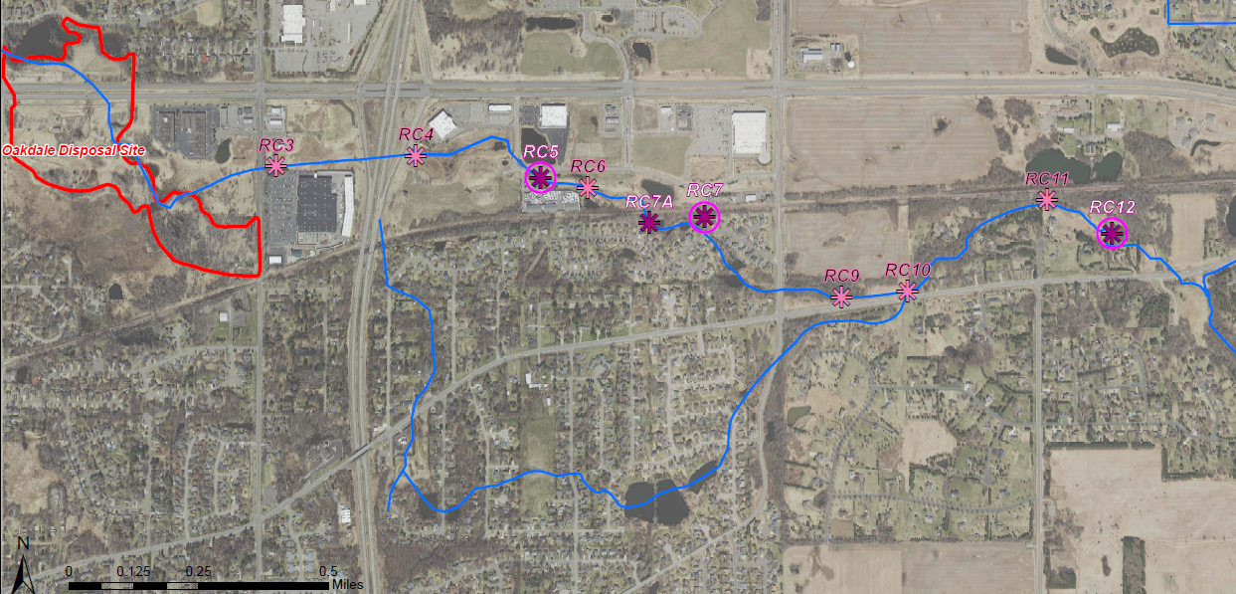
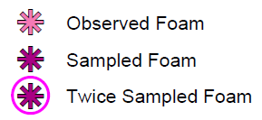
Project 1007 Focused Investigation Progress Report - Segment 2
June 2021 Minnesota Pollution Control Agency
Foam in Segment 2
Observed and Sampled Foam Locations

Slide 13
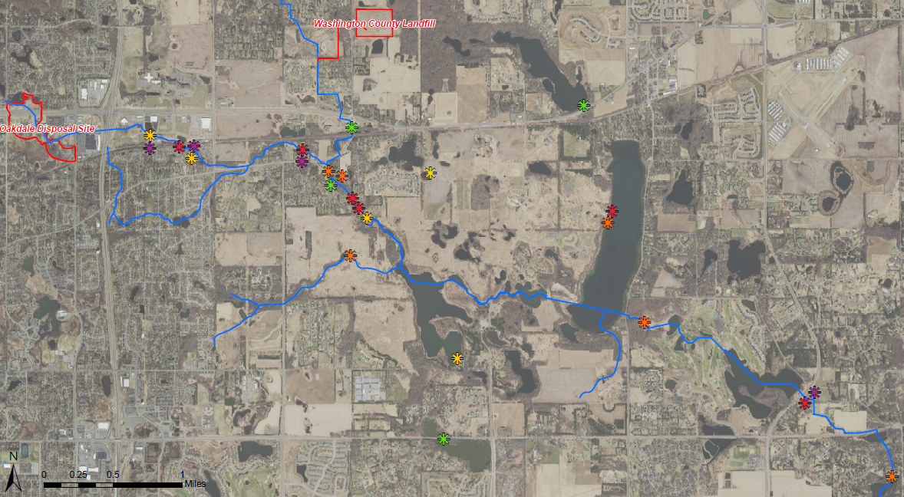
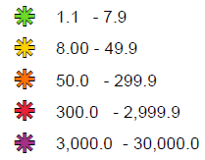

Project 1007 Focused Investigation Progress Report - Segment 2
June 2021 Minnesota Pollution Control Agency
Site-Wide Foam Results: PFOS
PFOS Heat Map: Foam
Legend
PFOS (ppb)
Segment 2
Circled symbols denote repeat foam sample locations
Foam in Segment 2
Foam has been routinely observed along Raleigh Creek in Segment 2. The locations with foam and types of foam observed are variable, largely depending on flow conditions.
PFOS in foam in Segment 2 is generally higher when compared to the other locations in the corridor.

Slide 14
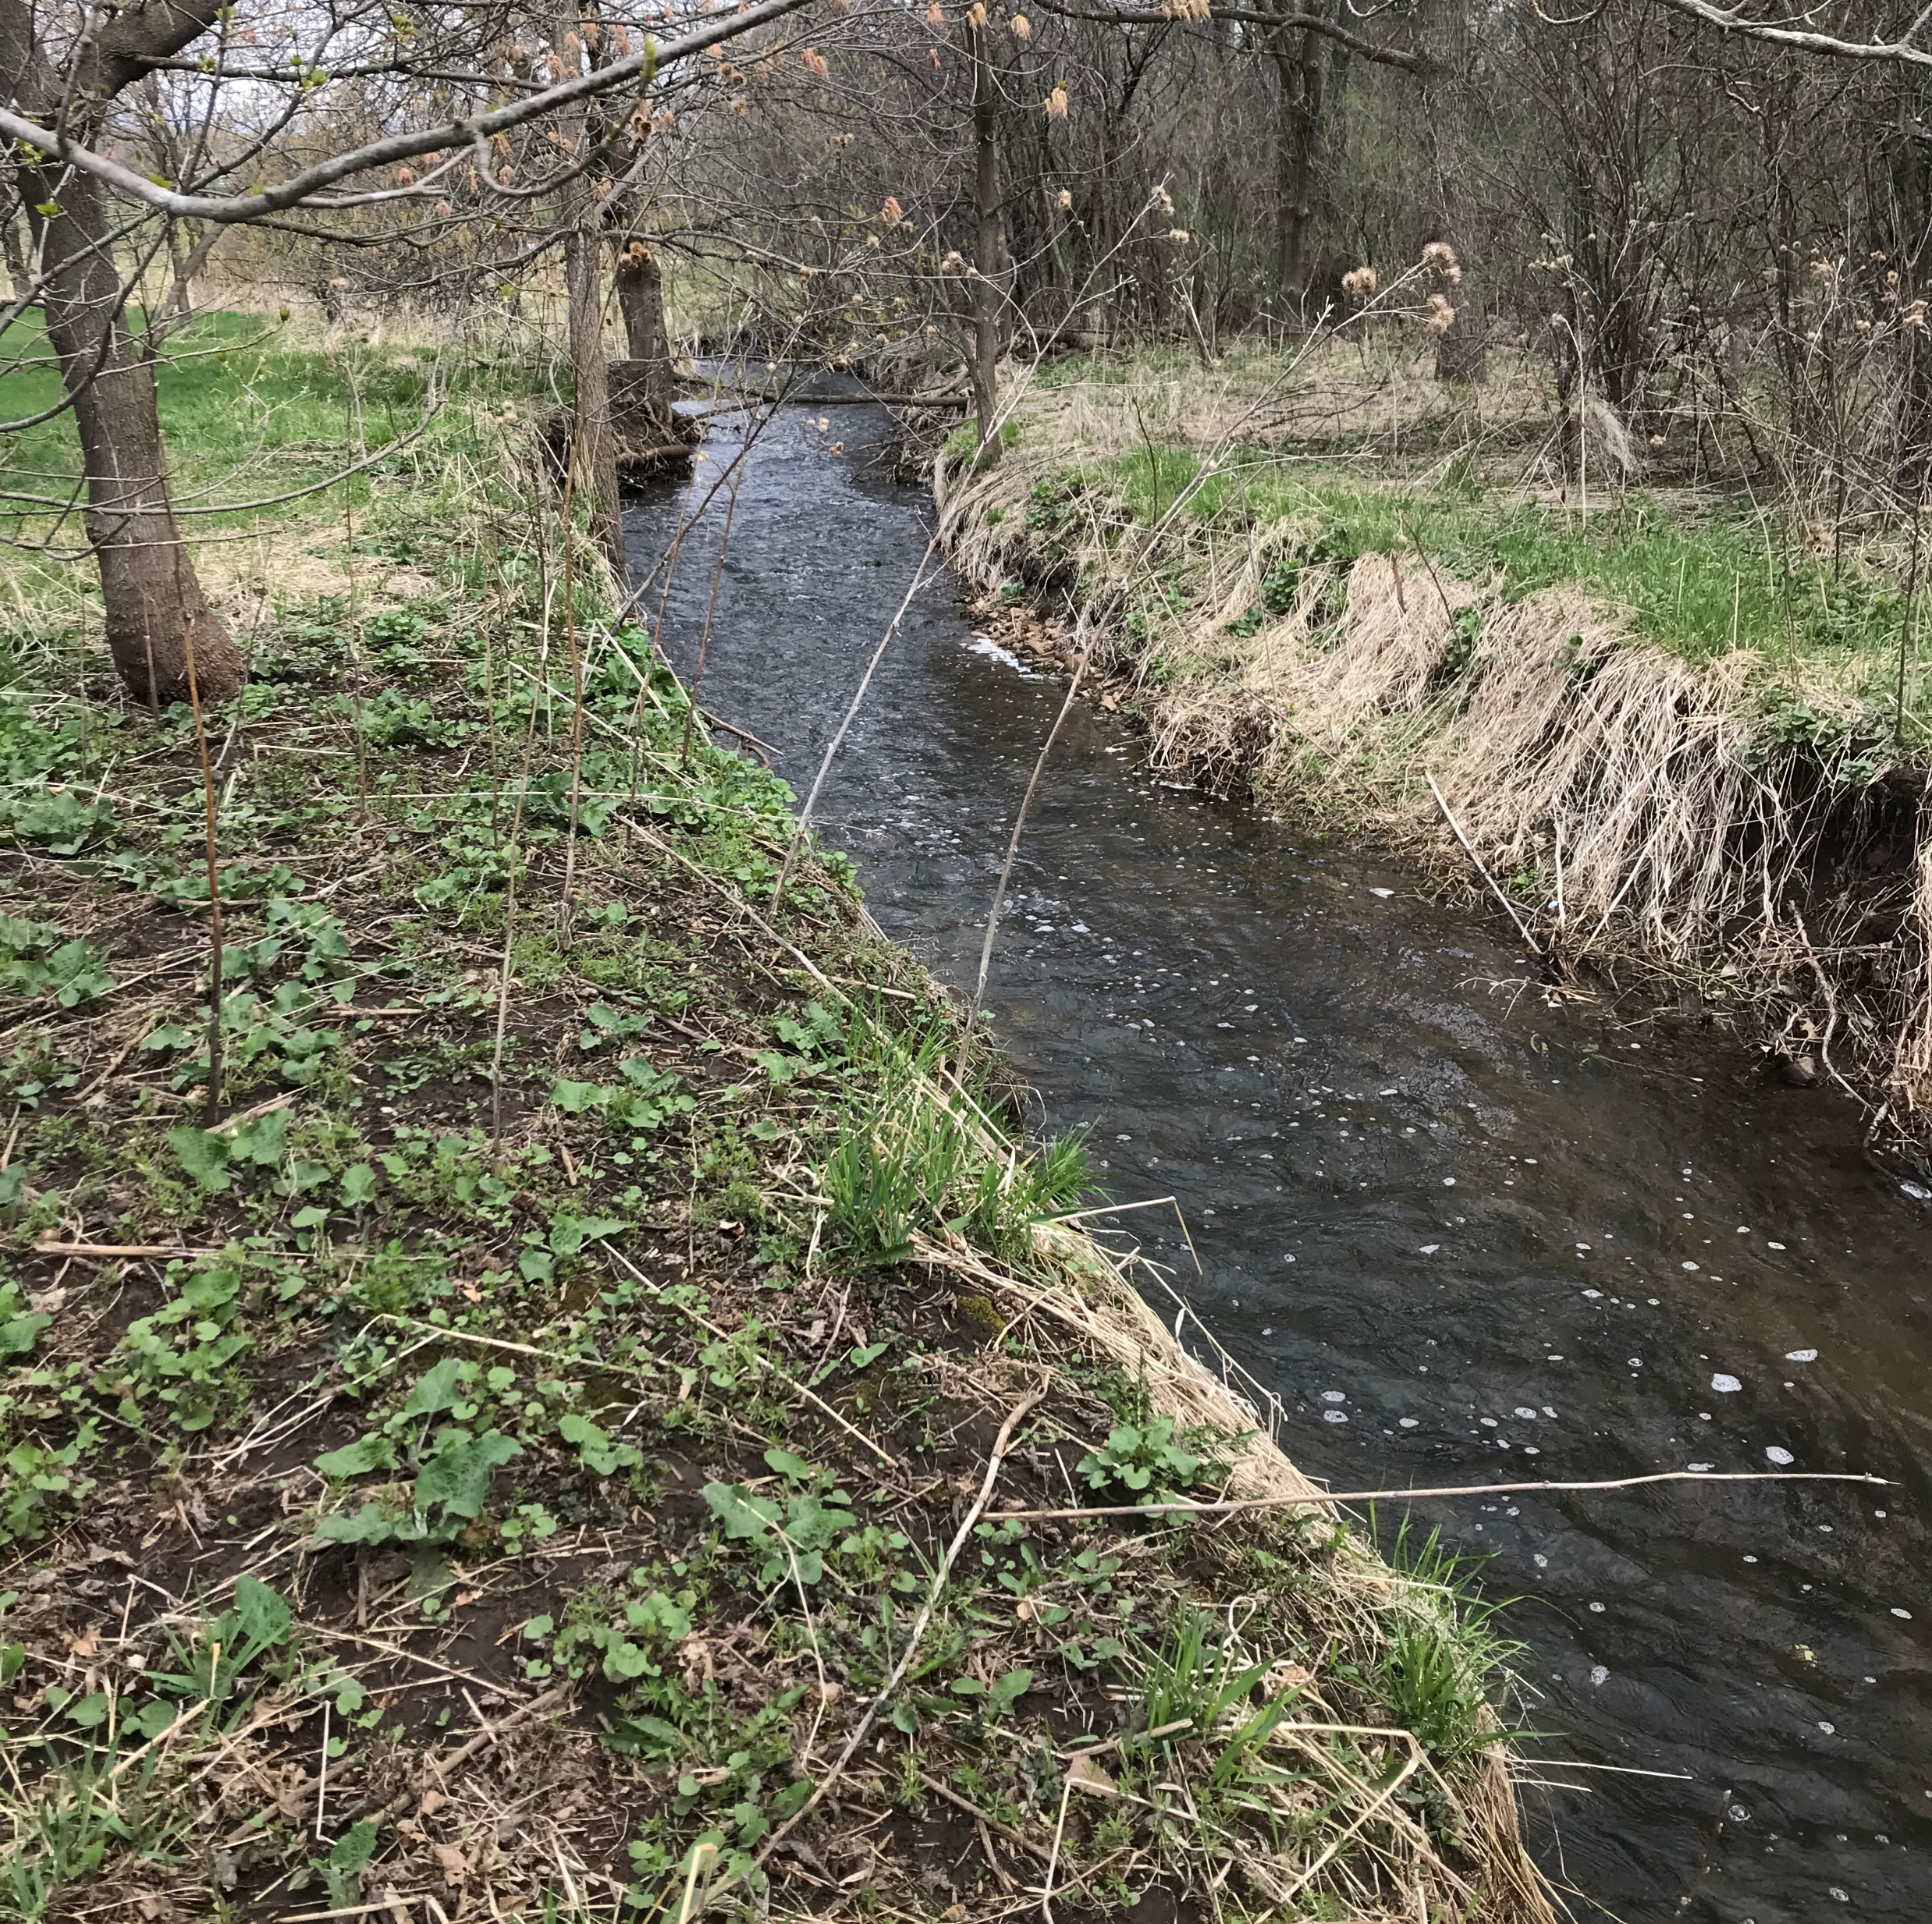
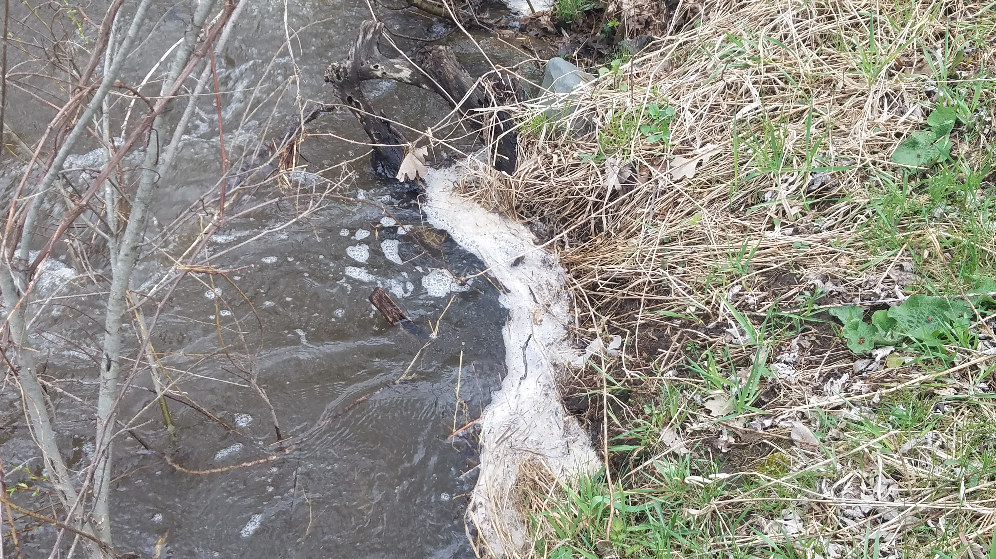
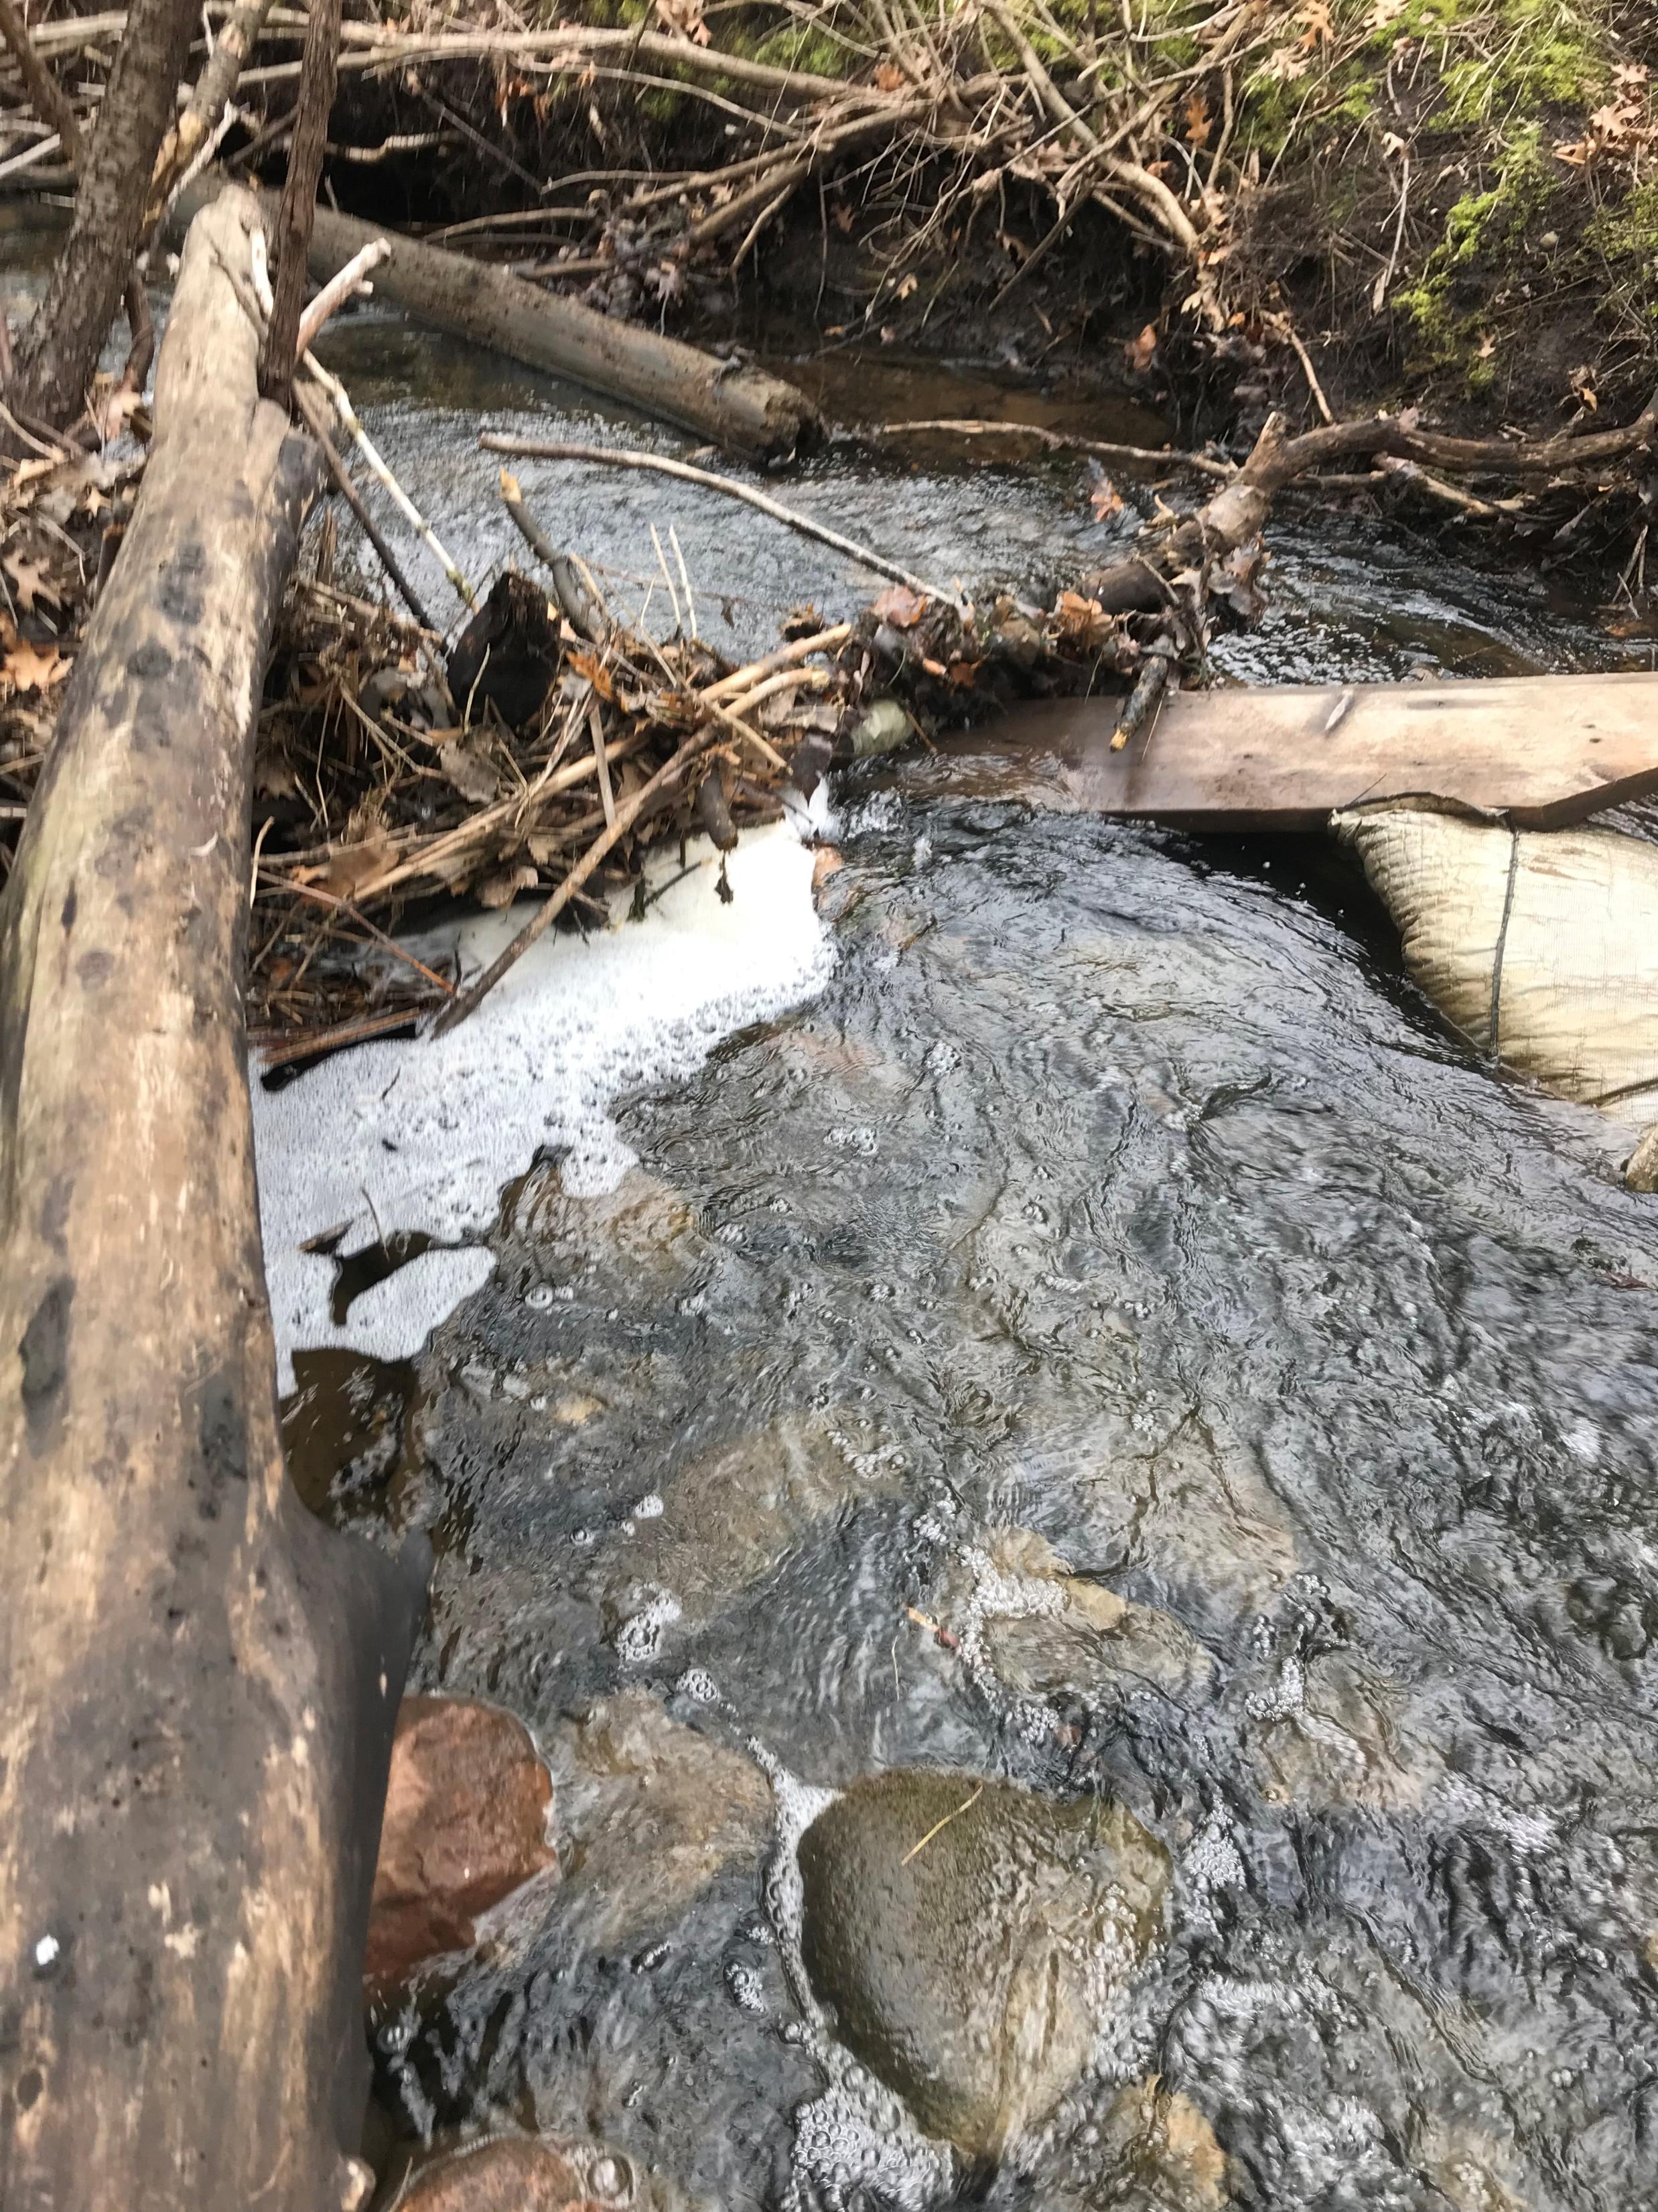
Project 1007 Focused Investigation Progress Report - Segment 2
June 2021 Minnesota Pollution Control Agency
Foam Formation in Raleigh Creek
Requirements for PFAS-Containing Foam Formation and Accumulation
Turbulence
Air must be mixed into the water column for foam to form. In Segment 2, this is most often caused by water flowing over rocks, trees, or other debris in the stream. The water level greatly affects the locations of turbulence.
Solid Substrate for Foam to Accumulate Against
After generation, the foam bubbles must have a solid substrate in relatively calmer water to accumulate along or against. Without accumulation, the foam bubbles will condense back into the stream. In Segment 2, foam was found to accumulate along the stream banks, debris, blocks of ice, and vegetation growing in the stream channel.
PFAS Concentrations in Surface Water
Foam will naturally form regardless of the presence of PFAS. However, it is not well understood the presence of PFAS in water affects foam formation. It is also not well understood how much PFAS will preferentially separate (enrich) into the foam relative to the PFAS in the corresponding surface water.
Shallow water flowing over rocks in the channel created turbulence and foam bubbles in Raleigh Creek.
Accumulated foam observed against debris in the stream channel and along the stream bank. The foam piles tend to be smaller in Segment 2 than those observed elsewhere.

Slide 15
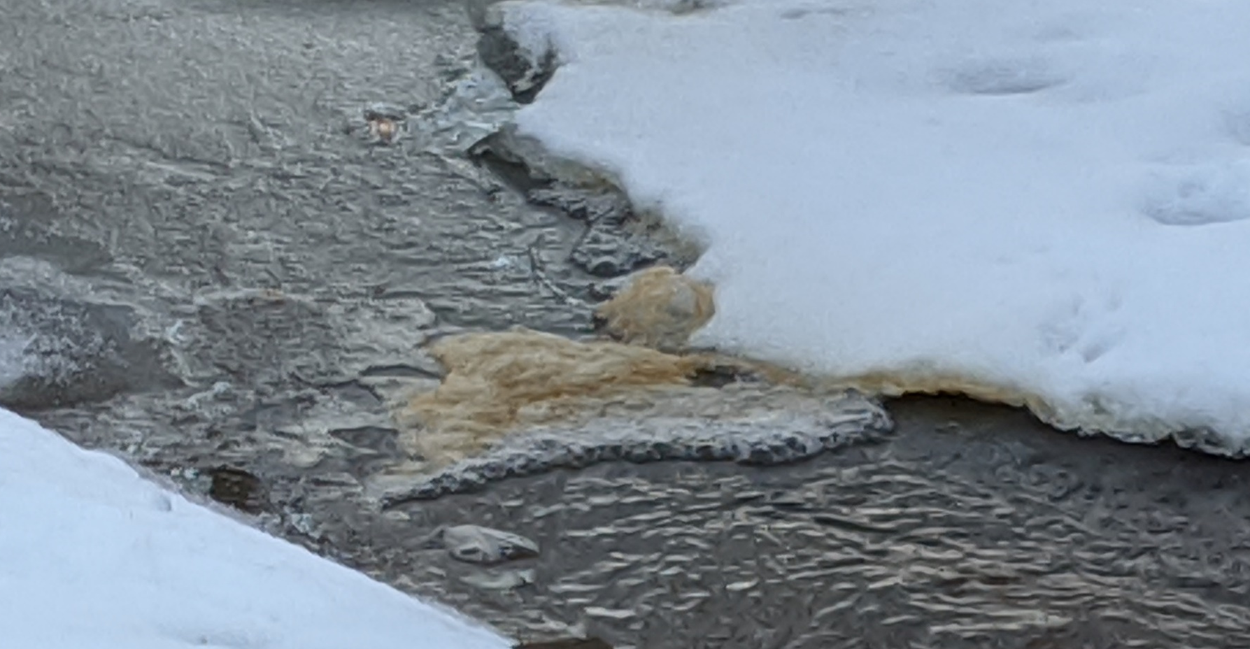
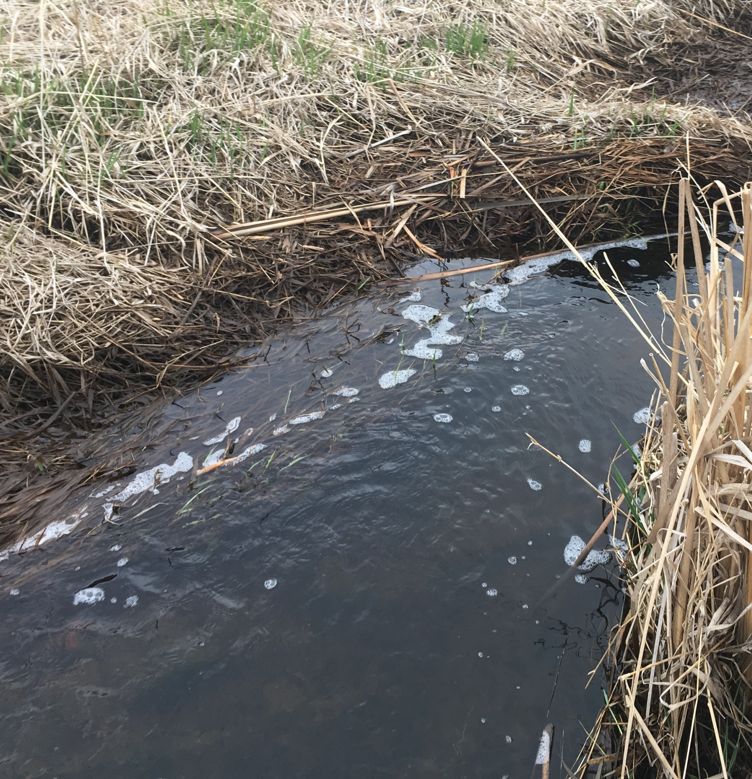
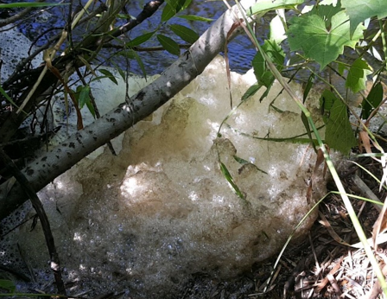
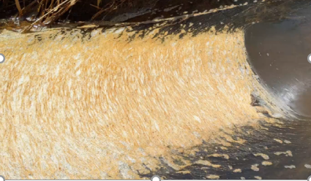
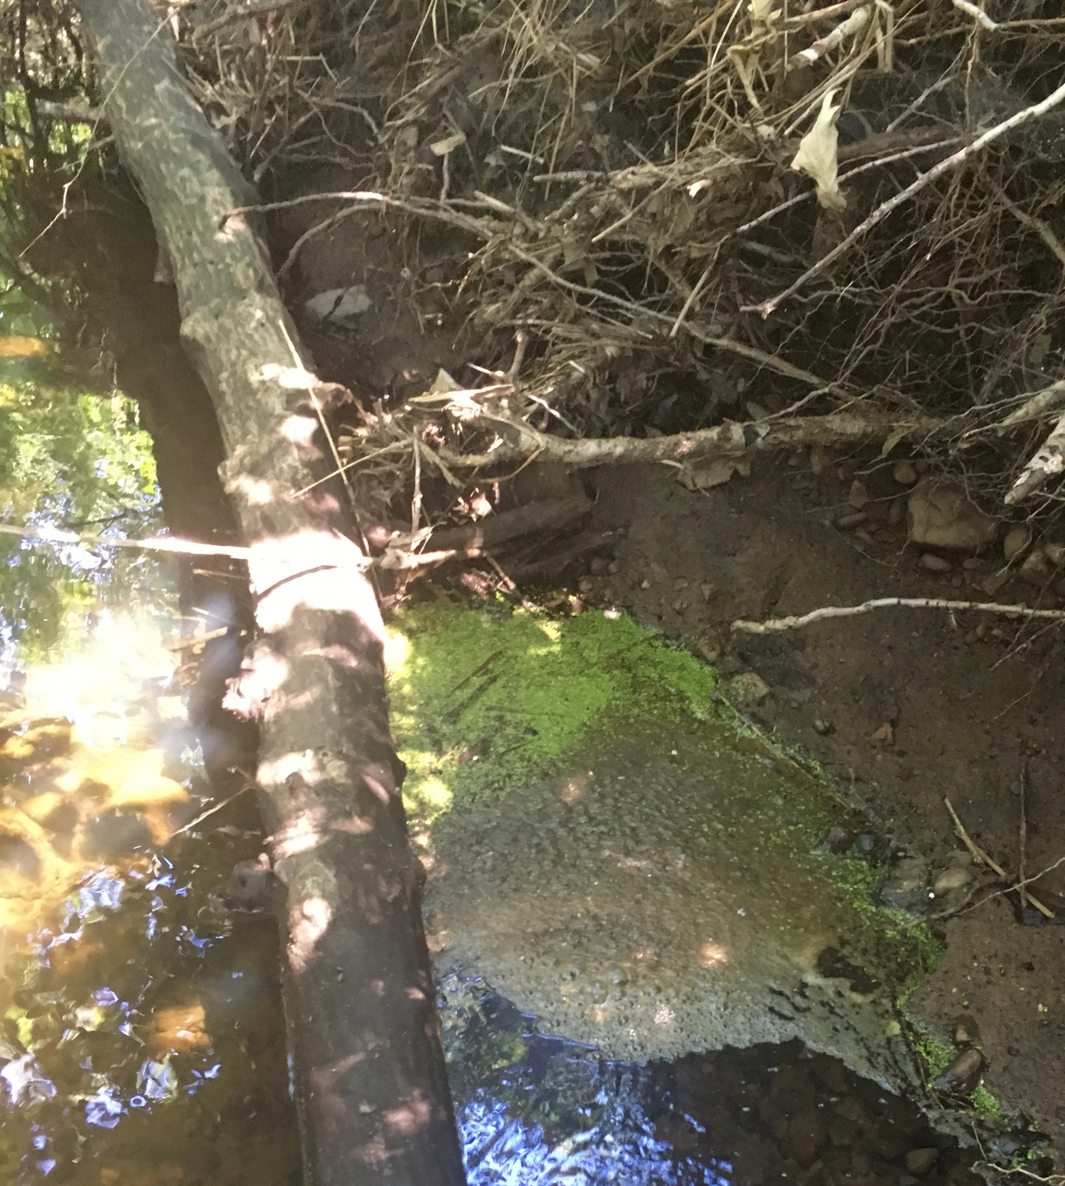
Project 1007 Focused Investigation Progress Report - Segment 2
June 2021 Minnesota Pollution Control Agency
Types of Foam
Foam in Segment 2
The foam observed and sampled in Segment 2 had several different appearances. The type of foam observed was not tied to an exact location, precipitation events, or seasons with the exception of frozen foam.
The different types of foam typically observed in Segment 2 are presented in this slide. Foam can present itself in any one of these types or as a combination.
Fluffy
Accumulated piles are larger and whiter in appearance, though some discoloring can occur. Can be more stable than other foam types. Fluffy foam condenses into a smaller liquid volume than other foam types, indicating the presence of more air.
Frozen
Occurs when foam accumulates against ice or snow and then freezes in place. Can range in appearance from bubbles to frozen piles.
Floating (not accumulating)
Foam bubbles that do not accumulate either because they condense too quickly or because there is no location for accumulation to occur. This foam cannot be isolated from the surface water and thus has not been sampled.
Deflated (old)
Typically thin, in smaller quantities, and discolored with organic matter present. Not actively reaccumulating.
Wrinkled
Foam bubbles that flow over a biosheen or thin layer of ice and then accumulate into thin layers that gather against and on top of each other, forming a wrinkled appearance. This foam is frequently discolored due to the organic matter.
Actively Generating and Accumulating (fresh)
Foam observed as actively accumulating. The accumulated foam can have a wide range of appearances from thin bubbles to fluffy piles. This foam is typically whiter than other types.

Slide 16
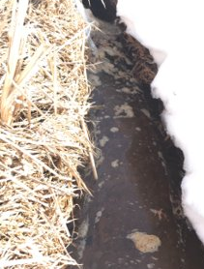
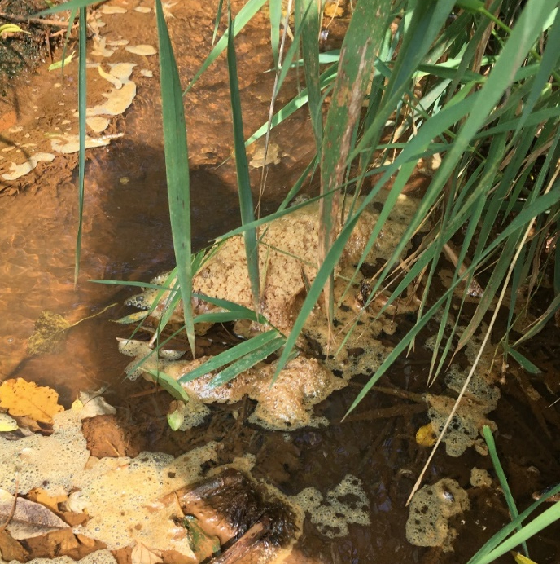
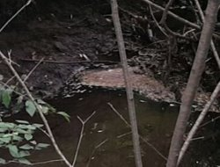
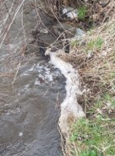
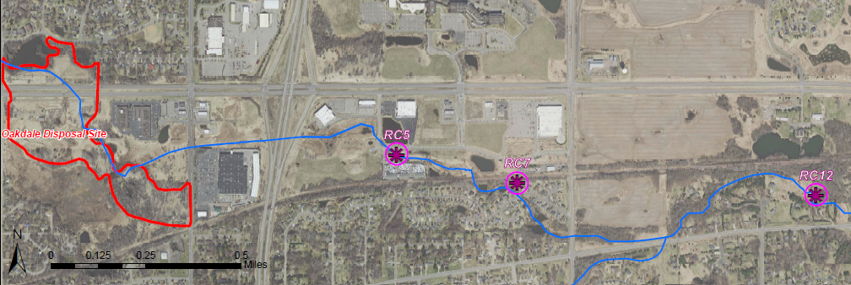
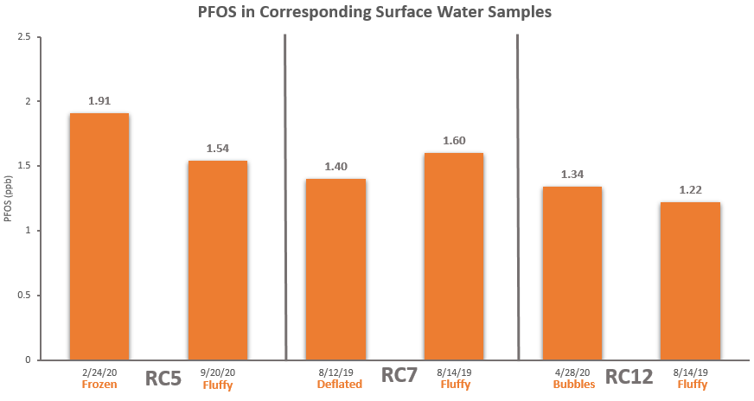
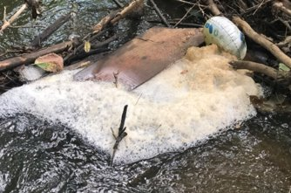
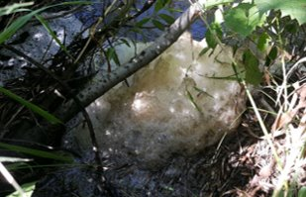

Project 1007 Focused Investigation Progress Report - Segment 2
June 2021 Minnesota Pollution Control Agency
Variation in PFOS due to Foam Type
Foam Type
At three locations in Segment 2 (RC5, RC7, and RC12), foam was collected and analyzed for PFAS twice to assess potential variation in PFAS due to variation in foam type. At each location, a “fluffy” foam sample was collected to compare against a “thin” foam type. PFOS concentrations from the larger and fluffier piles of foam were between 2 and 3 orders of magnitude greater than their thinner counterparts. The corresponding surface water samples had negligible variation in PFOS, suggesting that the PFAS enrichment in foam can be highly variable due to the environmental conditions.
2/24/20 - Frozen
9/20/20 - Fluffy
8/12/19 - Deflated
Frozen
Fluffy
Deflated
Fluffy
Bubbles
Fluffy
4/28/20 - Bubbles
RC5
RC7
RC12
8/14/19 - Fluffy
8/14/19 - Fluffy

Slide 17

Project 1007 Focused Investigation Progress Report - Segment 2
June 2021 Minnesota Pollution Control Agency
Foam: Enrichment Factors
RC5
RC7A
RC7
RC12
RC5
RC7A
RC7
RC12
Findings
An enrichment factor is the ratio of the PFAS concentration in the foam to that in the water.
Foam enrichment factors of PFOS ranged from 16 to nearly 10,000. Foam enrichment factors for PFOA were notably less, ranging from just over 1 to 766.
Enrichment factors from the same location can vary significantly as well (up to two orders of magnitude of difference).
Foam samples were overwhelmingly comprised of long-chain PFSAs and PFCAs, up to 97% of PFAS compounds in a sample.
Longer chain PFAS compounds like PFOA, PFOSA, and N-EtFOSA tend to enrich or preferentially separate into the foam more than shorter chain compounds like PFBA and PFBS because they are more hydrophobic.

Slide 18
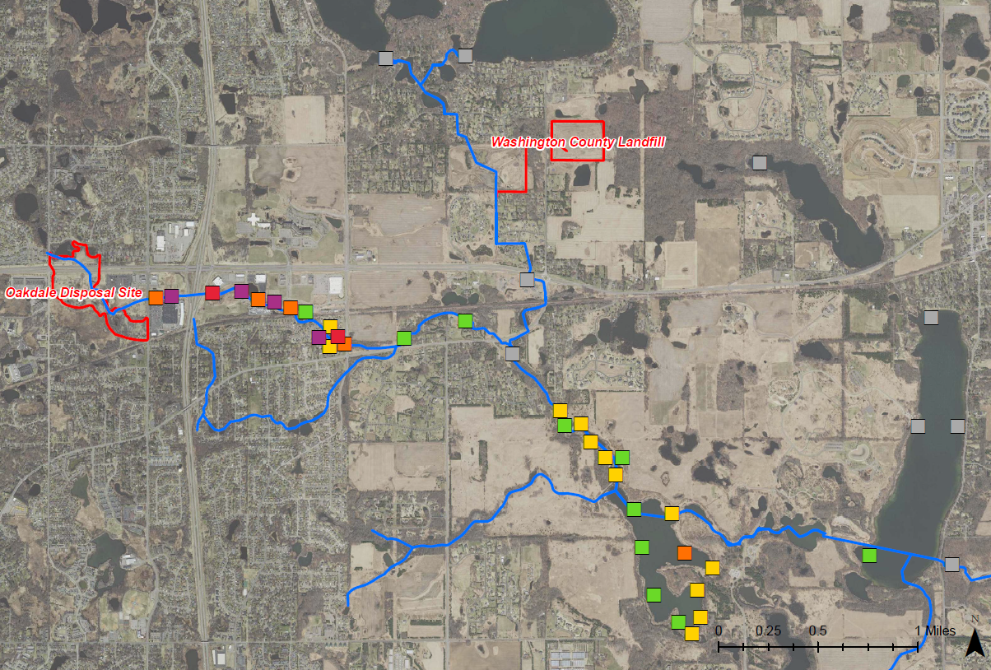

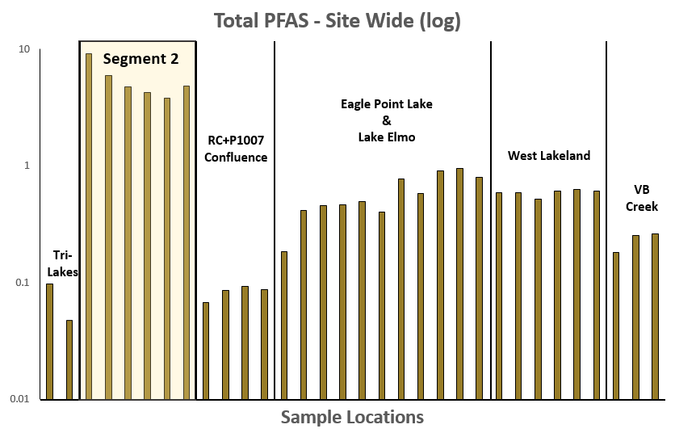
Project 1007 Focused Investigation Progress Report - Segment 2
June 2021 Minnesota Pollution Control Agency
Site-Wide Surface Sediment Results: PFOS
Sediment in Segment 2
PFAS in sediment in Segment 2 is generally higher than anywhere else in the corridor, with nearly every sampling location exceeding the 5-day per week Site-Specific Sediment Screening Value (SDCV) of 54 ppb.
Factors that may influence the sorption and retention of PFAS include:
Depositional Environment and Flow Path Morphology
Total Organic Carbon Content
Proximity to Source
Legend
PFOS Heat Map:
Sediment Sampling Locations
Tri-Lakes
P1007 Conveyance
Sunfish Lake
Raleigh Creek
Total PFAS in Sediment – Site Wide (log)
Lake Elmo
Eagle Point Lake
**Further assessment of the southeastern tributary of Raleigh Creek (i.e., upstream of RC8) is planned for the near future.

Slide 19
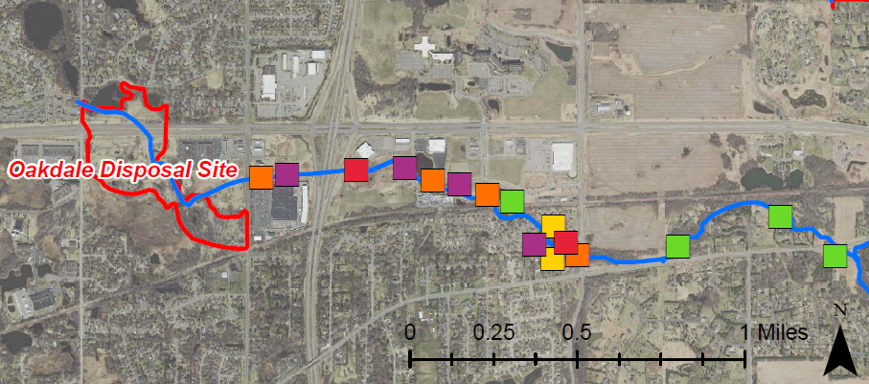
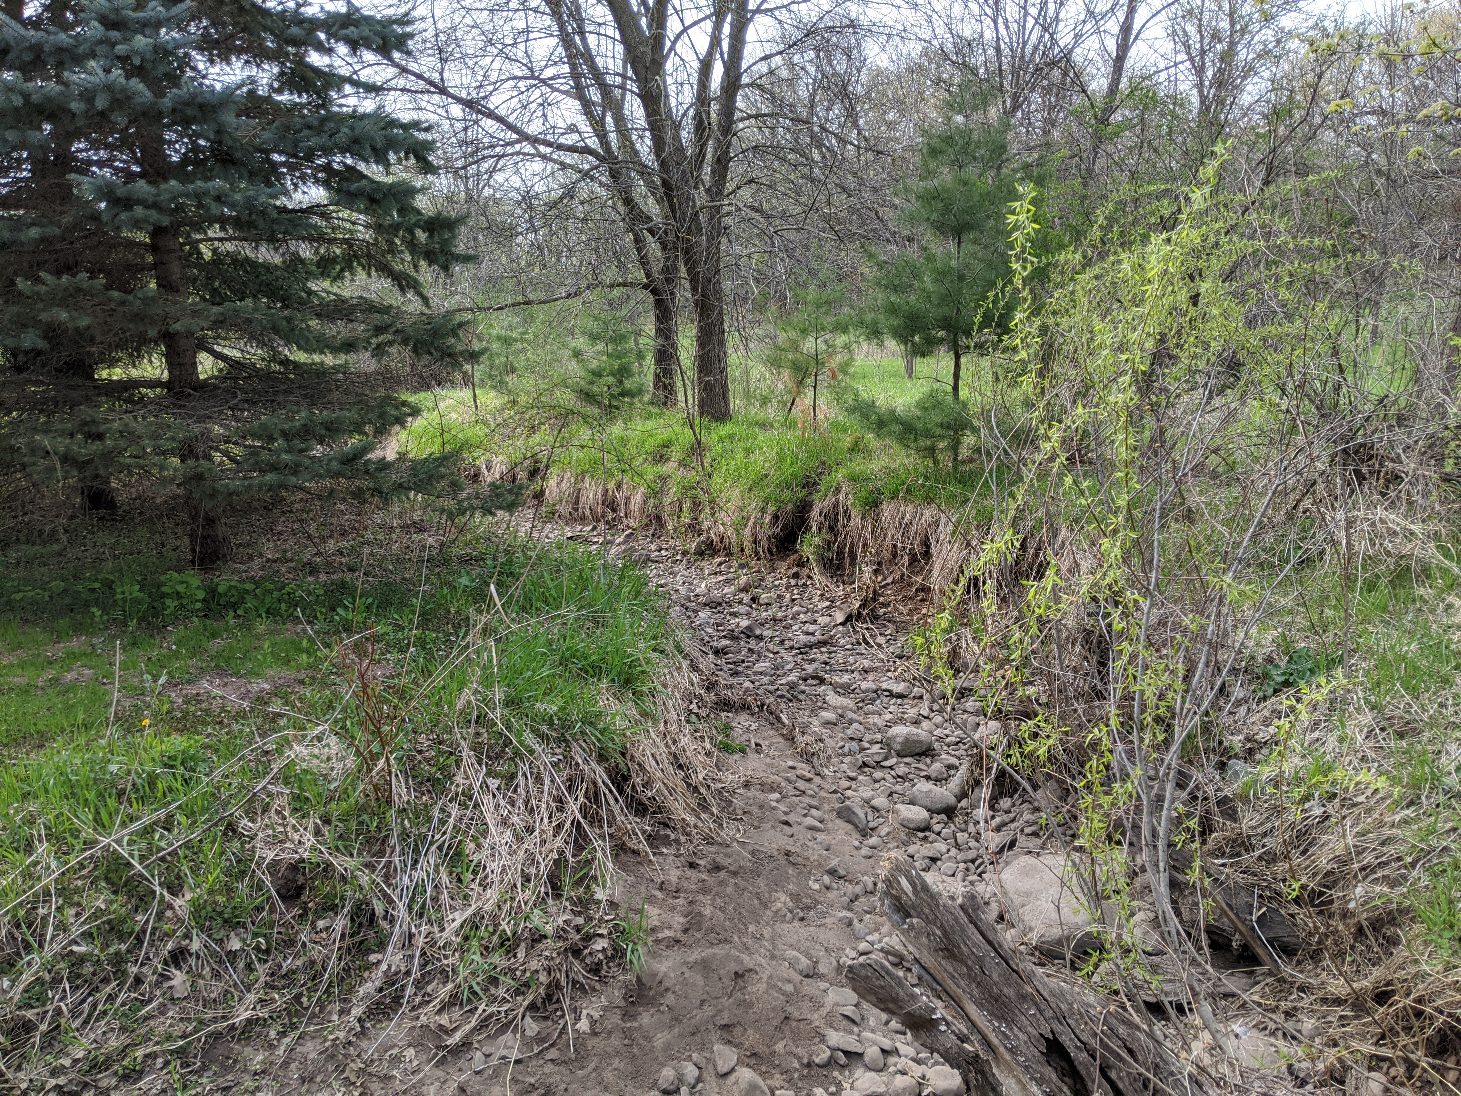
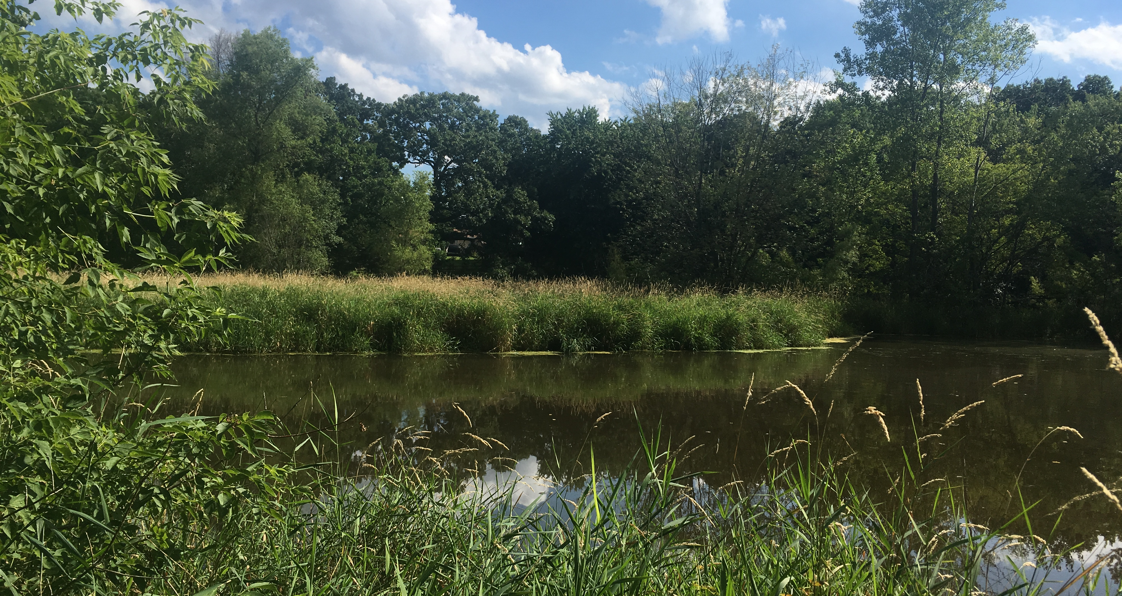
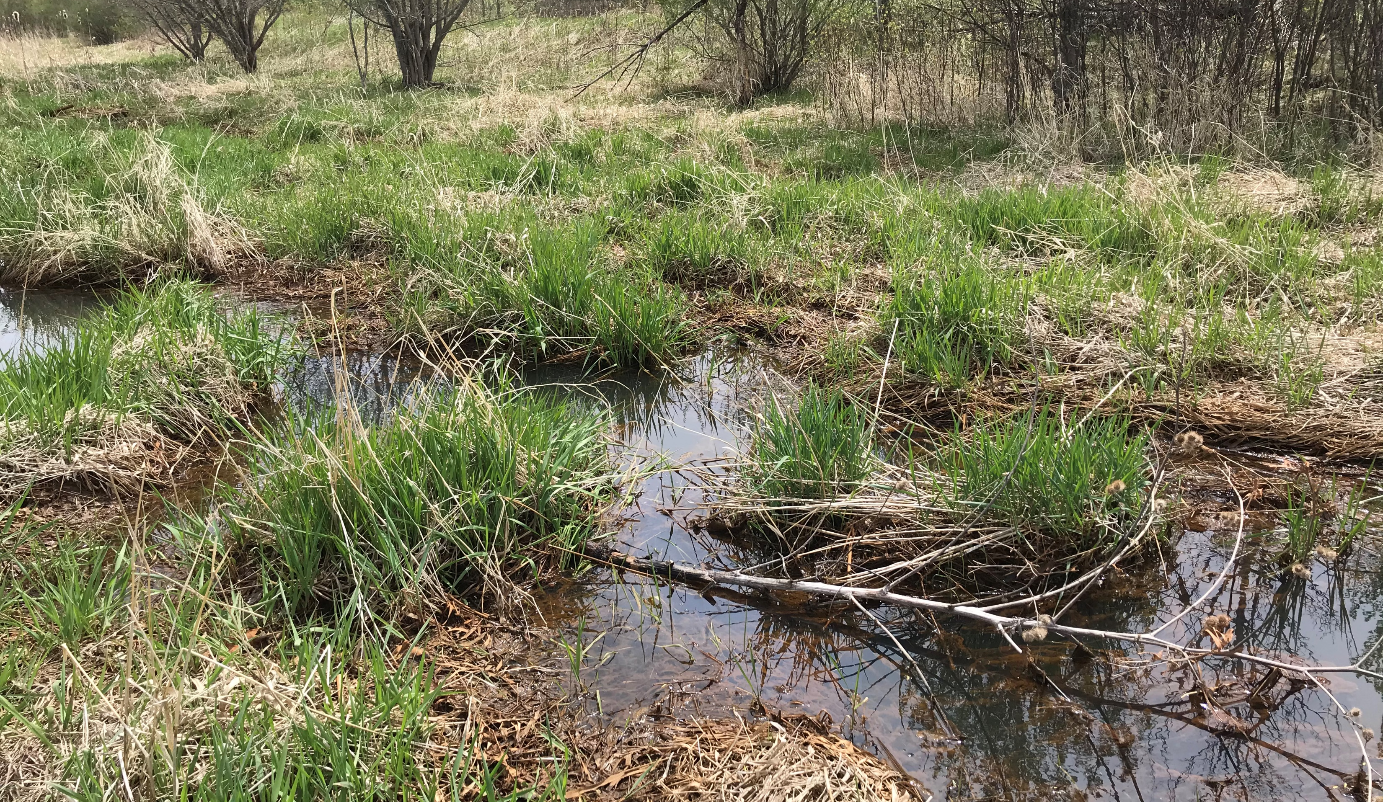
Project 1007 Focused Investigation Progress Report - Segment 2
June 2021 Minnesota Pollution Control Agency
Segment 2 Sediment Impacts: Depositional Environment
Incised Channel - RC12
Sunfish Lake
Raleigh Creek
Ponded Wetland- RC23
Channelized Wetland - RC6
Depositional Environment
Segment 2 includes of a variety of depositional environments including channelized wetlands, ponded wetlands, and incised channels. Further, flow within Segment 2 is intermittent to the east of Ideal Avenue.
Finding: The lowest PFAS sediment impacts appear to be in the incised channels, where flow is intermittent. Conversely, the highest PFAS impacts are in areas where Raleigh Creek flows through the channelized wetlands and flow is typically year-round.
Lake Elmo
Eagle Point Lake
Legend

Slide 20
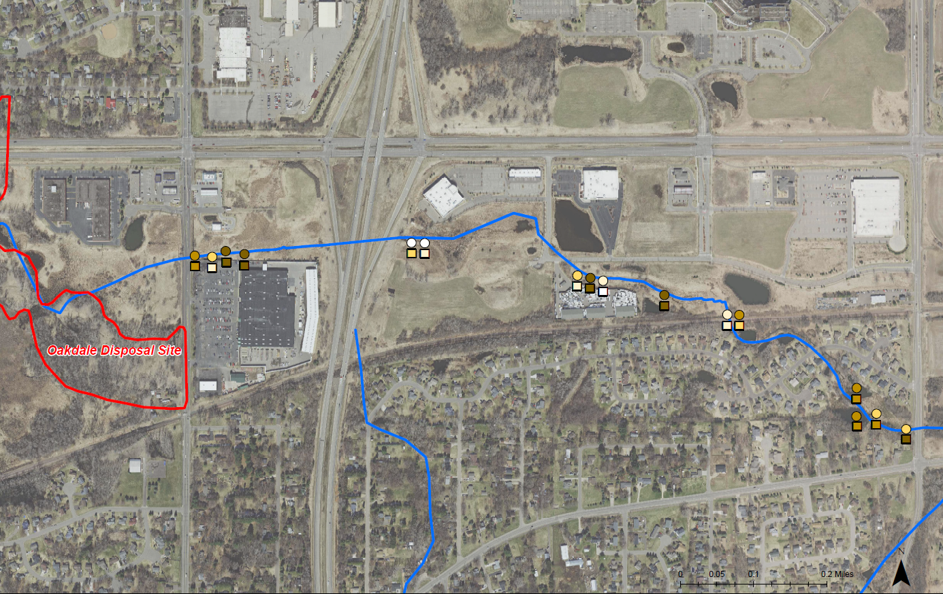
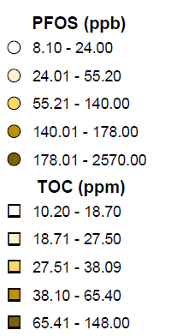
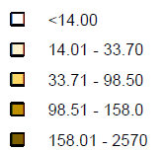
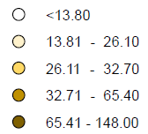
Project 1007 Focused Investigation Progress Report - Segment 2
June 2021 Minnesota Pollution Control Agency
Sediment Impacts: Total Organic Content
Organic Content
Organic content may have a causal influence on elevated concentrations of PFAS in sediment.
Finding: When looking at the statistical relationship between PFAS impacts and TOC, variations in PFOS, PFOA, PFBA, and PFHxS have statistically significant, strong positive correlation to TOC.
Sunfish Lake
Spearman’s Analysis
As opposed to a traditional best fit analysis, Spearman’s normalizes the data by ranking each variable from low to high (and renumbering them in order) before calculating correlation. As a result, both variables are represented by numbers of the same scale (e.g., 1 - 30 rank versus the full range of PFOS and TOC concentrations), resulting in a calculation of only the statistical strength of one variable’s correlation to another. In this case, a strong positive correlation of PFOS to TOC is shown in the Ranked Spearman’s Correlation graph.

Slide 21
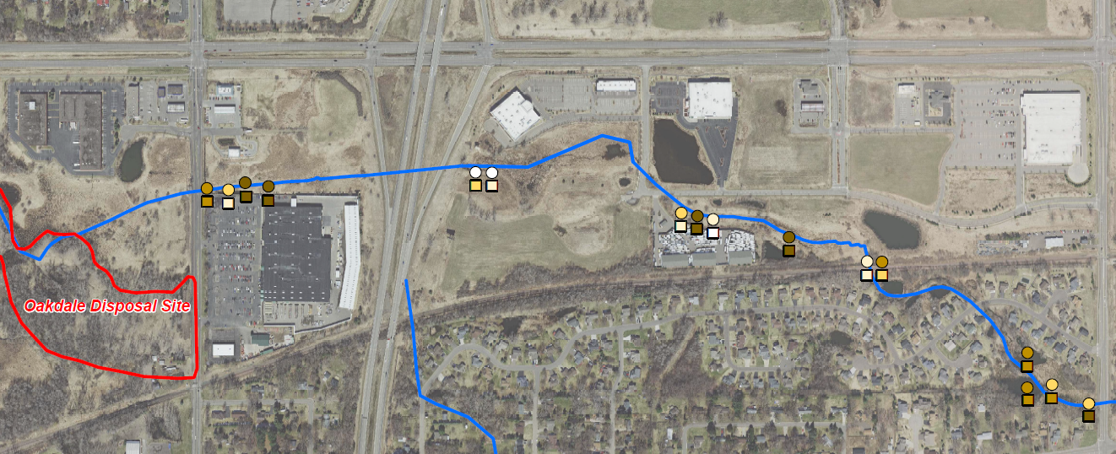

Project 1007 Focused Investigation Progress Report - Segment 2
June 2021 Minnesota Pollution Control Agency
Segment 2 Sediment Impacts: Depositional Environment (cont.)
Ponded Wetlands vs Channelized Wetlands
In channelized wetlands, PFOS and TOC have a statistically significant strong correlation, indicating the variation in PFOS in these wetlands is primarily a result of variation in TOC. However, in the ponded wetlands at Ideal Avenue Wetland Complex (IAWC), the correlation between PFOS and TOC is less apparent. Despite the greater distance from the source area, the ratio of PFOS:TOC is consistently higher in IAWC, indicating that other variables are enabling increased sediment retention of PFAS at this specific wetland complex. The flood control structure at Ideal Avenue reduces drainage from the wetland complex, resulting in shallow stagnant water to remain at the wetland complex for longer periods of time.
Finding: This unique depositional environment may allow for increased sorption of PFAS within these ponded wetlands.
Channelized vs Ponded Wetlands
Channelized Wetlands
Legend and Notes
Ponded Wetland
CH – sample collected from within main channel
BANK – sample collected from bank of channel
WET – sample collected from wetland area (off-channel)
POND – sample collected from within pond
RC3B-WET sample excluded from graph for scale purposes but is included in figures and statistical analysis.

Slide 22
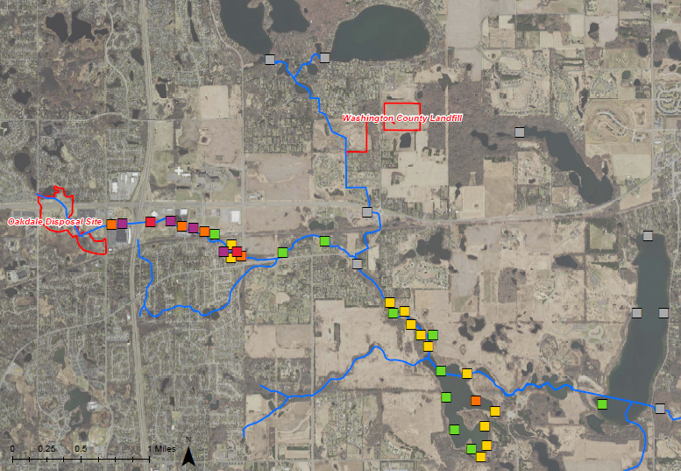
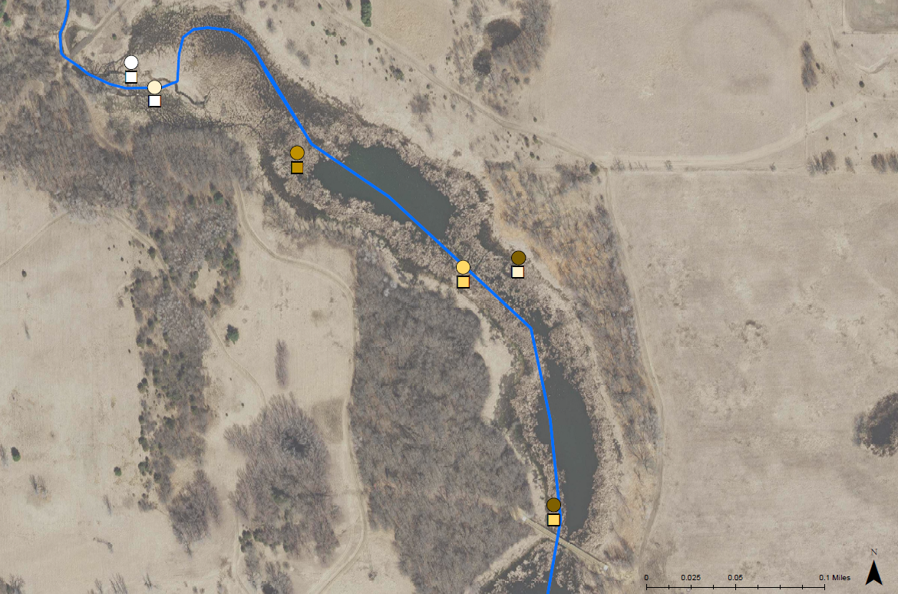
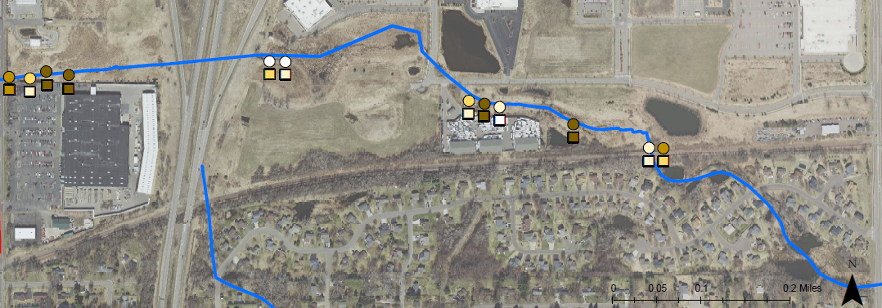
Project 1007 Focused Investigation Progress Report - Segment 2
June 2021 Minnesota Pollution Control Agency
Segment 2 Sediment Impacts: Proximity to Source
Reference Map: PFOS Results
Eagle Point Lake Inlet Channelized Wetlands
Raleigh Creek
Legend
Raleigh Creek
Eagle Point Lake
Raleigh Creek Channelized Wetlands
Isolating for Proximity to Source Area
As previously shown, PFOS in sediment is generally higher in Segment 2 than in other portions of the corridor. Two locations within the corridor, the western portion of Raleigh Creek in Segment 2 and the inlet to Eagle Point Lake in Segment 4, have very similar depositional environments (channelized wetlands) and a similar range in organic content (up to 150 g/kg).
Finding: However, the PFOS in the channelized wetlands is significantly higher than in any other segment in the system, supporting that proximity to source is the greatest contributing factor to PFAS concentrations in sediments.
Lake Elmo

Slide 23
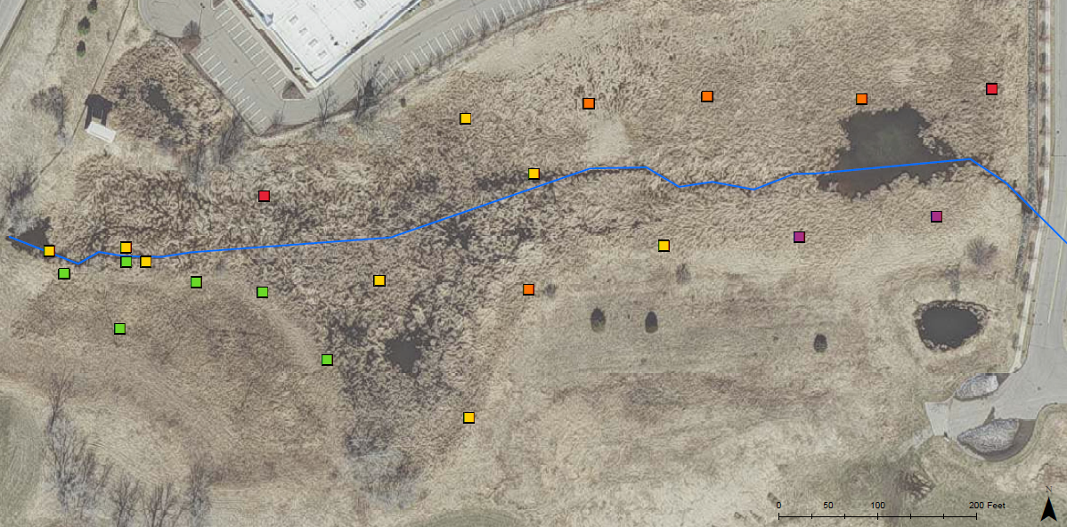
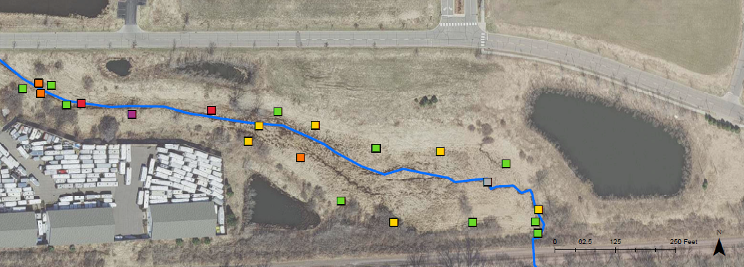
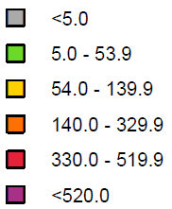
Project 1007 Focused Investigation Progress Report - Segment 2
June 2021 Minnesota Pollution Control Agency
A Closer Look: Channelized Wetland Complexes
Reference Map: Studied Wetland Complexes
Wetland Delineation
Due to the elevated PFOS impacts in areas of high organic content, wetland complexes in Segment 2 were selected for further sediment sampling for delineation purposes. The wetland complex immediately downgradient of ODS (between Hadley Ave. and I-694) has not yet been sampled for delineation.
LA Fitness Wetland Complex
Note: The wetland complex immediately downgradient of ODS is planned for additional delineation sampling when access is provided by the property owner.
Pinz Wetland Complex
Legend
PFOS (ppb)
PFOS (ppb)
Previously sampled location (0-6 inches)
Combined interval sample location (0-24 inches)
Combined interval sample location (0-18 inches)
Unless otherwise indicated, each sample represents 0-12 inches.

Slide 24
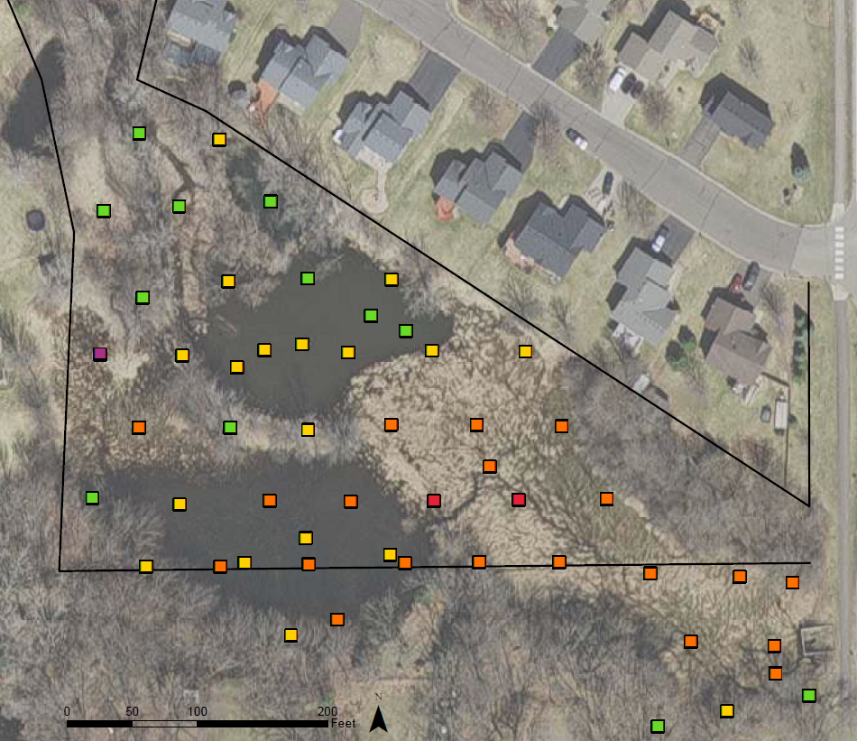
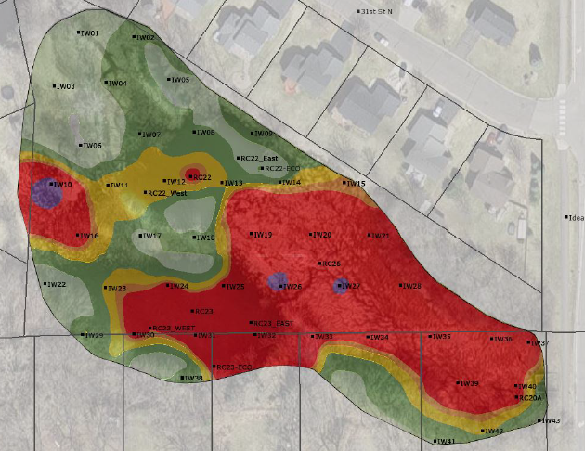
Project 1007 Focused Investigation Progress Report - Segment 2
June 2021 Minnesota Pollution Control Agency
A Closer Look: Ponded Wetland Complex - IAWC
Reference Map: IAWC
Legend
PFOS Results Surface Interval
IAWC
Modelled PFOS Plume: Surface

Slide 25
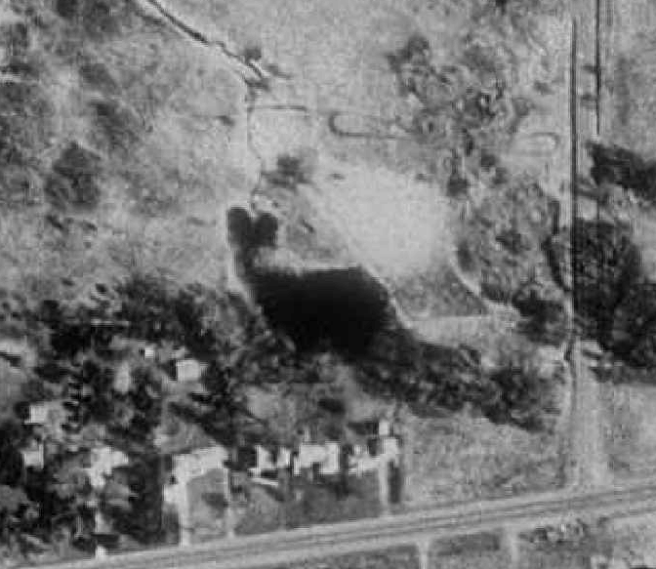



Project 1007 Focused Investigation Progress Report - Segment 2
June 2021 Minnesota Pollution Control Agency
A Closer Look: Ponded Wetland Complex – IAWC (cont)
1991: Pre-Development
Only one pond visible (southern pond). Single channel visible running N-S into the pond. Heavy vegetation along the
southern/southwestern edge of the pond.
1997: Post-Development
Northern pond now visible and two channels appear to be feeding the southern pond. The new surrounding residential development appears to have restricted the extent of the wetland complex, allowing for the wetland complex to flood more easily and for both ponds to hold water.
2004: Post-Flood Control Structure
Primary inlet channel appears to have shifted east. The flood control structure at Ideal Ave is now visible. Structure was designed to reduce the volume of water discharging downstream of Ideal Ave, resulting in the ponds holding water for longer periods of time.
2020: Current Conditions
Channel continues to feed both ponds. Outlet channel appears more pronounced.
Pre-Residential Development: One Pond and One Channel
Development of
Northern Pond
Flood Control
Structure:
Primary Channel Shift
Current Conditions:
One Channel and Two Ponds
IAWC Development Timeline
1940
1991
1997
2001
Present

Slide 26


Project 1007 Focused Investigation Progress Report - Segment 2
June 2021 Minnesota Pollution Control Agency
A Closer Look: Ponded Wetland Complex – IAWC (cont)
Depositional Environment at IAWC
During high flow conditions, intermittent channels within IAWC contain more water flow. With high enough water level, these channels may “overflow”, causing the surrounding wetlands to saturate with water. Since high rain events can cause an influx of PFAS-impacted waters from ODS to Raleigh Creek and the IAWC pond system, the sediment in the areas that experience this “overflow” may have elevated PFAS impacts. Further, given the propensity of PFAS molecules to gather at the air/water interface of surface water, these overflow water paths may act as a preferential transport pathway.
In the figure to the right, potential dispersal zones of water during flooding conditions are presented with buffers. Areas near the intermittent wetland channels (orange plus yellow) are more likely to experience increased sorption of PFAS during flooding conditions (compared to the areas farther away from the intermittent streams).
The western dispersal zone existed only prior to the development in the 1990’s. The eastern flow path and dispersal zone likely existed prior to development but has become more pronounced and more likely to experience overflow, potentially allowing for more PFAS deposition into sediments.
PFAS Flow Path Dispersal Zones
Pre-Development Flow Path and Dispersal Zone
Current Flow Path and Dispersal Zone
Legend
PFOS (ppb)

Slide 27



Project 1007 Focused Investigation Progress Report - Segment 2
June 2021 Minnesota Pollution Control Agency
IAWC PFOS Distribution by Depth: Sediment PFOS Results
Legend
PFOS (ppb)
Sunfish Lake
Raleigh Creek
PFOS Characteristics and Leaching Potential
In addition to the PFAS/TOC relationship previously presented, there are PFAS structural properties such as ionic charge and chain length that affect adsorption to sediment that may limits its ability to migrate or leach downward. As demonstrated by the vertical distribution of PFOS in sediment in the image to the left, PFOS sediment concentrations are predominantly higher is surface samples compared to samples at depth.
Lake Elmo
Eagle Point Lake

Slide 28

Project 1007 Focused Investigation Progress Report - Segment 2
June 2021 Minnesota Pollution Control Agency
IAWC PFOS Distribution by Depth: Statistical Exploratory Analysis
PFOS Concentrations With Depth
In effort to further evaluate PFOS impacts in sediment, a set of statistical parameters were calculated for the range in PFOS concentrations at each depth interval, including the minimum, maximum, median, mean, and standard deviation (Figure 4). Each depth interval was set for one foot of sediment depth, with the first depth interval representing the surface interval. At most locations, the depth intervals were 0-1 foot, 1-2 feet, 2-3 feet, and 3-4 feet. At the surface depth interval, the median and mean PFOS concentrations are 113 ppb and 134.8 ppb; respectively; at the second interval, 56.9 and 59.3 ppb; at the third interval, 20.4 and 36.1 ppb; at the fourth, interval, 7.8 and 17.7 ppb.
Finding: Not only do PFOS impacts decrease with depth, but the variability of PFOS concentrations within each depth interval also decreases with depth. The true mean value with a 95% Uniform Confidence Level (UCL) for sediment in IAWC within the surface interval is at least 112.7 ppb.
Depth Interval | Minimum | Maximum | Median | Mean | Standard Deviation
1 | 12.96 | 520.0 | 113.00 | 134.84 | 101.18
2 | 0.00 | 214.0 | 56.90 | 59.32 | 42.32
3 | 0.00 | 170.0 | 20.40 | 36.12 | 40.54
4 | 0.00 | 73.7 | 7.81 | 17.69 | 20.14
*Values below the laboratory method detection limits were calculated as 0.00 ppb.

Slide 29


Project 1007 Focused Investigation Progress Report - Segment 2
June 2021 Minnesota Pollution Control Agency
From the Surface to the Subsurface
Oakdale Disposal Site
Opg
Od
Raleigh Creek
Os
Confluence
with P1007
Os
Segment 2 Bedrock Geology and Hydrogeology
The bedrock geology in Segment 2 is diverse and contributes to a hydrogeologically complex system that influences PFAS migration from Raleigh Creek to groundwater. ODS is underlain by both the Decorah Shale, in the northern portion, and the Platteville Limestone Aquifer, in the central and southern portions. The Decorah Shale Aquitard acts as a barrier to downward groundwater migration from the quaternary into lower units, resulting in horizontal groundwater flow to the south, southwest, and southeast until the Decorah is no longer present. Once the Decorah Shale vertically pinches out, the quaternary units are hydrogeologically connected to the Platteville Aquifer. Below the Platteville Limestone is the Glenwood Shale, which is also an aquitard and acts as another barrier to vertical groundwater movement. As a result, groundwater again flows horizontally until the Platteville-Glenwood Formations vertically pinch out and vertical flow to the St Peter Sandstone is uninhibited.
The St Peter Sandstone is underlain by the Shakopee Dolostone Aquifer. This absence of the Platteville-Glenwood Formation, therefore, allows for a direct pathway from surface and shallow quaternary waters to the both St Peter and Shakopee Bedrock aquifers.
The Shakopee aquifer is underlain by the Oneota Dolostone aquitard, which can be fractured and “leaky”. The extent to which the aquitard functions as a barrier to the underlying Jordan Sandstone aquifer is not well understood. The hydraulic properties of this lower aquitard will be further assessed with a series of site-wide pumping tests, among other hydrogeologic testing techniques, planned for the late summer and fall of 2021.
*Prairie du Chien and Jordan units not on map.

Slide 30

Project 1007 Focused Investigation Progress Report - Segment 2
June 2021 Minnesota Pollution Control Agency
Segment 2: Site Features and Beta Sites
Beta Site Map: Segment 2
AECOM Beta Sites
Beta Site 1 (BS1)
MW1A: Jordan Aquifer Well
MW1B: St Peter Aquifer Well
MW1C: Platteville Aquifer Well
Vertical Aquifer Profile Samples from Quaternary Aquifer, Shakopee Aquifer, and Oneota Aquitard
Beta Site 14 (BS14)
Well Nest Downgradient of IAWC:
MW14A: Jordan Aquifer Well
MW14B: St Peter Aquifer Well
MW14C: Quaternary Aquifer Well
Vertical Aquifer Profile Samples from Shakopee Aquifer and Oneota Aquitard
Well Upgradient of IAWC:
MW14D: Quaternary Aquifer Well
Beta Site 2 (BS2)
MW2A: Jordan Aquifer Well
MW2E: St Peter Aquifer Well
MW2B: Deep Quaternary Aquifer Well
MW2C: Mid Quaternary Aquifer Well
MW2D: Shallow Quaternary Aquifer Well
Vertical Aquifer Profile Samples from Shakopee Aquifer and Oneota Aquitard
P1007 Conveyance
Raleigh Creek
(perennial portion)
BS14
Pre- and Post-IAWC
BS1
Raleigh Creek
(intermittent portion)
Confluence of Raleigh Creek and P1007
Ideal Ave Wetland Complex
BS2

Slide 31

Project 1007 Focused Investigation Progress Report - Segment 2
June 2021 Minnesota Pollution Control Agency
Shallow Quaternary Aquifers: PFAS Preferential Flow Path from Source
Quaternary Water Flow Path
The Oakdale Disposal Site (ODS) is underlain by approximately 40 to 60 feet of quaternary alluvium and undifferentiated glacial deposits, consisting of sands, clays, and gravels. Groundwater flow within the quaternary units effectively pools beneath ODS before migrating to the south, southwest, and southeast. Along the northern portion of the former disposal site, the Decorah Shale underlies these quaternary sediments. Where present, the confining shale units inhibits vertical flow. Once the Decorah pinches out in the southern portion of ODS, groundwater can migrate downward into the Platteville Limestone Aquifer.
East of ODS, surface water flows eastward along Raleigh Creek. Due to the creek’s intermittent nature and flow-through wetland systems, surface water in Raleigh Creek likely infiltrates into the quaternary aquifers periodically through Segment 2.
Conceptual Preferential Flow Path: Surface to Quaternary
Legend
Surface Water Flow Direction
Surface to Groundwater Infiltration
Horizontal GW Flow: Quaternary
Vertical GW Migration: Quat to Platteville
Extent of Decorah Shale
Quat Potentiometric Surface (5-ft Contours)

Slide 32


Project 1007 Focused Investigation Progress Report - Segment 2
June 2021 Minnesota Pollution Control Agency
Cross-Sectional View: PFAS Preferential Flow Path at ODS
A
Historic Extent of ODS
Cross-Sectional View: A-A’
Reference Map
Raleigh Creek
Quaternary
Decorah
Platteville
A’
Decorah Shale Extent
Glenwood
A Closer Look: Flow from ODS Surface to Platteville
The northern portion of ODS is underlain by the Decorah Shale Aquitard, which acts as a natural barrier to vertical groundwater migration from the quaternary aquifers into the underlying Platteville Limestone Aquifer. Once the Decorah Aquitard pinches out towards the middle of ODS, the quaternary aquifers are hydrogeologically connected to the Platteville Aquifer.
St Peter
N
S
Legend
Extent of Decorah Shale
Notes
Vertical exaggeration is 6.7:1.
Horizontal extent is approximately 1 miles
Quaternary groundwater flow is affected from pumping
at ODS. Net flow direction across the site is to the south.
Surface to Groundwater Infiltration
Horizontal GW Flow: Quaternary
Vertical GW Migration from Quaternary
Horizontal GW Flow: Platteville

Slide 33

Project 1007 Focused Investigation Progress Report - Segment 2
June 2021 Minnesota Pollution Control Agency
Platteville Aquifer: PFAS Preferential Flow Path from Source
Cross-Sectional View: B-B’
Reference Map
Oakdale Disposal Site
Decorah Shale Extent
BS1
BS14 (Pre-IAWC)
Ideal Avenue
Wetland Complex
B
Platteville Extent
BS14 (Post-IAWC)
B’
St Peter
Extent
A Closer Look: Platteville Groundwater Flow
Available gauging data from the Platteville aquifer indicates an eastward groundwater flow despite the westerly dip of the geologic unit. This eastward groundwater flow direction starts at the western edge of ODS.
Finding: Since the eastward flow path within the Platteville starts under, or just west of ODS, the source of the contamination in the Platteville is likely from ODS. Since the flow path is then to the east until the Platteville-Glenwood Formation pinches out, these impacts likely discharge to the St Peter aquifer.
W
E
Legend
Surface to Groundwater Infiltration
Horizontal GW Flow: Quaternary
Vertical GW Migration from Quaternary
Horizontal GW Flow: Platteville
Vertical GW Migration from Platteville
Extent of Decorah Shale
Extent of Platteville-Glenwood Formation
Approx. Water Table (Quaternary)
Notes
Vertical exaggeration is 24.5:1
Horizontal extent is approximately 1.4 miles

Slide 34


Project 1007 Focused Investigation Progress Report - Segment 2
June 2021 Minnesota Pollution Control Agency
St Peter Aquifer: PFAS Preferential Flow Path from Source
Conceptual Preferential Flow Path: ODS to St Peter
PFAS Preferential Flow Path: St Peter Aquifer
From ODS, PFAS-impacted waters may flow to the east via Raleigh Creek towards the Ideal Avenue Wetland Complex (IAWC) as well as through the Quaternary and Platteville Aquifers.
The approximate eastern-most edge of the Platteville-Glenwood Formation is located immediately to the west of the IAWC. This position of the edge of the aquitard overlying the St Peter Aquifer may allow for PFAS-impacted waters from three potential overlying sources:
Impacted surface water from Raleigh Creek and the IAWC system infiltrating downward,
Impacted groundwater in the quaternary aquifers flowing from the west, and
Impacted groundwater exiting the Platteville Aquifer.
Because of the effective groundwater divide within the St Peter aquifer under the approximate location of the edge the Platteville-Glenwood Formation, PFAS-impacted waters in the St Peter aquifer may then continue to the southeast and the southwest, as shown on the next slide in cross-section C-C’.
IAWC
Conceptual Flow Path: IAWC to St Peter
Legend
Notes
Refer to slides 25-27 for addition details on impacts to sediment in the Ideal Avenue Wetland Complex (IAWC).
IAWC
Surface to Groundwater Infiltration
Horizontal GW Flow: Quaternary
Vertical GW Migration from Quaternary
Horizontal GW Flow: Platteville
Vertical GW Migration from Platteville
Horizontal GW Flow: St Peter

Slide 35

Project 1007 Focused Investigation Progress Report - Segment 2
June 2021 Minnesota Pollution Control Agency
St Peter Aquifer: PFAS Preferential Flow Path from Source (cont.)
Reference Map
Oakdale Disposal Site
IAWC Infiltration and St Peter Potentiometric Peak
BS1
BS14 (Pre-IAWC)
Ideal Avenue
Wetland Complex
C
IAWC
C’
BS14 (Post-IAWC)
Confluence
BS2
A Closer Look: IAWC Infiltration
With the restriction of surface water discharge downstream of IAWC, and the steep vertical gradient between surface water and the quaternary aquifer at IAWC, it is likely that much of the ponds’ water readily infiltrates into the subsurface.
Due to the absence of the Platteville-Glenwood Formation under IAWC, surface water is thus directly connected to the quaternary and St Peter aquifers, making the ponds and channels a potential secondary source of PFAS to groundwater in both aquifer systems.
A Closer Look: Platteville Recharge to St Peter
According to historic gauging data, a potentiometric “peak” in the St Peter Aquifer is located immediately below the eastern edge of the Platteville Aquifer (see circled area in drawing to the right). According to the Minnesota Geological Survey, this peak may be the result of groundwater from the Platteville Aquifer flowing eastward to the edge of the unit and then cascading downward into the St Peter Aquifer. This secondary input of groundwater to the St Peter elevates the water table enough so that groundwater flow in the St Peter at this location is actually to the east, despite the relative dip of the geologic unit being to the west.
As a result, this location may be a confluence of PFAS-impacted waters from IAWC, Raleigh Creek, the Platteville Aquifer, and the quaternary aquifers.
W
E
Legend
Horizontal GW Flow: Platteville
Vertical GW Migration from Platteville
Horizontal GW Flow: St Peter
Approx. Water Table (Quaternary or St Peter)
Notes
Vertical exaggeration is 24.5:1
Horizontal extent is approximately 2.1 miles
Surface to Groundwater Infiltration
Horizontal GW Flow: Quaternary
Vertical GW Migration from Quaternary

Slide 36

Project 1007 Focused Investigation Progress Report - Segment 2
June 2021 Minnesota Pollution Control Agency
Groundwater Results: Distribution of PFAS Impacts in the Quaternary Aquifer
BS1
Typical PFAS
Distributions
ODS
PFOS-Dominant
BS14 (Pre-IAWC)
P1007
BS17
ODS
BS14
(Post-IAWC)
Confluence
BS2
Non-Source or Background PFAS
A Closer Look: BS1 to IAWC
Finding: From BS1 to downgradient of the IAWC system, quaternary groundwater shifts from PFBA-dominated to PFOS-dominated impacts. This gradual downgradient increase in PFOS concentrations that more closely resemble that of ODS impacts suggests that PFAS-impacted surface water from ODS is travelling eastward via Raleigh Creek and periodically infiltrating into the quaternary aquifers.
A Closer Look: Quaternary at Confluence
Like surface water, quaternary groundwater at the confluence is a mixture of groundwater from the west and the north. The western groundwater input is PFOS-dominant and similar to impacts at ODS, and the northern groundwater input is PFBA-dominant, generally low in PFAS impacts, and not clearly associated with any source areas.
As a result of the mixture of these two inputs, PFAS impacts in quaternary groundwater at the confluence (BS2) see a reduction in PFOS and an increase in PFBA.

Slide 37

Project 1007 Focused Investigation Progress Report - Segment 2
June 2021 Minnesota Pollution Control Agency
Current Groundwater PFOS Results
Oakdale Disposal Site
Current PFOS Data
Reference Site Map
BS1
BS14
(Pre-IAWC)
Ideal Avenue
Wetland Complex
ODS Wells
BS1
BS14
(Pre-IAWC)
Quaternary
ODS: 49.1
BS14
(Post-IAWC)
C
IAWC
BS2
0.803
BS14
(Post-IAWC)
C’
Decorah
Confluence
0.092
0.205
1.23
BS2
Current Post-IAWC PFOS Migration Path
Upon review of data collected from current monitoring wells in the St Peter and Quaternary aquifers, it is unclear exactly where the impacted groundwater at BS14 (post-IAWC) is going.
Finding: PFOS concentrations to the east and west of BS14 in the St Peter Aquifer are between one and two orders of magnitude lower than BS14 (post-IAWC). Vertically, PFOS concentrations are again an order of magnitude lower in the underlying Shakopee Aquifer, both directly below BS14 and to the west and east of BS14.
Unknown Flow Path of St Peter Impacts
The lack of active monitoring wells between BS14 and BS2 and south of Segment 2 further complicates the understanding of the migration flow path of the IAWC subsurface impacts. The key to understanding the PFOS flow path may be in evaluating historic data from previously abandoned wells, as presented in the next slide.
Platteville-Glenwood
Quaternary
2.46
0.644
0.129
0.031
St Peter
0.829
?
?
?
?
0.115
*0.438
*0.11
Shakopee
W
*0.43
E
Legend
Horizontal GW Flow: Platteville
Vertical GW Migration from Platteville
Horizontal GW Flow: St Peter
0.25 ppb PFOS
Notes
Vertical exaggeration is 24.5:1.
Horizontal extent is approximately 2.1 miles.
For illustration purposes, ODS PFOS is not graphically depicted.
All sample results are in ppb (collected between 2020 and 2021).
* Denotes samples collected during drilling.
Surface to Groundwater Infiltration
Horizontal GW Flow: Quaternary
Vertical GW Migration from Quaternary

Slide 38

Project 1007 Focused Investigation Progress Report - Segment 2
June 2021 Minnesota Pollution Control Agency
Historic and Current Groundwater Results
Current and Historic PFOS Data
Reference Site Map
BS1
BS1
Ideal Avenue
Wetland Complex
D
BS14 (pre-IAWC)
BS14
(Pre-IAWC)
Quaternary Aquifer
IAWC
BS14
(post-IAWC)
D’
0.803
BS14
(Post-IAWC)
BS2
Platteville
Quaternary Aquifer
Confluence
1.23
BS2
Quaternary
Historic Post-IWAC St Peter Migration Path
Historical groundwater data from abandoned wells (provided by MDH) show similar concentrations of PFOS were detected in St Peter and Shakopee wells to the east and southeast in 2006. This suggests that PFAS impacts, at least historically, moved vertically from the St Peter Aquifer into the Shakopee Aquifer. The lack of PFAS impacts in the Shakopee Aquifer at BS2 and BS14 suggests that PFAS impacts in the St Peter Aquifer at BS2 and BS14 are not currently migrating downward. A possible cause for this historic downward migration may be poor well construction or wells constructed through multiple aquifers. It is not yet understood how the impacts in the St Peter Aquifer currently move.
St Peter
2.46
0.031
2.9
Abandoned Wells
?
?
0.115
0.5
Legend
Notes
Vertical exaggeration is 24.5:1.
Horizontal extent is approximately 1.5 miles.
All sample results are in ppb.
Data from 2006 provided by MDH.
* Denotes samples collected during drilling.
Shakopee Aquifer
Surface to Groundwater Infiltration
Vertical GW Migration from Platteville
Horizontal GW Flow: St Peter
Active Well (sampled 2020-2021)
Abandoned Well (sampled 2006)
1.90
*0.438
1.0
Shakopee
*0.11
W
*0.43
E

Slide 39


Project 1007 Focused Investigation Progress Report - Segment 2
June 2021 Minnesota Pollution Control Agency
ODS to IWAC: Modelled Plume Surface to Ground
W
Legend
PFOS (ppb)
Oakdale
Disposal Site
Ideal Avenue
Wetland Complex
E

Slide 40
Project 1007 Focused Investigation Progress Report - Segment 2
June 2021 Minnesota Pollution Control Agency
Segment 2: Jordan Aquifer Impacts
PFAS Distribution: Shallow to Deep
BS1
Platteville
BS1
Jordan
BS14
Quaternary
BS2
Quaternary
BS14
Jordan
BS2
Jordan
PFAS Impacts in the Jordan Aquifer
Finding: Analytical results from the Jordan Aquifer wells within Segment 2 show relatively low PFOS impacts when compared to the overlying aquifers. Additionally, the PFAS impacts are consistently PFBA-dominant. Based on the southwest trending GW flow direction in the Jordan, PFOS impacts in the Jordan in Segment 2 are likely from downward infiltrations from overlying aquifers or source areas to the northeast (i.e., Washington County Landfill that is located northeast of the map extent).

Slide 41

Project 1007 Focused Investigation Progress Report - Segment 2
June 2021 Minnesota Pollution Control Agency
Next Steps
PFOS Impacts: Quaternary Aquifer
Unknown Flow Path of Impacts from IAWC
Reported concentrations of PFOS at BS14 in both the quaternary and St Peter aquifers are the highest groundwater impacts corridor-wide, second only to impacts at ODS. However, PFOS concentrations to east and west of BS14 (post-IAWC) are between one and two orders of magnitude lower, and vertically, PFOS concentrations are again an order of magnitude lower. To determine where these impacts are going both laterally and vertically, a future well nest is planned to the southeast of IAWC that will target all aquifers.
*ODS annual monitoring data has not been made available since 2019.
P1007 Conveyance
BS14 (Pre-IAWC)
BS1
BS2 Confluence
BS14 (Post-IAWC)
?
Legend
Surface to Groundwater Infiltration (uncertain)
Horizontal GW Flow: Quaternary
Vertical GW Migration from Quaternary (uncertain)
0.5 ppb PFOS
?
?
?
Notes
For illustration purposes, the concentration at ODS is scaled down by an order of magnitude and the concentrations at P1007 are scaled up by an order of magnitude.
Future Well Nest
Legend
Eagle Point Lake
Surface to Groundwater Infiltration
Horizontal GW Flow: Quaternary
Vertical GW Migration from Quaternary
0.25 ppb PFOS
Notes
Sample results from April 2021.

