Slide 1

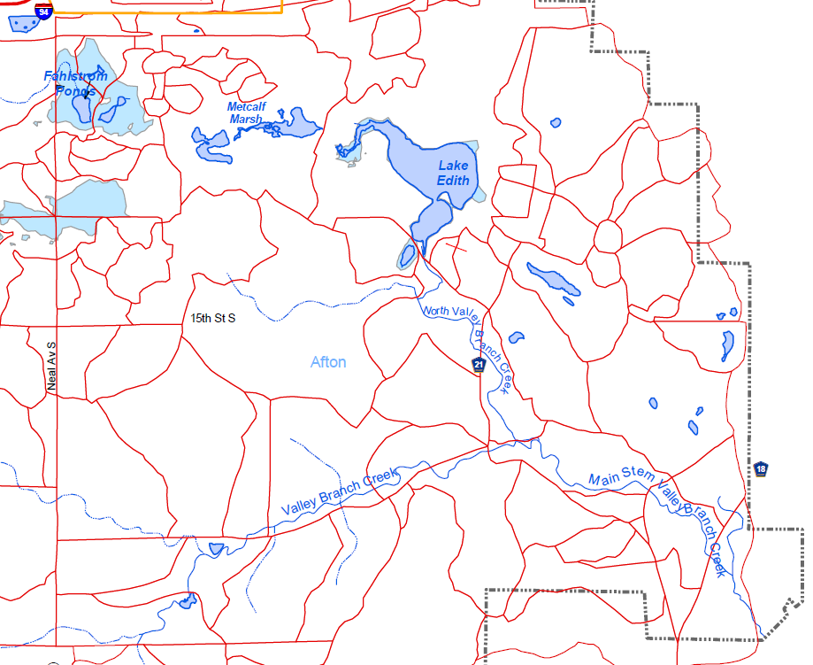
Segment 7 | Project 1007
Minnesota Pollution Control Agency
Introduction: Valley Branch Creek Surface Water System
Segment 7 consists of an unnamed intermittent stream flowing through wetlands and ponds, Lake Edith, and a forked perennial creek (North Valley Branch Creek, Valley Branch Creek, and Main Stem Valley Branch Creek) that discharges to the St Croix River.
The surface water flow path begins with an unnamed intermittent stream just south of I-94. The stream flows generally east-southeast through low-lying wetlands, natural channels, and culverts into Lake Edith.
Lake Edith, which is groundwater-fed, overflows to the south through a 24-inch diameter culvert, discharging to the headwaters of the North Valley Branch Creek. North Valley Branch Creek flows perennially south-southeast until the confluence with Valley Branch Creek. Valley Branch Creek, which is also perennial and flows east-northeast, is known to be groundwater-fed as evidenced by the volume of flow and presence of numerous springs. Due to its spring-fed conditions, Valley Branch Creek is a trout steam (Barr Engineering Company, 2015).
The Main Stem of Valley Branch Creek, or the confluence of Valley Branch Creek with the North Valley Branch Creek, flows perennially south-southeast and discharges to the St Croix River.

Slide 2
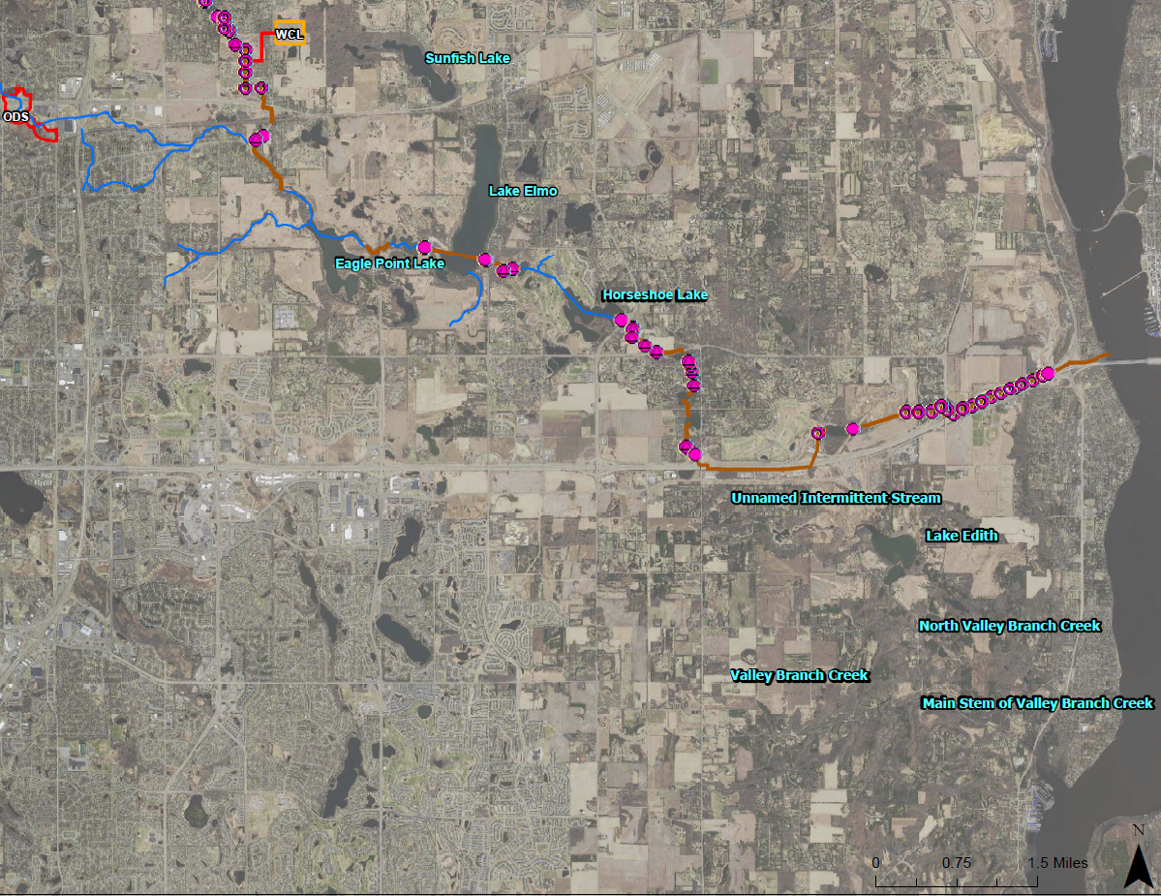
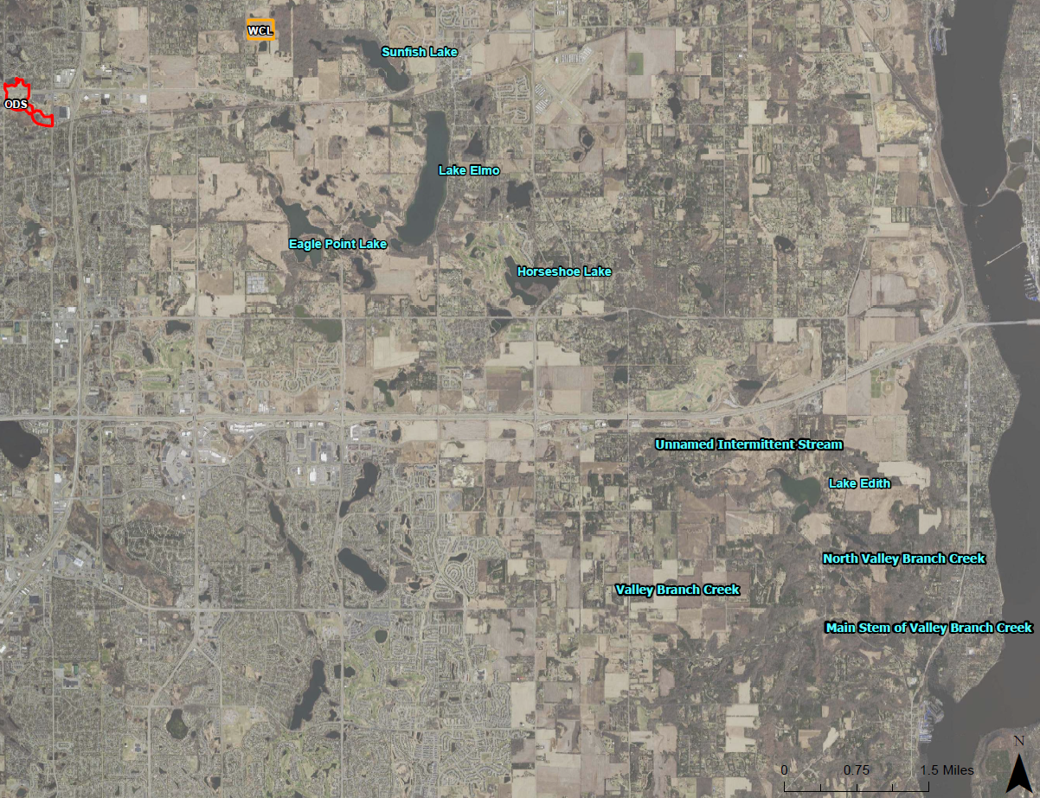
Segment 7 | Project 1007
Minnesota Pollution Control Agency
Project 1007: Historic and Current Surface Water Flow Paths
Surface Water Flow: Pre and Post P1007
Prior to the completion of P1007 (1987), a surface water flow path existed from the Oakdale Disposal Site (ODS) to the Valley Creek system. As part of P1007, a pipeline running parallel to I-94 was constructed to redirect flow from the West Lakeland Storage ponds and channels directly to the St Croix River, effectively cutting off surface water flow to south of the highway.
This historic flow path is likely a potential source of remaining PFAS impacts.
Post-Project 1007
Surface Water Flow Paths
Pre-Project 1007
Surface Water Flow Paths
Segment 7
Segment 7

Slide 3
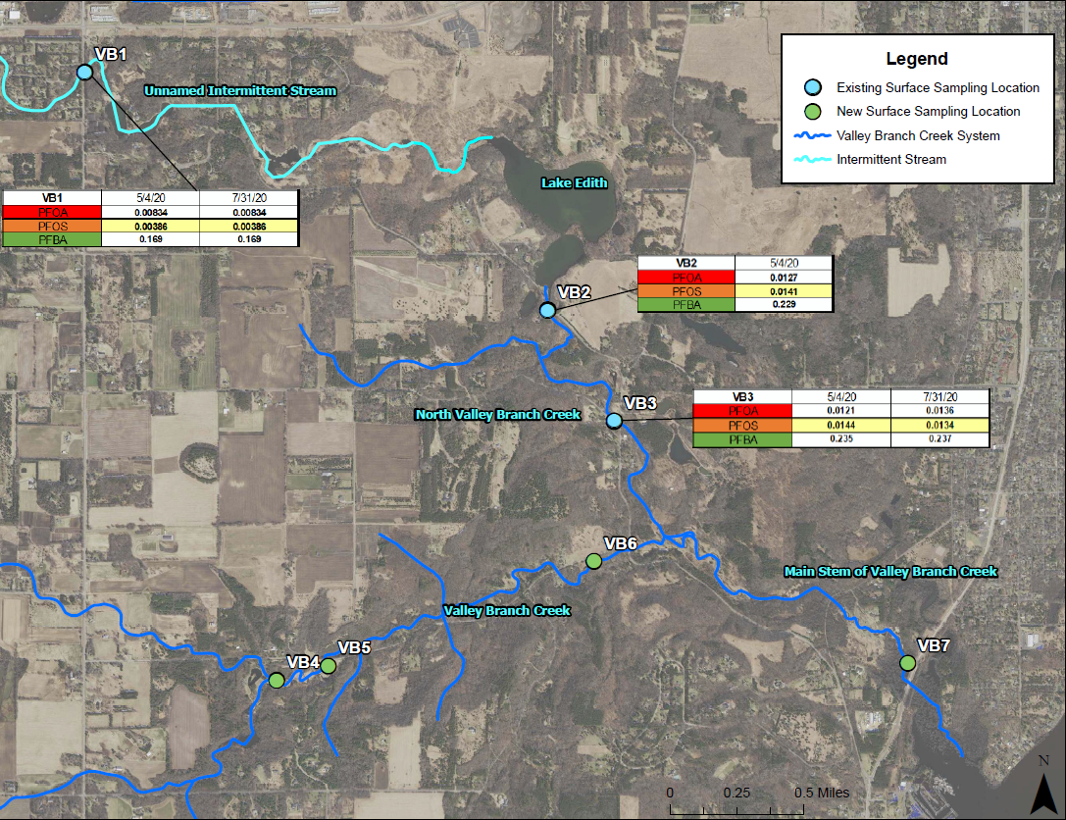
Segment 7 | Project 1007
Minnesota Pollution Control Agency
Surface Water Impacts: Results
PFAS Results: Intermittent Stream v.s. North Valley Branch Creek
PFAS impacts downstream of Lake Edith (i.e., in North Valley Branch Creek) are an order of magnitude greater those within the unnamed intermittent stream (VB1). This could be explained by the groundwater input to Lake Edith. The relative distribution of PFAS compounds are similar between the two water bodies (see next slide).
Seasonal variation and precipitation events appear to have minimal effect on PFAS impacts in Segment 7.

Slide 4
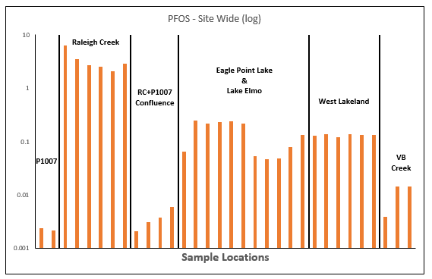
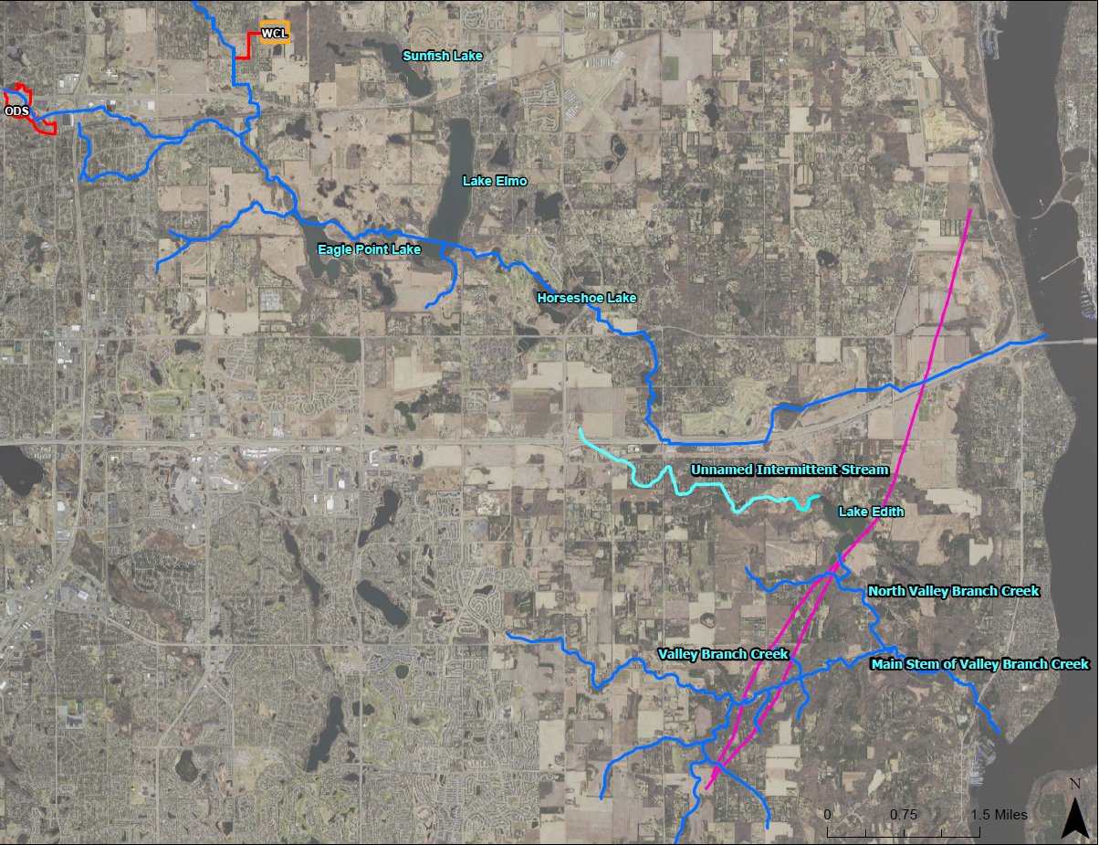
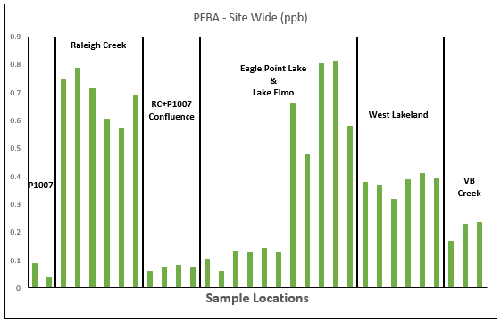

Segment 7 | Project 1007
Minnesota Pollution Control Agency
Site-Wide Compared to Valley Branch Surface Water Impacts: PFAS Compounds
PFAS Compound-Specific Results
Corridor-wide, Segment 7 has relatively low PFOS impacts. However, PFBA impacts are in fact greater than other parts of the corridor, in particular the northern portion corridor prior to the confluence of Raleigh Creek (i.e., P1007), the confluence when Raleigh Creek is not connected, and downstream of the Washington County Landfill source area (i.e., Lake Elmo and P1007).
PFAS Compound Distribution – Side-Wide Comparison
In looking at the relative distribution of PFAS compounds, surface water impacts in Segment 7 are made up of predominantly short-chain PFAS compounds (e.g., PFBA) which typically travel farther than long-chain compounds such as PFOS and PFOA.
This PFAS distribution signature could be a function of PFAS source area, distance travelled of PFAS-impacted waters, or both.
PFAS Compound Distributions

Slide 5
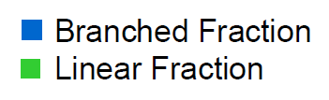
Segment 7 | Project 1007
Minnesota Pollution Control Agency
Site-Wide Surface Water Impacts: Preliminary Forensics Analysis of Segment 7
Branched to Linear Ratio of PFOS Isomers
PFAS Branched to Linear – Corridor-Wide
From initial analysis of the branch-linear factions, Segment 7 has a unique signature relative to other P1007 surface water samples.
Typically, a higher branched fraction suggests more migration of PFAS and is typically representative of groundwater, while greater linear fractions are typical of surface water.
North Valley Branch Creek has a slightly greater fraction of linear than branched, suggesting the PFAS impacts could originate from both surface and groundwater.

Slide 6
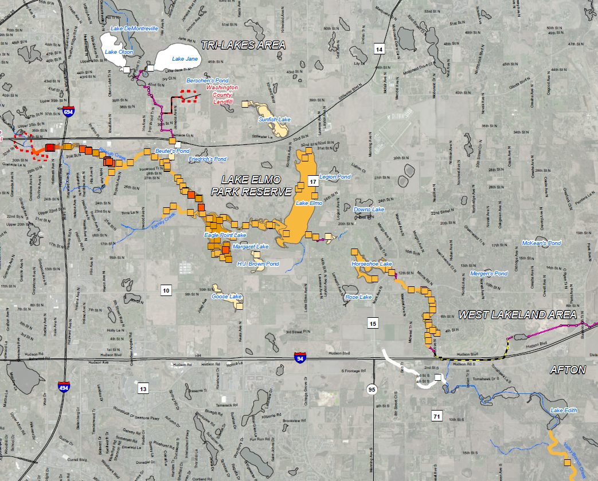
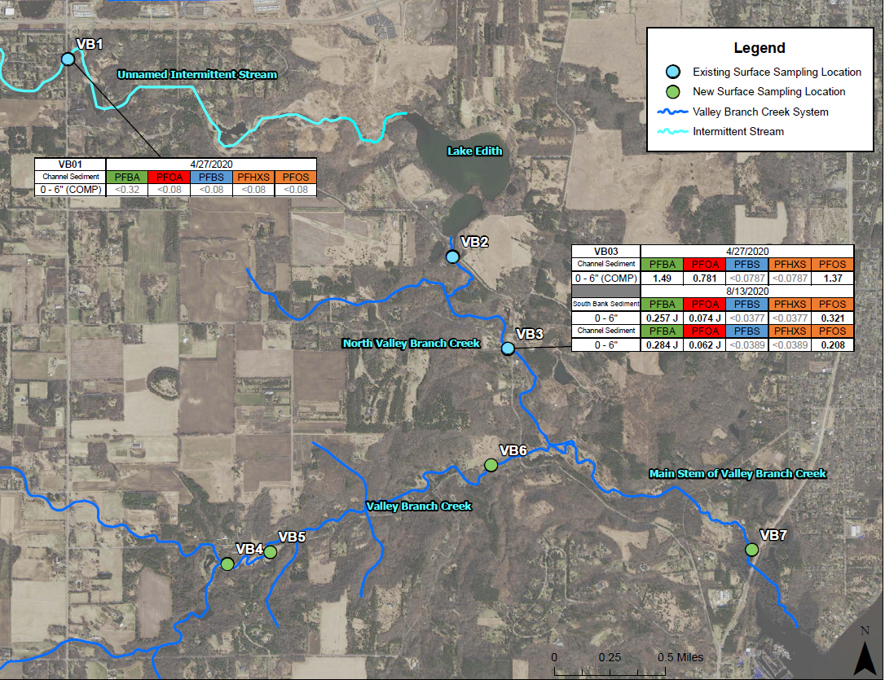
Segment 7 | Project 1007
Minnesota Pollution Control Agency
Site-Wide Compared to Valley Branch Surface Sediment Impacts
PFAS Results – Sediment
PFOS and PFOA impacts in sediment downstream of Lake Edith (i.e., in North Valley Branch Creek) are an order of magnitude greater than those within the unnamed intermittent stream.
Corridor-wide, PFAS impacts are relatively low in Segment 7. However, sediment sampling thus far has been very limited. Both locations are relatively close to culverts and roadways which are by nature more erosional environments. Furthermore, areas with high organic content, such as wetlands, have not yet been sampled.
Planned Future Sampling – Sediment
Planned future sampling efforts will include sediment sampling at new water sampling locations in the southern portion of Segment 7 as well as locations that may have a higher likelihood of PFAS deposition due to environmental factors such as organic content. Exact locations will be selected following site recon but will include Lake Edith and any wetlands along the intermittent stream and around the main Valley Branch Creek and North Valley Branch Creek.

Slide 7
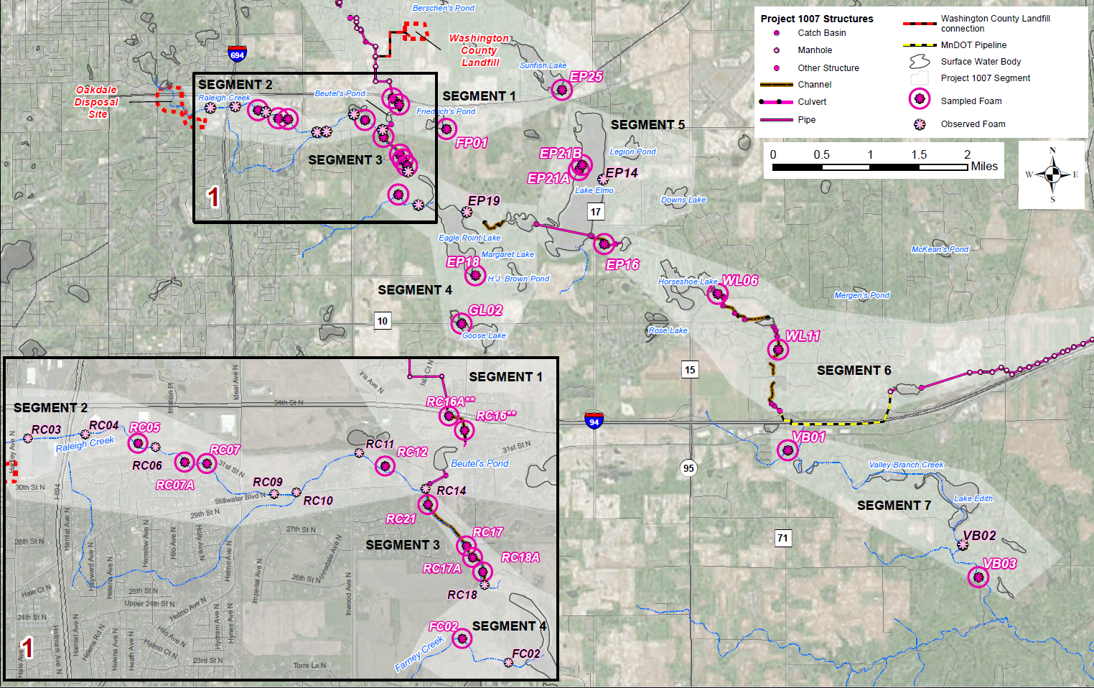
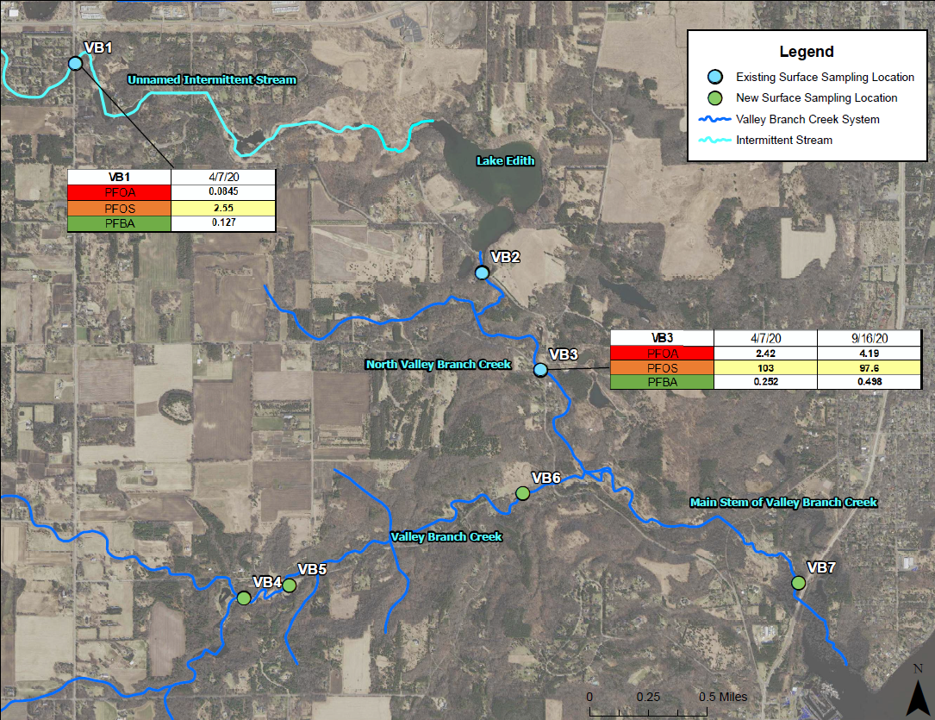
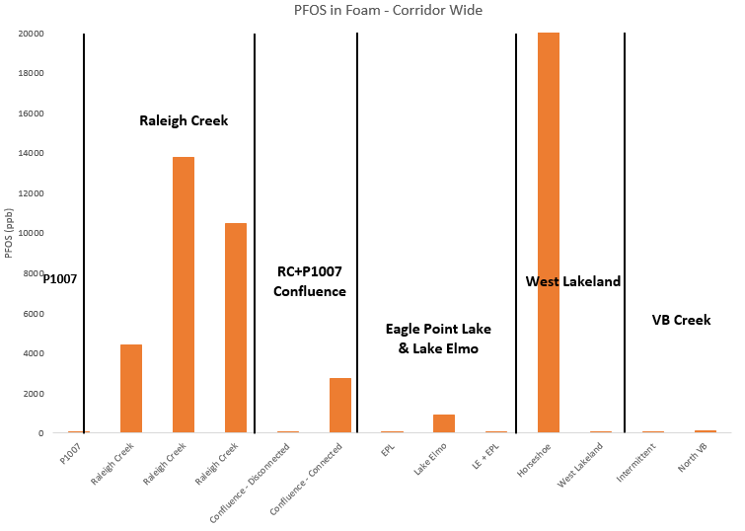
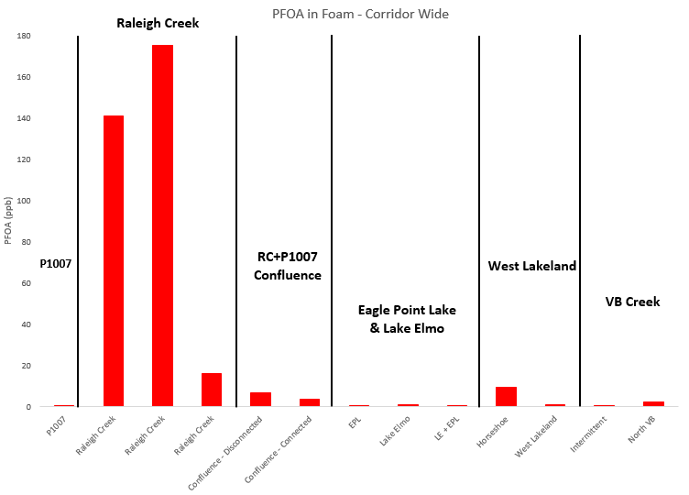
Segment 7 | Project 1007
Minnesota Pollution Control Agency
Site-Wide Compared to Valley Branch Foam Impacts
PFAS Results – Foam
PFOS and PFOA impacts in foam downstream of Lake Edith (i.e., in North Valley Branch Creek) are nearly 50 times greater than those within the unnamed intermittent stream.
Corridor-wide, PFAS impacts in foam like all other media are relatively low in Segment 7.

Slide 8
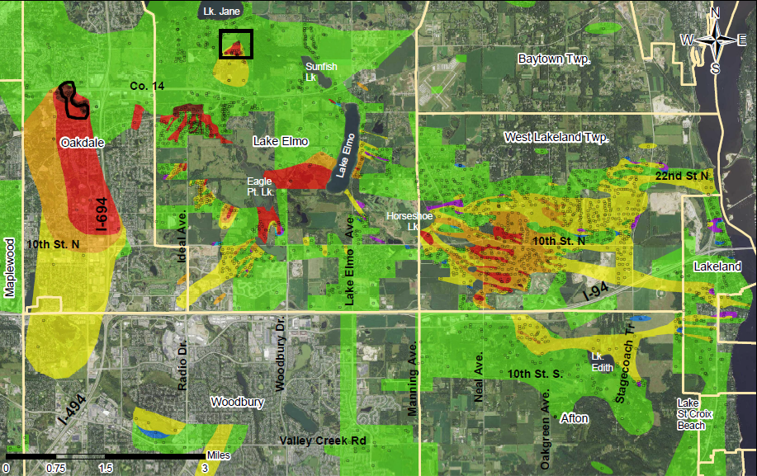
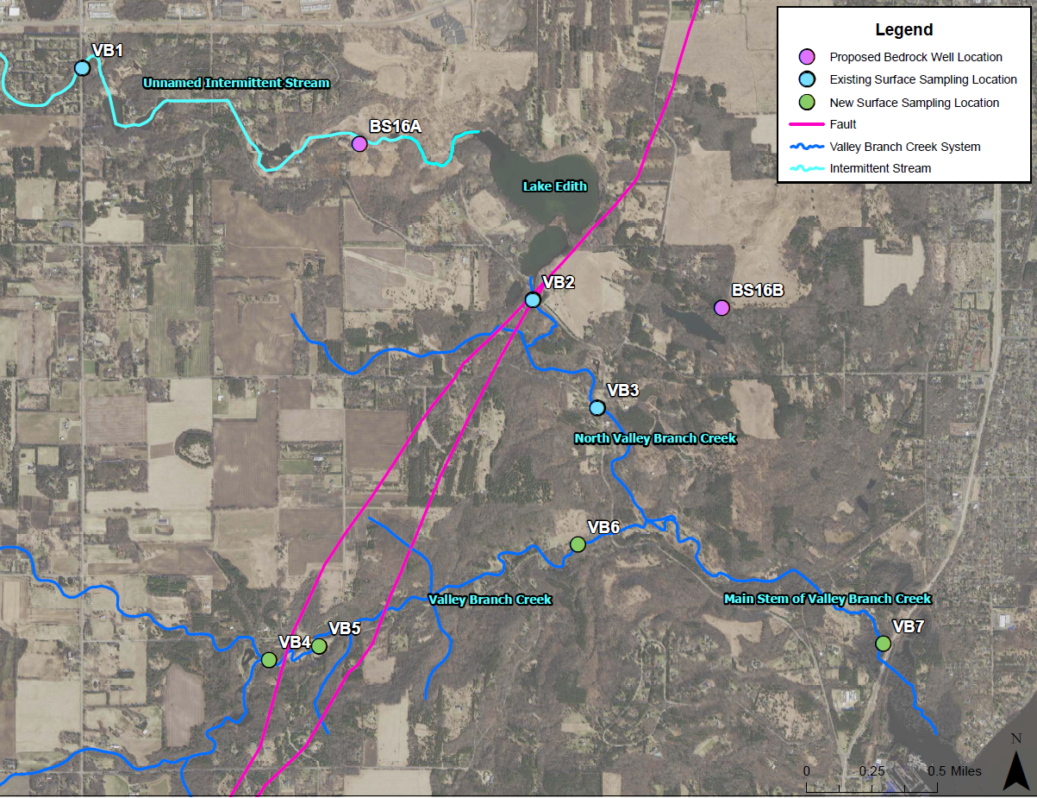
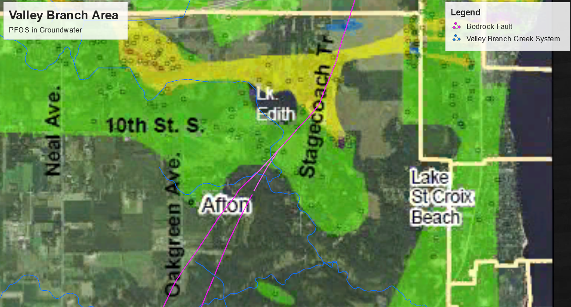
Segment 7 | Project 1007
Minnesota Pollution Control Agency
Groundwater – Known Impacts and Future Sampling Planned
The
PFAS Impacts – Groundwater
Corridor-wide, PFAS impacts are relatively low in Segment 7 and appear to be concentrated in the northern portion and near Lake Edith. However, limited data is available for groundwater conditions in Segment 6, especially in the southern portion where groundwater discharge is well documented as a result of the fault system.
Planned Future Sampling – Groundwater
Planned future sampling efforts will include surface water sampling locations where groundwater discharge is occurring to indirectly assess groundwater impacts in the southern portion of the Segment 7 where all data is limited. In addition, two bedrock monitoring wells are planned to assess differences across the fault system. These locations may change pending results of surface water sampling.

Slide 9
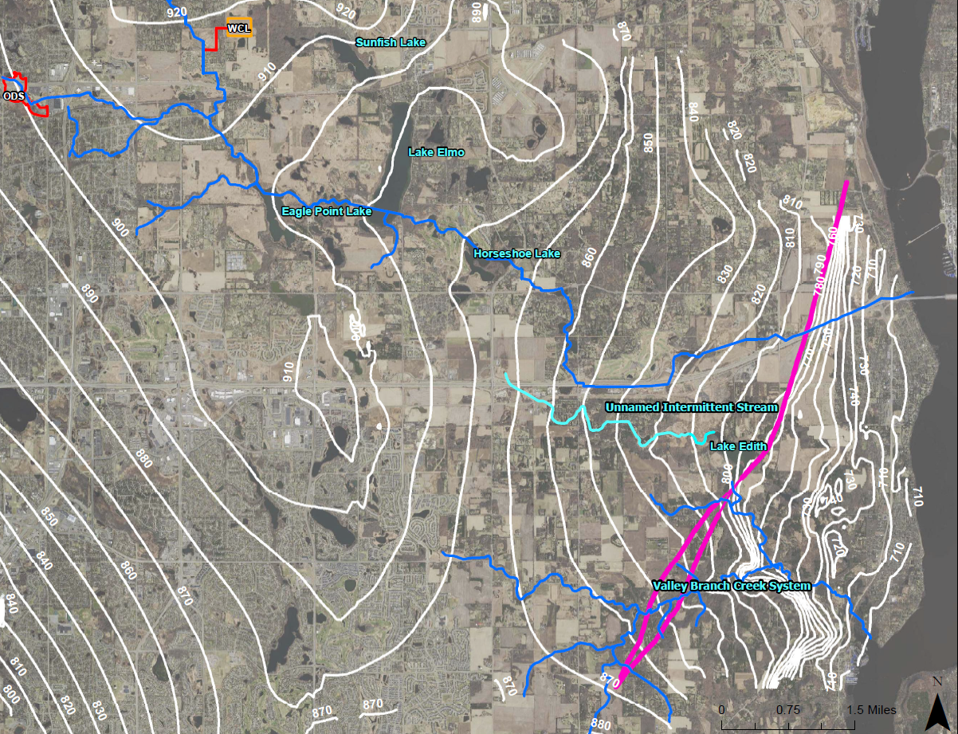
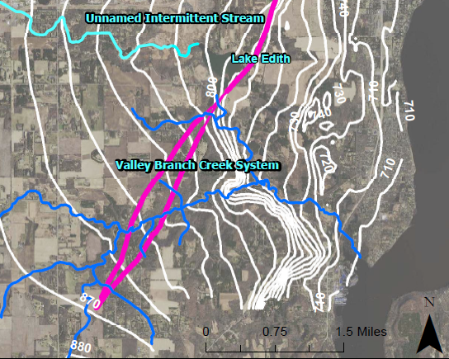
Segment 7 | Project 1007
Minnesota Pollution Control Agency
Fate and Transport: Surface to Ground and Ground to Surface Preferential PFAS Pathways
Prairie du Chien Aquifer Potentiometric Surface Map
Flow Path Surface to Ground: P1007-Impacted Surface to PDC Groundwater Prior to the implementation of P1007, groundwater PFAS impacts were likely the result of infiltration from impacted surface water moving through the wetlands and various creeks. Following the completion of P1007 (1987), impacted surface water was redirected away from the Valley Creek system. However, the P1007 infrastructure also facilitated the movement of impacted surface water from the source areas to the east, crossing the groundwater divide, and may have resulted in a larger volume of PFAS-impacted waters in Central Lake Elmo. Once in Central Lake Elmo, any number of hydrogeologic features including the bedrock valley, karst topography, and high infiltration leaky lakes would allow for infiltration to the subsurface. Though groundwater predominantly flows to the east regionally east of the groundwater divide, in Central Lake Elmo, groundwater flow is both to the east and to the south.
      Surface to ground flow path
      Inferred groundwater flow direction
      Ground to surface flow path
      Surface water flow direction
Flow Ground to Surface: P1007-Impacted PDC Ground Water to Valley Branch Creek System
Once PFAS-impacted water reached the subsurface, it should be able to easily move eastward towards the Valley Branch Creek System and Lake Edith where groundwater discharge is well documented.
The primary groundwater contribution to the Valley Branch Creek is from the Prairie du Chien aquifer. This groundwater input is the result of both bedrock artesian conditions as well fracturing associated with the Cottage Grove Fault, over which the creek crosses. Via upward movement through vertical fractures within the fault system, the Jordan, Tunnel City, and Wonewoc aquifer units are also all possible groundwater sources for the creek (Tipping et al., 2019).

